Slide 1
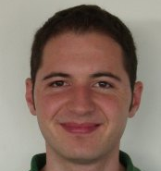
STAR: quad meshes
Denis Zorin
New York University
Marco Tarini
University of Insubria
National Research Council
Claudio Silva
Polytechnic Institute of NYU
New York University
Enrico Puppo
University of Genova
Nico Pietroni
National Research Council
Bruno Lévy
ALICE / INRIA
David Bommes
RWTH Aachen University

Slide 2
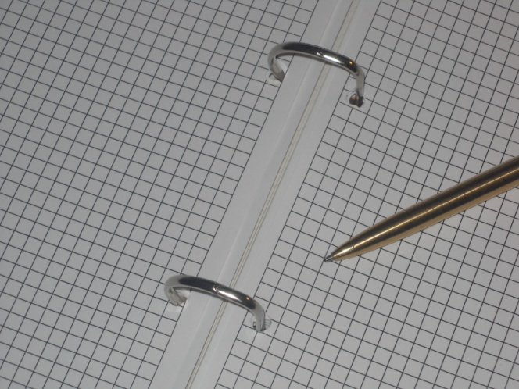
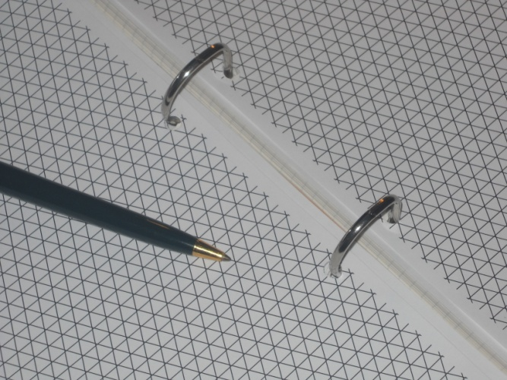
Quad VS Triangles

Slide 3
Motivations
People in computer graphics and geometry processing mostly [used to] use triangular meshes
People in CAD, automotive, industrial design, cinema, etc. mostly use quad meshes
(and, people in FEM tend to use both)

Slide 4
Motivation
Triangle meshes
natural output of
range-scanning,
MC,
ball pivoting, …
very adaptive
simplicial !
natural input for GPU rendering
Quad meshes
natural output of human modellers
natural representation for:
Catmull-Clark
Tensor products
B-Splines, NURBS…
texture mapping
but: [Hormann et Al, “A quadrilateral rendering primitive”, GH 2004]

Slide 5
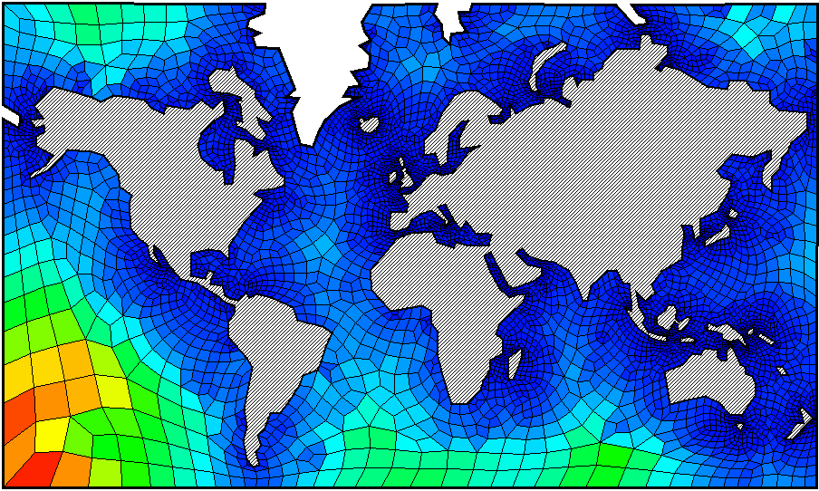
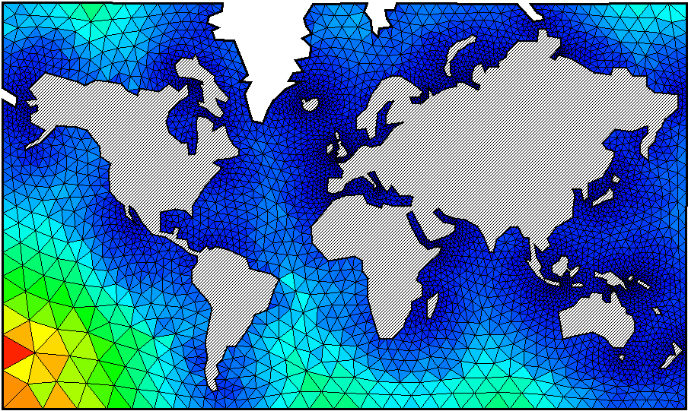
Motivations

Slide 6
Quad-Mesh basics
edge
vertex
face (“quad”, “patch”)

Slide 7
Quad-Mesh basics
border edge
irregular (interior) vertex

Slide 8
Quad mesh classification
Triangle mesh
all faces 3 sides
Quad mesh
all faces 4 sides
Quad dominant mesh
most faces 4 sides
(and a few 3 or 5 sided faces)

Slide 9
Quad-Mesh basics

Slide 10
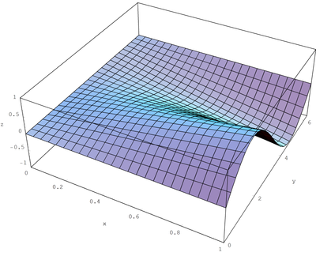
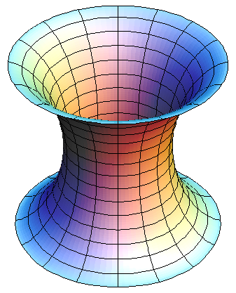
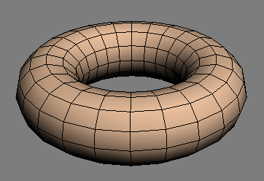
Quad Mesh classification
(pure) Regular Quad meshes
all vertices regular
a very narrow class!
trivial cases

Slide 11
Quad Mesh classification
(pure) Regular Quad meshes
all vertices regular
a very narrow class!
Ideal case
implicit connectivity!
trivial extension of image processing ➔ geometry processing
trivial storage on the GPU
trivial texture mapping
trivial storage

Slide 12
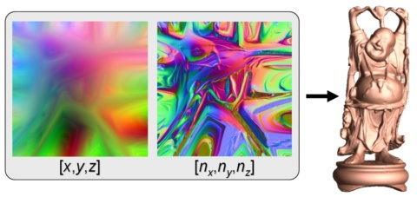
Quad Mesh classification
(pure) Regular Quad meshes
all vertices regular
a very narrow class!
[Geometry images – Gu et al, SIGG 2002]

Slide 13
Quad Mesh classification: can’t have pure regular
Euler Formula (closed mesh): # V − # E + # F = 2 G – 2
In a pure quad, closed mesh: # E = 2 # F
In a (fully) regular, closed mesh: # V = # F
Therefore: pure regular, pure quad, closed ==> G = 1 (topological torus)

Slide 14
Quad Mesh classification: can’t have pure regular
G = 0 (topological sphere): 8 total valency defects
eg.:
8 irregular (valency 3=4-1) vertices
4 irregular (valency 2=4-2) vertices
...
G = 1 (topological torus): can be regular ☺
but can have, e.g.:
2 valency 5=4+1 vertices and 2 valency 3=4-1) vertices
G = 2 (“two handles”): 8 total valency excesses
eg:
8 irregular (valency 5=4+1) vertices
4 irregular (valency 6=4+2) vertices

Slide 15
Quad Mesh classification
(pure) Regular Quad meshes
all vertices regular
a very narrow class!

Slide 16
Quad Mesh classification
(pure) Regular Quad meshes
all vertices regular
Semi-regular
set of regular patches glued side to side
or, low res quad mesh reguraly subdibided
i.e. what you get if you refine a coarse mesh

Slide 17
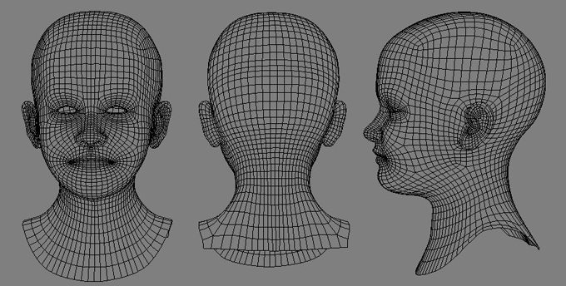
Semi-regular mesh
Most common class for hand-made quad mesh
e.g. CAD, games, …

Slide 18
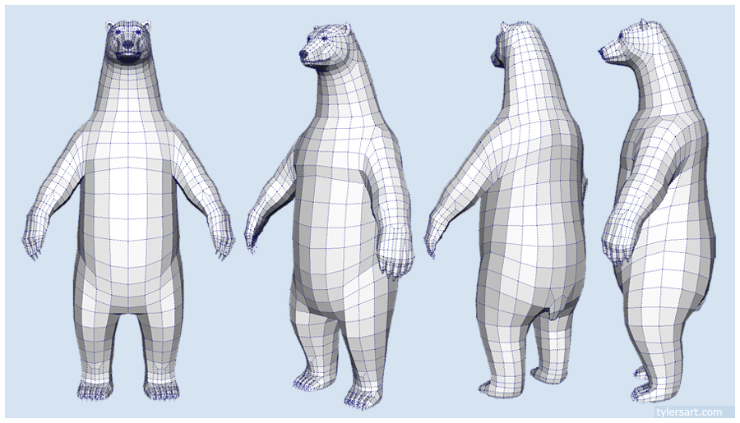
Semi-regular mesh
Most common class for hand-made quad mesh
e.g. CAD, games, …

Slide 19
Quad Mesh classification
(pure) Regular Quad meshes
all vertices regular
Semi-regular
set of regular patches glued side to side
“Valence Semi-regular”
just few irregular vertices

Slide 20
Quad Mesh classification
(pure) Regular Quad meshes
all vertices regular
Semi-regular
set of regular patches glued side to side
“Valence Semi-regular”
just few irregular vertices

Slide 21
Quad-Mesh basics

Slide 22
Quad Mesh classification
(pure) Regular Quad meshes
all vertices regular
Semi-regular
set of regular patches glued side to side
“Valence Semi-regular”
just few irregular vertices
Unstructured
many irregular vertices

Slide 23
Quad Mesh classification
(pure) Regular Quad meshes
all vertices regular
Semi-regular
set of regular patches glued side to side
“Valence Semi-regular”
just few irregular vertices
Unstructured
many irregular vertices

Slide 24
Quad Mesh classification
continuum of decreasing regularity
(fully)
Regular
Semi Regular
“Valence
Semi Regular”
Unstructured (more irregular)
Unstructured

Slide 25
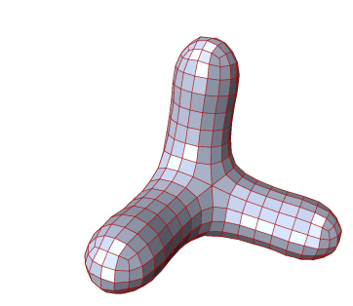
Quad Mesh Caracteristics
About Connectivity
Regularity
Good placement of irregular vertices
e.g.: reciprocally aligned
e.g.: dependent on Gaussian curvature
negative curvature: valency >4
positive curvature: valency <4

Slide 26
Quad Mesh Caracteristics
About Connectivity
Regularity
Good placement of irregular vertices
Consistency
T-Junctions?
Manifoldness? Watertight?
“degenerate” configurations

Slide 27
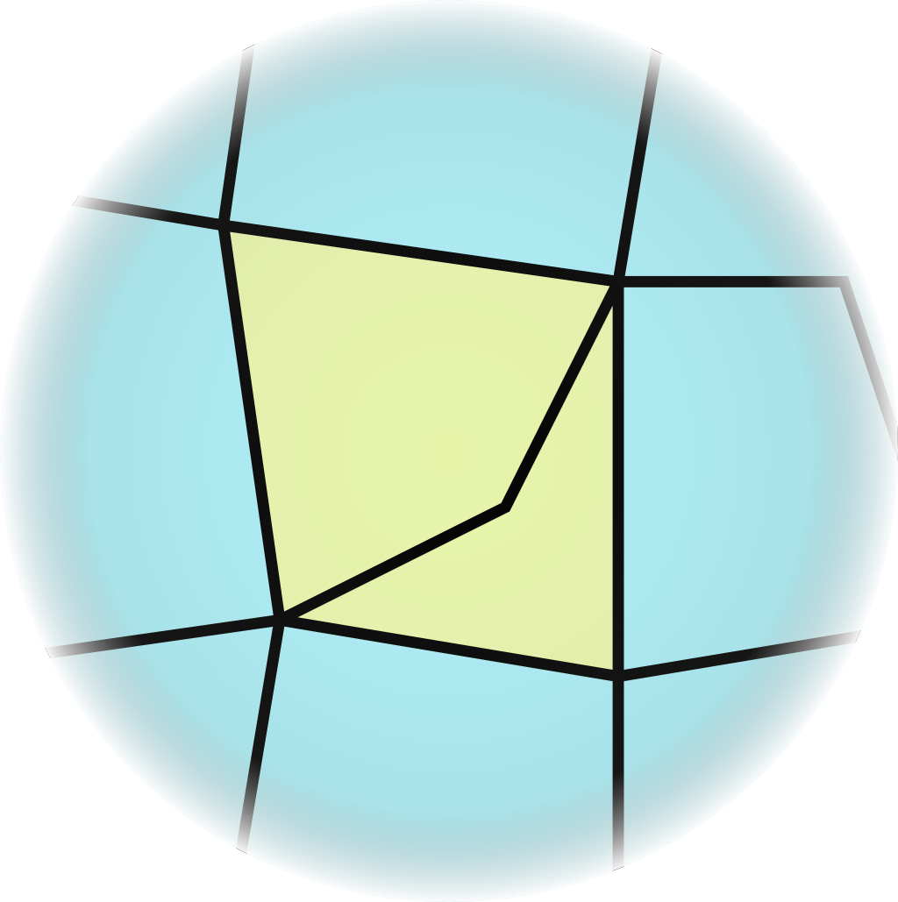
Quad Mesh Caracteristics
About Connectivity
Regularity
Good placement of irregular vertices
Consistency
T-Junctions?
Manifoldness? Watertight?
“degenerate” configurations: doublets
2

Slide 28
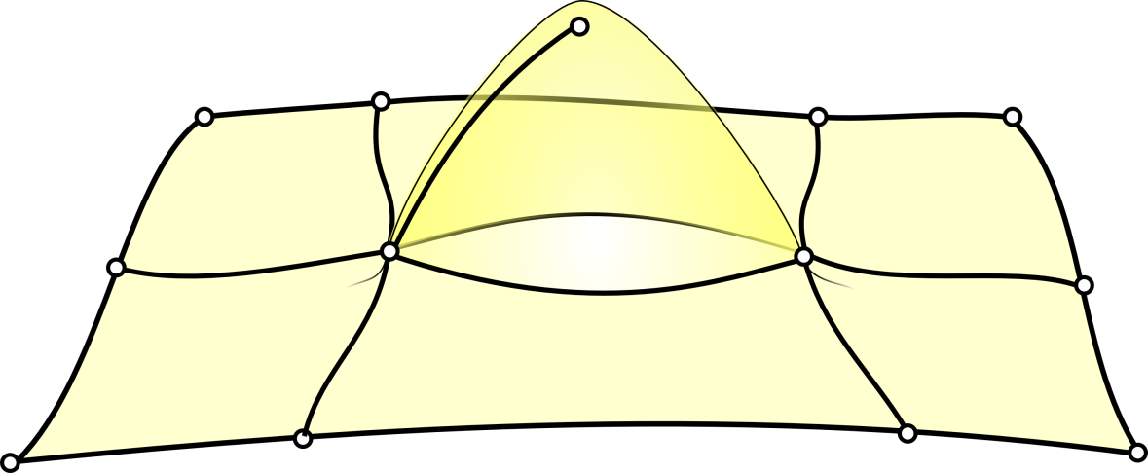
Quad Mesh Caracteristics
About Connectivity
Regularity
Good placement of irregular vertices
Consistency
T-Junctions?
Manifoldness? Watertight?
“degenerate” configurations: doublets, singlets

Slide 29
Quad Mesh Caracteristics
About Connectivity
Regularity
Good placement of irregular vertices
Consistency
T-Junctions?
Manifoldness? Watertight?
“degenerate” configurations: doublets, singlets
About Quad Quality
not flat
concave
self-intersecting

Slide 30
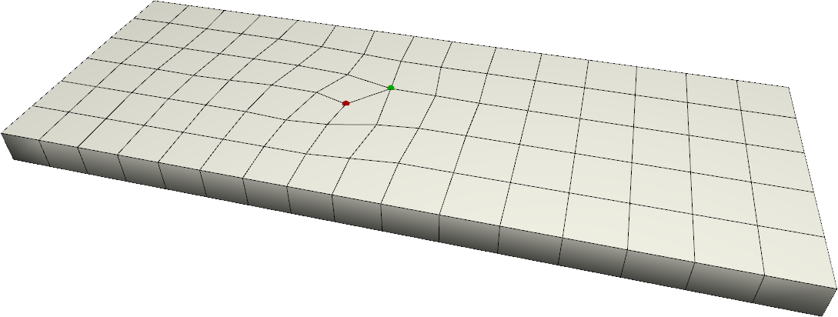
Quad Mesh Caracteristics
Note: conflicts with regularity tessellation density changes → more irregular vertices
About Connectivity
Regularity
Good placement of irregular vertices
Consistency
T-Junctions?
Manifoldness? Watertight?
“degenerate” configurations: doublets, singlets
About Quad Quality
About Quad Orientation and Size
Resolution
Adaptivity
6 quads
5 quads

Slide 31
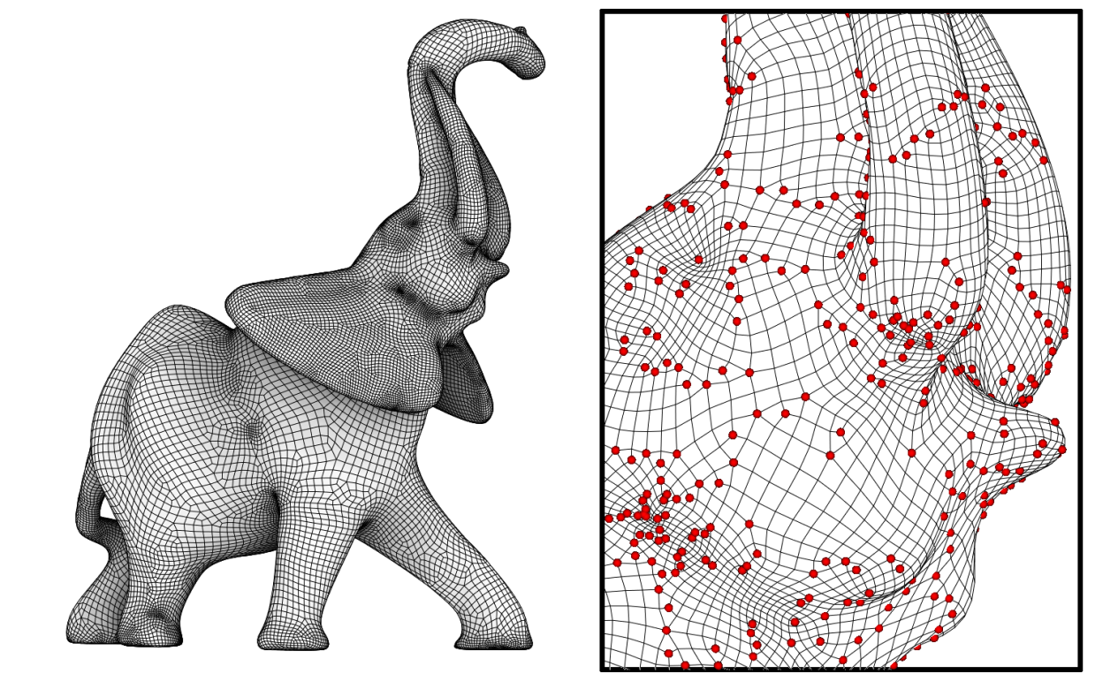
Quad Mesh Caracteristics
Note: conflicts with regularity tessellation density changes → more irregular vertices
About Connectivity
Regularity
Good placement of irregular vertices
Consistency
T-Junctions?
Manifoldness? Watertight?
“degenerate” configurations: doublets, singlets
About Quad Quality
About Quad Orientation and Size
Resolution
Adaptivity

Slide 32
Quad Mesh Caracteristics
About Connectivity
Regularity
Good placement of irregular vertices
Consistency
T-Junctions?
Manifoldness? Watertight?
“degenerate” configurations: doublets, singlets
About Quad Quality
About Quad Orientation and Size
Resolution
Adaptivity
Anisotropy
vs

Slide 33
Quad Mesh Caracteristics
Main characteristic: geometric faithfulness
well, obviously

Slide 34
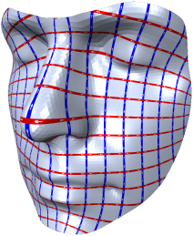
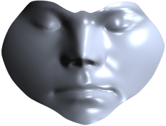
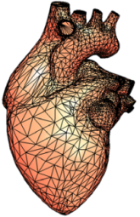
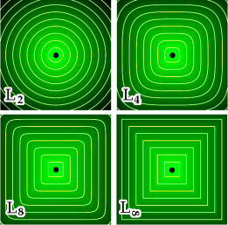
Overview
Quad mesh creation
by editing connectivity
via parameterizations
by defining patches
via Voronoi diagrams

Slide 35
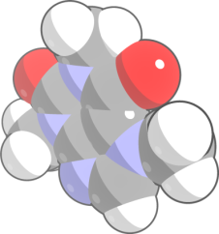
Overview
by editing connectivity
via parameterizations
Quad mesh creation methods:
Common issues:
by defining patches
via Voronoi diagrams
Field alignment
adding
Anisotropy
start from other
representations
vs

Slide 36
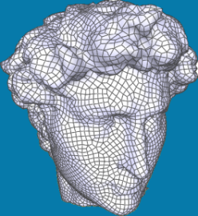
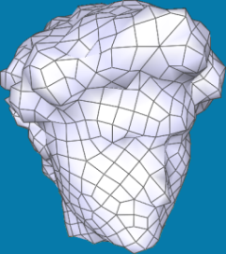
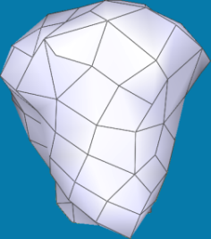
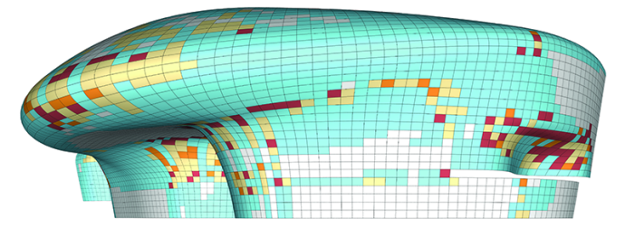
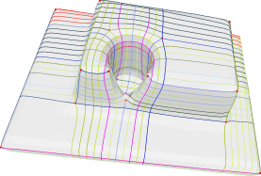
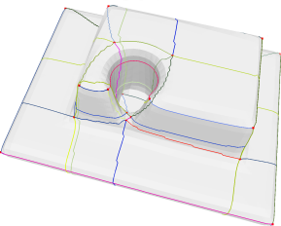
Overview
Simplification
Processing on Quad Meshes:
Geometric Optimization
Connectivity Optimization
36

Slide 37
Overview: quad meshes
processing
creation
creation issues
by editing connectivity
Field alignment,
anisotropy
Simplification
Backup of a
prev. version
(HIDDEN SLIDE)
by defining patches
via Voronoi diagrams
Geometric Optimization
via parameterizations
starting from other
representations
Connectivity Optimization

Slide 38
Overview
creation
processing
by editing connectivity
via parameterizations
Simplification
methods
by defining patches
via Voronoi diagrams
Geometric Optimization
Field alignment
adding
Anisotropy
start from other
representations
Connectivity Optimization
issues
vs

Slide 39
Overview
creation
processing
by editing connectivity
via parameterizations
Simplification
methods
by defining patches
via Voronoi diagrams
Geometric Optimization
Field alignment
adding
Anisotropy
start from other
representations
Connectivity Optimization
issues
vs

Slide 40
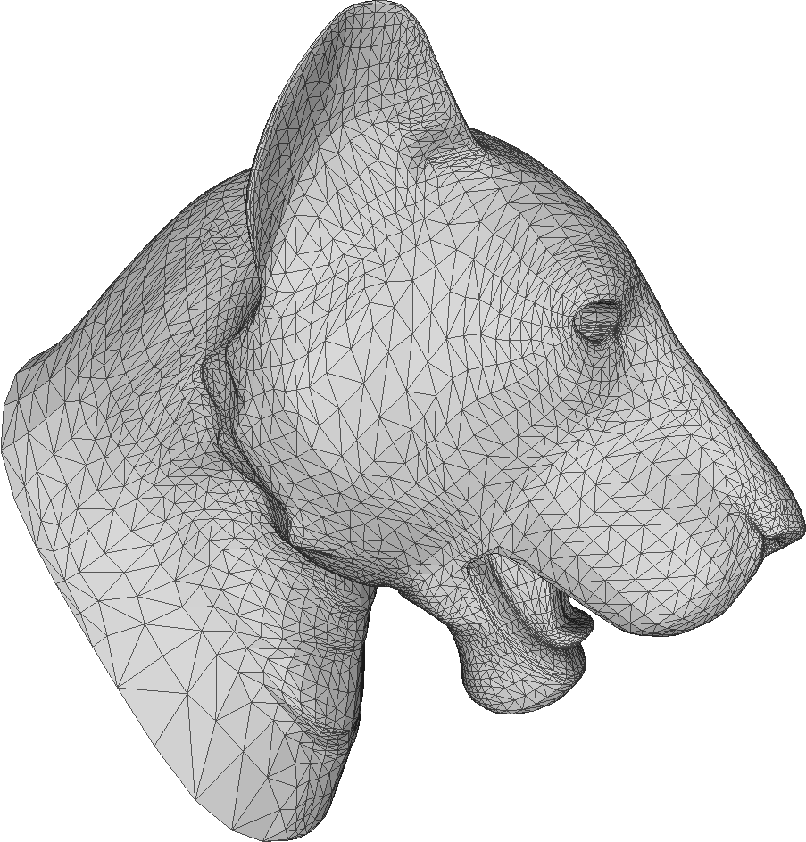
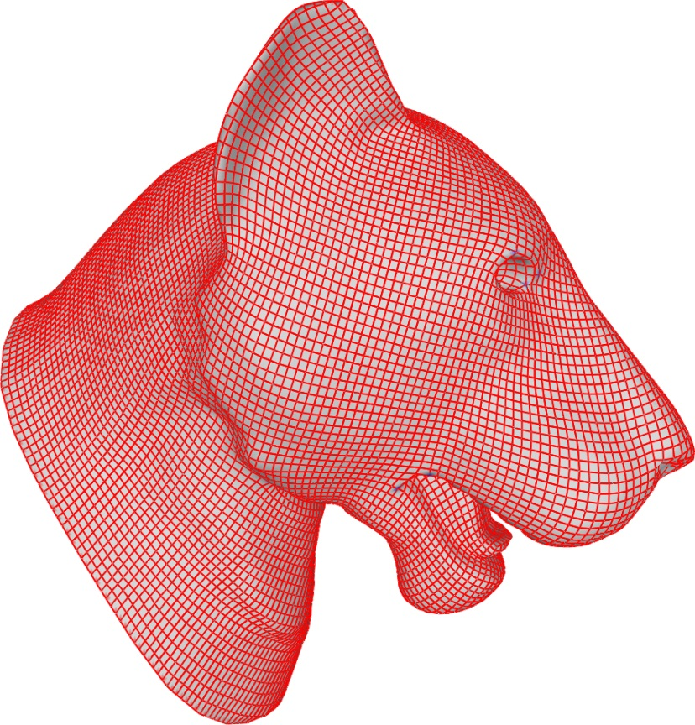
The problem:

Slide 41
Overview
creation
processing
by editing connectivity
via parameterizations
Simplification
methods
by defining patches
via Voronoi diagrams
Geometric Optimization
Field alignment
adding
Anisotropy
start from other
representations
Connectivity Optimization
issues
vs

Slide 42
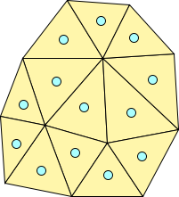
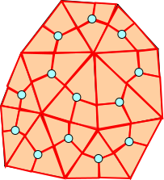
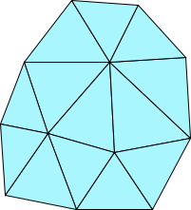
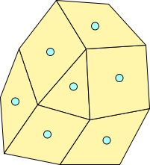
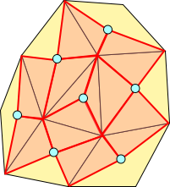
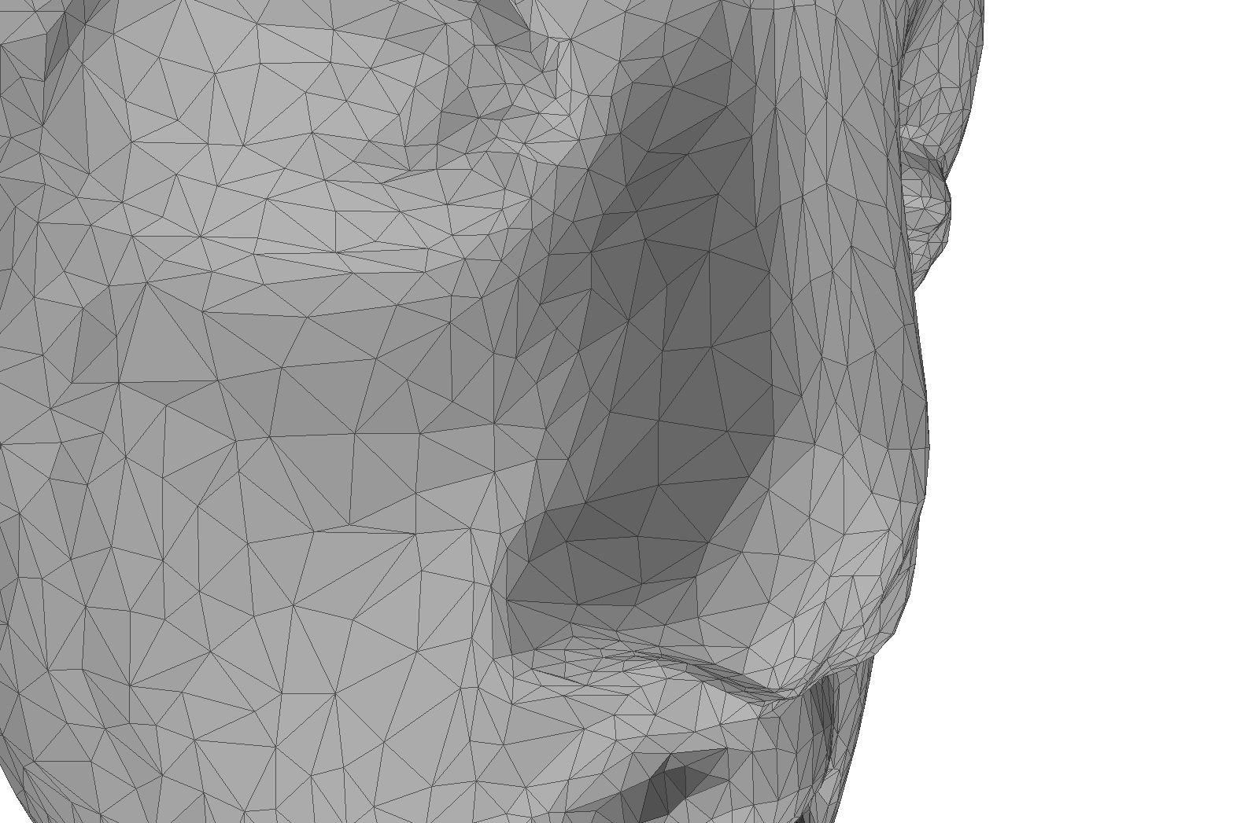
Subdivision Rules
Catmull-Clark Subdivision
Split each k-facet into k quads
Pro: preserve all original edges
Pro: trivial
Con: complexity increase
Con: many irregular vertices!!
4-8 Subdivision
Luiz Velho et al. 4-8 Subdivision.
Computer Aided Geometric Design
Pro: trivial
Con: complexity increase
Con: many irregular vertices!!

Slide 43
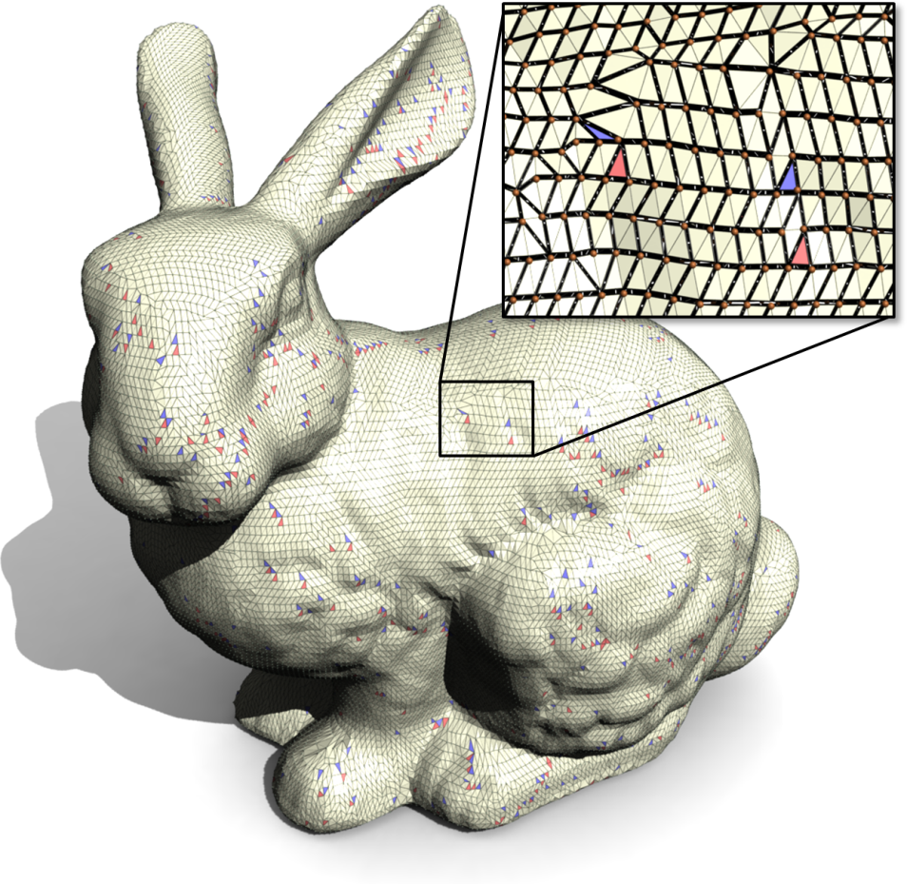
Editing Connectivity(1)
SQUAD
Topraj Gurung, et al SQuad: Compact Representation for Triangle Meshes Eurographics 2011
Designed to improve the internal representation of meshes but can be used to define a quad mesh.
Store for each pair of triangles as a candidate quad.
Reorder these quads so that, after re-ordering, we gather a quad dominant mesh.

Slide 44
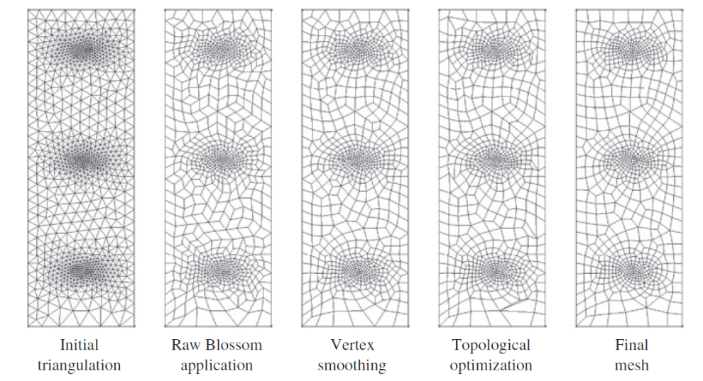
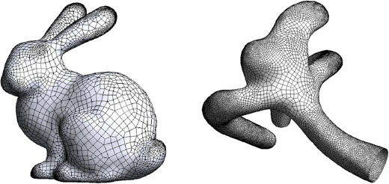
Editing Connectivity(2)
BlossomQuad
Remacle et al Blossom-Quad: A non-uniform quadrilateral mesh generator .. Numerical Methods in Engeneering
Uses perfect matching algorithm (global optimum triangle pairing)
Use local deletion operation and Laplacian smooth to improve connectivity and geometry.
Pro: Pure Quad-mesh
Con: quadratic time → too slow!

Slide 45
Editing Connectivity(3)
Practical Quad Mesh Simplicication
M.Tarini et al Eurographics 2010
Match “good” pairs of adjacent triangles
Use local connectivity editing operations to gather a Quad-only mesh
Use local tangent space smoothing to improve shape of quads

Slide 46
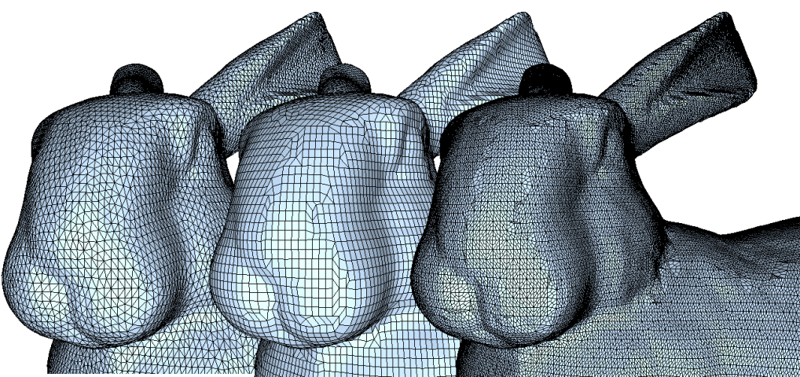
Editing Connectivity(3)
input tri mesh
result
Catmull-Clark

Slide 47
Overview
creation
processing
by editing connectivity
via parameterizations
Simplification
methods
by defining patches
via Voronoi diagrams
Geometric Optimization
Field alignment
adding
Anisotropy
start from other
representations
Connectivity Optimization
issues
vs

Slide 48
Overview
creation
processing
by editing connectivity
via parameterizations
Simplification
methods
by defining patches
via Voronoi diagrams
Geometric Optimization
Field alignment
adding
Anisotropy
start from other
representations
Connectivity Optimization
issues
vs

Slide 49
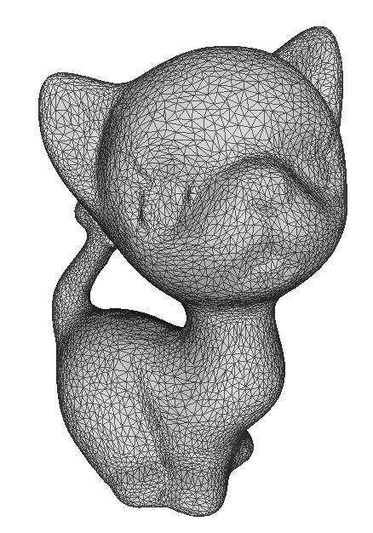
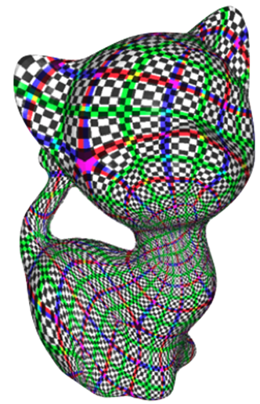
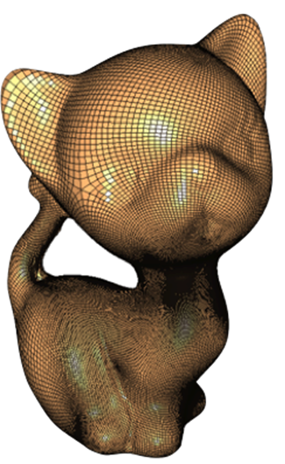
Defining patches
Define a set of quadrilateral patches that sample the surface
Sample uniformly each patch to gather the quadrangulation

Slide 50
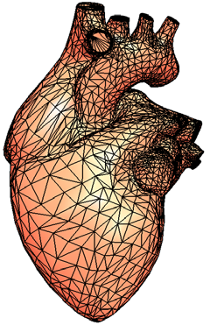
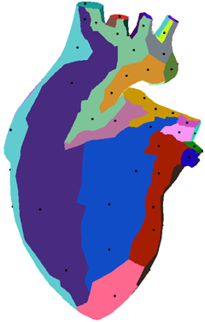
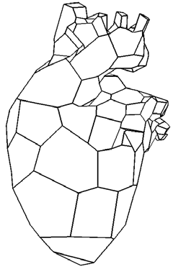
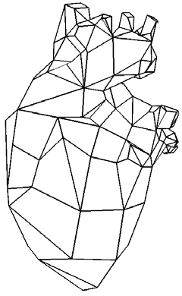
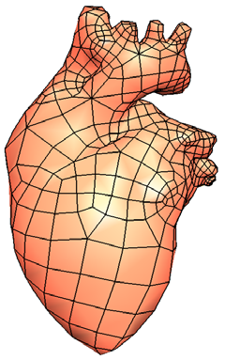
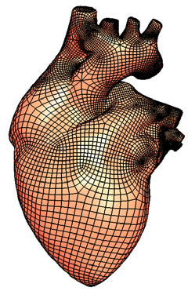
Defining patches (1)
Parameterization of Triangle Meshes over Quadrilateral Domains
Ioana Boier-Martin et al SGP 2004
Normal Clustering
Voronoi Central-based technique to extract patches
a base mesh is computed and
transformed to a quad dominant mesh
Catmull Clark Subdivision to gather a Quad Only mesh

Slide 51
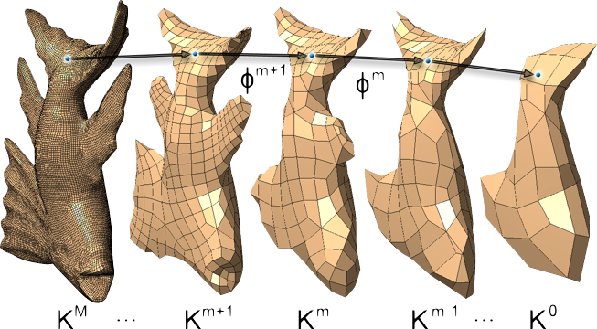
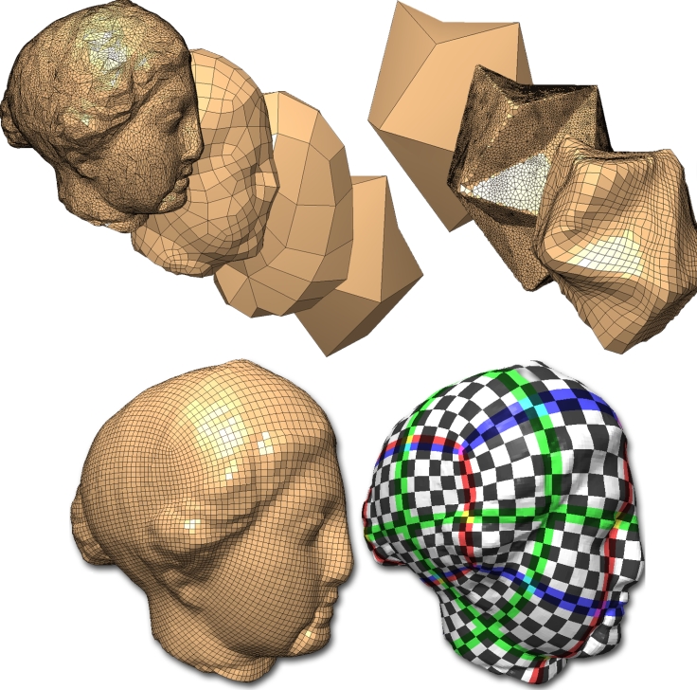
Defining patches (2)
Semi-regular, Quadrilateral-only Remeshing from Simplified Base Domains
Joel Daniels II et al SGP 2009
Build map between each consecutive pair of keyframe meshes
Project vertices through keyframes to base domain
Resample the original surface (uniformly) to reduce projections
The mapping of these points will guide the backward projections

Slide 52
Defining patches (3)
v
Spectral Surface Quadrangulation
S. Dong et al Siggraph 2006
starting with a scalar field on the triangle mesh.
finding its critical points and extract
the Morse-Smale complex of that field.
Which is composed of quadrilateral patches

Slide 53
Defining patches(3)
Polycube-maps
Tarini et al Siggraph 2004
Polycube maps are a special sub-class of global seamless quad-based parameterization
The parametrization domain is an axis aligned polycube
re-sampling produces semi-regular, meshed made of well shaped quads
User assisted
Polycube- map
object

Slide 54
Overview
creation
processing
by editing connectivity
via parameterizations
Simplification
methods
by defining patches
via Voronoi diagrams
Geometric Optimization
Field alignment
adding
Anisotropy
start from other
representations
Connectivity Optimization
issues
vs

Slide 55
Overview
creation
processing
by editing connectivity
via parameterizations
Simplification
methods
by defining patches
via Voronoi diagrams
Geometric Optimization
Field alignment
adding
Anisotropy
start from other
representations
Connectivity Optimization
issues
vs

Slide 56
Parametrization-based Methods
Maps between ℝ² and ℝ³
v
f
f ⁻¹

Slide 57
Parametrization-based Methods(1)
Harmonic and Conformal Maps
Conformal and harmonic maps are good candidates for quadrangulation because of low distorsion
Cut trough integer lines in parametric space to get a quadrangulation
Needs generalization to works with non disk-like objects!
ℝ³
ℝ²
ℝ³

Slide 58
Parametrization-based Methods (2)
Cut into disk topology
Continuity of isolines must be enforced along seams

Slide 59
Parametrization-based Methods (3)
Discontinuous integer-lines at cut edges
Not suitable to produce a quadrangulation!

Slide 60
Parametrization-based Methods (5)
Cut into disk topology
Continuity of the isolines is enforced by coupling the position of points on both sides of a cut by transition functions
Transitions functions implies rotation and translations in parametric space

Slide 61
Parametrization-based Methods (4)
Designing Quadrangulations with Discrete Harmonic Forms
Tong et al SGP 2006
Given an initial (semi-automatic) singularity placement.
The singularity are connected thought a graph
A modified Laplace equations gives two potentials.
Tracing isolines of those potentials is possible to gather a quad only mesh

Slide 62
Using a field
Why align quads to a field?
Global Structure
Semantics

Slide 63
Prototype of a field guided method
input tri mesh
Orientation field
A sizing field is determined
Final quadrangulation

Slide 64
Overview
creation
processing
by editing connectivity
via parameterizations
Simplification
methods
by defining patches
via Voronoi diagrams
Geometric Optimization
Field alignment
adding
Anisotropy
start from other
representations
Connectivity Optimization
issues
vs

Slide 65
Overview
creation
processing
by editing connectivity
via parameterizations
Simplification
methods
by defining patches
via Voronoi diagrams
Geometric Optimization
Field alignment
adding
Anisotropy
start from other
representations
Connectivity Optimization
issues
vs

Slide 66
What is a field? (1)
What is a field?
A direction field is, for each point of a surface, a set of N unit vectors of the tangent plane that is invariant by rotation of 2π/N.
N =1
N =2
N =4
N =6

Slide 67
What is a field? (2)
What is a singularity?
Singularities are a generalization of the poles (and saddles) of vector field.
N =1
N =2
N =4
N =6

Slide 68
What is a field? (3)
We rely on N=4 for quad remeshing
In the discrete settings
One cross field per face
Evaluate singularities in a local map
I =ΣC/2π = 1/4

Slide 69
What is a field? (4)
Several Methods to compute a Smooth cross field
Geometry-aware direction field processing
N.Ray et al TOG 2009
Illustrating smooth surfaces
Hertzmann et al SIGGRAPH 2000

Slide 70
Why singularity are important?
Singularity -> Irregular vertices
Good Singularity placement -> Good structure

Slide 71
Overview
creation
processing
by editing connectivity
via parameterizations
Simplification
methods
by defining patches
via Voronoi diagrams
Geometric Optimization
Field alignment
adding
Anisotropy
start from other
representations
Connectivity Optimization
issues
vs

Slide 72
Overview
creation
processing
by editing connectivity
via parameterizations
Simplification
methods
by defining patches
via Voronoi diagrams
Geometric Optimization
Field alignment
adding
Anisotropy
start from other
representations
Connectivity Optimization
issues
vs

Slide 73
Field aligned continuous parametrization
Discontinuous integer-lines at cut edges

Slide 74
Field aligned continuous parametrization
Discontinuous integer-lines at cut edges
Continuity constraint
i, j and k constant per edge
with and
(u‘,v‘)
(u,v)
Notes:
Again we can solve this mixed-integer problem with direct rounding and compare it to our greedy strategy.

Slide 75
Field aligned continuous parametrization
Discontinuous integer-lines at cut edges
Continuity constraint
i, j and k constant per edge
with and
(u‘,v‘)
(u,v)
rotation
known from
orientation field
Notes:
Again we can solve this mixed-integer problem with direct rounding and compare it to our greedy strategy.

Slide 76
Field aligned continuous parametrization
Discontinuous integer-lines at cut edges
Continuity constraint
i, j and k constant per edge
with and
(u´,v´)
(u,v)
rotation
translation
known from
orientation field
Notes:
Again we can solve this mixed-integer problem with direct rounding and compare it to our greedy strategy.

Slide 77
Field aligned continuous parametrization
Discontinuous integer-lines at cut edges
Continuity constraint
i, j and k constant per edge
with and
(u´,v´)
(u,v)
rotation
translation
known from
orientation field
Notes:
Again we can solve this mixed-integer problem with direct rounding and compare it to our greedy strategy.

Slide 78
Field aligned continuous parametrization
Periodic Global Parametrization
uses the periodicity of the sine and cosine functions to represent seamless coordinates
Ray et al TOG 2006
Quadcover
Approximate all the integer at once ensuring continuity along cuts
Felix Kälberer et al EUROGRAPHICS 2007
Mixed Integer Quadrangulation
Use an iterative mixed-integer solver
Bommes et al SIGGRAPH 2009

Slide 79
Field aligned continuous parametrization
Periodic Global Parametrization
Ray et al TOG 2006
For regular grid, we can map the surface to a line parameterized by u
u = d
u
u

Slide 80
Field aligned continuous parametrization
Periodic Global Parametrization
For complex grid topology, we need to map the surface onto a circle parameterized by θ
θ= d
θ

Slide 81
Field aligned continuous parametrization
Periodic Global Parametrization
No need of explicit threating of singularities, they come out naturally from the optimization process
Semi regular (need 1 subdivision step!)

Slide 82
Direct Vs Iterative Greedy integer rounding
direct
iterative

Slide 83
Limitations
Density of quadrangulation MUST be adequate to capture shape complexity
Stiffness help to reduce foldovers!

Slide 84
Field aligned continuous parametrization

Slide 85
Overview
creation
processing
by editing connectivity
via parameterizations
Simplification
methods
by defining patches
via Voronoi diagrams
Geometric Optimization
Field alignment
adding
Anisotropy
start from other
representations
Connectivity Optimization
issues
vs

Slide 86
Overview
creation
processing
by editing connectivity
via parameterizations
Simplification
methods
by defining patches
via Voronoi diagrams
Geometric Optimization
Field alignment
adding
Anisotropy
start from other
representations
Connectivity Optimization
issues
vs

Slide 87
LP Voronoi Tassellation(1)
Voronoi
B.Lévy et al SIGGRAPH 2010
Uses Lloyd’s relaxation
Modified L2 norm
Quad Dominant

Slide 88
LP Voronoi Tassellation(2)

Slide 89
Overview
creation
processing
by editing connectivity
via parameterizations
Simplification
methods
by defining patches
via Voronoi diagrams
Geometric Optimization
Field alignment
adding
Anisotropy
start from other
representations
Connectivity Optimization
issues
vs

Slide 90
Overview
creation
processing
by editing connectivity
via parameterizations
Simplification
methods
by defining patches
via Voronoi diagrams
Geometric Optimization
Field alignment
adding
Anisotropy
start from other
representations
Connectivity Optimization
issues
vs

Slide 91
Allowing anisotropy
Anisotropic quadrangulation
Kovacs et al SPM 2010
adapts quad aspect ratios to local curvature.
Improve the final rendering

Slide 92
Allowing anisotropy
A Wave-based Anisotropic Quadrangulation Method
Zhang et al SIGGRAPH 2010
As in PGP uses the periodicity of the sine and cosine functions
An anisotropic sizing function is used as guidance in order to construct a standing wave which provides a quasi-dual Morse-Smale complex
isotropic
Anisotropic

Slide 93
Overview
creation
processing
by editing connectivity
via parameterizations
Simplification
methods
by defining patches
via Voronoi diagrams
Geometric Optimization
Field alignment
adding
Anisotropy
start from other
representations
Connectivity Optimization
issues
vs

Slide 94
Overview
creation
processing
by editing connectivity
via parameterizations
Simplification
methods
by defining patches
via Voronoi diagrams
Geometric Optimization
Field alignment
adding
Anisotropy
start from other
representations
Connectivity Optimization
issues
vs

Slide 95
Dealing with other shape representations(1)
Geometry comes in many forms
volumetric data (CT/MRI/simulation)
range images
Implicit surfaces

Slide 96
Dealing with other shape representations(2)
Meshless Quadrangulation by Global Parametrization
Er Li et al COMPUTER & GRAPHICS 2011
Extension of PGP
energy formulated per edge instead of per face
Using Local triangulation

Slide 97
Dealing with other shape rapresentations
Global parametrization of range image sets
Pietroni et al Siggraph Asia 2011
Input

Slide 98
Dealing with other shape rapresentations
Global parametrization of range image sets
Implicit surface
Triangle soup
Point clouds

Slide 99
The big picture
by editing connectivity
by defining patches
via parameterizations
Keep original edges
No resampling
Unstructured (high number of singularity)
Constrained Number of primitives

Slide 100
The big picture
by editing connectivity
by defining patches
via parameterizations
Keep original edges
No resampling
Unstructured (high number of singularity)
Constrained Number of primitives
Semi Regular
Coarse resolution
Trivial to sample
Low controllability
Sensitive to initial meshing
Difficult to make isometric

Slide 101
The big picture
by editing connectivity
by defining patches
via parameterizations
Keep original edges
No resampling
Unstructured (high number of singularity)
Constrained Number of primitives
Semi Regular
Coarse resolution
Trivial to sample
Low controllability
Sensitive to initial meshing
Difficult to make isometric
Field Alignment
Controllable
Good Isometry
☹ ”Valence semi-regular”
Tricky to sample

Slide 102
by defining patches
via parameterizations
by editing connectivity
(fully)
Regular
Semi Regular
“Valence
Semi Regular”
Unstructured (more irregular)
Unstructured

Slide 103
Overview
creation
processing
by editing connectivity
via parameterizations
Simplification
methods
by defining patches
via Voronoi diagrams
Geometric Optimization
Field alignment
adding
Anisotropy
start from other
representations
Connectivity Optimization
issues
vs

Slide 104
Overview
creation
processing
by editing connectivity
via parameterizations
Simplification
methods
by defining patches
via Voronoi diagrams
Geometric Optimization
Field alignment
adding
Anisotropy
start from other
representations
Connectivity Optimization
issues
vs

Slide 105
Quad-Mesh simplification
Main uses:
(continous?) LOD pyramids construction
construction of base domain for parameterization
control meshes for higher order surfaces
…

Slide 106
(Triangular) Mesh Simplification
64K tri
500 tri
Many great solutions (and stars) [ Garland:1997,Cignoni:1998,Hoppe:1999, Lindstrom:2001,Lindstrom:2002]

Slide 107
(Triangular) Mesh Simplification
64K tri
500 tri
Adaptivity
(more faces where needed)
Fine granularity
(continuous LOD)
Good meshing quality
(e.g. reasonable face shapes)

Slide 108
Can we do the same with quads?
?
?
?
12K quads
Adaptivity
(more faces where needed)
Fine granularity
(continuous LOD)
Good meshing quality
(e.g. reasonable face shapes)
!!!

Slide 109
Can we do the same with quads?
?
?
?
12K quads
Sequence of atomic coarsening operations
Set of operations:
with large footprint → “local” methods
with small footprint → “global” methods

Slide 110
Polychord collapse
[MURDOCH et al, Finite Element in Analysis and Design1997 ]

Slide 111
Polychord collapse
Preserve quad only
Preserve regularity ☺ !
But, large footprint (global operation)
and, difficult to control

Slide 112
Polychord collapse
Large footprint (global operation)
In semiregular meshes… too large!

Slide 113
More local operations
quad-collapse [Tarini - EG10], [Daniels - SigAsia 08]
aka quad-close [Kinney - IMR 97]
aka quadvertex merge [Daniels – EGSP 09]

Slide 114
More local operations
double removal

Slide 115
Combining collapse operations
QMS [Daniels - SigAsia 08]

Slide 116
Going local
QCorasen [Daniels II et al – EGSP 09]
Quadrilateral-Edge Merge (qeMerge)
Merges neighbor quads to a common edge
Requires a remesh to resolve potential triangles
0, 2, or 4 triangles may be generated
Initiates a zippering effect that replicates the effects of polychord collapses

Slide 117
Going local
[Tarini et al EG10]
Coarsening operations:
Optimization operations:
vertex rotate
diag. collapse
edge rotates
edge collapse
edge collapses

Slide 118
What about regularity?
[Tarini et al EG10]
Seek valency-four vertices?

Slide 119
Seeking regularity… indirectly
[Tarini et al EG10]
Seek valency four vertices?
Seek vertices with curvature-dependent val?
Seek “homeometry”:
all edges same length k
all diagonals same length 2 k

Slide 120
[Tarini et al EG10]
Simplification
Select Local Op.
Perform it
Tangent space
smoothing

Slide 121
Preserving creases

Slide 122
Comparison
[Daniels II et al SiaAsia 08]
[Daniels II et al EGSP 09]

Slide 123
Comparison
[Daniels II et al – EGSP 09]
[Tarini et al EG10]

Slide 124
Quad-mesh simplification: the big picture
Efficiency: still lagging behind w.r.t. trinagles
quad-mesh we can afford: order of 10^5 elements
but slowing getting better
Extra challange: preserve or enforce good strucutre

Slide 125
Quad-mesh simplification: the big picture
Local operations (small footprints)
more control
finer granularity
more regularity degradation
Global operations (big footprint)
less control
less granularity
but: less regularity degradation
Which way to go?
irregular input? severe coarsening? maybe go LOCAL
very regular input? mild coarsening? maybe go GLOBAL

Slide 126
continuum of decreasing regularity
(fully)
Regular
Semi Regular
“Valence
Semi Regular”
Unstructured (more irregular)
Unstructured

Slide 127
An use for simpification
[Tarini et al– EG10]

Slide 128
An use for simpification
[Tarini et al– EG10]
Simplify all the way to very coarse
Refine
Easy semi regular meshes!

Slide 129
Quad-mesh simplification: the big picture
What about introduced error?
all the effort focus on tesselation quality
less juice left to focus on geometric fidelity

Slide 130
Seeking faithfulness… indirectly
Instead of: carefully pick least damaging operation
Do this: 1- determine a priory varying tesselation density 2- target that density during simplification

Slide 131
Importance maps
[Daniels – EGSP 09]

Slide 132
Importance maps
[Tarini et al – EG10]
importance map
“here, elements be 50% of avrg size”
“here, elements be 180% of avrg size”

Slide 133
Fit-maps
[Panozzo – TVCG11]
Importance maps… refurbished
Per point approximate evaluation of:
how fast error will grow with ‘patch’ size
how large a ‘patch’ can be before reprojectability is lost
Adaptable to patches of various kind
flat quads
bilinear patches
NURBs
…

Slide 134
Fit-maps
[Panozzo et al – TVCG11]

Slide 135
Fitmaps applied to CC
[Panozzo et al – TVCG11]
CCs are a generalization of bi-cubic uniform B-spline surfaces to arbitrary topology
CCs are defined recursively
CCs can be evaluated in closed form
CCs can be converted to bi-cubic Bezier patches

Slide 136
Fitmaps applied to CC
[Panozzo et al – TVCG11]

Slide 137
Overview:
creation
processing
by editing connectivity
via parameterizations
Simplification
methods
by defining patches
via Voronoi diagrams
Geometric Optimization
Field alignment
adding
Anisotropy
start from other
representations
Connectivity Optimization
issues
vs

Slide 138
Quad-Mesh geometry optimization
Optimizing XYZ positions of vertices of a quad mesh
Connectivity unaffected

Slide 139
Most common example: tangent space smoothing
Vertices constrained not to leave surface
(e.g. by smoothing + reprojection)
(e.g. by stretch minimization in parameteriz, prior to sampling)
Improve quad shapes!

Slide 140
Architectural applications
Special geometric constraints justified by construction considerations
planarty (“PQ meshes”)
“circularity” (each quad has circumcicle)
compression only (no tension or bending)
…

Slide 141
Paneling architectural freeform surfaces
[EIGENSATZ M et al, SIGG 2010]
Favour mold reuse
Use flat or single curved panels (especially for glass)
Notes:
Mark Pauli
mold reuse
The emergence of large-scale freeform shapes in architecture poses big challenges to the fabrication of such structures. A key problem is the approximation of the design surface by a union of patches, socalled panels, that can be manufactured with a selected technology at reasonable cost, while meeting the design intent and achieving the desired aesthetic quality of panel layout and surface smoothness. The production of curved panels is mostly based on molds. Since the cost of mold fabrication often dominates the panel cost, there is strong incentive to use the same mold for multiple panels. We cast the major practical requirements for architectural surface paneling, including mold reuse, into a global optimization framework that interleaves discrete and continuous optimization steps to minimize production cost while meeting user-specified quality constraints. The search space for optimization is mainly generated through controlled deviation from the design surface and tolerances on positional and normal continuity between neighboring panels. A novel 6-dimensional metric space allows us to quickly compute approximate inter-panel distances, which drastically improves the performance of the optimization and enables the handling of complex arrangements with thousands of panels. The practical relevance of our system is demonstrated by paneling solutions for real, cuttingedge architectural freeform design projects.

Slide 142
Paneling architectural freeform surfaces
[EIGENSATZ M et al, SIGG 2010]
Yet another good reason to be aligned to principal curvature directions
single curved (cylindrical) panels
(less $)
double curved (toroidal) panels (more $)

Slide 143
K-set tilable surfaces
[Y-L Yang et al, SIGASIA 11]
Notes:
Cohen-Or

Slide 144
Shape space exploration of constrained meshes.
[Y-L Yang et al, SIGASIA 11]
General framework!
applied to:
PQ meshes
circular meshes
various other constraints
Interactive navigation in space of acceptable solutions
Compute tangent space (first order approx) or “osculant” (second order approx) manifold passing through current solution
Notes:
Pottman, Mitra

Slide 145
Overview:
creation
processing
by editing connectivity
via parameterizations
Simplification
methods
by defining patches
via Voronoi diagrams
Geometric Optimization
Field alignment
adding
Anisotropy
start from other
representations
Connectivity Optimization
issues
vs

Slide 146
Working on connectivity
Leave geometry as is
Focus on ameliorate connectivity
The most common objective is…

Slide 147
the objective
continuum of decreasing regularity
(fully)
Regular
Semi Regular
“Valence
Semi Regular”
Unstructured (more irregular)
Unstructured

Slide 148
Set of local operations like this one…
Coarsening operations:
Optimization operations:
vertex rotate
diag. collapse
edge rotates
edge collapse
[Tarini et al EG10]
edge collapses

Slide 149
…are too low level
Whenever applied, they introduce more irregular points
unless you find combinations that cancel these irregulars
…too difficult a game to play

Slide 150
An ideal set of operations would include things like:
Move an irregular vertex around
Fuse a valency 3 with a valency 5 (==> all regular)
…just like we would do with singularities on a cross field:
but, a quad mesh
is a discretized
cross field! ☹

Slide 151
You can’t have that ☹
No way
No way
[Connectivity editing for quadrilateral meshes, C-H Peng, SIGASIA 2011]
Notes:
CHI-HAN PENG EUGENE ZHANG Y. K., WONKA, Peter Wonka

Slide 152
You can’t have that ☹
because…
6 quads
5 quads
Notes:
CHI-HAN PENG EUGENE ZHANG Y. K., WONKA, Peter Wonka

Slide 153
But you can act on pairs of irregular

Slide 154
Example
[Connectivity editing for quadrilateral meshes, C-H Peng et al, SIGASIA 2011]
Possible moves

Slide 155
Use 1: cancel opposite irregularities
[Connectivity editing for quadrilateral meshes, C-H Peng et al, SIGASIA 2011]

Slide 156
Use 1: cancel opposite irregularities
[Connectivity editing for quadrilateral meshes, C-H Peng et al, SIGASIA 2011]

Slide 157
continuum of decreasing regularity
(fully)
Regular
Semi Regular
“Valence
Semi Regular”
Unstructured (more irregular)
Unstructured

Slide 158
Use 2: align irregular vertices
[Connectivity editing for quadrilateral meshes, C-H Peng et al, SIGASIA 2011]

Slide 159
continuum of decreasing regularity
(fully)
Regular
Semi Regular
“Valence
Semi Regular”
Unstructured (more irregular)
Unstructured

Slide 160
The objective
Making singularities reciprocally aligned
i.e. turning a “semi-regular valency” mesh into a real semi-regular mesh
a.k.a “Global Structure Optimization”
a.k.a. “Finding a Coarse Base Domain”

Slide 161
The problem with “semi-regular valency”
start cutting form an irregular point
continue cutting following the crossfield
end cut in another irregular point
repeat from 1
==> you built a “graph of separatrices”!

Slide 162
The problem with “semi-regular valency”
you end up with confetti! :-(

Slide 163
Solutions so far:
1. Define good vocabulary of operations 2. Let user play with that
[Connectivity editing for quadrilateral meshes, C.-H.Peng et al, SIGASIA 2011]

Slide 164
Solutions so far:
1. Define good vocabulary of operations 2. Let user play with that
1. Identify elices 2. Heal them by an appropriately designed polychord collapse
[Connectivity editing for quadrilateral meshes, C.-H.Peng et al, SIGASIA 2011]
[Global structure Optimization for Quad mesh, D.Bommes et al, EG 2011]

Slide 165
Problems are often case of “spirals”
[Global structure Optimization for Quad mesh, D.Bommes et al, EG 2011]

Slide 166
Solutions so far:
1. Define good vocabulary of operations 2. Let user play with that
1. Identify elices 2. Heal them by appropriate selected polychord collapse
1. Extract the graph of separatrices 2. Simplify the graph
[Connectivity editing for quadrilateral meshes, C.-H.Peng et al, SIGASIA 2011]
[Global structure Optimization for Quad mesh, D.Bommes et al, EG 2011]
[Simple quad domains for ﬁeld aligned mesh M.Tarini et al, SIGASIA 2011]

Slide 167
A difficult game
Given a “valency semi-regular” mesh with its set of irregular points
(or, a cross field with corresponding singularities)
determine a good way to connect them

Slide 168
Sometimes it is easy to see a good solution

Slide 169
Sometimes it is not easy to see

Slide 171
Opening Move

Slide 172
Opening Move

Slide 173
Continuation Move
before

Slide 174
Continuation Move
after

Slide 175
Continuation Move
after
cross-field
α (“drift”)

Slide 176
Closing Move

Slide 177
Closing Move

Slide 178
Search the solution space
[M.Tarini et al, SIGASIA 2011]
States:
consistent
inconsistent
Potential moves:
opening
continuation
closing

Slide 180
Simplification Results

Slide 181
Summary: three ways
1. Define good vocabulary of operations 2. Let user play with that
1. Identify elices 2. Heal them by appropriate selected polychord collapse
1. Extract the graph of separatrices 2. Simplify the graph
[Connectivity editing for quadrilateral meshes, C.-H.Peng et al, SIGASIA 2011]
[Global structure Optimization for Quad mesh, D.Bommes et al, EG 2011]
[Simple quad domains for ﬁeld aligned mesh M.Tarini et al, SIGASIA 2011]

Slide 182
Results
[Global structure Optimization for Quad mesh, D.Bommes et al, EG 2011]
[Simple quad domains for ﬁeld aligned mesh M.Tarini et al, SIGASIA 2011]
input:
408
144
117
1368
216
149

Slide 183
Results
[Global structure Optimization for Quad mesh, D.Bommes et al, EG 2011]
[Simple quad domains for ﬁeld aligned mesh M.Tarini et al, SIGASIA 2011]
input:
4957
1034
460
1126
178
89

Slide 184
Results
[Global structure Optimization for Quad mesh, D.Bommes et al, EG 2011]
[Simple quad domains for ﬁeld aligned mesh M.Tarini et al, SIGASIA 2011]
input:
2271
526
357
5578
907
89

Slide 185
Thanks!
creation
processing
by editing connectivity
via parameterizations
Simplification
methods
by defining patches
via Voronoi diagrams
Geometric Optimization
Field alignment
adding
Anisotropy
start from other
representations
Connectivity Optimization
issues
vs

Slide 186
Comments? Questions?
Denis Zorin
New York University
Marco Tarini
University of Insubria
National Research Council
Claudio Silva
Polytechnic Institute of NYU
New York University
Enrico Puppo
University of Genova
Nico Pietroni
National Research Council
Bruno Lévy
ALICE / INRIA
David Bommes
RWTH Aachen University

