Slide 1
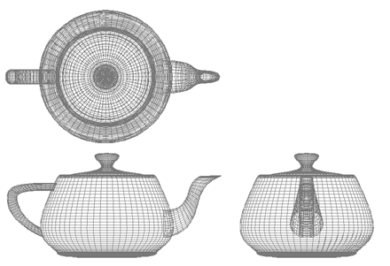
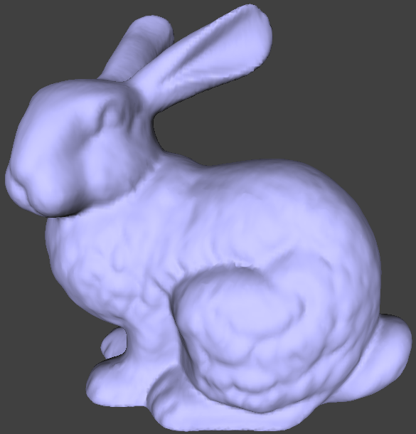
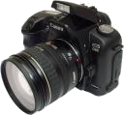
Computer Graphics
The transform phase
University of Technology Sydney
Teacher: Nico Pietroni

Slide 2

Recap: Ray-Tracing
Same as ray casting, but ray bounces multiple times
  Easy to compute: specular reflections (multiple too)
Primary ray
Reflected ray

Slide 3
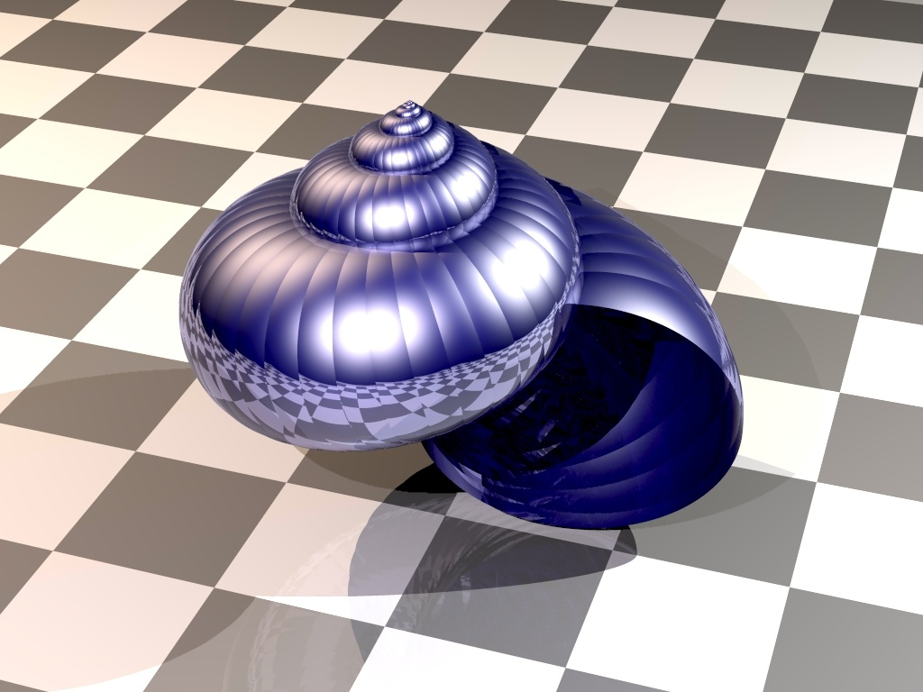
Recap: Ray-Tracing
( Advanced Rendering Toolkit - Alexander Wilkie - 1999)

Slide 4
Recap: Rasterization-based pipeline
also known as
Transform and Lighting (T&L)
y
v1
v0
v1
v0
transform
rasterize
fragment
process
Output Image
v2
v2
z
x
Fragments
a.k.a. Pixels
triangle 2D
on screen
Vertices 3D
  Compute per Pixel color wrt Lighting
All operations are massively parallelizable!
Notes:
Il lighitng si può fare insieme al transform, o nel fragment process

Slide 5

Recap: Rendering Algorithms Paradigms
for each pixel
for each primitive
RAY TRACING
for each primitive
for each pixel
RASTERIZATION

Slide 6
Recap: The common places
Ray tracing:
  good for complex visual effects
    shadows, specular reflections, refractions...
  SW-based (CPU)
  therefore: off-line, hi-quality renderings!
Rasterization:
  fast!
    for each primitive, process only a few pixels
    (instead of: for each pixel, process all primitives)
  HW-based (GPU)
  therefore: real-time, compromise-quality renderings!

Slide 7
Back to graphics: Transform
For each vertex of a given model:
y
v0
v1
?
v0
v1
z
v2
x
v2
Coordinates of vertices in the 3D modeling system of the input object
(“object coordinates”)
Coordinates of vertices in the 2D system of the view window
(“screen coordinates”)

Slide 8
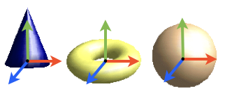
Coordinate Systems
Object coordinates

Slide 9
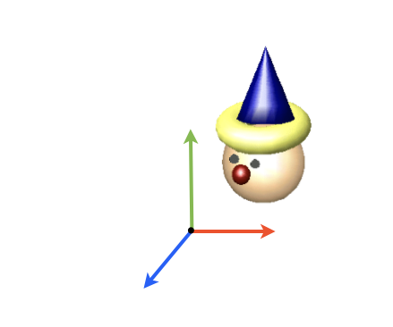
Coordinate Systems
Object coordinates
World coordinates

Slide 10

Coordinate Systems
Object coordinates
World coordinates
Camera coordinates

Slide 11
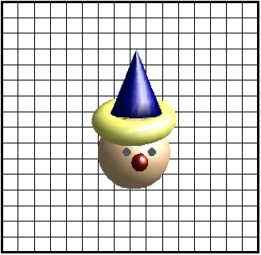
Coordinate Systems
Object coordinates
World coordinates
Camera coordinates
Screen coordinates

Slide 12
Coordinate Transformation
object space
camera space
screen space
model
camera
projection
viewport
canonical
view volume
world space

Slide 13
Transform
It is more complex than this…
y
v0
v1
View transformation
View transformation
Projection Transformation
Viewport Transformation
v1
z
v0
v2
x
object Coordinates
v2
screen Space
0
3
y
y
1
v1
v1
v
v0
v2
2
v0
-1
-u
v1
1
v1
v2
-z
-n
z
v2
x
v0
v0
x
1
v2
view Coordinates
(a.k.a. eye Coordinates)
-1
clip
coordinates
world Coordinates

Slide 14
Transform
In principle, there are four transformation matrices:
y
v0
T_{m} modeling matrix
T_{v} view matrix
T_{p} projection matrix
T_{vp} viewport matrix
v1
z
v0
v1
v2
x
object Coordinates
v2
screen Space
Tm
Tvp
y
y
1
v1
v1
v
v0
Tv
Tp
v0
-1
-u
v1
v2
v1
v2
-z
-n
z
v2
x
v0
v0
x
v2
view Coordinates
(a.k.a. eye Coordinates)
-1
clip
coordinates
world Coordinates

Slide 15
Transform
It is more complex than this…
y
v0
v1
Modelling transformation
View transformation
Projection Transformation
Viewport Transformation
v1
z
v0
v2
x
object Coordinates
v2
screen Space
0
3
y
y
1
v1
v1
v
v0
v2
2
v0
-1
-u
v1
1
v1
v2
-z
-n
z
v2
x
v0
v0
x
1
v2
view Coordinates
(a.k.a. eye Coordinates)
-1
clip
coordinates
world Coordinates

Slide 16
Modeling transformations (example in 2D)
y
Object space
axes x and y of
object space
origin o of
object space
3
2
1
x
-3
-2
-1
1
2
3
-1
-2
-3
object space (“car space”)

Slide 17
Modeling transformations (example in 2D)
World space
y
y
Coordinates of p
in object space
p = (1.5, 2.3)
8.1
2.3
= (12.5, 8.1)
Coordinates of p
in world space
x
1.5
object space (“car space”)
1
x
1
12.5
World frame

Slide 18


Bring scene in front of the camera
Input:
1) camera position: p_{pov}
2) target position: p_{target}
3) up camera vector: v_{up}
Points and vectors in world coordinate frame !
y
v_{up}
p_{pov}
z
0
p_{target}
x
world coordinate frame

Slide 19
Modeling transformations (example in 2D)
Usually Point of view is on (0,0)

Slide 20
Modeling transformations (example in 2D)
Scale to match right proportions

Slide 21
Modeling transformations (example in 2D)
Rotate

Slide 22
Modeling transformations (example in 2D)
Translate

Slide 23
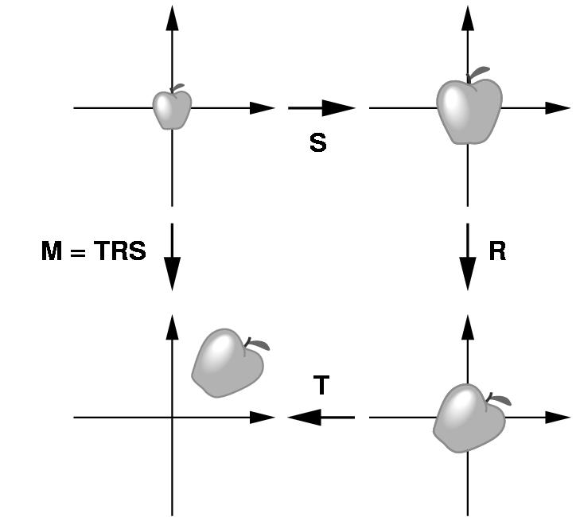
Modeling transformations
How do we proceed to create an instance of an object in a scene?
Scale first, to obtain desired size an proportions
Next, rotate to orient
Finally, translate to the desired position

Slide 24
What is the right rotation?
Defined by two angles and a distance:
  theta: elevation
  phi: azimuth
  ro: distance from origin
y
theta
ro
phi
z
-x

Slide 25
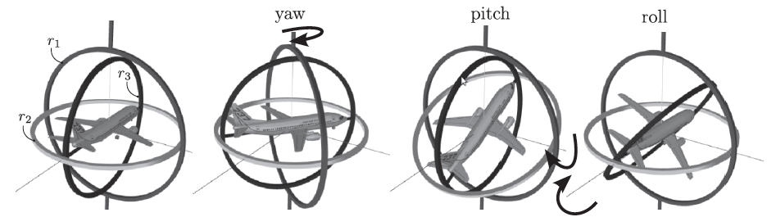
Euler angles
Euler angles:
  Generic rotation expressed as a sequence of three rotations about axes:
    Yaw about y axis
    Pitch about x axis
    Roll about z axis
  As for an object mounted on a gimbal
Not easy to devise the proper angles

Slide 26
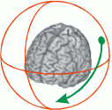
Trackball
A more elegant solution:
Put a sphere around the object
Get the intersections between the sphere and rays cast from consecutive mouse positions
Compute the angle and axis of rotation explicitly
Combine with previous rotation

Slide 27
Trackball
Axis of rotation
Angle of rotation
Mouse initial
position
(on screen)
Mouse final
position
(on screen)

Slide 28
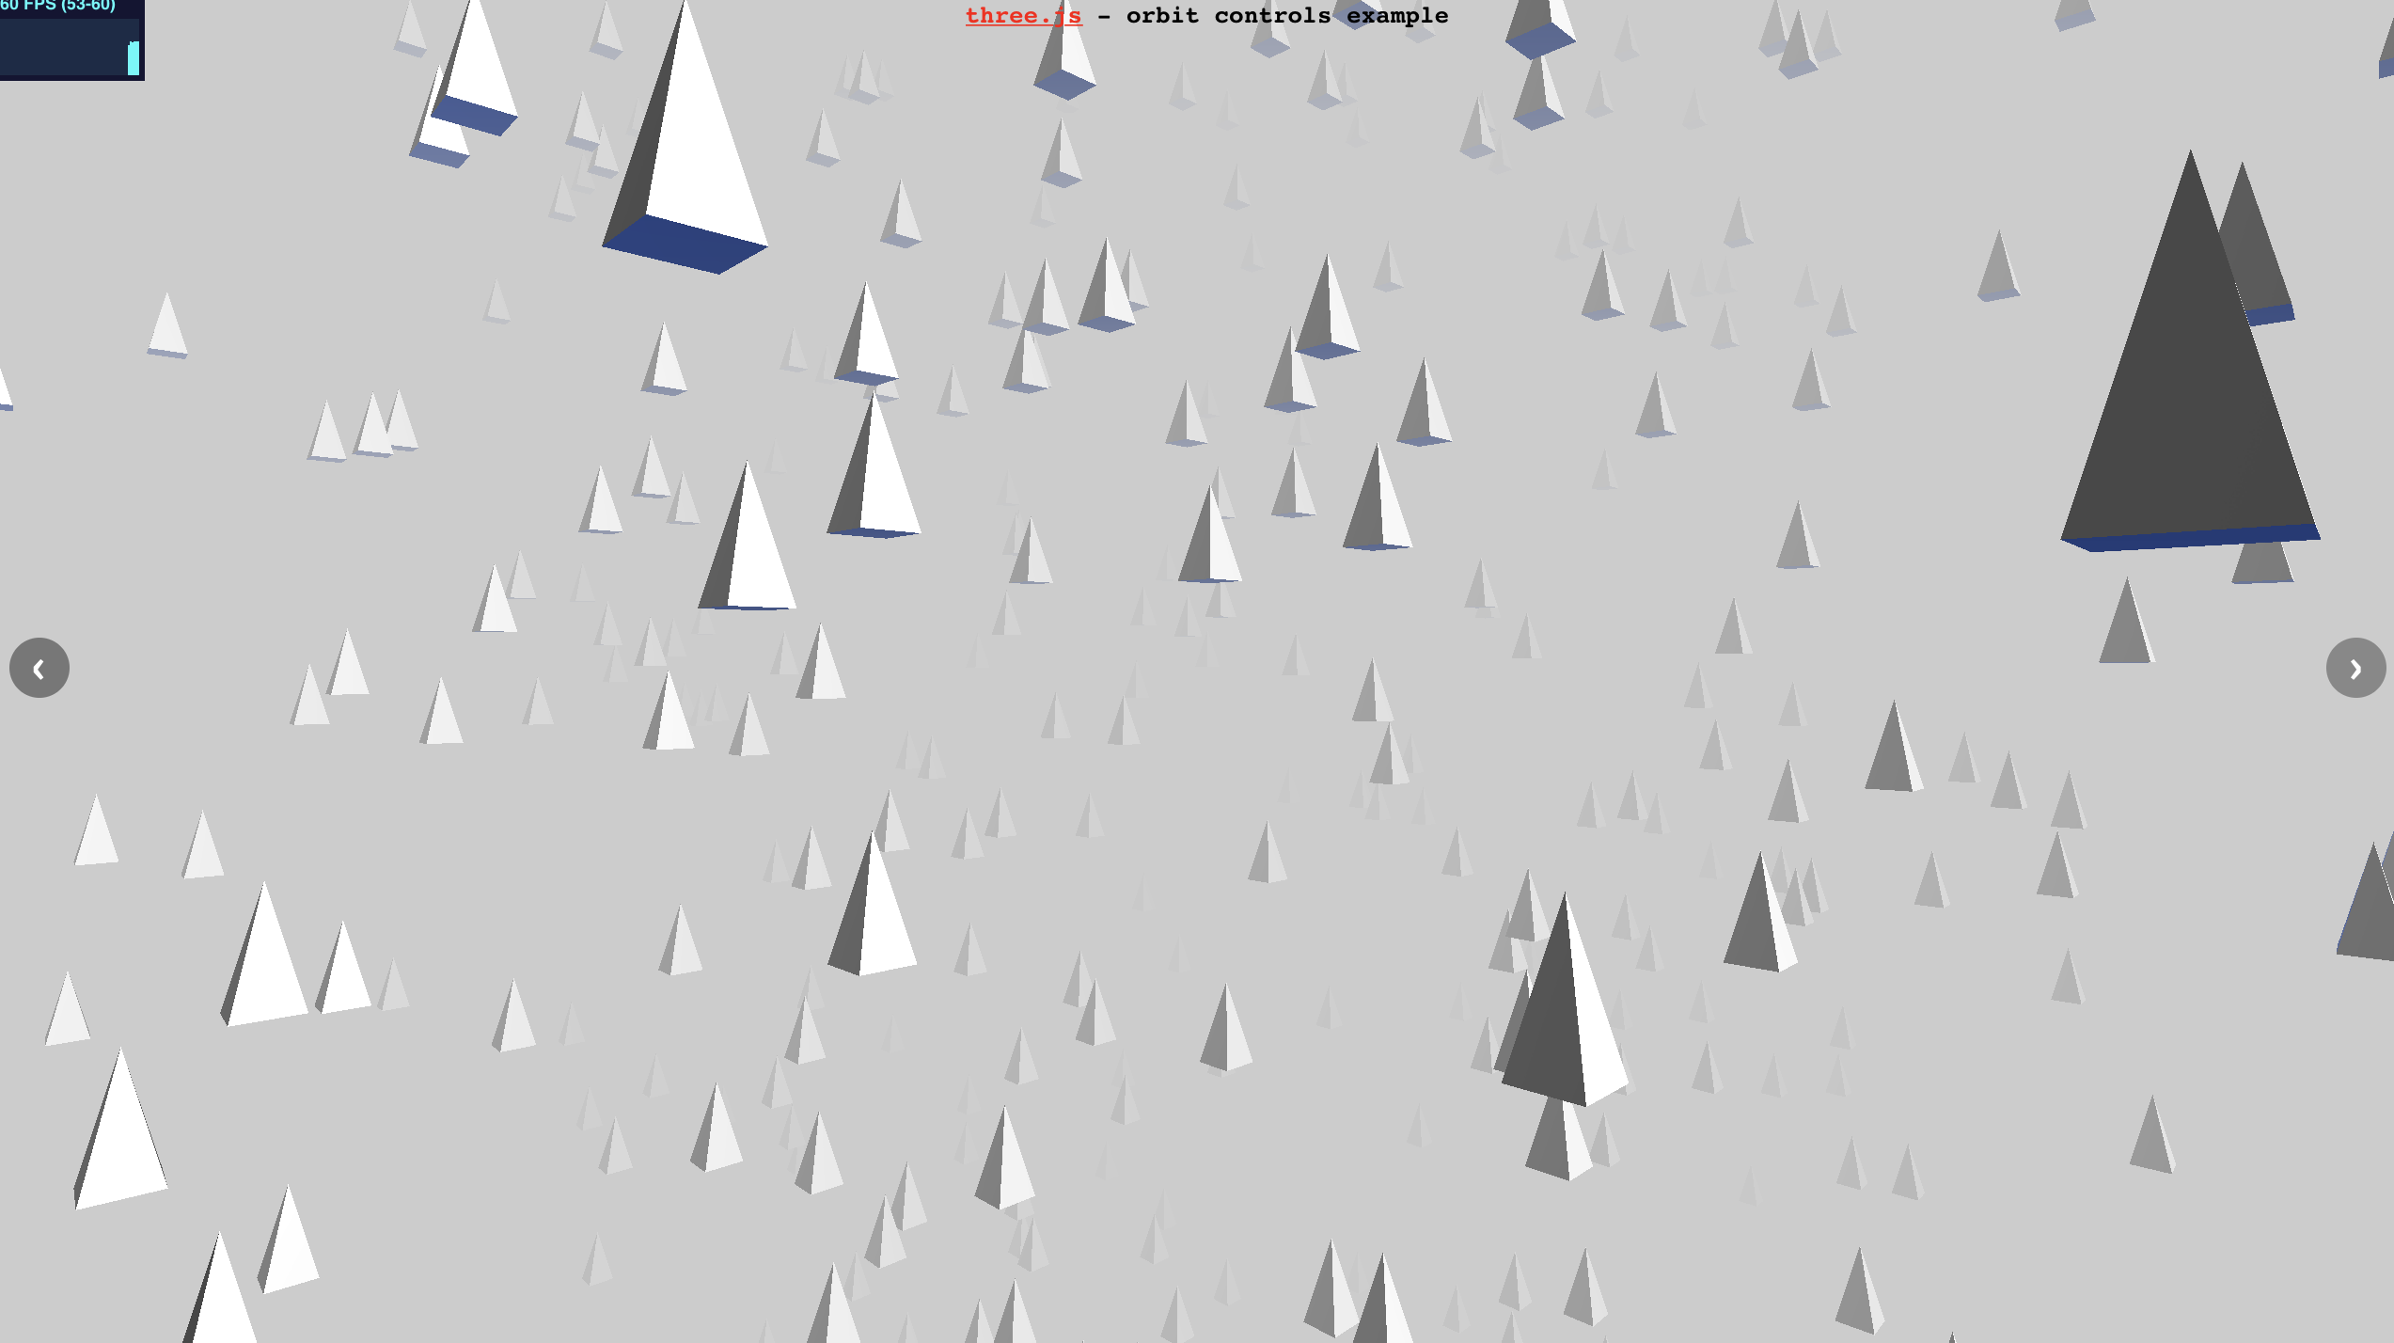
In ThreeJs
See
  http://davidscottlyons.com/threejs-intro/#slide-38
To
  http://davidscottlyons.com/threejs-intro/#slide-41

Slide 29
View transformation
y
v0
v1
z
v0
v1
0) Modeling transformation
1) View transformation
2) Projection transformation
3) Viewport transformation
v2
x
object Coordinates
v2
screen Space
0
3
y
y
1
v1
v1
v
v0
2
v0
-1
-u
v1
1
v2
v1
v2
-z
-n
z
v2
x
v0
v0
x
1
v2
view Coordinates
(a.k.a. eye Coordinates)
-1
clip Coordinates
world Coordinates

Slide 30
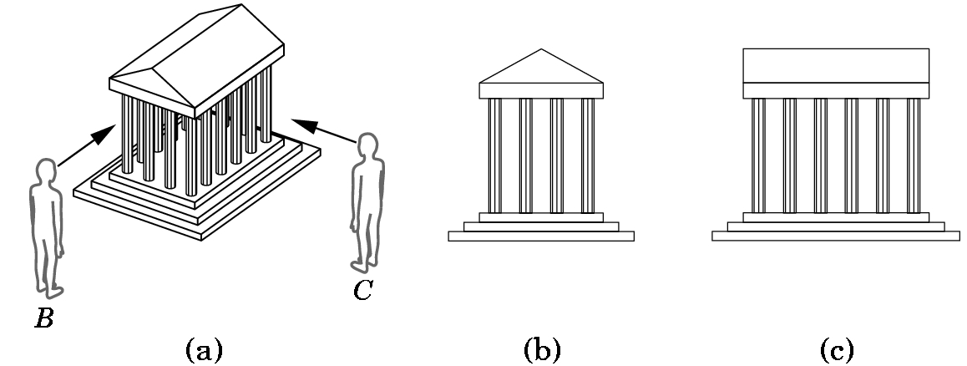
View transformation
Dipending on position of camera
  A.k.a.:
    Viewer position
    eye position
    PoV (Point of View)
As seen from B
As seen from C

Slide 31
View transformation: typical example
Input:
1) camera position: p_{pov}
2) target position: p_{target}
3) up camera vector: v_{up}
Points and vectors in world coordinate frame!
y
v_{up}
p_{pov}
z
0
p_{target}
x
world coordinate frame

Slide 32
View transformation: typical example
Input:
1) camera position: p_{pov}
2) target position: p_{target}
3) up camera vector: v_{up}
Output:
Trasformation matrix
world frame → eye frame
v
u
n
y
eye coordinate frame
oe
v_{up}
z
0
x
world coordinate frame

Slide 33
View transformation: typical example
Now...
Geometry is expressed in a coordinate frame where:
origin is the center of projection (camera lens / viewpoint)
camera looks toward direction -n
v is camera upward direction, u points to the right of camera
v
u
n
y
eye coordinate frame
oe
v_{up}
z
0
x
world coordinate frame

Slide 34
Projection transformation
y
v0
v1
z
v0
v1
0) Modeling transformation
1) View transformation
2) Projection transformation
3) Viewport transformation
v2
x
object Coordinates
v2
screen Space
0
3
y
y
1
v1
v1
v
v0
2
v0
-1
-u
v1
1
v2
v1
v2
-z
-n
z
v2
x
v0
v0
x
1
v2
view Coordinates
(a.k.a. eye Coordinates)
-1
clip Coordinates
world Coordinates

Slide 35
Projection transformation
Time to move to 2D !
y
1
v1
v
2
v0
-1
-u
v1
v2
v1
v2
-z
-n
v0
v0
x
1
v2
view Coordinates
(a.k.a. eye Coordinates)
-1
Clip
coordinates

Slide 36
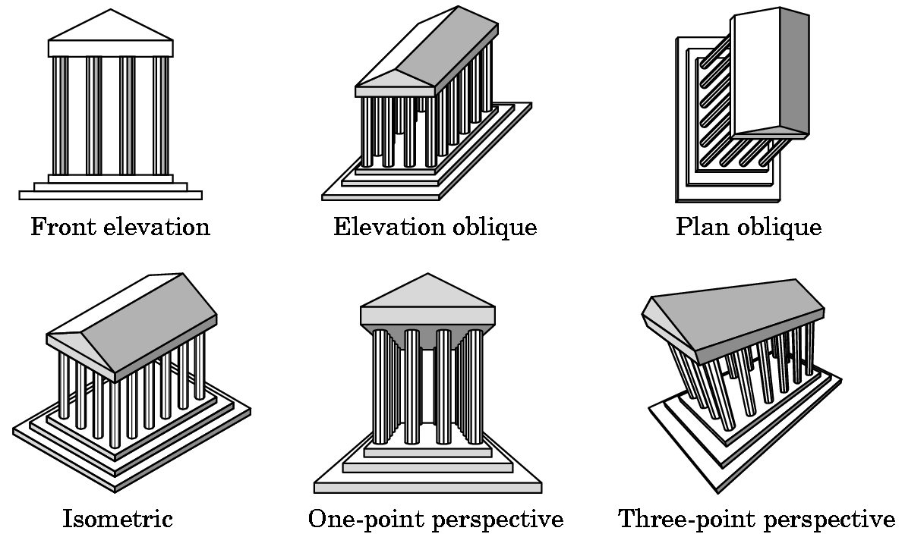
Projection transformation
Classical problem:
  (in arts and architecture)
How to represent
  3D objects
  on a 2D plane

Slide 37

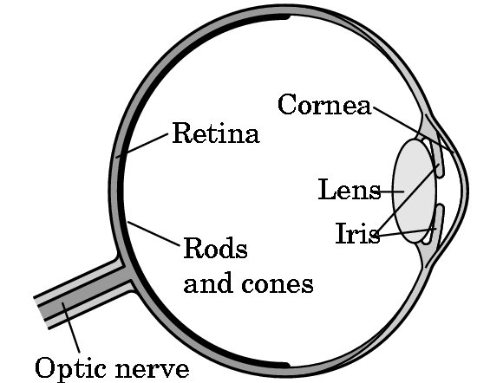
The physical process
Eye or camera, same concept
CCD or film
(2D screen buffer)
retina
(2D screen
buffer)
lens
lens
Focal
distance
Focal
distance

Slide 38
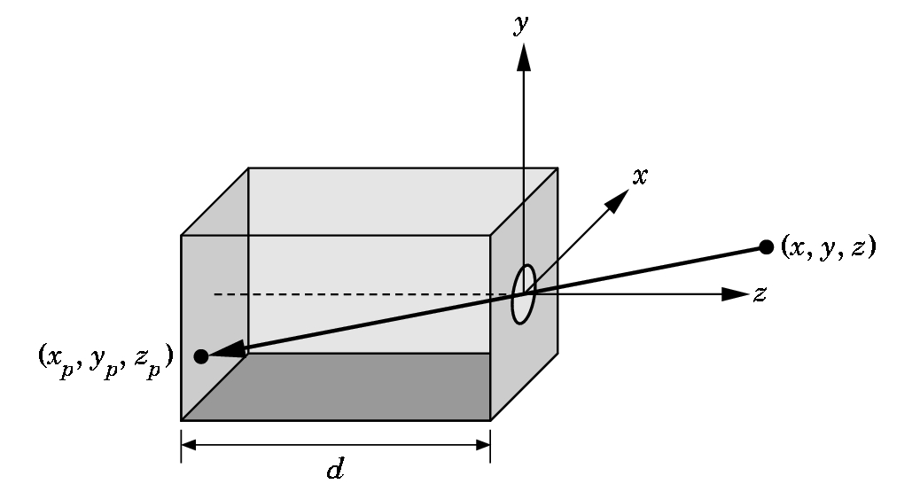
Our metaphor
pin-hole camera
y
image
plane
-x
-z
Focal
distance

Slide 39
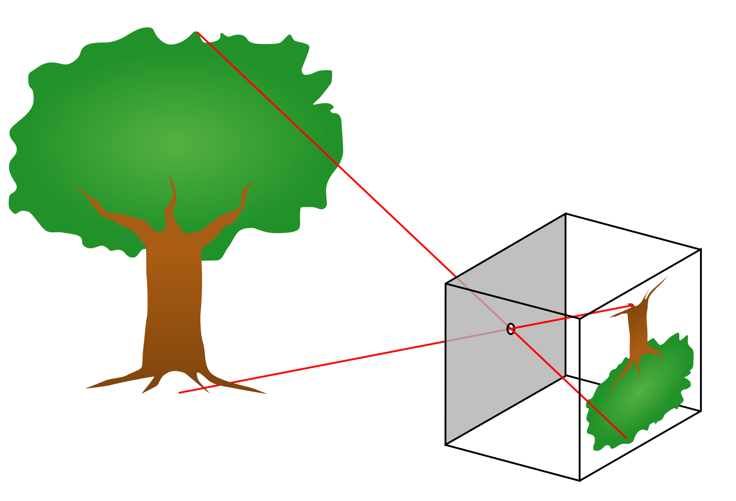
Pin Hole camera
For simplicity, we set the image plane in front of the camera and upright
(i.e., on plane n = -d in the eye frame)
focal distance

Slide 40
Math of simple projection to 2D
with k s.t.
v
therefore…
image plane
u
-n
and
Center of projection (origin)
Remark:
Not reversible
We lose notion of depth
Focal
distance d

Slide 41
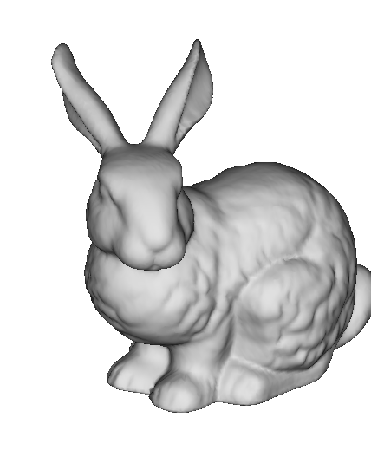
Varying d
Notes:
sisnstra: proiezione ortogonale
Destra: proiezione prospettica

Slide 42
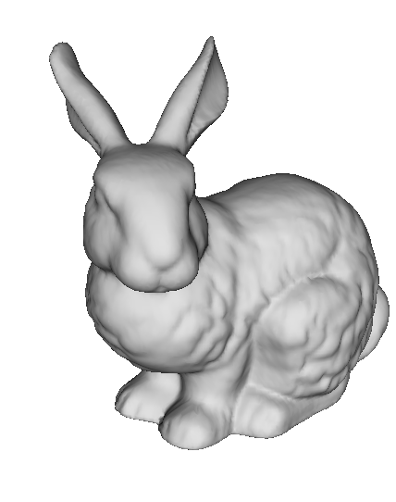
Varying d
Notes:
sisnstra: proiezione ortogonale
Destra: proiezione prospettica

Slide 43
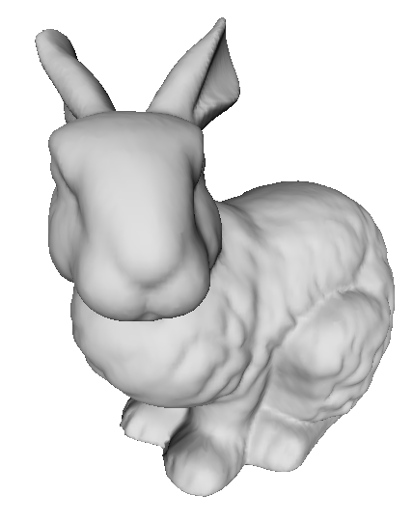
Varying d
Notes:
sisnstra: proiezione ortogonale
Destra: proiezione prospettica

Slide 44
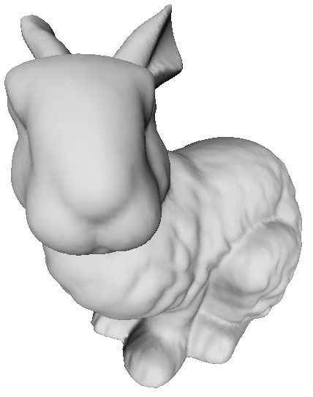
Varying d
Notes:
sisnstra: proiezione ortogonale
Destra: proiezione prospettica

Slide 45
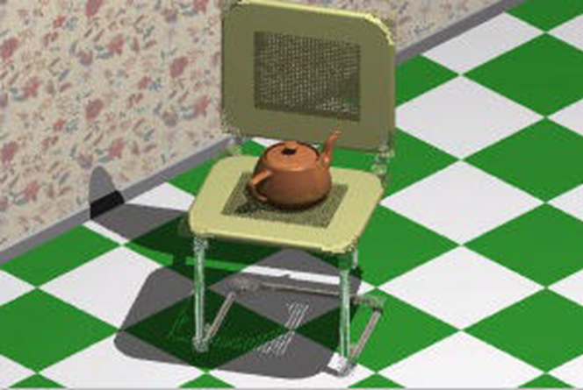
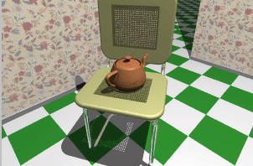
Find the differences...
Same scene, same view:
  different projections
Notes:
sisnstra: proiezione ortogonale
Destra: proiezione prospettica

Slide 46
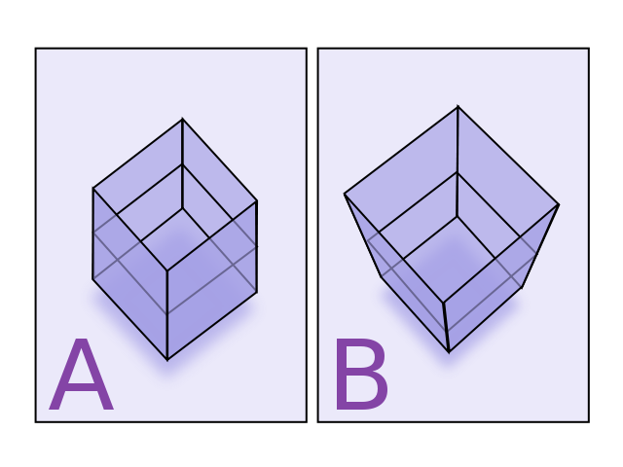
Find the differences...
Notes:
sisnstra: proiezione ortogonale
Destra: proiezione prospettica

Slide 47

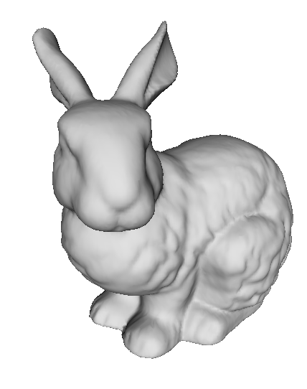

Perspective projection: how it looks
d small
d infinite
(orthogonal
projection)
d large
More perspective distortion.
“Fish-eye” effect
(wide angle)
Less perspective distortion
“Zoom” effect
(eg. Satellite view)

Slide 48
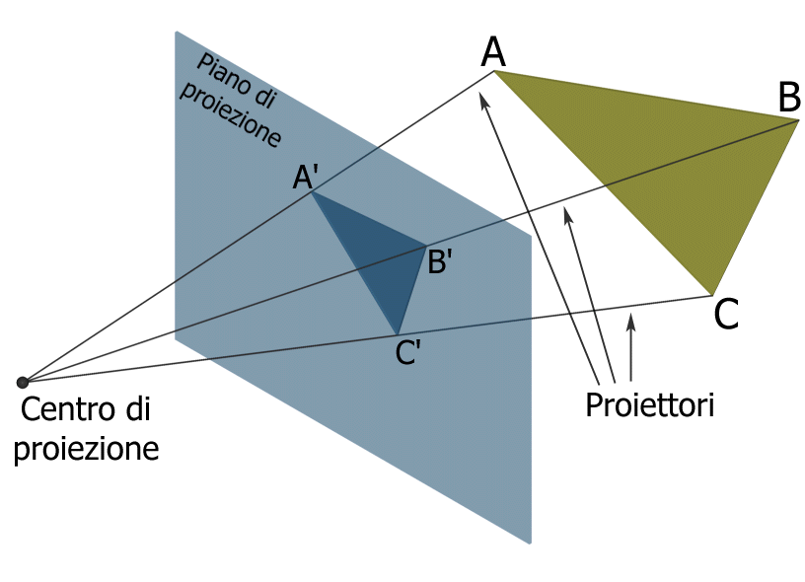
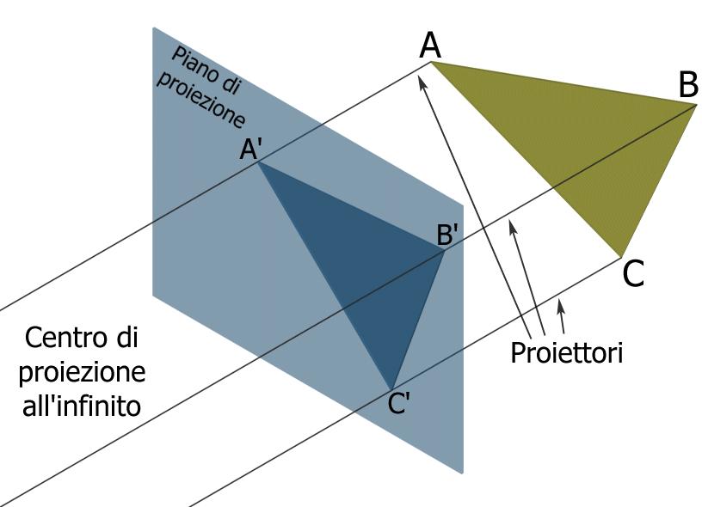
Perspective vs Orthogonal
Perspective projection (finite distance between center ed proiection plane)
Orthographic projection (infinite distance between center ed proiection plane).

Slide 49
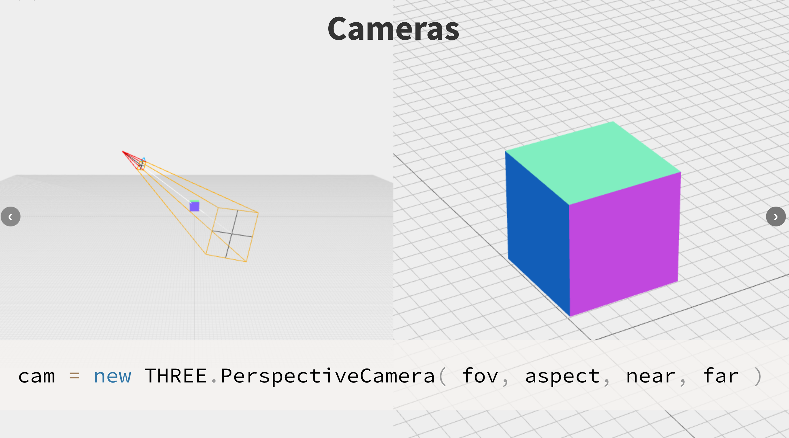
In ThreeJs
See
  http://davidscottlyons.com/threejs-intro/#slide-30
To
  http://davidscottlyons.com/threejs-intro/#slide-37

Slide 50
Focal distance or Field of View?
Focal distance (d ) or angle Field of View ( FoV )
  d used for computations, FoV more intuitive to set
    Large FoV >60° (small focal distance): «wide angle»
    Small FoV <45° (large focal distance): «telephoto»
w
Field of View (vertical)
(angle)
h
Focal ditance d

Slide 51
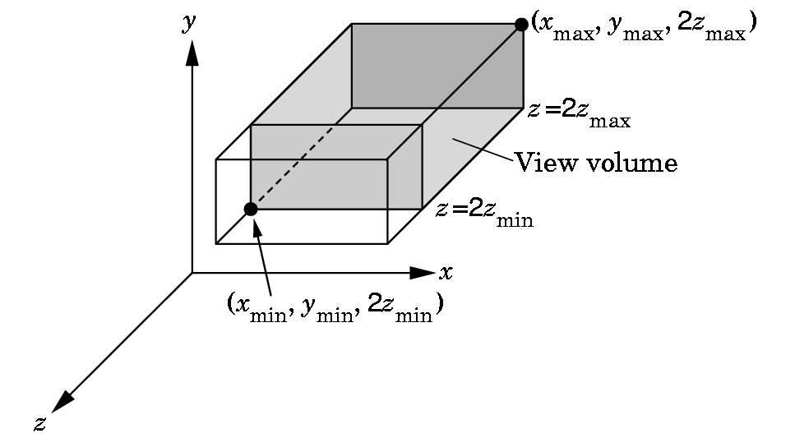
The View Volume
The view volume is defined by:
Type of projection (parallel / perspective)
Lower-left-near corner of volume
Upper-right-far corner of volume
(x_{max},y_{max},-far)
Example with
parallel projection
z=-far
z=-near
(x_{min},y_{min},-near)

Slide 52
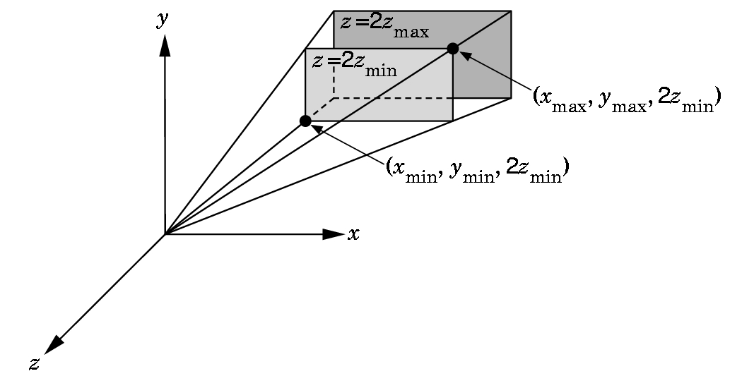
The View Volume
The view volume is defined by:
Type of projection (parallel / perspective)
Lower-left-near corner of volume
Upper-right-far corner of volume
-far
-near
Example with
perspective projection
-near)
-near)

Slide 53
The clip space
Projection to clip space:
  Set the view volume (framed portion of the scene)
  Project it onto a normalized space (a cube with all coordinates in the range [–1,1])
The “shape” of the view volume defines the projection law:
  frustum  perspective projection
  parallelepiped  parallel projection

Slide 54
The Clip space
X e Y: between -1 and +1
  Independently of dimensions / proportions of viewport
  X = -1 left border X = +1 right border
  Y = -1 lower border Y = +1 upper border
  Origin: Center of rendered image
If a point is partially inside and partially outside:
«clip» it !
  Splitted in parts

Slide 55
After perspective division
y
y
v1
P
v2
Normalization
-z
x
v0
x
view Coordinates
(a.k.a. eye Coordinates)
z
Cube defines the
Normalized projection
coordinates
Multiplication by the projection matrix
Framed objects fall inside the cube
Objects outside it are out of the image

Slide 56
Viewport transformation
y
v0
v1
x
v0
v1
0) Modeling transformation
1) View transformation
2) Projection transformation
3) Viewport transformation
v2
z
object Coordinates
v2
screen Space
0
3
y
y
1
v1
v1
y
v0
2
v0
-1
x
v1
1
v2
v1
v2
-z
-z
x
v2
z
v0
v0
x
1
v2
view Coordinates
(a.k.a. eye Coordinates)
-1
Clip
Coordinates
world Coordinates

Slide 57
Viewport transformation
v0
v1
v1
v0
z
v2
x
v2
OBJECT
COORDS
CLIP
COORDS
SCREEN
COORDS

Slide 58
Viewport transformation
The viewport is the portion of output window to which the frame buffer is mapped:
  rectangle w × h pixels
Vertices in the Normalized projection coordinate system are further transformed to express them in Window coordinates
3D coordinate system, with x, y in pixels (size of the viewport) and z in range [0,1]
Origin at lower left corner

Slide 59
Viewport transformation
Normalized frame Window frame
y
y
(-1,1,-1)
1
(-1,1,1)
(1,1,-1)
p_{y}
(1,1,1)
z
(-1,-1,-1)
o
z
x
(-1,-1,1)
Viewport
(1,-1,-1)
p_{x}
NPC
(1,-1,1)
x

Slide 60
Viewport transformation
Combination of translation and scaling
Very easy, computed directly in Cartesian coordinates:
  (p_{x},p_{y}) size of the viewport
  (o_{x},o_{y}) center of the viewport
  (x_{d},y_{d} ,z_{d}) vertex in normalized coordinates

Slide 61
Eventually 2D + depth
All primitives in devices coordinates are projected on plane z = 0 (i.e., we just “forget” the third coordinate of each point)
These 2D primitives are passed on to the rasterizer
Actually the third coordinate of each vertex is preserved as an attribute. We will need it later on…

Slide 62
Aspect ratio
The combined effect of projection and viewport transformations may deform the image (horizontal / vertical stretch)
In order to keep the aspect ratio we need to have the same ratio w/h for the viewport as well as for the cross section of the view volume
Upon resize of the view window, we need to keep the aspect ratio consistent.

Slide 63
In ThreeJs
We we’ll see soon!

Slide 64
Computer Graphics
The transform phase
University of Technology Sydney
Teacher: Nico Pietroni

