Slide 1
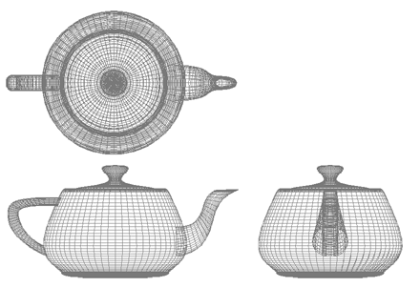
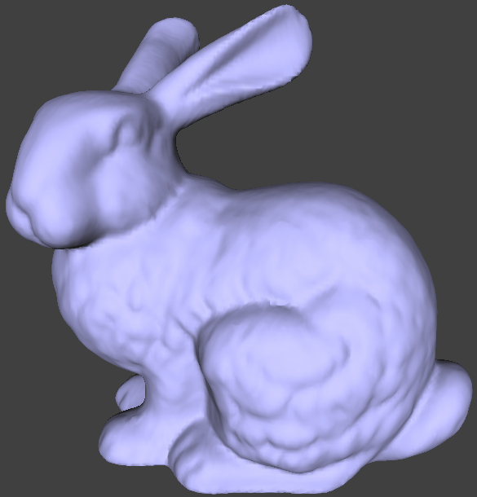
Computer Graphics
Geometric transformations
University of Technology Sydney
Teacher: Nico Pietroni

Slide 2
Recap: The graphics pipeline
object space
camera space
screen space
model
camera
projection
viewport
canonical
view volume
world space

Slide 3
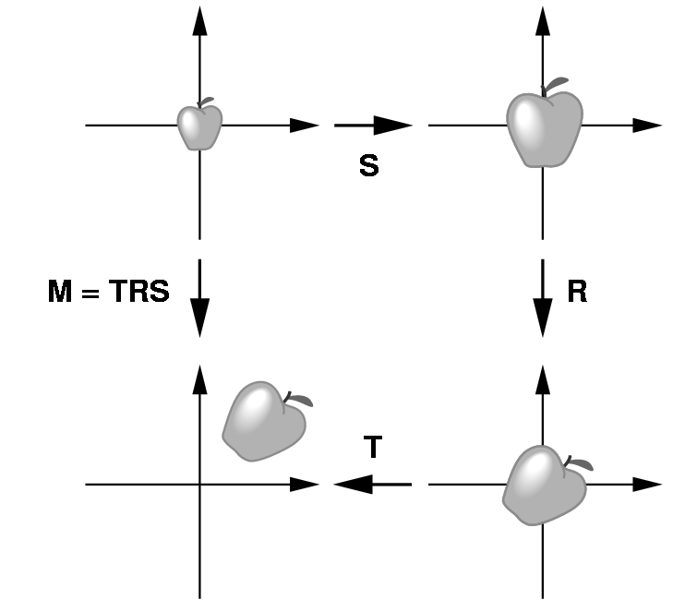
Recap: Object space to World Space
Bring an object in front of the camera
Scale first, to obtain desired size an proportions
Next, rotate to orient
Finally, translate to the desired position

Slide 4
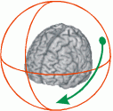
Recap: Object space to World Space (Interactive)
A more elegant solution:
Put a sphere around the object
Get the intersections between the sphere and rays cast from consecutive mouse positions
Compute the angle and axis of rotation explicitly
Combine with previous rotation

Slide 5
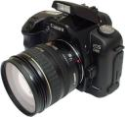
Recap: View transformation
Now...
Geometry is expressed in a coordinate frame where:
origin is the center of projection (camera lens / viewpoint)
camera looks toward direction -n
v is camera upward direction, u points to the right of camera
v
u
n
y
eye coordinate frame
oe
v_{up}
z
0
x
world coordinate frame

Slide 6
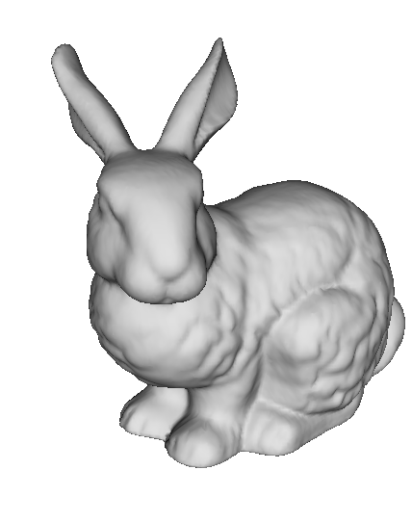
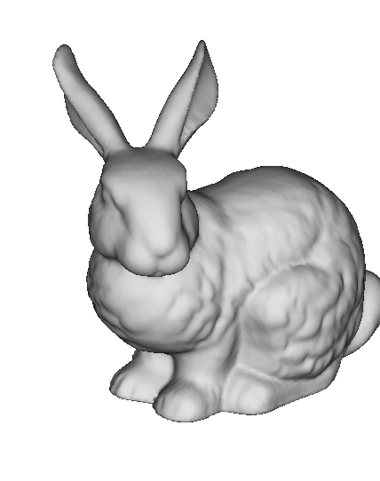
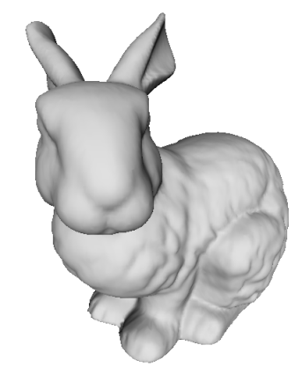
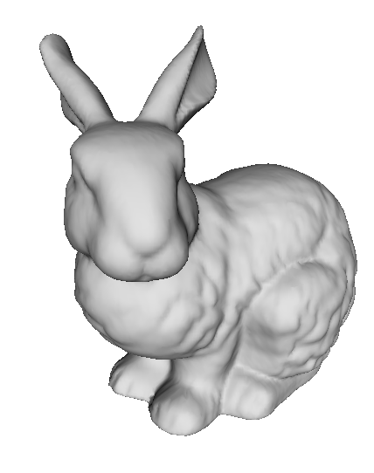
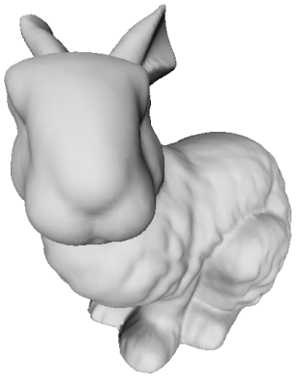
Recap: Projection Transformation
d small
d infinite (orthogonal
projection)
d large
More perspective distortion.
“Fish-eye” effect (wide angle)
Less perspective distortion
“Zoom” effect (eg. Satellite view)

Slide 7
Recap: Viewport transformation
Normalized frame Window frame
y
y
(-1,1,-1)
1
(-1,1,1)
(1,1,-1)
p_{y}
(1,1,1)
z
(-1,-1,-1)
o
z
x
(-1,-1,1)
Viewport
(1,-1,-1)
p_{x}
NPC
(1,-1,1)
x

Slide 8
Recap: pipeline detail
It is more complex than this…
y
v0
v1
View transformation
View transformation
Projection Transformation
Viewport Transformation
v1
z
v0
v2
x
object Coordinates
v2
screen Space
0
3
y
y
1
v1
v1
v
v0
v2
2
v0
-1
-u
v1
1
v1
v2
-z
-n
z
v2
x
v0
v0
x
1
v2
view Coordinates
(a.k.a. eye Coordinates)
-1
clip
coordinates
world Coordinates

Slide 9
Recap: pipeline maths detail
In principle, there are four transformation matrices:
y
v0
T_{m} modeling matrix
T_{v} view matrix
T_{p} projection matrix
T_{vp} viewport matrix
v1
z
v0
v1
v2
x
object Coordinates
v2
screen Space
Tm
Tvp
y
y
1
v1
v1
v
v0
Tv
Tp
v0
-1
-u
v1
v2
v1
v2
-z
-n
z
v2
x
v0
v0
x
v2
view Coordinates
(a.k.a. eye Coordinates)
-1
clip
coordinates
world Coordinates

Slide 10
Geometric transformations (in general)
Functions that
Take a point / vector
and map it to another point / vector
We need to review some goemetry...
p
q
q = (p)
v = (u)

Slide 11
Affine space
Three types of entities
scalars
vectors
points
attributes:
Norm (length), Direction
attribute:
Position in space

Slide 12
Vectors
A vector describes a direction and a length
Do not confuse it with a location, which represent a position
When you encode them in your program, they will both require 2 (or 3) numbers to be represented, but they are not the same object!

Slide 13
Geometric transformations (in particular)
Functions that
Take a point / vector
and map it to another point / vector
p
q
q = (p)
v = (u)
Three examples:
Translation
Scaling
Rotation

Slide 14
Affine space: Operations
Sum (point , vector ) → point
Subtraction (point , point) → vector
point
( a + v )
vector v
point
a
point
b
remember: “tip minus tail” of the arrow
vector (b – a )
point
a

Slide 15
Example: translation
Offset vector
y
y
x
x

Slide 16
Translation
Remarks:
Points are translated
E.g.: positions of vertices of a mesh
But vectors must remain unchanged!
E.g.: normal vectors to the surface of the mesh view direction of the observer upward direction of the observer
With Translation: Angles are preserved
it is a «conformal» transformation (= it preserves the shape) (= it does not deform shapes)
With Translation:Distances between points are preserved
it is an «isometric» transformation

Slide 17
Example: uniform scaling
y
y
x
x

Slide 18
Example: uniform scaling
note: when applied to points it "scales" also distance from origin
y
y
x
x

Slide 19
Example: generic scaling
“component-wise product”
(non standard operation in the algebra)
y
y
x
x

Slide 20
Generic scaling
Remarks:
Scale factors smaller than 1 move the object closer to the origin
Scale factors larger than 1 move it farther
If s_{x} ≠ s_{y} or s_{y} ≠ s_{z} proportions of the object are not preserved (non uniform, or anisotropic scaling)
If s_{x} = s_{y} = s_{z} proportions (and angles) are preserved and scaling is uniform (or isotropic) and so conformal
not isometric (distances between points are not preserved)

Slide 21
Example: rotation about the z axis
y
(x,y)
z
x
ρ

Slide 22
Example: rotation about the z axis
y
(x’,y’)
β
(x,y)
z
x
ρ

Slide 23
Example: rotation about the z axis
y
(x’,y’)
ρ
z
x

Slide 24
Rotation
y
(x’,y’)
β
(x,y)
z
x
ρ
y
y
x
x
y
y
x
x

Slide 25
Transformations
IF They preserve:
Distances & Angles
RIGID TRANSFORMATIONS
Only Angles
CONFORMAL TRANSFORMATIONS
More Generic Transormations: Affine transformations

Slide 26
Affine transformations
They preserve:
Co-linearity
Straight lines are transformed into straight lines
Ratios between distances
i.e. The midpoint of a segment is mapped into the midpoint of the mapped segment
Parallelism
between pairs of straight lines

Slide 27
Affine transformations
In General they NOT preserve:
Distances
Angles
Areas
Rigid Transformations and Conformal transformations are a subset of Affine Transformations.

Slide 28
Affine Transformations
They can all be expressed as multiplications by a matrix
always
Homogeneous coords of starting point
Homogeneous coords of target point

Slide 29
Representation in homogenoeus coordinates
Points:
Vectors:
1
0

Slide 30
Reminder: product Matrix – Vector
“row x column”
i.e. dot products with row vectors
A
·
B
·
A
B
·
=
C
C
·
D
D
·

Slide 31
Affine matrix for translation
On a point
i.e.:
In matrix form:
Translation vector

Slide 32
Example: translation
no effect on vectors!
0
0

Slide 33
Affine Transformations on Vectors
this only matters
0
0
0
...
always
homogenoeus coords
input vector
homogeneous coords
output vector

Slide 34
Affine matrix for Uniform Scale
y
y
x
x
Scaling matrix

Slide 35
Example: non-uniform scaling
y
y
x
x
Scaling matrix
Inverse matrix?

Slide 36
Example: rotation about the z axis
y
(x’,y’)
β
(x,y)
z
x
ρ
y
y
x
x

Slide 37
Example: rotation about the z axis
y
(x’,y’)
β
(x,y)
z
x
ρ

Slide 38
Rotations about axes x, y, and z

Slide 39
Other Affine: Shearing
It can be expressed as a 4x4 matrix

Slide 40
Composite transformations
Multiplication is associative!
B(Ax) = (BA)x
Matrix A «does» a transformation a
Matricx B «does» another transformation b
Matrice (BA) «does» la transformation a, followed by b
Applying to transformation means apply their multiplication

Slide 41
Reminder: matrix multiplication
Associative yes, commutative no!
AB ≠ BA
finding correct order is not intuitive
y
y
RT
TR
x
x
Notes:
Sinistra RT Destra TR

Slide 42
Rotation parallel about an axis parallel to z
y
y
z
z
x
x

Slide 43
Rotation parallel about an axis parallel to z
y
y
z
z
x
x
1
translation T⁻¹
y
x

Slide 44
Rotation parallel about an axis parallel to z
y
y
z
z
x
x
1
translation T⁻¹
y
y
2
x
rotationt R
x

Slide 45
Rotation parallel about an axis parallel to z
y
y
z
z
x
x
Bring center of rot. to origin
Rotate
Bring center of rotation back
1
translation T⁻¹
3
translation T
y
y
2
x
rotationt R
x

Slide 46
Rotation parallel about an axis parallel to z
y
y
z
z
x
x
f( p )
=
T ( R ( T⁻¹ p ) )
1
translation T⁻¹
3
translation T
y
y
2
x
rotationt R
x

Slide 47
Composite transformations
Apply associative property:
f(p) = T ( R ( T⁻¹ p ) )
= (T R T⁻¹) p
a matrix M 4x4 does all
efficient
what if we multiply a vector by M ?
Notes:
Che fa tutto = che fa la freccia senza in alto del lucido precedente.
Efficienza: moltiplicazione matrici = 4 alla 3 = 64 moltiplicazioni.
Se fosse un vert solo da proiettare, sarebbe meglio fare come la formula sotto. Ma i vertici sono moltissimi e conviene quella sotto.
Cosa possiamo dire della matrice? (untima riga = 0,0,0,1)
Cosa succede se la moltiplico per un vettore? (e' come moltiplicare per R) Perche'?

Slide 48
Scene graph (hierarchical modeling)
y
z
y
y
x
x
y
y
z
World
space
x
x
z
z
z
x
T1
T4
T2
T3

Slide 49
Scene graph (hierarchical modeling)
“car”
coord. frame
“wheel”
coord. frame
Same template
different instances undergo
different scaling and roto-translation

Slide 50
Assembling complex scenes
Object space
“wheel”
Object space
“car”
World space (global)
Notes:
RISULTATO: Stack di matrici di modelling!

Slide 51
Scene graph
V
Placing car (wrt world)
Placing wheel
(wrt car)
M0
M2
M1
M3
M4
M5
M6
Notes:
RISULTATO: Stack di matrici di modelling!

Slide 52
Scene graph
Eye space
View matrix
V
World space
Modeling matrices
M0
M2
M0 · M3
M1
Car
space 1
Car
Space 2
Car
Space 3
M3
M4
M5
M6
Wheel
space A
Wheel
space C
Wheel
space D
Wheel
space B
Notes:
RISULTATO: Stack di matrici di modelling!

Slide 53
Setting the model-view matrix
Idea: depth first navigation of scene graph
Init: model-view = view
Follow links from parents to children:
Accumulate modeling matrices (multiply to the right)
When backtracking to parent:
Recover its matrix (how?)

Slide 54
Keep a stack of model-view matrices!
I·V·M0·M3
I · V · M0
I · V
M

Slide 55
Keep a stack of model-view matrices!
Matrix at the top = current model-view
Operations we need: (e.g. in an API / library)
overwrite identity on the top matrix
To initialize!
multiply top matrix by a given matrix
remark: on the right! M[top] = M[top] * Mnew
Rule of thumb: “last thing in the code is first transformation to apply”
push: save current matrix in the stack
It becomes the top matrix
Do it when going down one level in the graph
pop: discard the top matrix in the stack
The last saved matrix becomes the current matrix
Do it when going up one level in the graph

Slide 56
Change of reference Frame
It is more complex than this…
y
v0
v1
View transformation
View transformation
Projection Transformation
Viewport Transformation
v1
z
v0
v2
x
object Coordinates
v2
screen Space
0
3
y
y
1
v1
v1
v
v0
v2
2
v0
-1
-u
v1
1
v1
v2
-z
-n
z
v2
x
v0
v0
x
1
v2
view Coordinates
(a.k.a. eye Coordinates)
-1
clip
coordinates
world Coordinates

Slide 57
View transformation: typical example
Input:
1) camera position: p_{pov}
2) target position: p_{target}
3) up camera vector: v_{up}
Output:
Trasformation matrix world frame → eye frame
v
u
n
y
eye coordinate frame
oe
v_{up}
z
0
x
world coordinate frame

Slide 58
Reminder: reference frame
Defined by:
Axes x, y, z (vectors)
Origin (a point)
A frame can be:
orthogonal (iff vectors x, y, z, are mutually orthogonal) (otherwise: “skew”)
orthonormal (iff vectors x, y, z, are mutually orthogonal and unary)

Slide 59
Reference Framens
“row x column”
i.e. linear combination of column vectors
x
y
·
=
x
·
+
y
·
+
z
·
+
w
·
z
w
A
B
C
D
A
B
C
D

Slide 60
Three JS
Define Vector/Matrices:
var v0 = new THREE.Vector3(0.5, 1, 0);
var v1 = new THREE.Vector4();
var v2 = new THREE.Vector4();
var Ma = new THREE.Matrix3();
var Mb = new THREE.Matrix4();
Access to Components:
v0.x = 2.0;
var k = v0.x; // .y , .z
// equivalently:
var k = v0.getComponent( 0 ); // 1 , 2

Slide 61
Three JS
Function on Vectors:
var v0 = new THREE.Vector3();
var v1 = new THREE.Vector3();
var v2 = new THREE.Vector3();
v0.set( 2, 0.5, 0.5 );
v0.add( v1 );
v2.addVectors( v0 , v1 );
v0.sub( v1 );
v2.subVectors( v0 , v1 );
v0.multiplyScalar( 3.0 );
v0.divideScalar( 3.0 );
// component-wise product
v2.multiplyVectors( v0 , v1 );

Slide 62
Three JS
Function on Matrices:
var v0 = new THREE.Vector3();
var Ma = new THREE.Matrix3();
var Mb = new THREE.Matrix3();
var Mc = new THREE.Matrix3();
Ma.multiplyScalar( 2.0 );
// row colums multiplication:
Ma.multiply( Mb ); // a dx: Ma=Ma*Mb
Mc.multiplyMatrices( Ma , Mb );
Ma.getInverse( Mb );
Ma.transpose(); // (in place)
var k = Ma.determinant();
// matrix vector product:
v0.applyMatrix3( Ma );

Slide 63
Recap: Three Kind of Entities
Three types of entities
scalars
vectors
points
attributes:
Norm (length), Direction
attribute:
Position in space

Slide 64
Recap: Geometric transformations
Functions that
Take a point / vector
and map it to another point / vector
p
q
q = (p)
v = (u)
Three examples:
Translation
Scaling
Rotation

Slide 65
Recap: Affine Transformations
They can all be expressed as multiplications by a matrix
always
Homogeneous coords of starting point
Homogeneous coords of target point

Slide 66
Recap: matrix multiplication
Associative yes, commutative no!
AB ≠ BA
finding correct order is not intuitive
y
y
RT
TR
x
x
Notes:
Sinistra RT Destra TR

Slide 67
Recap: Scene graph (hierarchical modeling)
“car”
coord. frame
“wheel”
coord. frame
Same template
different instances undergo
different scaling and roto-translation

Slide 68
Recap: Keep a stack of matrices!
I·V·M0·M3
I · V · M0
I · V
M

