Slide 1
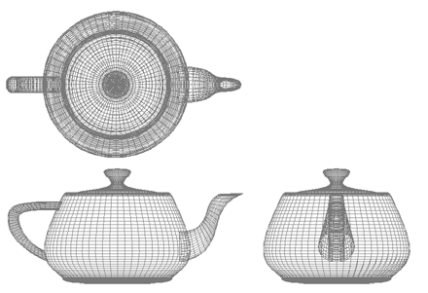
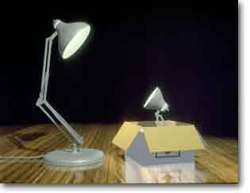
Computer Graphics
Lighting: Illumination
University of Technology Sydney
Teacher: Nico Pietroni

Slide 2
Recap: Three Kind of Entities
Three types of entities
  scalars
  vectors
  points
attributes:
Norm (length), Direction
attribute:
Position in space

Slide 3
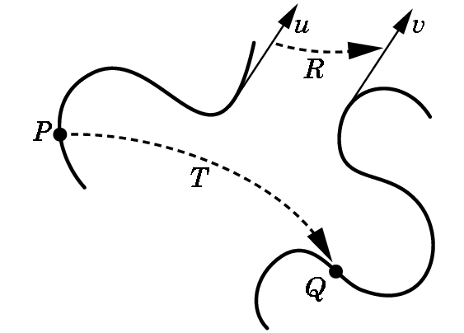
Recap: Geometric transformations
Functions that
  Take a point / vector
  and map it to another point / vector
p
q
q = (p)
v = (u)
Three examples:
  Translation
  Scaling
  Rotation

Slide 4
Recap: Affine Transformations
They can all be expressed as
multiplications by a matrix
always
Homogeneous coords
of starting point
Homogeneous coords
of target point

Slide 5
Recap: matrix multiplication
Associative yes, commutative no!
      AB ≠ BA
  finding correct order is not intuitive
y
y
RT
TR
x
x
Notes:
Sinistra RT Destra TR

Slide 6
Recap: Scene graph (hierarchical modeling)
“car”
coord. frame
“wheel”
coord. frame
Same template
different instances undergo
different scaling and roto-translation

Slide 7
Recap: Keep a stack of matrices!
I·V·M0·M3
I · V · M0
I · V
M

Slide 8
Recap: pipeline detail
It is more complex than this…
y
v0
v1
View transformation
View transformation
Projection Transformation
Viewport Transformation
v1
z
v0
v2
x
object Coordinates
v2
screen Space
0
3
y
y
1
v1
v1
v
v0
v2
2
v0
-1
-u
v1
1
v1
v2
-z
-n
z
v2
x
v0
v0
x
1
v2
view Coordinates
(a.k.a. eye Coordinates)
-1
clip
coordinates
world Coordinates

Slide 9
Lighting: intro
Transform and Lighting:
  The other half of rendering
Determine the light
  how much light
  which color
getting
  to the eye
  from a point in the scene
It is a complex problem...

Slide 10
Lighting: intro
Input:
  characteristics of the object lightened (“material”)
    (e.g.: wet paper, rough plastic, …)
    (or trivially, «its color» - see later)
  characteristics of the light(s) illuminating the scene
    (where are the sources, their intensity / color)
  and shape of objects in the scene
    especially, orientation of surfaces, i.e., their normal
Output:
  color perceived by the eye for any given point

Slide 11
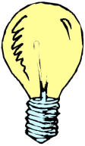

Lighting: some factors
OTHER LIGHT
blocker
absorption
in the
shade
LIGHT
incident ray
transmission (with refraction)
internal reflection
reflection
sub-surface
scattering
absorption
(e.g. fog)
OBJECT
EYE

Slide 12
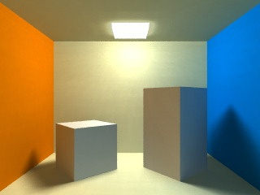
Lighting: some factors multiplereflections: light → obj1 → obj2 → … → eye
multiple reflections
(indirect illumination)
LIGHT
OBJECT
EYE

Slide 13
Lighting: global VS local
Local illumination
  takes into account just:
    light conditions
      # lights
      their pos
      their color
    fragment of surface to lighten
      orientation (normal)
      material
        e.g.: color, shininess
    position of viewer (POV)
  the rest of the world does not have any influence
Global illumination
  multiple reflections
  shadows
  subsurface scattering
  refraction
  ...
much easier
to do with our
hardware

Slide 14
Local lighting: emitter → object → eye (nothing else!)
LIGHT
incident ray
n
reflection
OBJECT
EYE

Slide 15
A bit of math: Normal Vector
A surface normal to a surface at a point P is a vector that is perpendicular to the tangent plane to that surface at P
The normal is used in computer graphics to determine a surface's orientation toward a light source for flat shading

Slide 16
A bit of math: How to compute Normals
Use cross product between two vectors tangent to the surface.
Usually Use 2 vectors lying the triangle (get two different edges)

Slide 17
Recap: Operations on Affine space
Sum (point , vector ) → point
Subtraction (point , point) → vector
point
( a + v )
vector
v
point
a
point
b
remember:
“tip minus tail”
of the arrow
vector
(b – a )
point
a

Slide 18
A bit of math: How to compute Normals
Cross Product of 2 vectors is a vector!
How to compute:
  C_{x} = a_{y}b_{z} − a_{z}b_{y}
  C_{y} = a_{z}b_{x} − a_{x}b_{z}
  C_{z} = a_{x}b_{y} − a_{y}b_{x}
Length : |a| |b| sin(θ)
  Depends of the length of the two vectors and the sing of the angle

Slide 19
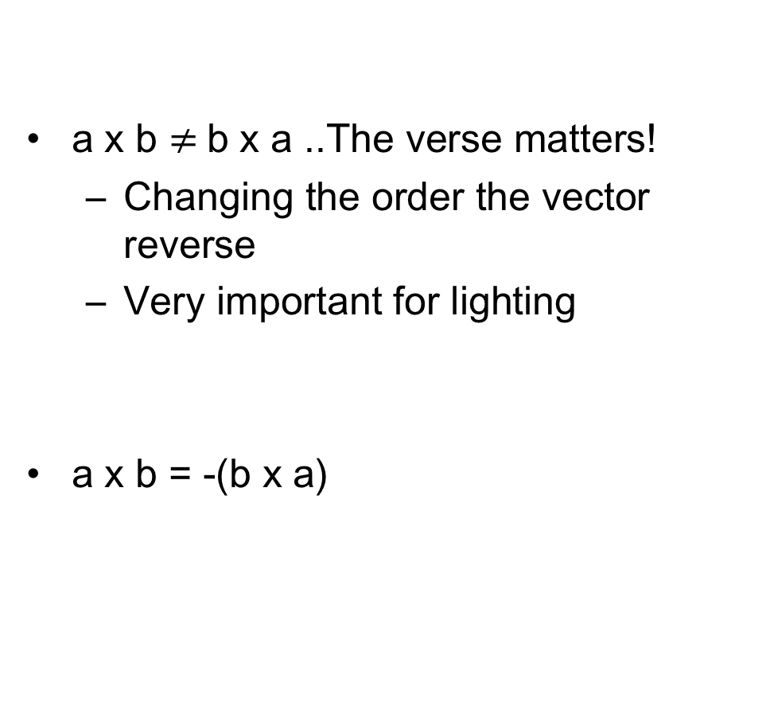
A bit of math: Normal, which side?
a x b $≠$b x a ..The verse matters!
  Changing the order the vector reverse
  Very important for lighting
a x b = -(b x a)

Slide 20
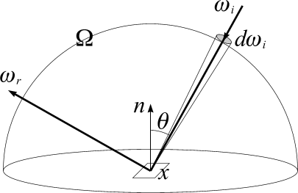
Equation of radiance: the most general local lighting
Based on the conservation of energy

Slide 21
Equation of radiance: the most general local lighting
Output light

Slide 22
Equation of radiance: the most general local lighting
Output light
point on surface to be illuminated

Slide 23
Equation of radiance: the most general local lighting
Output light
direction from x towards the eye
point on surface to be illuminated

Slide 24
Equation of radiance: the most general local lighting
Output light
emissive
component
reflective
component

Slide 25
Equation of radiance: the most general local lighting
point on surface to be illuminated;
direction from x towards the eye
direction of incident light
angle between the light ray and surface normal
domain of all possible directions
(i.e., all normalized vectors incoming from the front side)
(i.e., the surface of the unit half-sphere)

Slide 26
Emissive component
Used just for the few materials that emit their proper light
  In OpenGL, just: emitter→eye
  (not emitter→object→eye)
  In OpenGL , the emitted light does not illuminate other objects (unless we also put a source of light at the same location)

Slide 27
Equation of radiance: the most general local lighting
reflective
component

Slide 28
Equation of radiance: the most general local lighting
reflective
component
For every possible direction

Slide 29
Equation of radiance: the most general local lighting
reflective
component
Incoming light
For every possible direction

Slide 30
Equation of radiance: the most general local lighting
reflective
component
Direction of incoming light
Incoming light
For every possible direction

Slide 31




Incoming light
For each position , models
the distribution of incident light
= how much light hits from direction
In the metaphor of next slides: how many “tennis balls” hit x from each direction!
Modeling all possible environments of illumination. E.g.:
room with open window
sunny day
cloudy day
a discotheque

Slide 32
Equation of radiance: the most general local lighting
bidirectional reflectance
distribution function
(BRDF)

Slide 33
Equation of radiance: the most general local lighting
function determining the fraction of incident light reflected to different directions
(i.e.: ”how much of the light hitting x from dir w_{i} will be reflected to dir w_{r}")

Slide 34
Equation of radiance: the most general local lighting
function determining the fraction of incident light reflected to different directions
(i.e.: ”how much of the light hitting x from dir w_{i} will be reflected to dir w_{r}")
It describes object material
  depending on microscopic properties of material
If constant in x ⇒ uniform material:
  same material at all points
  without 1st parameter it is called BRDF of the material
  BRDF = Bidirectional Reflectance Distribution Function)
    describes optical properties of the material
    (e.g.: it is shiny, it has purple reflections, or it is matt, or iridescent – as velvet, or metallic, chrome, etc., etc.)

Slide 35

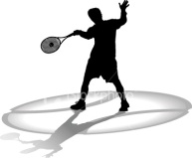


BRDF of a (uniform) material
out of 100 getting to
from dir ,
how many he will bounce
to dir ?
(for any possible and )
=
=
photon =
Each material has its own BRDF:
- chrome metal
- satin
- wood
- fabric
- chalk
- paper
- mirror…
Function has 4 dimensional domain!
(each direction = 2 dimensions)
USE of Polar coordinates

Slide 36
Polar Coordinates
For an unitary size vector
  x,y,z can be represented using 2 angles

Slide 37
Equation of radiance: the most general local lighting
cosine
law

Slide 38
Subproblem
From dir there are L incoming lumens (“tennis balls”):
how many of them hit a neighborhood of ?

Slide 39
Subproblem
From dir there are L incoming lumens (“tennis balls”):
how many of them hit a neighborhood of ?

Slide 40
Subproblem
From dir there are L incoming lumens (“tennis balls”):
how many of them hit a neighborhood of ?

Slide 41
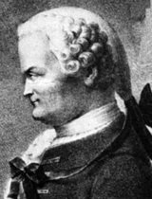
Subproblem
From dir there are L incoming lumens (“tennis balls”):
how many of them hit a neighborhood of ?
Solution:
=
“cosine law”
Johann
Heinrich
Lambert
1728 - 1777

Slide 42
Dot Product
Two vectors and of unitary length
Dot product measure the angle between them
Dot =1
Dot > 0
Dot = 0
Dot < 0
Dot = -1

Slide 43
Again
From dir there are L incoming lumens (“tennis balls”):
how many of them hit a neighborhood of ?
Dot =1

Slide 44
Again
From dir there are L incoming lumens (“tennis balls”):
how many of them hit a neighborhood of ?
Dot > 0

Slide 45
Again
From dir there are L incoming lumens (“tennis balls”):
how many of them hit a neighborhood of ?
Dot > 0
(but smaller than before)

Slide 46
Subproblem: grazing light
From dir there are L incoming lumens (“tennis balls”):
how many of them hit a neighborhood of ?
Perfectly grazing light:
in fact
no photon hits the neighborhood!

Slide 47
Subproblem: back light
From dir there are L incoming lumens (“tennis balls”):
how many of them hit a neighborhood of ?
Back light:
answer: 0
(not a negative number)
Because the neighborhood of
hides itself!

Slide 48
Equation of radiance: the most general local lighting
“Light received from a point x of scene is the sum of emitted light (from that point) plus reflected light (from that point)”
“Reflected light is computed as the sum (in the continuum: integral)
of the contributions of all light sources in the scene (potentially one source per direction)”
For each direction, the contribution is given by the product of:
(A) the amount of light from that direction (illumination environment)
(B) the portion of such light received by a neighborhood of x (cosine law)
(C) the portion of it that is reflected towards the observer
(C)
(A)
(B)

Slide 49
Lighting equation
The equation of radiance provides a very accurate rendering model
  material is modeled by a BRDF which can be accurately computed
  E.g. BRDF acquired from real objects or computed by very complicated functions
Optimal for off-line rendering
However, too expensive for real time rendering
We recur to some drastic simplifications

Slide 50
Simplification N 1: discrete light environment
Instead of
Let us assume:
  each point of the model receives the same light
    (equation is independent from x)
  Light comes just from a small number N of directions
  maybe just one ( N = 1 )
    no light from all other directions
    integral becomes a small sum (on N)
    one term per light (maybe just one)

Slide 51
Simplification N 1: discrete light environment
From integral (on all possible directions of the light)
to sum (of few lights, or even just one ! )
For colored lights, intensity values for r,g,b:
constant intensity
of i-th light
constant
color and intensity
of i-th light

Slide 52
Equation of radiance: simplifying
Independent from
Position on the object
N directions instead of all possible

Slide 53
Equation of radiance: the most general local lighting
constant color and intensity of i-th light
Direction of incidence of i-th light

Slide 54
Simplification N 2 : material as simple as possible
Constant BRDF
  not depending on direction of incident light
  not depending on direction of observation
  (it is «view-independent»)
Metaphor: totally chaotic tennis player
  bounces photons in random direction (stocastic choice), independently of incoming direction of light
Do there exist real materials behaving in this way?
  Yes: e.g. chalk, matt plastic
  Totally dull materials, not shiny, without reflections
  A.k.a.: «(purely) diffusive» or «(purely) Lambertian» materials

Slide 55
Simplification N 2 : material as simple as possible
Constant BRDF
  not depending on direction of incident light
  not depending on direction of observation
  (it is «view-independent»)
Do there exist real materials behaving in this way?
  Yes: e.g. chalk, matt plastic
  Totally dull materials, not shiny, without reflections
  A.k.a.: «(purely) diffusive» or «(purely) Lambertian» materials

Slide 56
Simplification N 2 : material as simple as possible
It happens when…
  at microscopic level...
  surface has micro-facets arranged in a chaotic manner
Note:
  BRDF’s of materials
  are a consequence of microscopic configurations
  (and of their electromagnetic properties)

Slide 57
Simplification N 2 : material as simple as possible
From function (variable with dir’s of incident and reflected light)
to constant, called albedo
For colored materials, 3 constants, for R,G,B:
albedo (of point x):
ratio between incident light and reflected light (from x).
base color
or diffusive color
(of point x)

Slide 58
Albedo and base color
A purely Lambertian material
is described by a single parameter
  Albedo – if we disregard color
  Base Color (or diffuse color) – for color rendering
The Diffuse Color is the intuitive answer to question
« what color is this object?»
  But not «what color do we see it?»,
  which depends on light conditions, normals, etc.
  «At night all cats are grey»
As all material parameters, albedo / base color can be: constant per object, variable on the object

Slide 59
a simple Lighting equation (purely diffusive!)
note:
the three bullets
in the equation
represent different
products!
which ones?
diffuse,
(dot product)
the factor
that determines
the “chiaroscuro”
in this model
of lighting
«what color we see»
(result of lighting)
base color - «what color it is»
(material, one input of lighting)

Slide 60
Models (or equations) of lighting
The equation of lighting we have seen is very simple
  it consists exclusively of a component of diffuse reflection
  with simple materials, described exclusively with a base color
  but it is physically based
OpenGL, include also:
  an ambient component
    modeling (with brutal approximation) global lighting effects
  a specular reflection component
    modeling (roughly) non Lambertian BRDF (for glossy materials)
  an emitting light component
    for emitting light (seldom used, but really simple)

Slide 61
The 3 terms of the lighting model of OpenGL
final light
=
ambient
+
reflection
+
emission
for each term, we have
components R, G & B.

Slide 62
Emission component
LEDs, lamps present as objects in the scene
Not depending on external lights
  light emitted from the object
Just an additive component
  constant for R, G & B
Modeling just light from emitter to eye
  Not: light-emitter → object → eye
  Note: it does not send light to other objects
  it is not global illumination (for that, another light is necessary)

Slide 63
The 3 terms of the lighting model of OpenGL
final light
=
ambient
+
reflection
+
emission

Slide 64
Ambient component
Modeling (in an extremely simplified way)
the light hitting the object from multiple reflections
  global effect
Equivalent to assumption:
”a little light gets to any point of surface"
  E.g. also those in the shade
Little additive constant
  not depending on surface normal

Slide 65
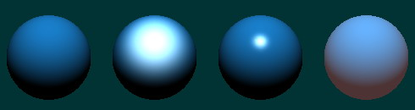
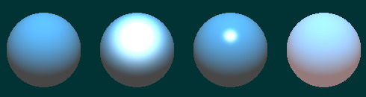
Ambient component
without
with

Slide 66

The 3 terms of the lighting model of OpenGL
final light
=
ambient
+
reflection
+
emission
ambient
component
only
diffuse reflection
+
specular reflection

Slide 67
The 4 terms of the lighting model of OpenGL
final light
=
ambient
+
diffuse reflection
+
specular reflection
+
emission

Slide 68
Diffuse reflection
Light hitting a Lambertian surface is reflected
  in all directions (in the hemisphere)
  in the same way

Slide 69
Diffuse reflection
Light hitting a Lambertian surface is reflected
  in all directions (in the hemisphere)
  in the same way

Slide 70
Diffuse reflection
Light hitting a Lambertian surface is reflected
  in all directions (in the hemisphere)
  in the same way

Slide 71
Diffuse reflection
Depending only on:
  orientation of surface
    (its "normal")
  direction of light
    incident ray

Slide 72
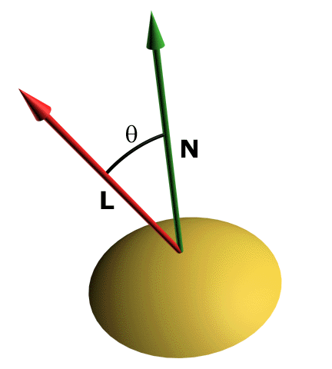
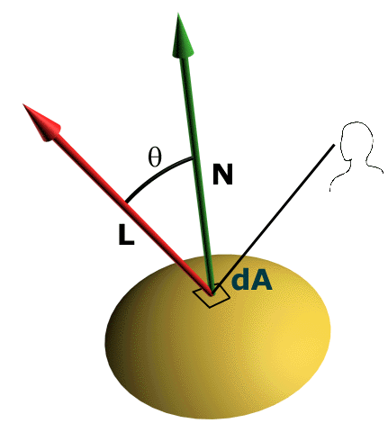
Diffuse reflection
Depending only on:
  orientation of surface
    (its "normal")
  direction of light
    incident ray
R, G, B
(usually white: 1,1,1)
R, G, B
(”base color” of the object)
component by component

Slide 73
Diffuse reflection
Depending only on:
  orientation of surface
    (its "normal")
  direction of light
    incident ray
base color,
or diffuse color,
is part of the
"material"

Slide 74
Diffuse reflection
Depending only on:
  orientation of surface
    (its "normal")
  direction of light
    incident ray
if angle is between 0° and 90°,
else: 0,
(object in its own shadow)
note: each “bullet" in this equation
is a different type of multiplication!

Slide 75
Diffuse reflection
L
L
L
N
N
N
small
diffuse
component
⍬=70⁰
large
diffuse
component
⍬=35⁰
maximum
diffuse
conponent
⍬=0⁰

Slide 76
Diffuse reflection
L
L
N
N
ZERO
diffuse
component
⍬=90⁰
ZERO
diffuse
component
⍬>90⁰
(surface in its own shadow)

Slide 77
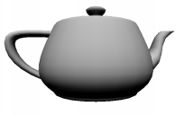
The 3 terms of the lighting model of OpenGL
final light
=
ambient
+
diffuse reflection
+
specular reflection
+
emission

Slide 78
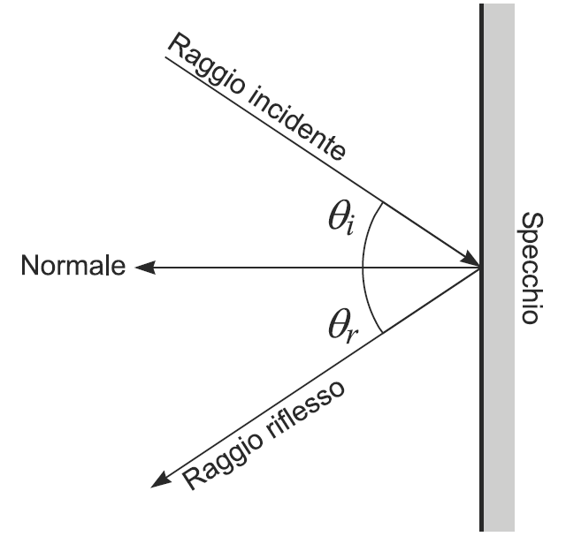
Specular reflection
Simple phenomenon (conceptually):
photons “bouncing”
  as if they were balls!
    Note: corpuscular nature of photon
  bounce depends on surface normal
    in formula?
At microscopic level:
normal of “microfacets”
is close to the one of macroscopic surface
(the more similar, on average, the more specular the appearance of surface)

Slide 79
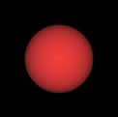
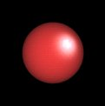
Specular reflection
"Specular" reflection
  a.k.a. «Phong» reflection, from its inventor
For glossy materials
  shining reflexes
  ("highlights")
without
with

Slide 80
Specular reflection
Base idea:
glossy materials do not reflect light equally in all directions
Reflection is view-dependent

Slide 81
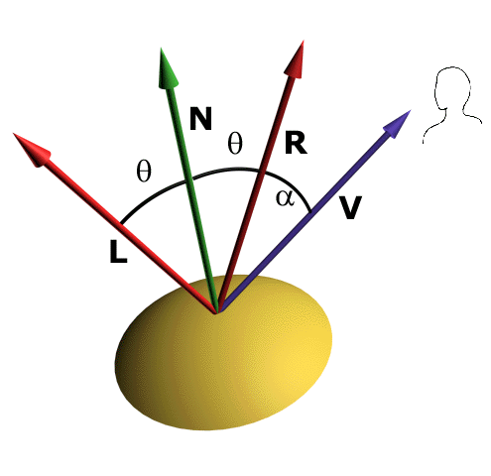
Specular reflection
L: incident ray
N: normal
R: reflected ray
V: view direction
L
N
R
α
V

Slide 82
Specular reflection
Phong light model
  by Bui-Tuong Phong, 1975

Slide 83
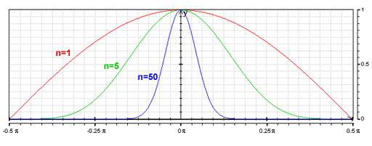
Specular reflection
Shininess refers to the brightness and extension of reflections
Controlled by an integer exponent of the cosine:
  lower exponent: softer and larger reflection
  higher exponent: brighter and smaller reflection

Slide 84
Specular reflection
Phong light model
  by Bui-Tuong Phong, 1975
“glossiness”
(how intense)
“shininess”
(how concentrated)
part of "material"
(description of optical characteristics of the object)

Slide 85
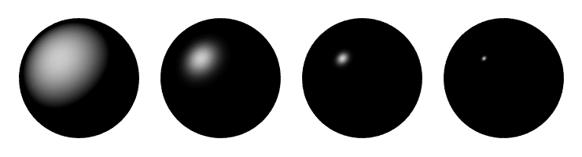
Phong Model
Effect of shininess

Slide 86
Specular reflection
Phong light model
  by Bui-Tuong Phong, 1975
direction of reflected light

Slide 87
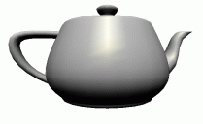
The 3 terms of the lighting model of OpenGL
final light
=
ambient
+
diffuse reflection
+
specular reflection
+
emission

Slide 88
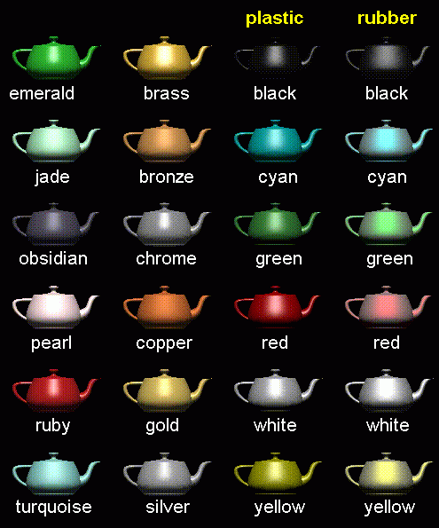
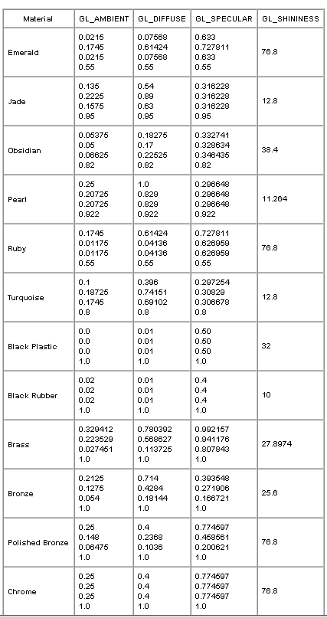
Materials...

Slide 89
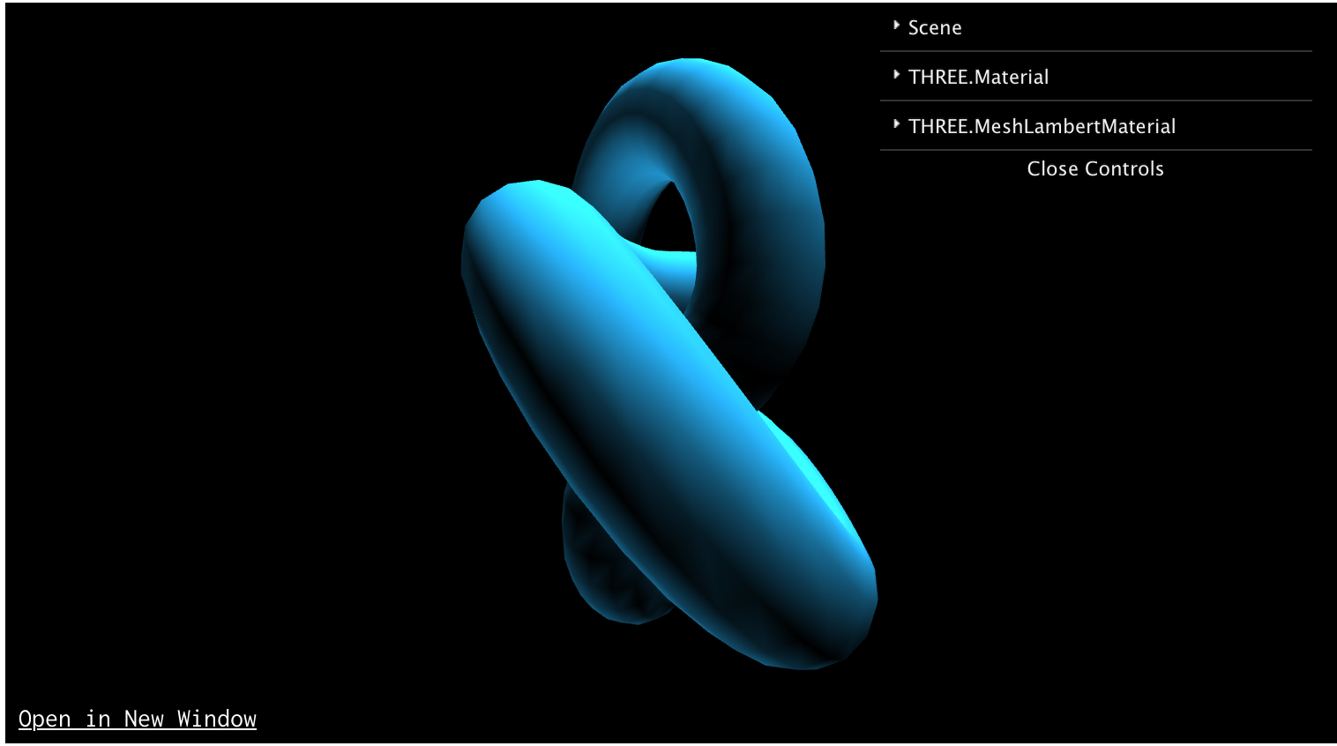
Three JS : Lambertian
see
var material= new THREE.MeshLambertMaterial();
material.color= new THREE.Color(1,0,0);
material.emissive=…;
material.emissiveIntensity=…;

Slide 90
Three JS : Phong
see
var sphere_material = new THREE.MeshPhongMaterial(); sphere_material.color=sphere_color; sphere_material.shininess=100;

Slide 91
Adding Light to the scene

Slide 92
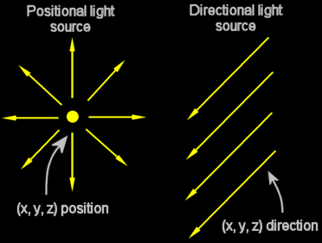
Modeling lights
Direction L?
  constant over the scene: "directional” light sources
    modeling sources of light far away, e.g., the sun
  variable in the scene: "positional” light sources
    modeling near sources of light, e.g., a lamp

Slide 93
Three JS : PointLight
See
    https://threejs.org/docs/#api/lights/PointLight
Very Useful .. Light from camera!
var cameralight = new THREE.PointLight( new THREE.Color(1,1,1), 0.5 ); camera.add( cameralight );
scene.add(camera);

Slide 94
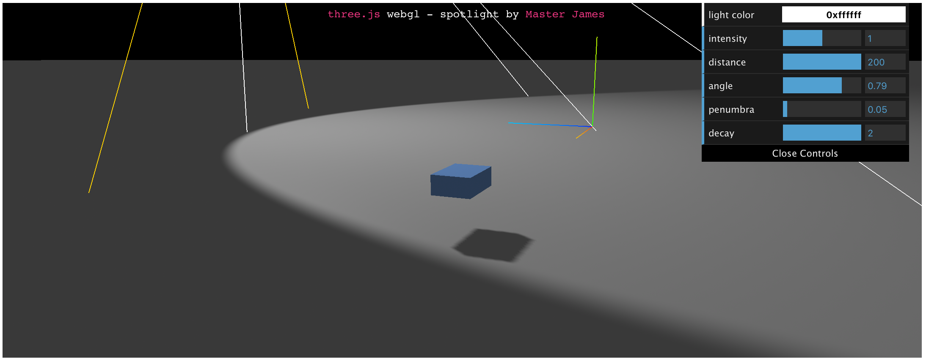
Three JS : SpotLight
see
var spotlight= new THREE.SpotLight(color, 2); spotlight_cube.position.copy(cube_light_pos);
spotlight_cube.angle = Math.PI / 4;
spotlight_cube.penumbra = 0.5;
spotlight_cube.decay = 4;
spotlight_cube.distance = 50;
spotlight_cube.target=sphere_mesh

Slide 95
Recap: Local lighting: emitter → object → eye (nothing else!)
LIGHT
incident ray
n
reflection
OBJECT
EYE

Slide 96
Recap: Equation of radiance: the most general local lighting
reflective
component
Direction of incoming light
Incoming light
For every possible direction

Slide 97
Recap (purely diffusive! - Lambertian)
note:
the three bullets
in the equation
represent different
products!
which ones?
diffuse,
(dot product)
the factor
that determines
the “chiaroscuro”
in this model
of lighting
«what color we see»
(result of lighting)
base color - «what color it is»
(material, one input of lighting)

Slide 98
Recap: Phong Model
Effect of shininess

Slide 99
Recap: The terms of the lighting model of OpenGL
final light
=
ambient
+
diffuse reflection
+
specular reflection
+
emission

Slide 100
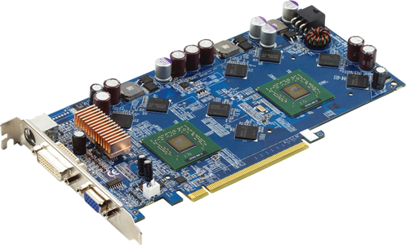
Coming soon: shading
lighting: WHERE? (and: with what normal?)
rasterizer
points
Projected vertices
& varyings
Fragments
& interpolated varyings
Screen
buffer
Vertices
& their attributes
rasterizer triangles
computations
per vertex
computations
per fragment
rasterizer
lines
y
v0
v1
v1
v0
x
v2
z
v2

Slide 101
Computer Graphics
Lighting: Illumination

