Slide 1
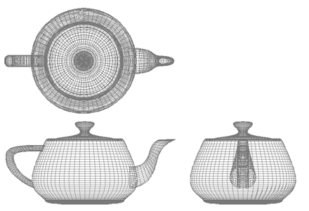
Computer Graphics
Bonus Lecture: A summary
University of Technology Sydney
Teacher: Nico Pietroni

Slide 2
Computer Graphics: applications
Videogames
Cinematography
  Visual effects
  Cartoons
Manufacturing industry
  e.g. Computer Aided Design
Medicine
  Support to diagnosis
  Remotely operated surgery
  Simulation
Virtual Reality
  and augmented reality
Cultural heritage
  Virtual museums
  Support to restoration
  Support to analysis
  Monitoring
Data Visualization
Architecture
  Support to design
  Previews
Telecommunications
  Personalized Avatars
  E–commerce
…

Slide 3
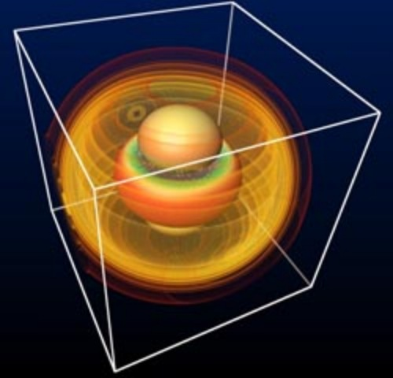
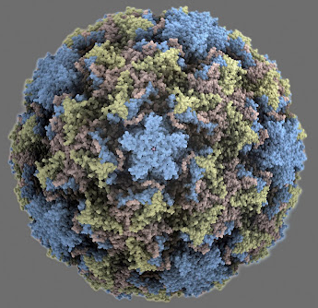
Applications: Scientific Visualization
Gravitational waves during a
Collision of black holes
(Max Planck Insitute for Gravitational Physics)
Rhinovirus 3 protein

Slide 4
Scientific Visualization
Applications: Data Visualization
Information Visualization
Data with “natural” 3D interpretation
  often: + time, makes them 4D
Aim: to make them understandable
How:
realism, or…
Abstract data
(N-dimensional)
Aim: to make them understandable
How:
in many possible ways

Slide 5
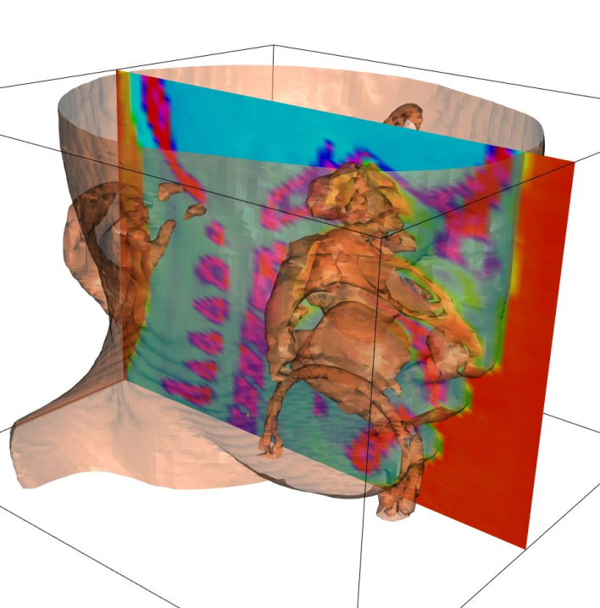
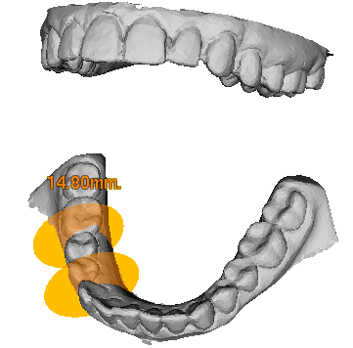
Applications: Biomedical Applications
Biomedical applications
  support to diagnosis
    e.g. visualize CAT scans
  Prosthetics design
  Virtual surgery
  Remotely operated surgery

Slide 6
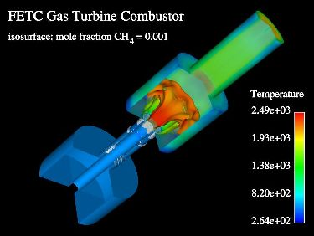
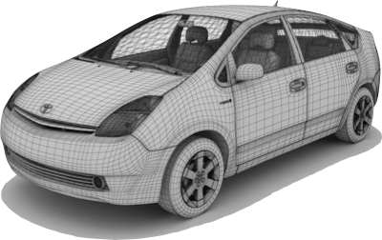
Applications: Manufacturing Industry
Manufacturing Industry
  CAD
  Rapid Prototyping
  Simulation of
  operation
  Defect detection
  …

Slide 7
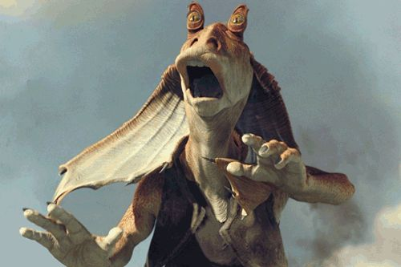
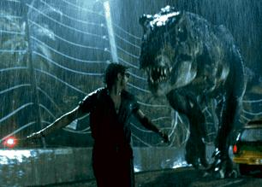
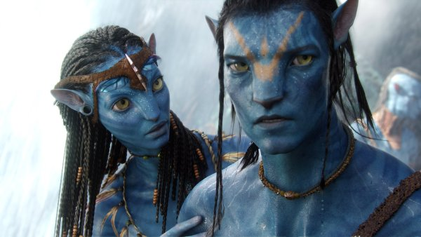
Applications: Entertainment
Entertainment: movie industry
  visual effects
Star Wars: The Phantom Manace - Lucasart 1999
Jurassic Park - Universal Studios 1993
Avatar – ILM 2009

Slide 8
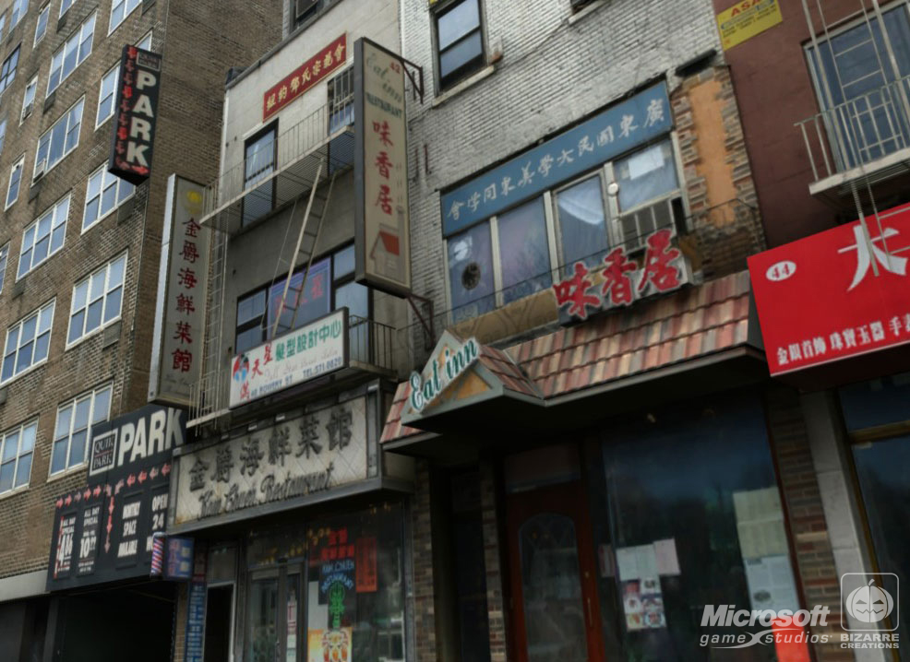
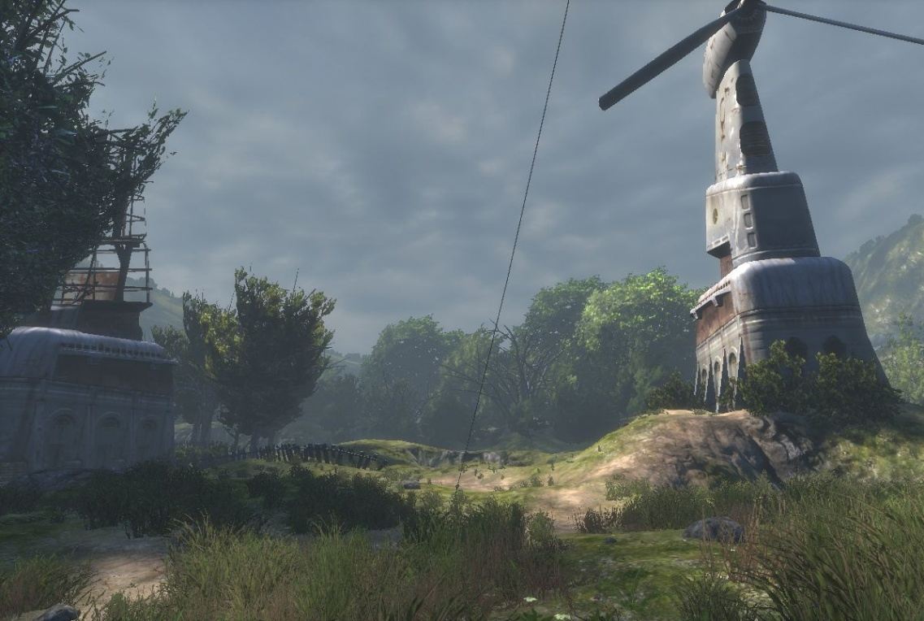
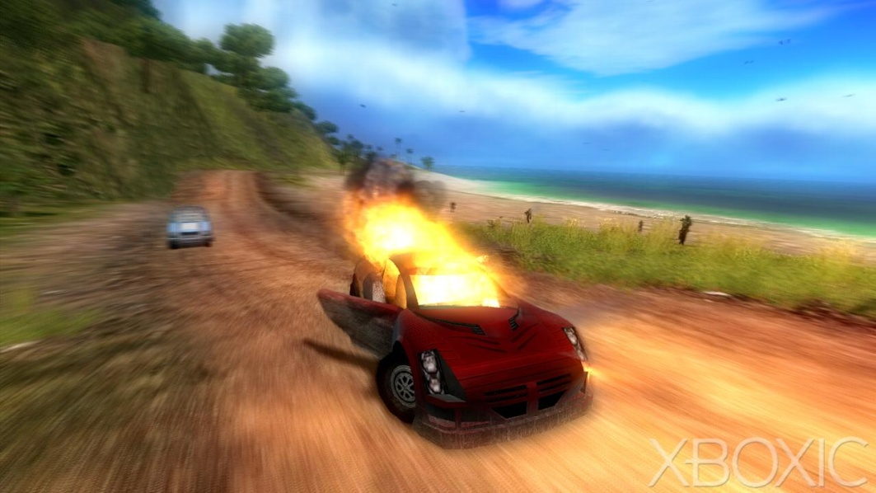
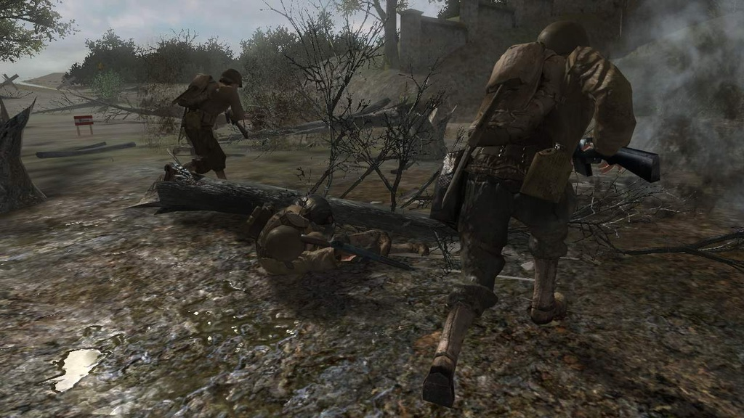
Applications: Game Industry
  Driving force of the field (believe it or not) ...
World of Warcraft,
Blizzard Entertainment 2004
various

Slide 9
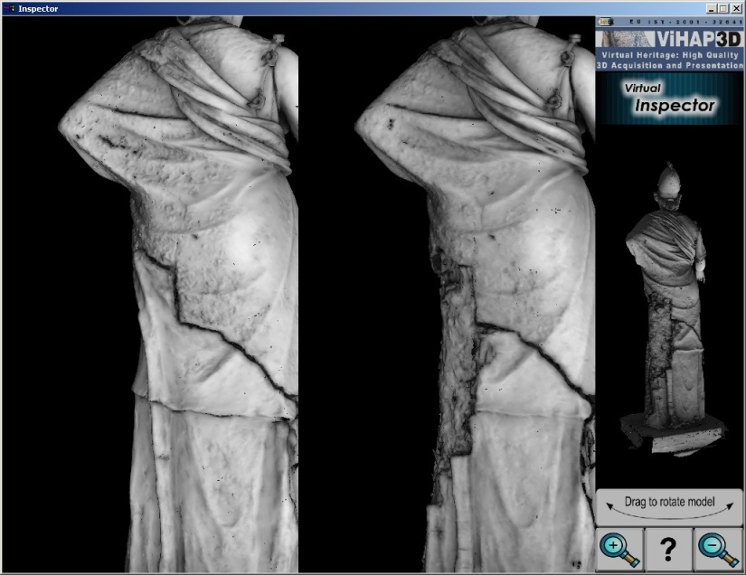
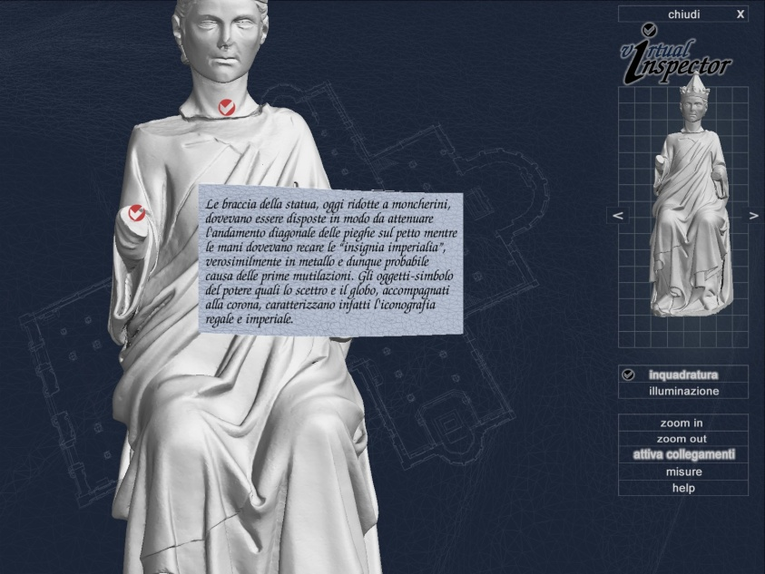
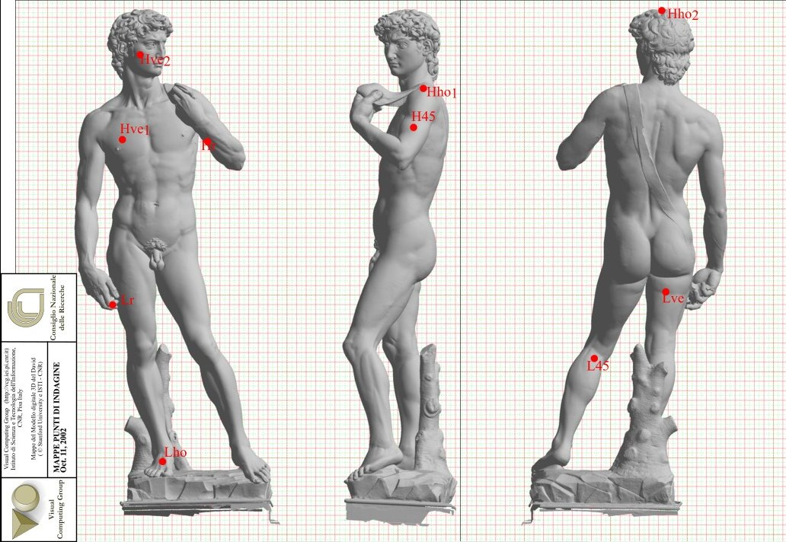
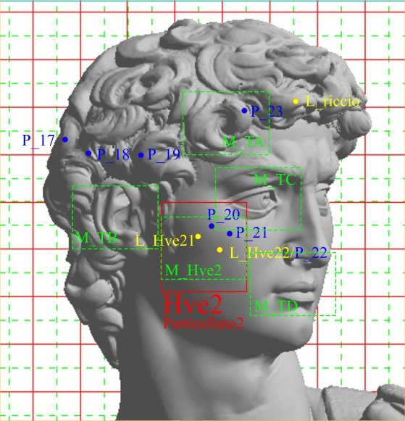
Applications: Cultural heritage

Slide 10
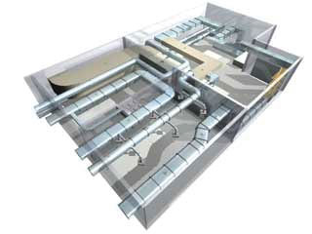
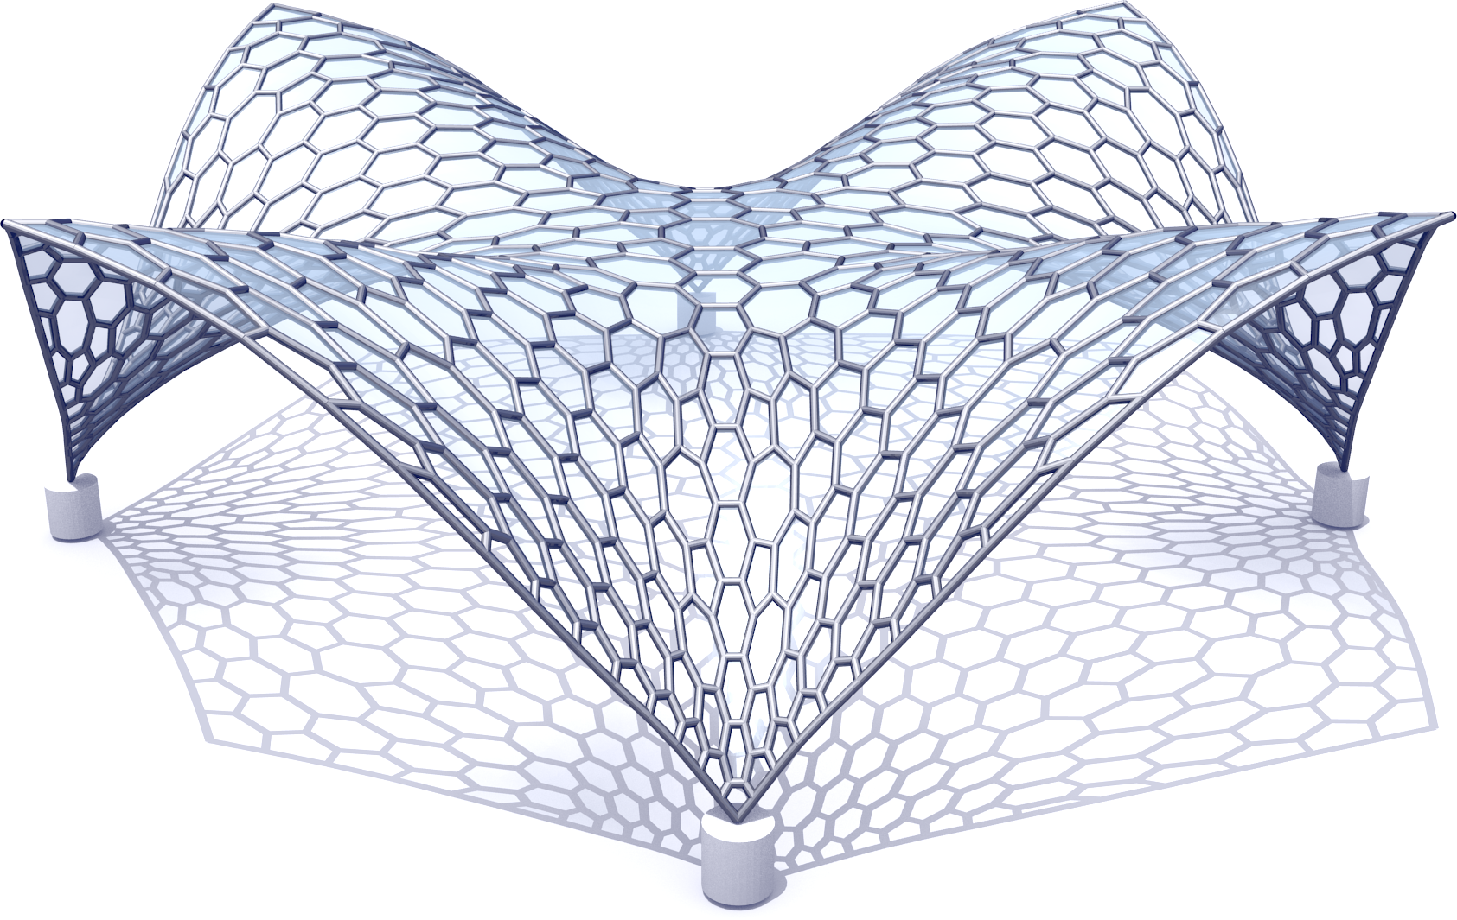
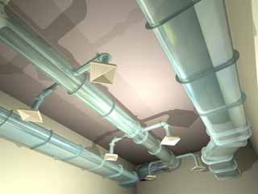
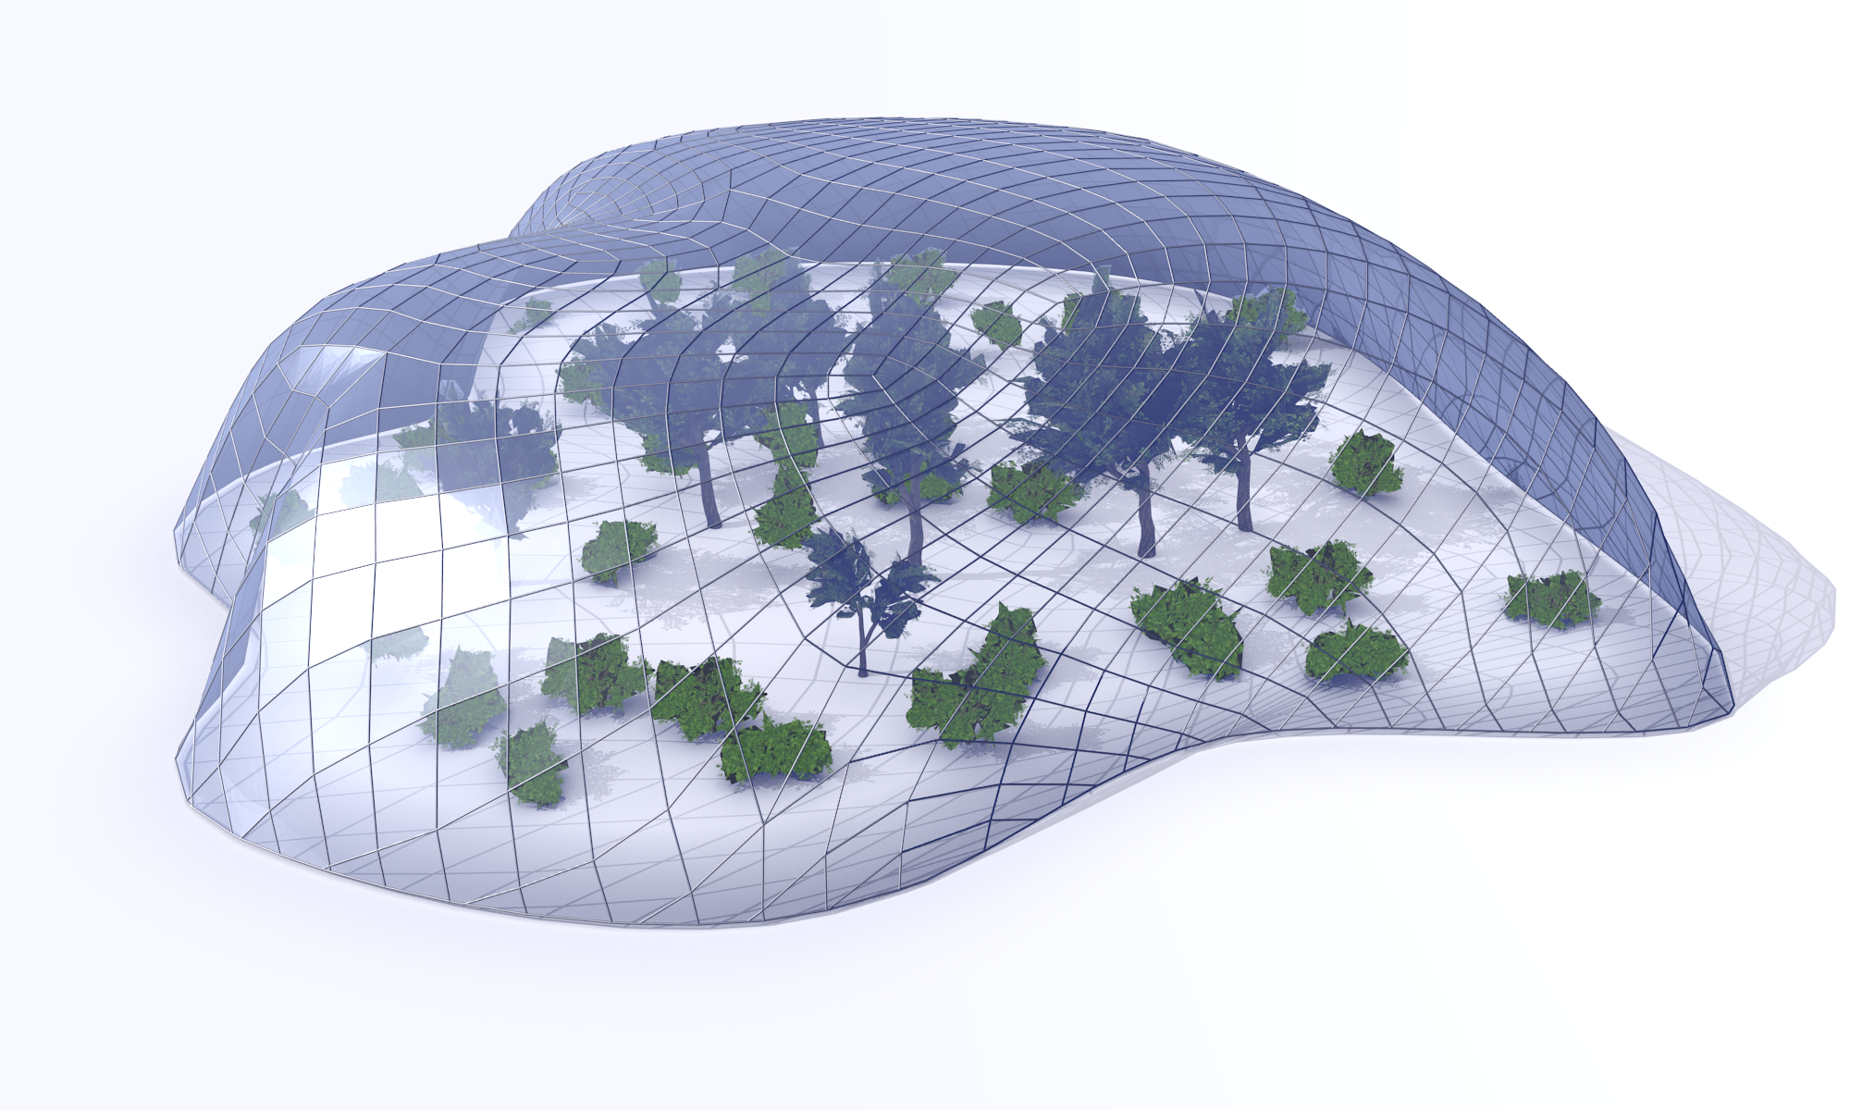
Applications: Architecture
Architecture:
  Support to design
ArchiCAD (Graphsoft)

Slide 11

Ray-Tracing
Same as ray casting, but ray bounces multiple times
  Easy to compute: specular reflections (multiple too)
Primary ray
Reflected ray

Slide 12
Ray-Tracing
Easy to compute: semi-transparency with refraction
Primary ray
Reflected ray
Refracted ray

Slide 13
Ray tracing pseudo-code
For each pixel p:
make a ray r (from viewpoint to p)
while (…)
for each primitive o in scene:
find if intersect(r,o)
keep closest intersection;
r = new_bounce( r );
find color for p (according to all paths)

Slide 14
Rasterization-based pipeline
also known as
Transform and Lighting (T&L)
y
v1
v0
v1
v0
transform
rasterize
fragment
process
Output Image
v2
v2
z
x
Fragments
a.k.a. Pixels
triangle 2D
on screen
Vertices 3D
  Compute per Pixel color wrt Lighting
All operations are massively parallelizable!
Notes:
Il lighitng si può fare insieme al transform, o nel fragment process

Slide 15
Rasterization: rendering primitives
anything we can:
  project from 3D to 2D
  rasterize in 2D == intersect with a grid of pixels
Most commonly:
  SEGMENTS
  POINTS
  TRIANGLES
x
v0 =( x0, y0, z0 )
v1 =( x1, y1, z1 )
v2 =( x2, y2, z2 )
y
z

Slide 16
Rendering Algorithms Paradigms
For each pixel p:
make a ray r
for each primitive o in scene:
if intersect(r,o)
then find color for o
color p with it
RAY-CASTING
LIGHTING
For each primitive o:
find where o falls on screen
rasterize 2D shape
for each produced pixel p :
find color for o
color p with it
RASTERIZATION
PROJECTION
3D → 2D
(aka TRANSFORM)
LIGHTING

Slide 17

Rendering Algorithms Paradigms
for each pixel
for each primitive
RAY TRACING
for each primitive
for each pixel
RASTERIZATION

Slide 18
Advantages of ray tracing
Conceptually simple algorithm
Takes into account GLOBAL effects
More realistic rendering of lighting effects
More freedom of primitives
(intersect easier than project+rasterize)
Potentially great scalability with scene complexity

Slide 19
Advantages of rasterization
More easily parallelizable
More controllable complexity
Better-suited for graphics cards (for now)
Easier with dynamic data
Better treatment of anti-aliasing (more later on)
Better scalability with image resolution

Slide 20
The common places
Ray tracing:
  good for complex visual effects
    shadows, specular reflections, refractions...
  SW-based (CPU)
  therefore: off-line, hi-quality renderings!
Rasterization:
  fast!
    for each primitive, process only a few pixels
    (instead of: for each pixel, process all primitives)
  HW-based (GPU)
  therefore: real-time, compromise-quality renderings!

Slide 21
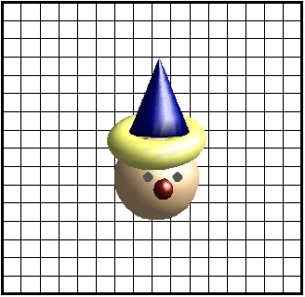
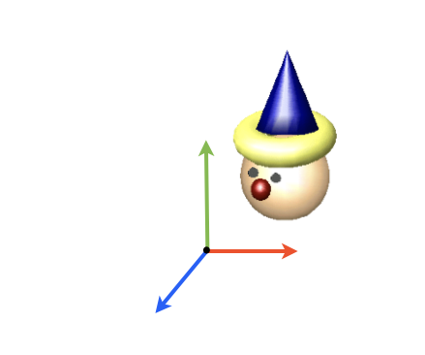

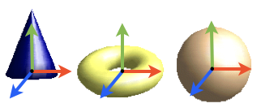
Coordinate Systems
Object coordinates
World coordinates
Camera coordinates
Screen coordinates

Slide 22
Coordinate Transformation
object space
camera space
screen space
model
camera
projection
viewport
canonical
view volume
world space

Slide 23
Transform
It is more complex than this…
y
v0
v1
View transformation
View transformation
Projection Transformation
Viewport Transformation
v1
z
v0
v2
x
object Coordinates
v2
screen Space
0
3
y
y
1
v1
v1
v
v0
v2
2
v0
-1
-u
v1
1
v1
v2
-z
-n
z
v2
x
v0
v0
x
1
v2
view Coordinates
(a.k.a. eye Coordinates)
-1
clip
coordinates
world Coordinates

Slide 24
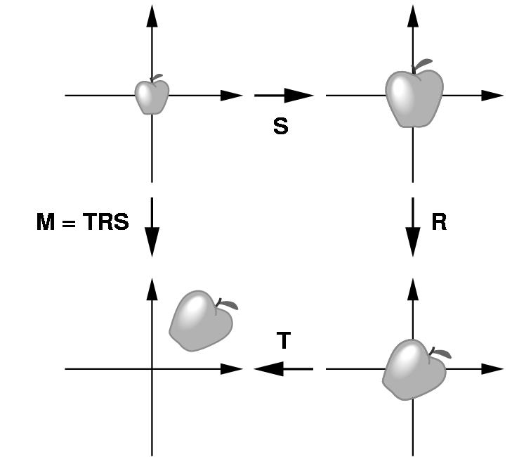
Modeling transformations
How do we proceed to create an instance of an object in a scene?
Scale first, to obtain desired size an proportions
Next, rotate to orient
Finally, translate to the desired position

Slide 25
View transformation
y
v0
v1
z
v0
v1
0) Modeling transformation
1) View transformation
2) Projection transformation
3) Viewport transformation
v2
x
object Coordinates
v2
screen Space
0
3
y
y
1
v1
v1
v
v0
2
v0
-1
-u
v1
1
v2
v1
v2
-z
-n
z
v2
x
v0
v0
x
1
v2
view Coordinates
(a.k.a. eye Coordinates)
-1
clip Coordinates
world Coordinates

Slide 26
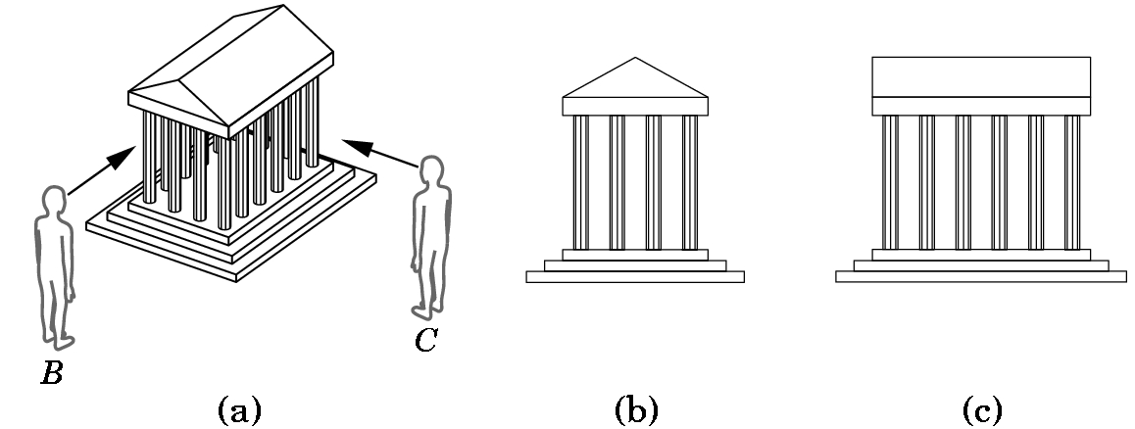
View transformation
Dipending on position of camera
  A.k.a.:
    Viewer position
    eye position
    PoV (Point of View)
As seen from B
As seen from C

Slide 27
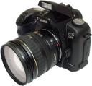
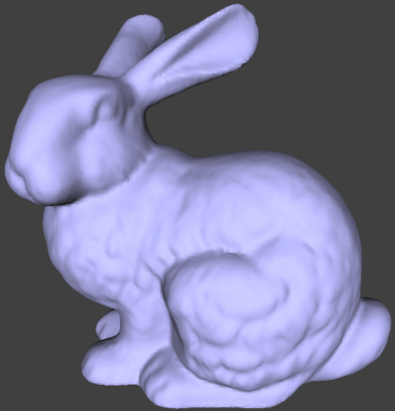
View transformation: typical example
Input:
1) camera position: p_{pov}
2) target position: p_{target}
3) up camera vector: v_{up}
Output:
Trasformation matrix
world frame → eye frame
v
u
n
y
eye coordinate frame
oe
v_{up}
z
0
x
world coordinate frame

Slide 28
View transformation: typical example
Now...
Geometry is expressed in a coordinate frame where:
origin is the center of projection (camera lens / viewpoint)
camera looks toward direction -n
v is camera upward direction, u points to the right of camera
v
u
n
y
eye coordinate frame
oe
v_{up}
z
0
x
world coordinate frame

Slide 29
Projection transformation
y
v0
v1
z
v0
v1
0) Modeling transformation
1) View transformation
2) Projection transformation
3) Viewport transformation
v2
x
object Coordinates
v2
screen Space
0
3
y
y
1
v1
v1
v
v0
2
v0
-1
-u
v1
1
v2
v1
v2
-z
-n
z
v2
x
v0
v0
x
1
v2
view Coordinates
(a.k.a. eye Coordinates)
-1
clip Coordinates
world Coordinates

Slide 30
Projection transformation
Time to move to 2D !
y
1
v1
v
2
v0
-1
-u
v1
v2
v1
v2
-z
-n
v0
v0
x
1
v2
view Coordinates
(a.k.a. eye Coordinates)
-1
Clip
coordinates

Slide 31
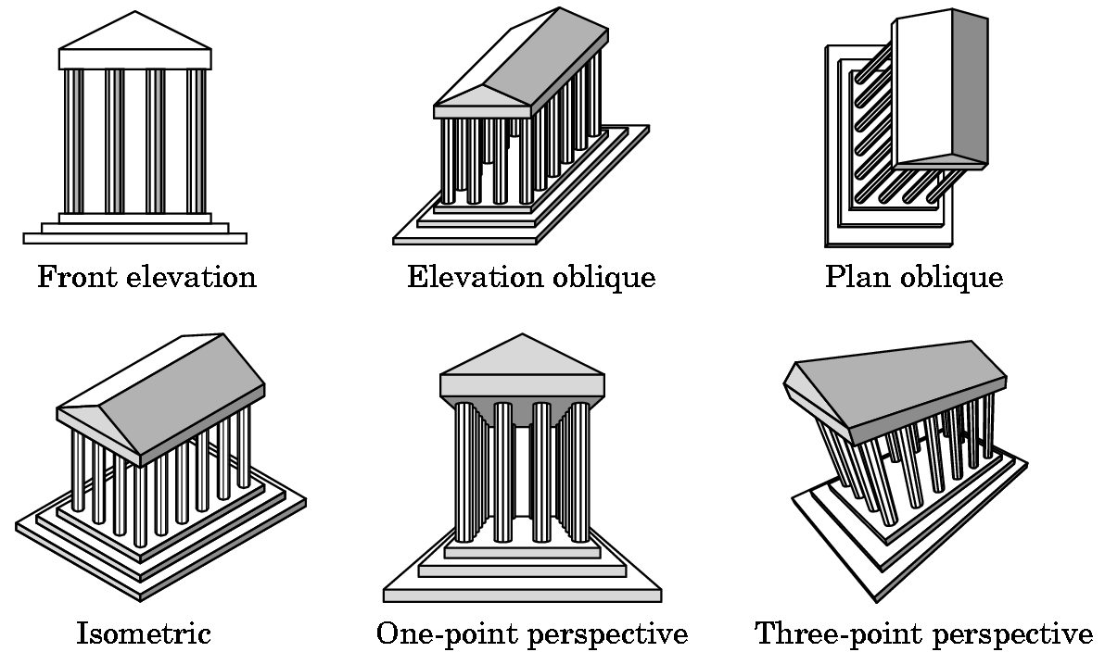
Projection transformation
Classical problem:
  (in arts and architecture)
How to represent
  3D objects
  on a 2D plane

Slide 32
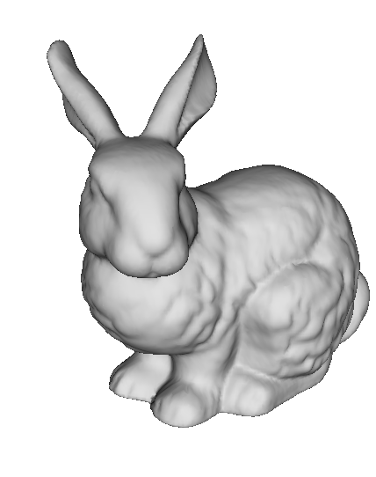
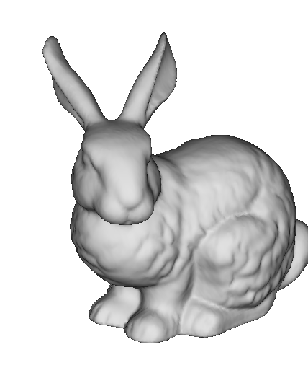
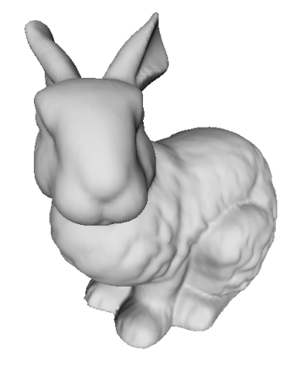
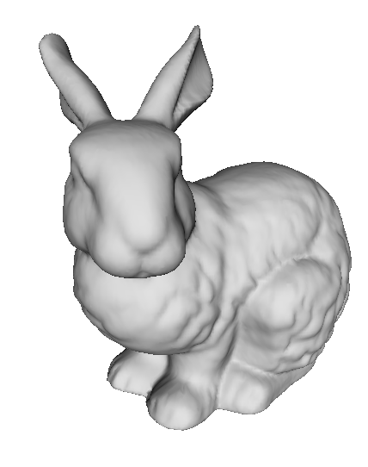
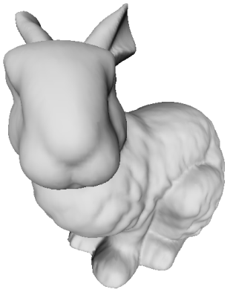
Perspective projection: how it looks
d small
d infinite
(orthogonal
projection)
d large
More perspective distortion.
“Fish-eye” effect
(wide angle)
Less perspective distortion
“Zoom” effect
(eg. Satellite view)

Slide 33
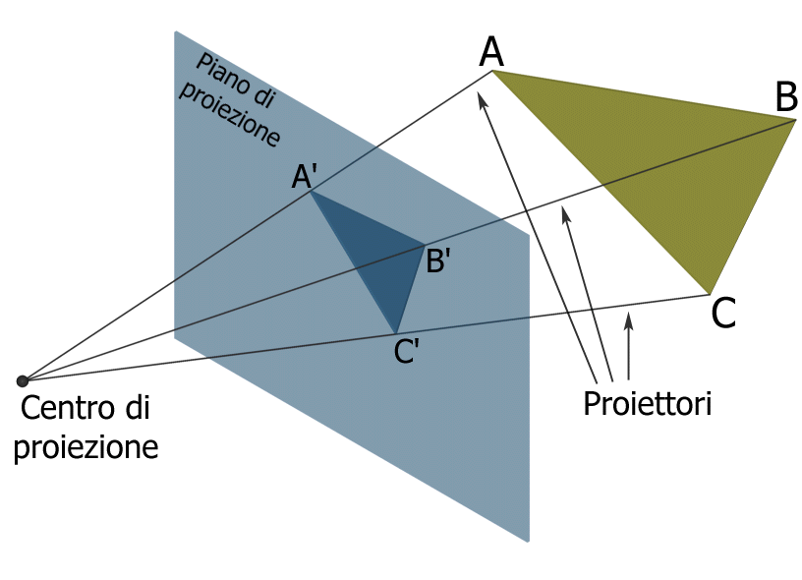
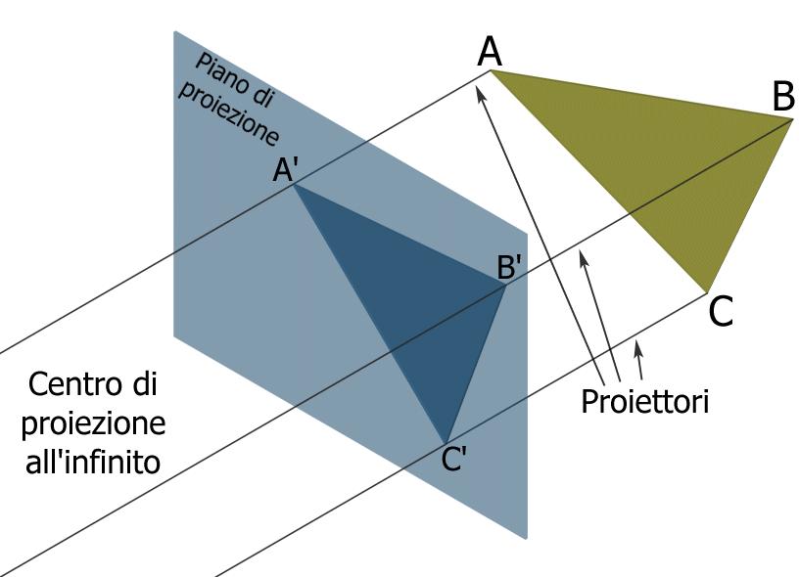
Perspective vs Orthogonal
Perspective projection (finite distance between center ed proiection plane)
Orthographic projection (infinite distance between center ed proiection plane).

Slide 34
After perspective division
y
y
v1
P
v2
Normalization
-z
x
v0
x
view Coordinates
(a.k.a. eye Coordinates)
z
Cube defines the
Normalized projection
coordinates
Multiplication by the projection matrix
Framed objects fall inside the cube
Objects outside it are out of the image

Slide 35
Viewport transformation
y
v0
v1
x
v0
v1
0) Modeling transformation
1) View transformation
2) Projection transformation
3) Viewport transformation
v2
z
object Coordinates
v2
screen Space
0
3
y
y
1
v1
v1
y
v0
2
v0
-1
x
v1
1
v2
v1
v2
-z
-z
x
v2
z
v0
v0
x
1
v2
view Coordinates
(a.k.a. eye Coordinates)
-1
Clip
Coordinates
world Coordinates

Slide 36
Viewport transformation
Normalized frame Window frame
y
y
(-1,1,-1)
1
(-1,1,1)
(1,1,-1)
p_{y}
(1,1,1)
z
(-1,-1,-1)
o
z
x
(-1,-1,1)
Viewport
(1,-1,-1)
p_{x}
NPC
(1,-1,1)
x

Slide 37
Coordinate transformation
3D
(object is ref frame)
3D
(origin of scene is ref frame)
3D
(camera is ref frame)
3D
(between -1 and 1)
2D
(between width and height)
Object
Coordinates
World
Coordinates
Screen
Coordinates
View
Coordinates
Clip
Coordinates
v0
v1
v1
v0
v1
v0
v1
v0
v2
z
v2
x
v2
z
x
v2
object space
camera space
canonical
view volume
screen space
world space
Modelling Transformation
View
Transformation
Projection
Transformation
Viewport
Transformation

Slide 38
Recap: pipeline detail
It is more complex than this…
y
v0
v1
View transformation
View transformation
Projection Transformation
Viewport Transformation
v1
z
v0
v2
x
object Coordinates
v2
screen Space
0
3
y
y
1
v1
v1
v
v0
v2
2
v0
-1
-u
v1
1
v1
v2
-z
-n
z
v2
x
v0
v0
x
1
v2
view Coordinates
(a.k.a. eye Coordinates)
-1
clip
coordinates
world Coordinates

Slide 39
Recap: pipeline maths detail
In principle, there are four transformation matrices:
y
v0
T_{m} modeling matrix
T_{v} view matrix
T_{p} projection matrix
T_{vp} viewport matrix
v1
z
v0
v1
v2
x
object Coordinates
v2
screen Space
Tm
Tvp
y
y
1
v1
v1
v
v0
Tv
Tp
v0
-1
-u
v1
v2
v1
v2
-z
-n
z
v2
x
v0
v0
x
v2
view Coordinates
(a.k.a. eye Coordinates)
-1
clip
coordinates
world Coordinates

Slide 40
Affine space
Three types of entities
  scalars
  vectors
  points
attributes:
Norm (length), Direction
attribute:
Position in space

Slide 41
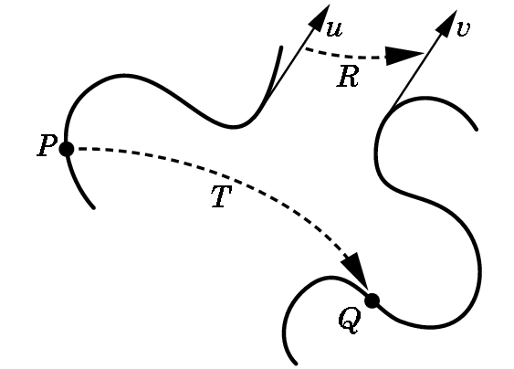
Geometric transformations (in particular)
Functions that
  Take a point / vector
  and map it to another point / vector
p
q
q = (p)
v = (u)
Three examples:
  Translation
  Scaling
  Rotation

Slide 42
Affine space: Operations
Sum (point , vector ) → point
Subtraction (point , point) → vector
point
( a + v )
vector
v
point
a
point
b
remember:
“tip minus tail”
of the arrow
vector
(b – a )
point
a

Slide 43
Transformations
IF They preserve:
  Distances & Angles
    RIGID TRANSFORMATIONS
  Only Angles
    CONFORMAL TRANSFORMATIONS
More Generic Transormations: Affine transformations

Slide 44
Affine transformations
They preserve:
  Co-linearity
    Straight lines are transformed into straight lines
  Ratios between distances
    i.e. The midpoint of a segment is mapped into the midpoint of the mapped segment
  Parallelism
    between pairs of straight lines

Slide 45
Affine Transformations
They can all be expressed as
multiplications by a matrix
always
Homogeneous coords
of starting point
Homogeneous coords
of target point

Slide 46
Representation in homogenoeus coordinates
Points:
Vectors:
1
0

Slide 47
Affine matrix for translation
On a point
i.e.:
In matrix form:
Translation vector

Slide 48
Example: non-uniform scaling
y
y
x
x
Scaling matrix
Inverse matrix?

Slide 49
Example: rotation about the z axis
y
(x’,y’)
β
(x,y)
z
x
ρ

Slide 50
Composite transformations
Multiplication is associative!
B(Ax) = (BA)x
  Matrix A «does» a transformation a
  Matricx B «does» another transformation b
  Matrice (BA) «does» la transformation a, followed by b
Applying to transformation means apply their multiplication

Slide 51
Reminder: matrix multiplication
Associative yes, commutative no!
      AB ≠ BA
  finding correct order is not intuitive
y
y
RT
TR
x
x
Notes:
Sinistra RT Destra TR

Slide 52
Composite transformations
Apply associative property:
f(p) = T ( R ( T⁻¹ p ) )
= (T R T⁻¹) p
a matrix M 4x4 does all
efficient
what if we multiply a vector by M ?
Notes:
Che fa tutto = che fa la freccia senza in alto del lucido precedente.
Efficienza: moltiplicazione matrici = 4 alla 3 = 64 moltiplicazioni.
Se fosse un vert solo da proiettare, sarebbe meglio fare come la formula sotto. Ma i vertici sono moltissimi e conviene quella sotto.
Cosa possiamo dire della matrice? (untima riga = 0,0,0,1)
Cosa succede se la moltiplico per un vettore? (e' come moltiplicare per R) Perche'?

Slide 53
Scene graph (hierarchical modeling)
“car”
coord. frame
“wheel”
coord. frame
Same template
different instances undergo
different scaling and roto-translation

Slide 54

Local lighting: emitter → object → eye (nothing else!)
LIGHT
incident ray
n
reflection
OBJECT
EYE

Slide 55
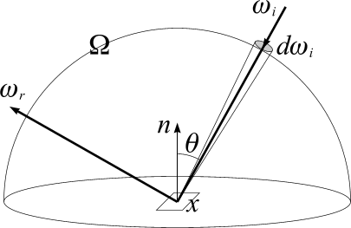
Equation of radiance: the most general local lighting
Output light
emissive
component
reflective
component

Slide 56
Equation of radiance: the most general local lighting
reflective
component

Slide 57
Equation of radiance: the most general local lighting
reflective
component
Direction of incoming light
Incoming light
For every possible direction

Slide 58




Incoming light
For each position , models
the distribution of incident light
= how much light hits from direction
In the metaphor of next slides: how many “tennis balls” hit x from each direction!
Modeling all possible environments of illumination. E.g.:
room with open window
sunny day
cloudy day
a discotheque

Slide 59




BRDF of a (uniform) material
out of 100 getting to
from dir ,
how many he will bounce
to dir ?
(for any possible and )
=
=
photon =
Each material has its own BRDF:
- chrome metal
- satin
- wood
- fabric
- chalk
- paper
- mirror…
Function has 4 dimensional domain!
(each direction = 2 dimensions)
USE of Polar coordinates

Slide 60
Equation of radiance: the most general local lighting
cosine
law

Slide 61
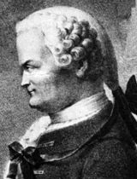
Cosine Law
Solution:
=
“cosine law”
Johann
Heinrich
Lambert
1728 - 1777

Slide 62
Simplify Lighting equation (purely diffusive!)
note:
the three bullets
in the equation
represent different
products!
which ones?
diffuse,
(dot product)
the factor
that determines
the “chiaroscuro”
in this model
of lighting
«what color we see»
(result of lighting)
base color - «what color it is»
(material, one input of lighting)

Slide 63

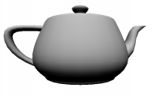
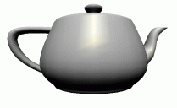
The 3 terms of the lighting model of OpenGL
final light
=
ambient
+
diffuse reflection
+
specular reflection
+
emission

Slide 64
Diffuse reflection
L
L
L
N
N
N
small
diffuse
component
⍬=70⁰
large
diffuse
component
⍬=35⁰
maximum
diffuse
conponent
⍬=0⁰

Slide 65
Diffuse reflection
Depending only on:
  orientation of surface
    (its "normal")
  direction of light
    incident ray

Slide 66
Specular reflection
Base idea:
glossy materials do not reflect light equally in all directions
Reflection is view-dependent

Slide 67
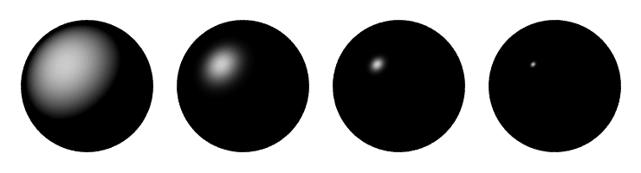
Specular Reflection: Phong Model
Effect of shininess

Slide 68
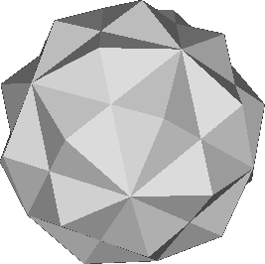
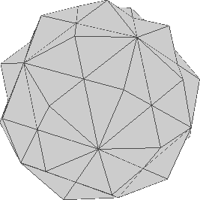
Lighting face by face
"flat shading"
1.
geometry
2.
for each face,
compute normal
3.
apply lighting to each
normal and shade face
with resulting RGB

Slide 69
Definition
Shading:
  recipe to apply a lighting model
  remark: choice of lighting model independent from
  choice of shading
First example:
flat shading
    Apply lighting to face normal
      (obtain a color)
    Render the whole face with such a color

Slide 70
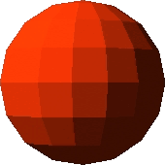
Flat shading: problem
Correct choice for polyhedral objects (e.g., a cube)
Smooth surfaces are approximated with triangle meshes
Result:
  apparent edges on smooth surfaces
ugly
artifact!
not looking like a sphere

Slide 71
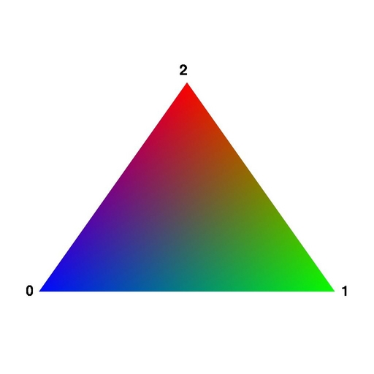
Idea
Exploit interpolation of color inside a face

Slide 72
Per-vertex normal: inferred from mesh geometry
Normal of a triangle:
v₁
v₁×v₂
v₂
Normal of a vertex
shared among n triangles:

Slide 73
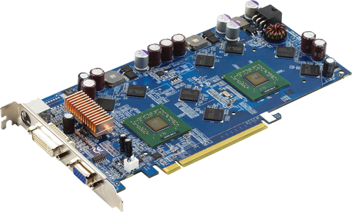
Coming soon: shading
lighting: WHERE? (and: with what normal?)
rasterizer
points
Projected vertices
& varyings
Fragments
& interpolated varyings
Screen
buffer
Vertices
& their attributes
rasterizer triangles
computations
per vertex
computations
per fragment
rasterizer
lines
y
v0
v1
v1
v0
x
v2
z
v2

Slide 74
Per-vertex lighting (a.k.a. “Gouraud shading”): Where?
rasterizer
points
Projected vertices
& varyings
Fragments
& interpolated varyings
Screen
buffer
Vertices
& their attributes
rasterizer triangles
computations
per vertex
computations
per fragment
rasterizer
lines
transform geometry
and
apply lighting
including:
per vertex color
(result of lighting)
interpolate
color
including: final color
including:
property of material
and normal

Slide 75
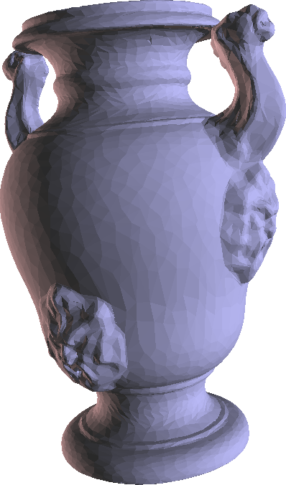
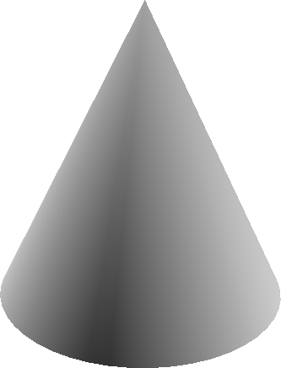



Gouraud shading
Result:
including: final color

Slide 76
We can do better
Idea: instead of interpolating color after lighting, interpolate normal before lighting!
caveat: by interpolating between two normal vectors,
we do not obtain a normal vector:
    (we must re-normalize after interpolation)
interpolation between and
interpolation between and
re-normalized
1

Slide 77
We can do better
Idea: instead of interpolating color after lighting, interpolate normal before lighting!
*
Per-fragment Shading
(a.k.a. “Phong shading” )
Bui-Tuong Phong , 1973
*
1- Interpolate normal in the face
2- Re-normalize
3- Apply lighting
*
*
* Warning: do not mistake Phong Shading (a shading)
with Phong Lighting Model (model of illumination)

Slide 78
Phong shading: where?
rasterizer
points
Projected vertices
& varyings
Fragments
& interpolated varyings
Screen
buffer
Vertices
& their attributes
rasterizer triangles
computations
per vertex
computations
per fragment
rasterizer
lines
including:
properties of material
and normal
transform
both
normal
and
position
interpolate
normal
including:
trasformed normal
including: interpolatednormal
re-normalize and apply
lighting
to obtain
fragment color

Slide 79



Comparison
Per-vertex Lighting - (a.k.a. "Gouraud Shading")
  less expensive:
    apply lighting once per vertex – usually: #vertices << #fragments
Per-fragment* Lighting – (a.k.a. " Phong Shading“)
  better results
    especially with high shininess
(*) sometimes (with abuse) called: per-pixel lighting
Flat shading
Goraund shading
Phong Shading

Slide 80
Computer Graphics
Bonus Lecture: A summary
University of Technology Sydney
Teacher: Nico Pietroni

