Slide 1
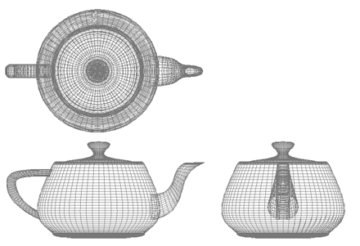
Computer Graphics
Shapes
University of Technology Sydney
Teacher: Nico Pietroni

Slide 2
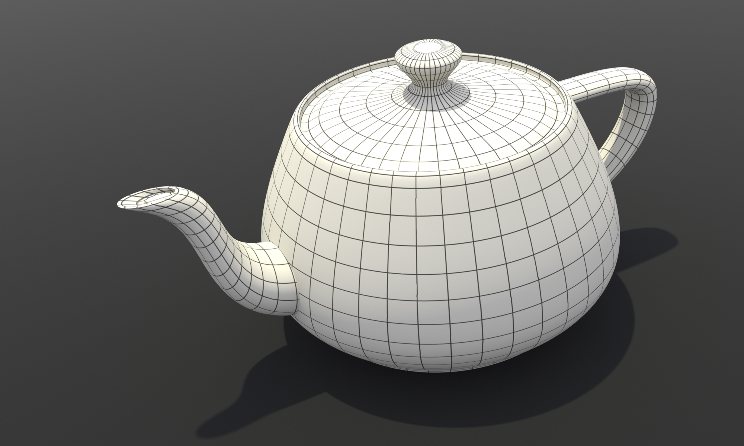
Recap: 3D Model
A mathematical
representation
of a 3D object

Slide 3
Recap: Mesh: geometry
Set of vertices
  A point (x,y,z) for each vertex
  (Object Space)
V1
V2
V3
V4
V5

Slide 4
Recap: Mesh: connectivity
Triangles (o quads, o edges…)
  That interconnect vertices
  Like interconnected nodes in a graph
V1
V2
T1
V3
T3
T2
V4
V5

Slide 5
Recap: Mesh: attributes
Quantities that variates over the surface
  Sampled per vertex
  Interpolated within polygons
RGB1
RGB2
V1
V2
RGB3
T1
V3
T3
RGB4
T2
RGB5
V4
V5

Slide 6
Recap: Attribute interpolation
Attributes inside fragments are interpolated:
  from attributes at vertices
  using barycentric coordinates of the fragment as weights

Slide 7
Recap: Data Structures : Indexed
indexed
vert | X | Y | Z | R | G | B
V1 | x1 | y1 | z1 | r1 | g1 | b1
V2 | x2 | y2 | z2 | r2 | g2 | b2
V3 | x3 | y3 | z3 | r3 | g3 | b3
V4 | x4 | y4 | z4 | r4 | g4 | b4
V5 | x5 | y5 | z5 | r5 | g5 | b5
V1
V2
T1
V3
T3
GEOMETRY + ATTRIBUTES
T2
Tri: | Wedge 1: | Wedge 2: | Wedge 3:
T1 | V4 | V1 | V2
T2 | V4 | V2 | V5
T3 | V5 | V2 | V3
V4
V5
CONNECTIVITY

Slide 8
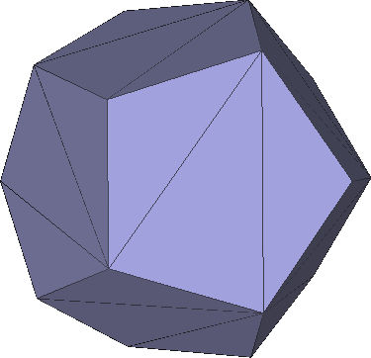
Recap: Coherent Orientation
Orientation
A
1
1
D
3
2
3
2
C
B
Opposite directions along shared edges

Slide 9
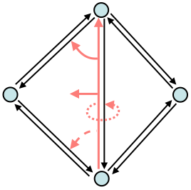
Recap: Half-edges
Half‐edge has:
  Pointer to twin half-edge
  Pointer to origin vertex
  Pointer to next half-edge
  Pointer to previous half-edge
  Pointer to incident face
Vertex Has
  Pointer to emanating half-edge
Face Has
  Pointer to one of its half-edges

Slide 10
What is a surface?
A 2-dimensional region of 3D space
A portion of space having length and breadth but no thickness

Slide 11
Where does the shape come from?
Modeling “by hand”:
  High order rapresentation allowing control
  Parametric surfaces, subdivision surfaces
Acquired real-world objects
  3D Scanning
  3D from images

Slide 12
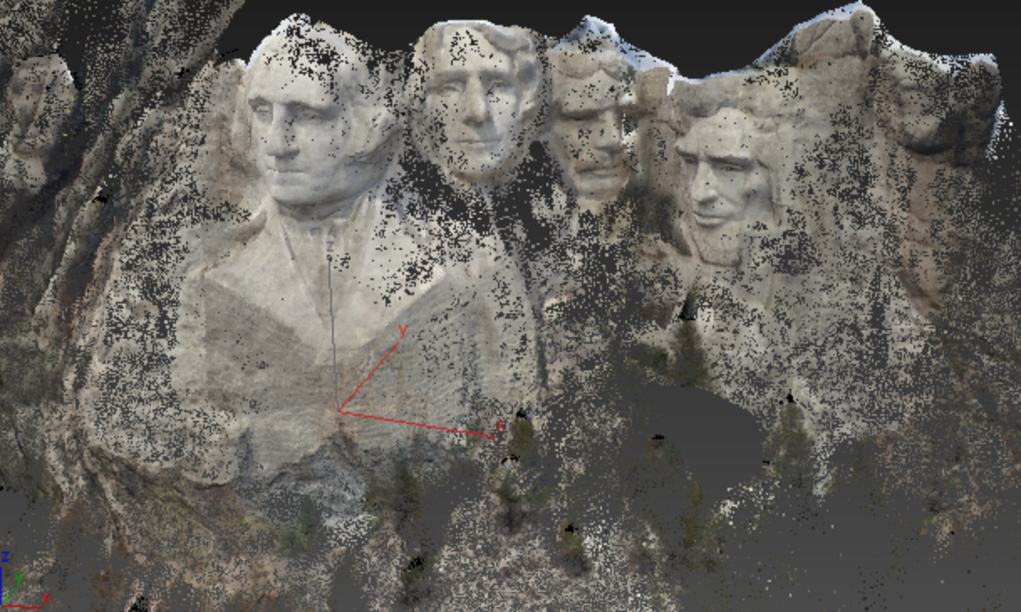
Shape rapresentations
Points

Slide 13
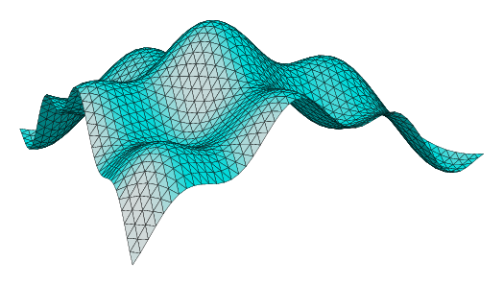
Shape rapresentations
Parametric surfaces

Slide 14
Shape rapresentations
Implicit surfaces

Slide 15
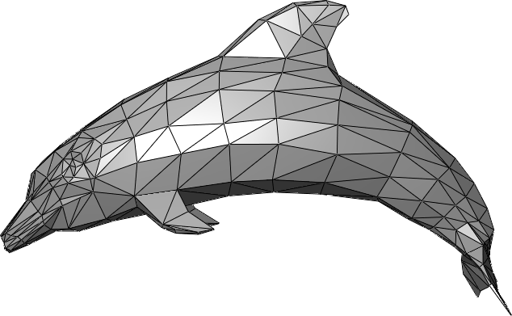
Shape rapresentations
Polygonal meshes

Slide 16
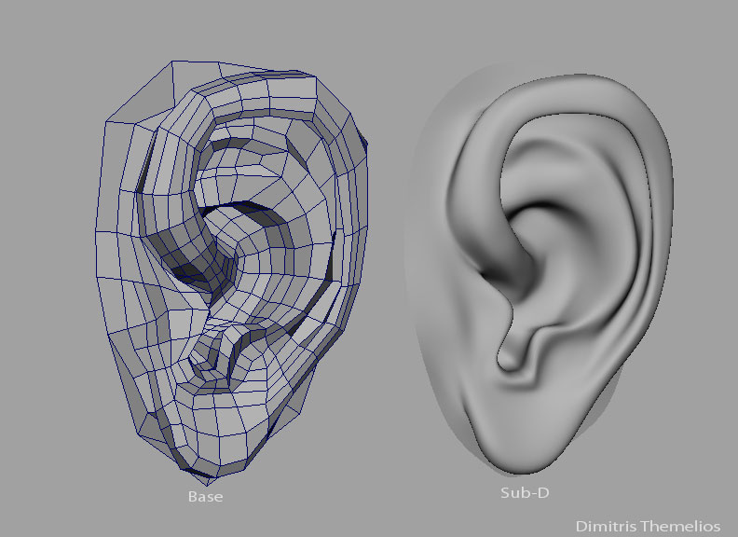
Shape rapresentations
Subdivision surfaces

Slide 17
Point-based rapresentation
Standard 3D data from a variety of sources
  Often results from scanners
  Potentially noisy
  Depth images
  Need to be globally aligned

Slide 18
Point-based rapresentation
points = unordered set of 3‐tuples
Difficoult to render/process
Efficient point processing requires to figure out neighborhoods
  Evaluate Normal (shading)
  Upsample surface

Slide 19
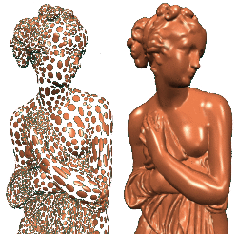
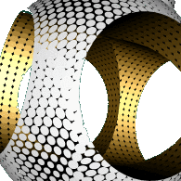
Point-based rapresentation
Spatial Queryes
  k‐nearest neighbors to point x
  Find all points within a certain radius r
Need sublinear implementations

Slide 20
Small Digression: Spatial queries
Regular Grid
Octree
Kd-Tree

Slide 21
Parametric Surfaces: as a function
As 1D object
  (x,y) =S(t)
Explicit curve in 2D p : R → R²
S(t) = r ⋅(cos(t), sin( t))
t ∈[0, 2π)

Slide 22
Parametric Surfaces : Bezier Curves
Bezier curves
Control points
Basis functions

Slide 23
Parametric Surfaces : Bezier Surfaces
Bezier Surfaces

Slide 24
Parametric Surfaces : defined on 2D domain
Surfaces are 2‐dimensional parameterizations
  S(u,v) = (x(u,v), y(u,v), z(u,v))

Slide 25
Parametric Surfaces
Advantages
  Fast to generate
  Theoretically infinite resolution
  Implicit parametrization
Drawbacks
  Difficoult to determine if a point lies inside/outside
  Difficoult to determine if a point lies on the surface

Slide 26


Implicit Surfaces
Definition:
Space Partitioning

Slide 27
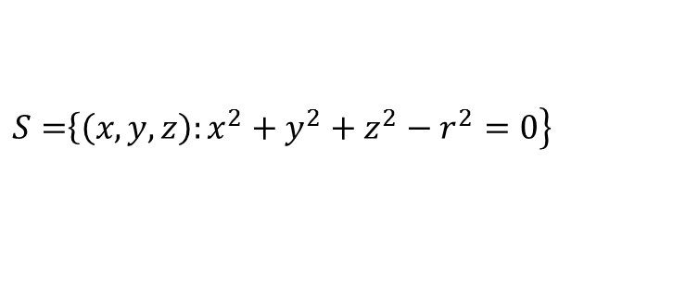
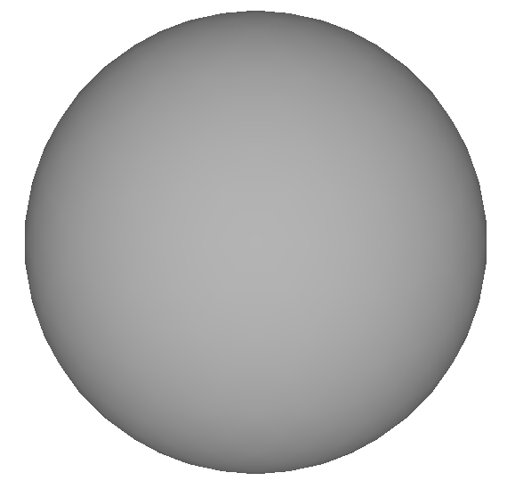
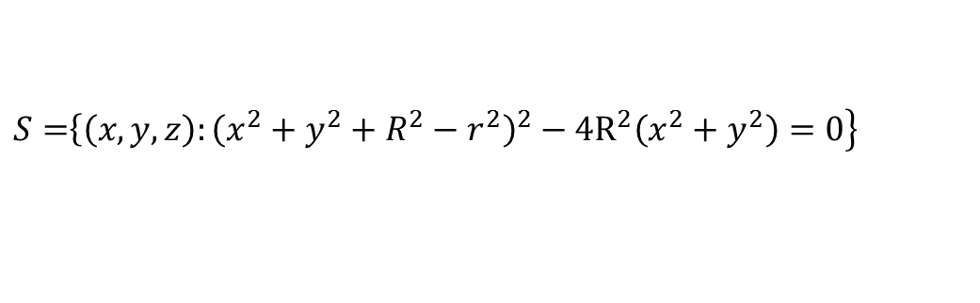
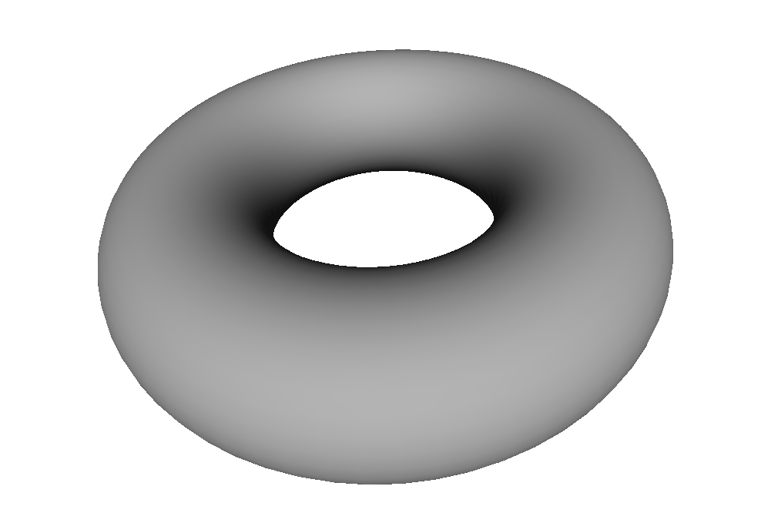
Implicit Surfaces: an example

Slide 28
Implicit Surfaces: normals
The normal vector to the surface (curve) is given by the gradient of the (scalar) implicit function
Example:

Slide 29
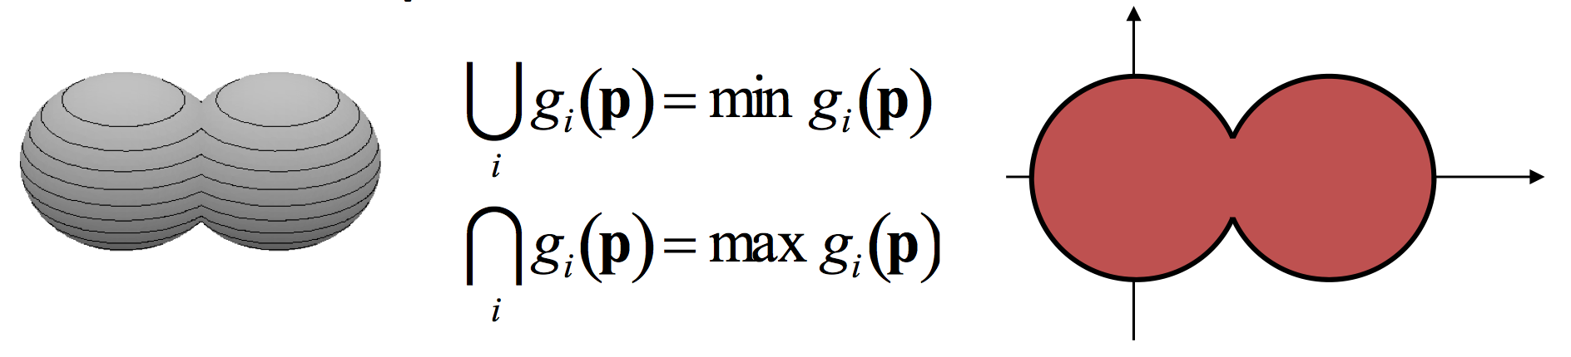
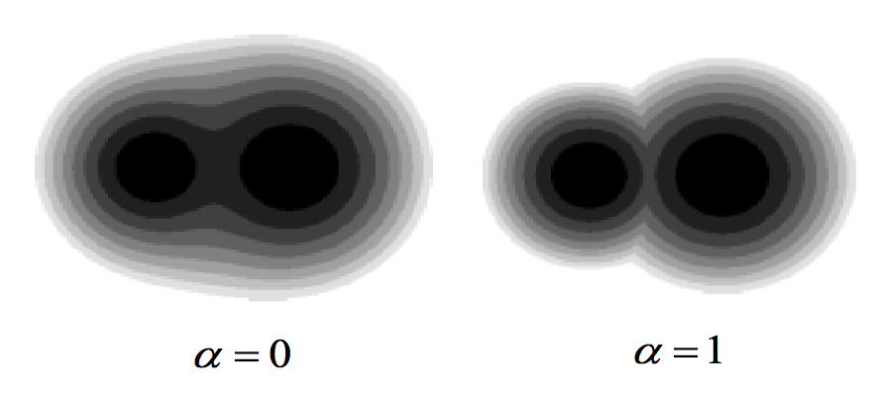
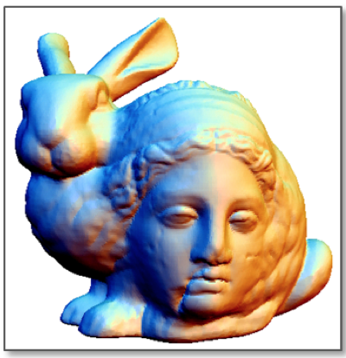
Implicit Surfaces
Standard operations: union and intersection
In many cases, smooth blending is desired

Slide 30
Implicit Surfaces
Blobs
  Defined implicitly by a potential function around a point p

Slide 31
Implicit Surfaces
Advantages
  Precise definition of outside/inside
  Easy to determine if a point lie on a surface
  Easy to perform boolean operations
Drawbacks
  Need additional algorithms to extract thesurface
  Do not allows direct rendering
  Problems definign sharp features

Slide 32
Subdivision Surfaces
Subdivision defines a smooth curve or surface as the limit of a sequence of successive refinements.
Pixar’s Geri's Game (1997)

Slide 33
Subdivision Surfaces
Advantages
  Potentially infinitely smooth
  Start form a poygonal mesh
  Good results and intuitive for animation/modelling
Drawbacks
  Need an initial quad base mesh
  May create artifacts if the base mesh is not aligned with curvature or deformation field during the animation

Slide 34
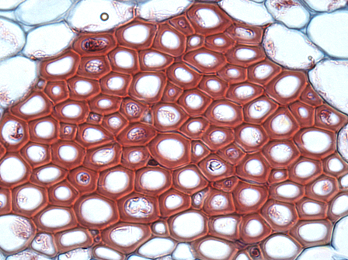
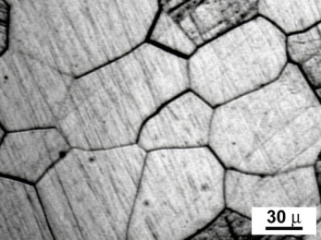
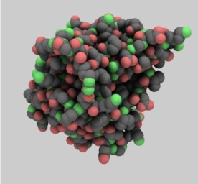
Polygonal meshes
In nature, meshes arise in a variety of contexts:
  Cells in organic tissues
  Crystals
  Molecules
…
Mostly convex but irregular cells
Common concept: complex shapes can be described as collections of simple building blocks

Slide 35
Polygonal Meshes
Advantages
  Many algorithms in Geometry processing are designed fot polygonal meshes
  Rendering immediate
Drawbacks
  Boolean operations are difficoult
  Resolution limited by the number of polygons

Slide 36
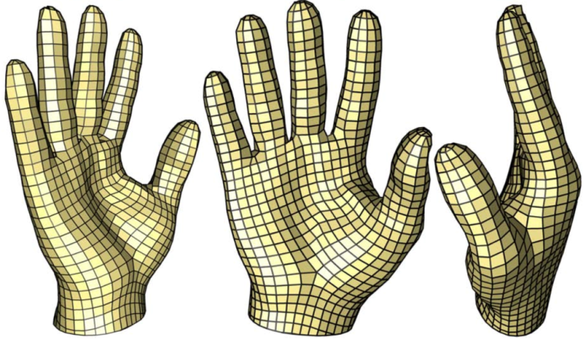
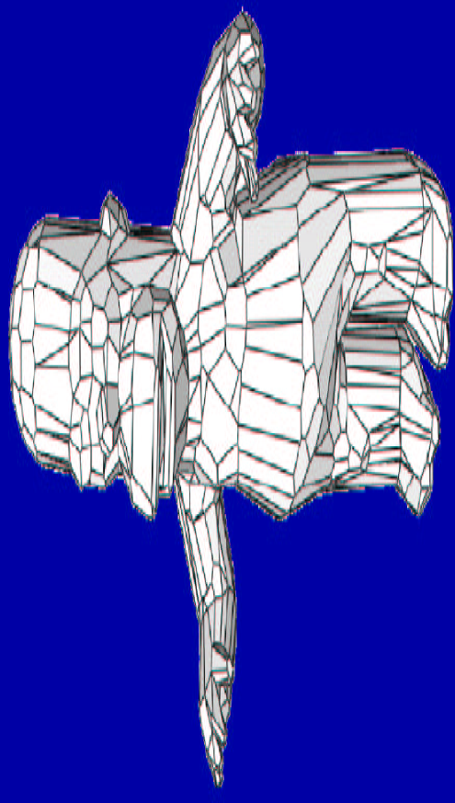
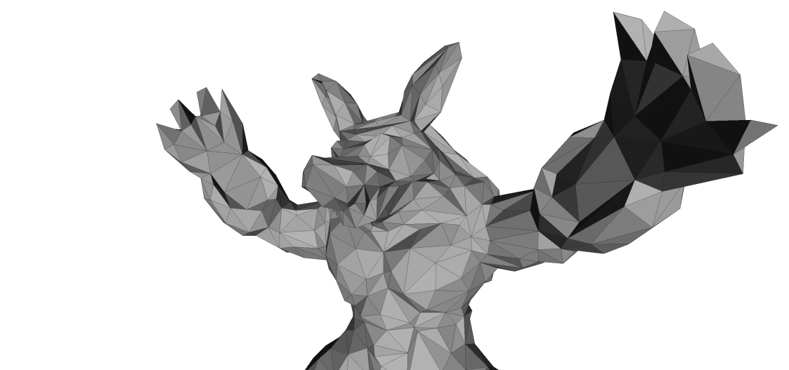
Polygonal meshes
Rapresentation of the boundary of an object
Intuitive description: a continuous surface divided in polygons
quadrilaterals (quads)
triangles
generic polygons

Slide 37
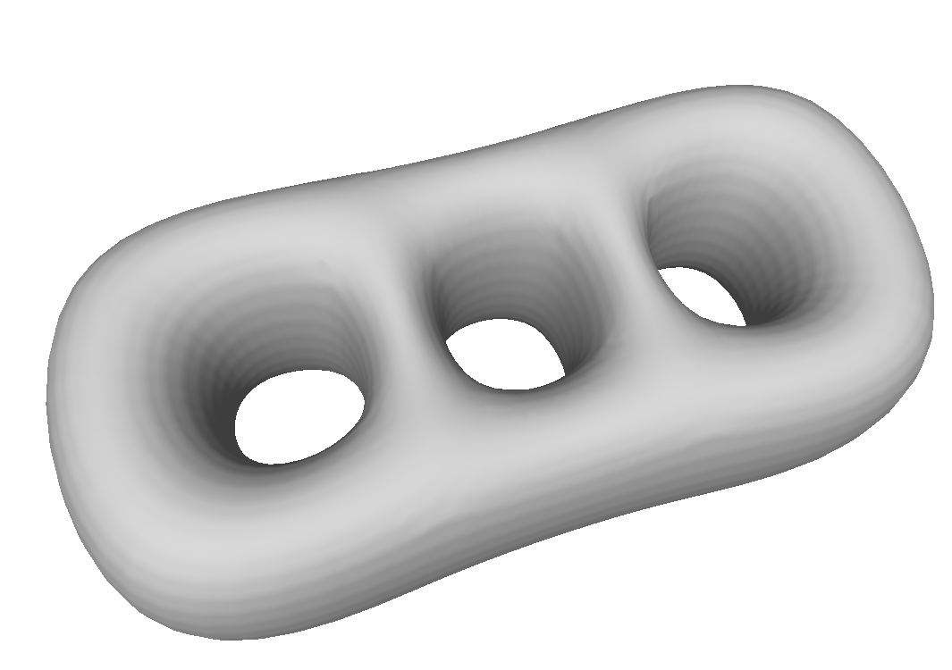
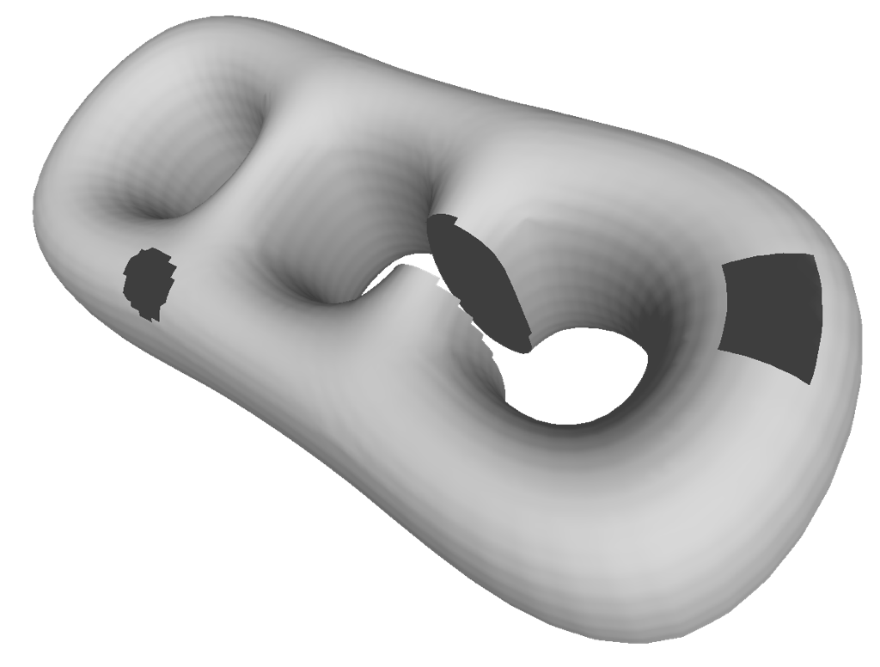
Boundaries
Boundary edge if belonds to a single face
Watertight
Bordered

Slide 38
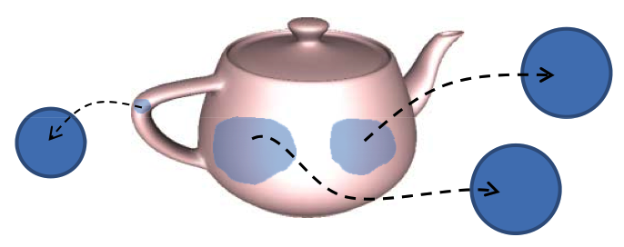
Manifoldness
A surface is a 2‐manifold if it is everywhere locally homeomorphic to a disk.
manifold
Non-manifold
Non-manifold

Slide 39
Recap: Quick..
two-manifold
  two-manifold = each edge shared by max 2 faces
Non Manifold
Manifold

Slide 40
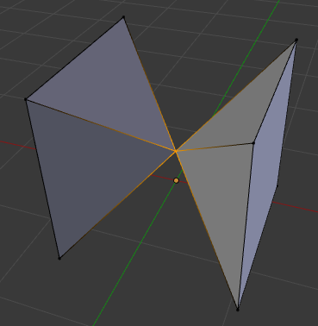
Recap: Quick..
two-manifold
  two-manifold = each edge shared by max 2 faces
  two-manifold = each vertex shared by a single star of faces
⬅ NON Manifold

Slide 41
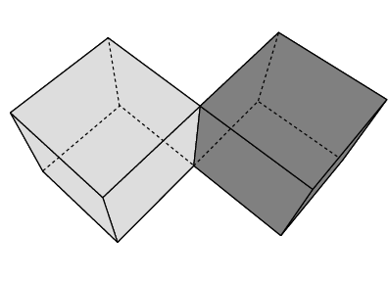
NON 2-manifolds example

Slide 42
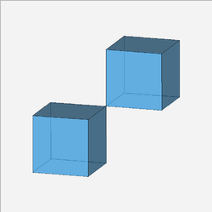
NON 2-manifolds example

Slide 43
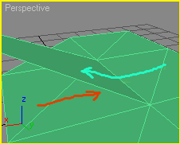
NON 2-manifolds example

Slide 44
Examples of NOT 2-manifolds meshes
1 non manifold
edge here
1 non manifold
edge here
1 non manifold
vertex here

Slide 45
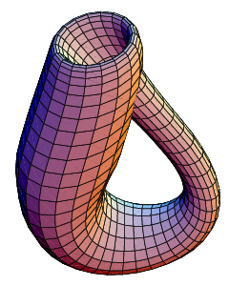
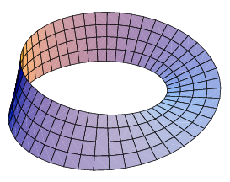
Orientability
A polygonal mesh is orientable, if the incident faces to every edge can be equally oriented
Notes
  An orientable surface has 2 sides
  Non manifold surfaces are non-orientable.
  Every non‐orientable closed mesh embedded in R³ intersects itself
  Manifold open mesh can be non-orientable
Klein bottle
Moebius strip

Slide 46
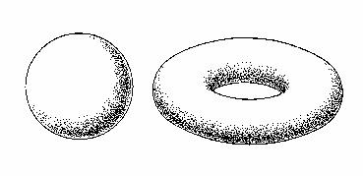
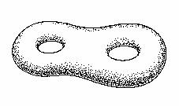
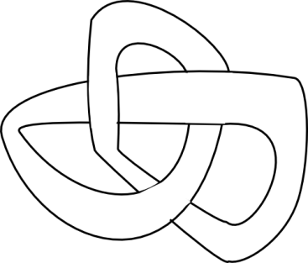
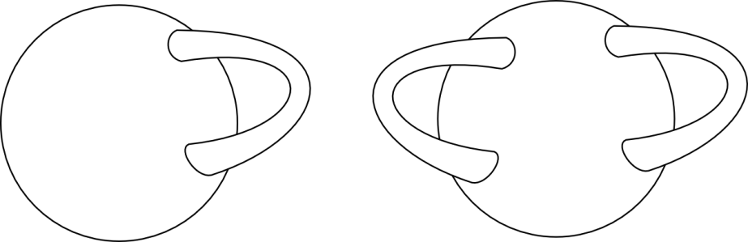
Genus
The Genus of a closed surface, orientable and 2-manifold is the maximum number of cuts we can make along non intersecting closed curves without splitting the surface in two.
0
1
2

Slide 47
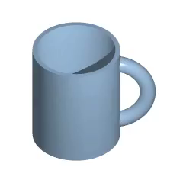
Omeomorphism
two shapes are the omeomorph iff they can be mapped into each other through a bijective and bi-continuous mapping
Topology study invariance of geometric objects upon elastic deformations
Same genus -> omeomorph

Slide 48
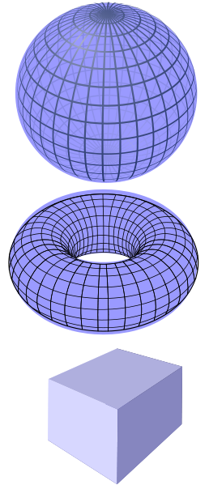
Omeomorphism
Sphere and cube can be mapped into each other by stretching/pulling/pushing: they are homeomorphic
Sphere and torus cannot be mapped into each other without tearing or puncturing: they are not homeomorphic

Slide 49
Euler‐Poincaré Formula
Relation between #vertices, #edges and #faces of a polygonal mesh
The sum χ(M) = v – e + f is constant for a given topology, no matter which mesh we choose
v =8
e=12
f =6
v=8
e=12 +1
f=6+1
χ(M)=8-12+6=2
χ(M)=8-13+7=2

Slide 50
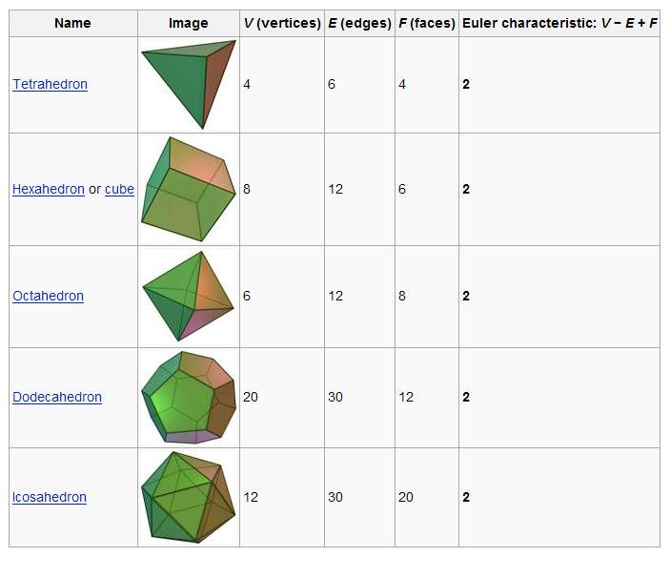
Euler‐Poincaré Formula
If M is homeomorphic to a sphere χ(M) = 2
The ralation between genus g and χ(M)
  χ(M)= v – e + f = 2(1 – g)
  g=1-χ(M)/2

Slide 51
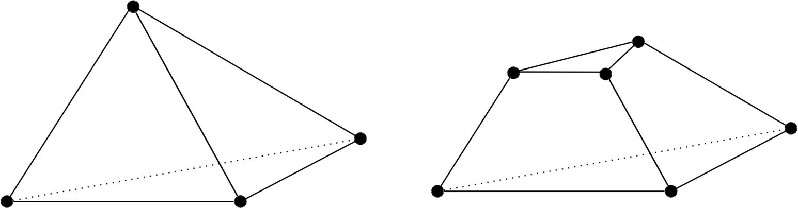
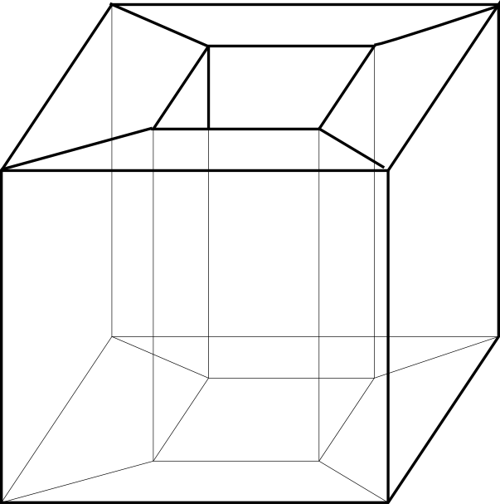
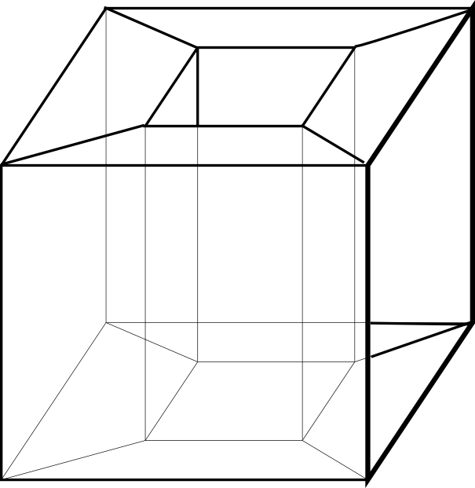
Euler‐Poincaré Formula
examples
χ(M)=v – e + f = 4 – 6 + 4= 2
Genus=0
χ(M)=v – e + f = 6 – 9 + 5= 2
Genus=0
Erased
1 face !
χ(M)=v – e + f = 16 – 32 + 16= 0
Genus=1
χ(M)=v – e + f = 16 – 32 + 15= -1 ??

Slide 52
Euler‐Poincaré Formula
Generalization
  v = # vertices
  e = # edges
  f = # faces
  c = #connected components
  b = #boundary loops
  g = genus
v – e + f – b = 2 (c – g)

Slide 53
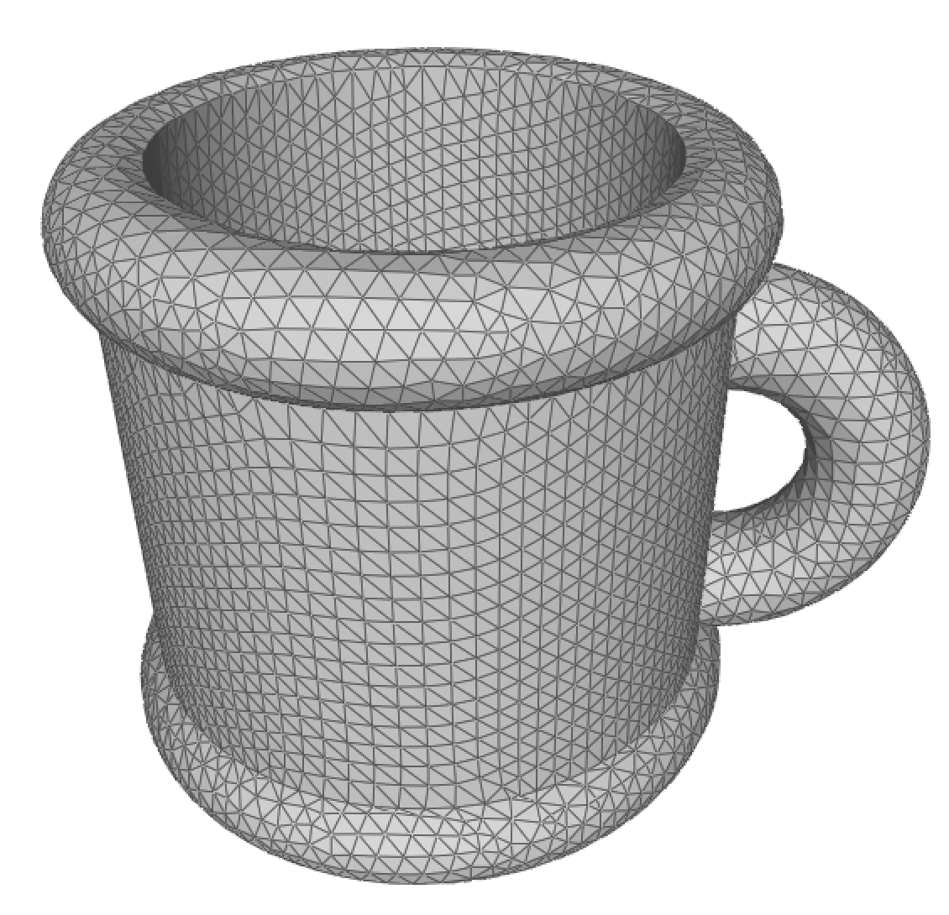
Euler‐Poincaré Formula
In a closed mesh
  Ratio of edges to faces: e = 3/2 f (each edge belongs to exactly 2 triangles each triangle has exactly 3 edges )
  Ratio of vertices to faces: f ~ 2v
    2 = v – e + f = v – 3/2 f + f
    2 + f/2 = v
  Ratio of edges to vertices: e ~ 3v
  Average degree of a vertex :6
    Since each edge has 2 vertices

Slide 54
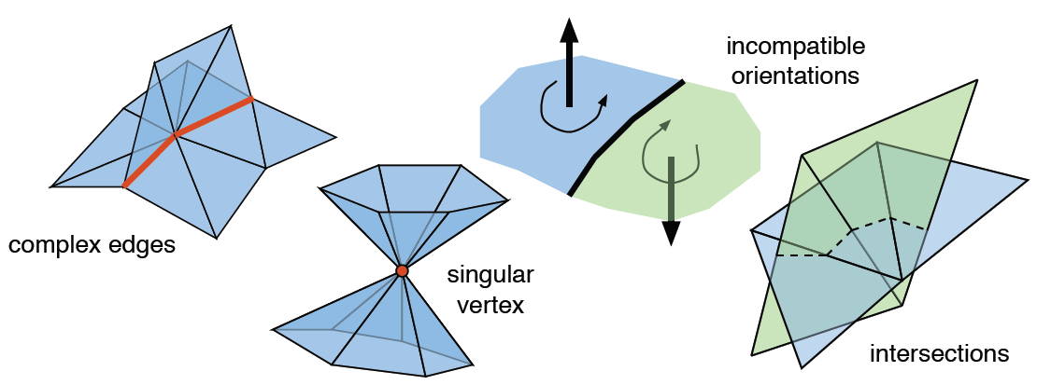
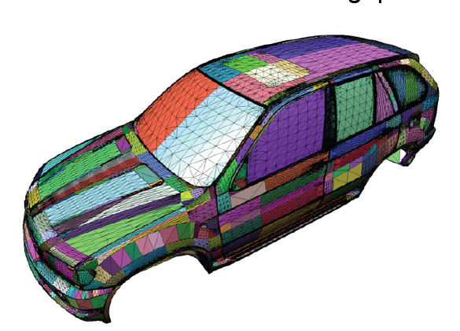
Why Cleaning a mesh?
how a 3d model has produced influence the type of geometric and topological problems that you can get
range scan
  large overlapping area, may produce inconsistency
  holes
triangle soup
  a lot of problems (see the left picture)

Slide 55
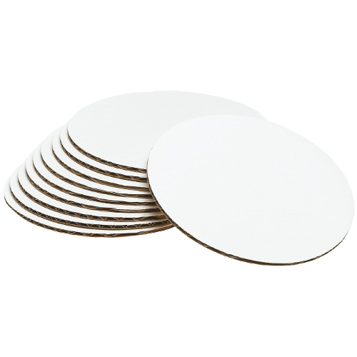
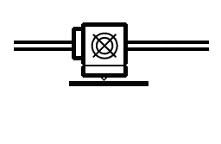
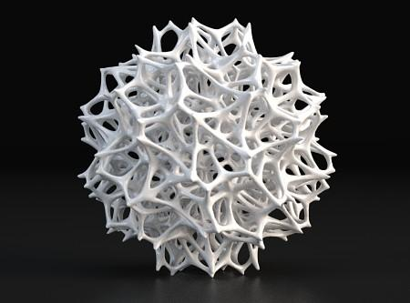
Additive Manufacturing
aka 3D Printing
Builds objects adding material,
one layer at the time.
Enables the creation of objects that are not feasible with subtractive technology

Slide 56
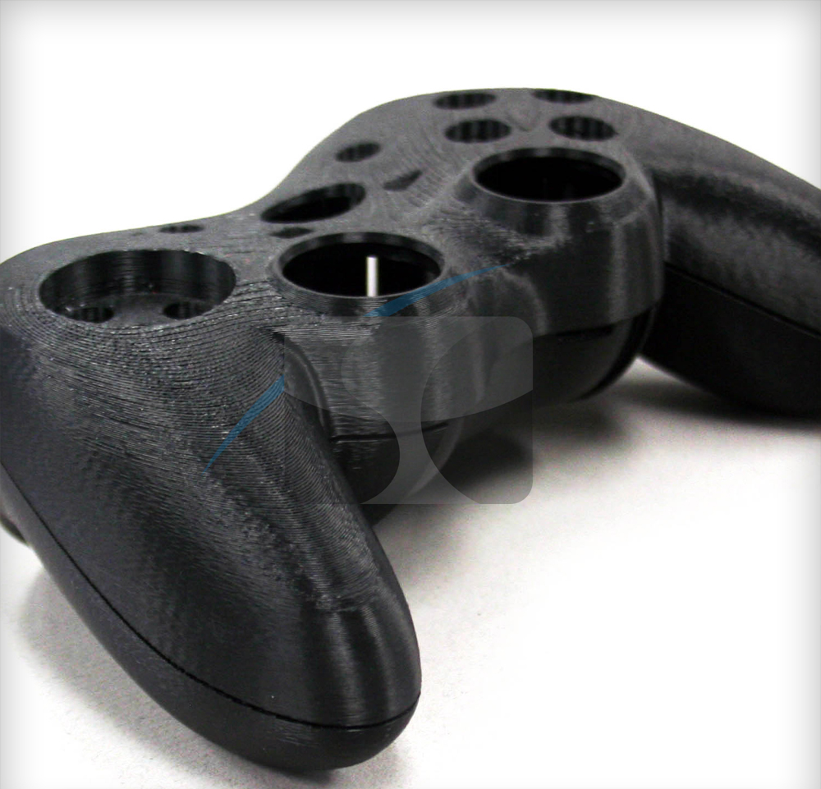
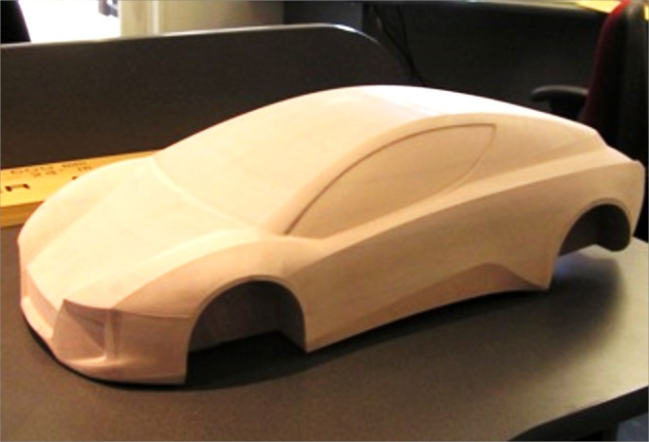
History
3D printing is ~30 years old!!!
Formerly known as
Rapid Prototyping
Allow for rapid production of parts without setting up a whole production pipeline.
Enables rapid feedback during the design phase.
Cuts the costs for manufacturers

Slide 57










History
World leaders in 3D printers market
NASDAQ: SSYS
NYSE: DDD
57

Slide 58
Today
Why is 3D printing so popular now???
Many patents have expired :)
In particular thanks to FDM technology, which is very simple and cheap
Prices for FDM printers have dropped to 1/10th

Slide 59

3D printing
FULL FLEXIBILITY
COST does NOT depend on COMPLEXITY!
cost(complex shape) = cost(cube with same volume)
59

Slide 60

GE 3D-Printed Fuel Nozzles
LEAP Jet Engine
Cobalt-Chromium DMLM
(Direct Metal Laser Melting)
25% lighter, 5x more durable,
replaces 20-part assembly
Flying from 2016

Slide 61
3D printing
Several classes of 3D printing technologies
LOM (Laminated Object Manufacturing)
SLA (Stereolithography)
SLS (Selective Laser Sintering)
FDM (Fused Deposition Modeling)
…

Slide 62



Addictive FDM
Fused Deposit Modeling
By far the most diffuse
Hundreds of 3D
printers on the
market
From 500 € up
Suitable for
home and
office use

Slide 63

Addictive FDM

Slide 64


Slicing

Slide 65
Slicing
Closed Objects
Get rid of small disconnected components
Manifold better
Orientable is better

Slide 66
Recap: Shape rapresentations
Points

Slide 67
Recap: Shape rapresentations
Parametric surfaces

Slide 68
Recap: Shape rapresentations
Implicit surfaces

Slide 69
Recap: Shape rapresentations
Polygonal meshes

Slide 70
Recap: Shape rapresentations
Subdivision surfaces

Slide 71
Recap: Manifoldness
A surface is a 2‐manifold if it is everywhere locally homeomorphic to a disk.
manifold
Non-manifold
Non-manifold

Slide 72
Recap: Orientability
A polygonal mesh is orientable, if the incident faces to every edge can be equally oriented
Notes
  An orientable surface has 2 sides
  Non manifold surfaces are non-orientable.
  Every non‐orientable closed mesh embedded in R³ intersects itself
  Manifold open mesh can be non-orientable
Klein bottle
Moebius strip

Slide 73
Recap: Genus
The Genus of a closed surface, orientable and 2-manifold is the maximum number of cuts we can make along non intersecting closed curves without splitting the surface in two.
0
1
2

Slide 74
Recap: Addictive FDM

Slide 75
Computer Graphics
Shapes
University of Technology Sydney
Teacher: Nico Pietroni

