Slide 1
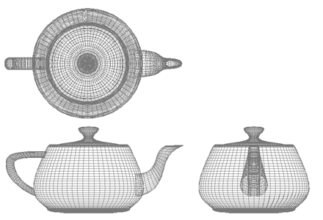
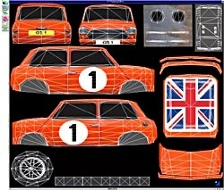
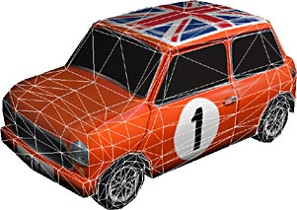
Computer Graphics
Textures
University of Technology Sydney
Teacher: Nico Pietroni

Slide 2
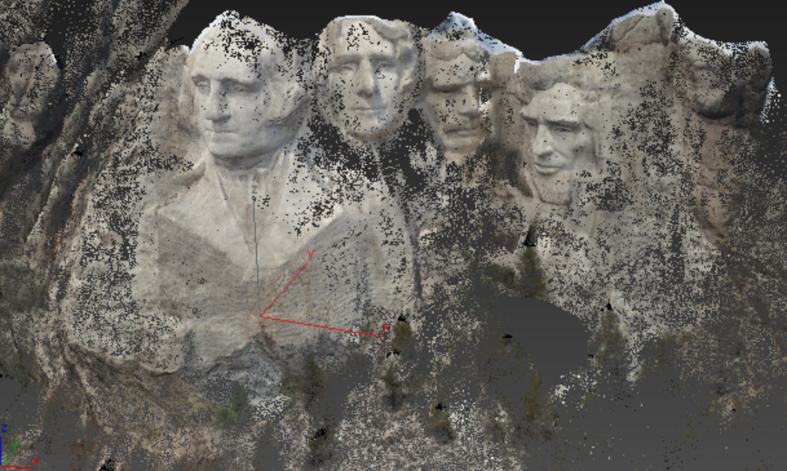
Recap: Shape rapresentations
Points

Slide 3
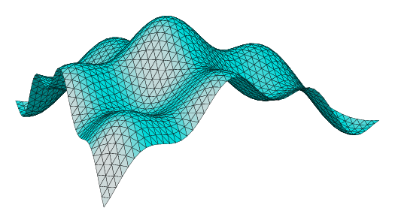
Recap: Shape rapresentations
Parametric surfaces

Slide 4
Recap: Shape rapresentations
Implicit surfaces

Slide 5
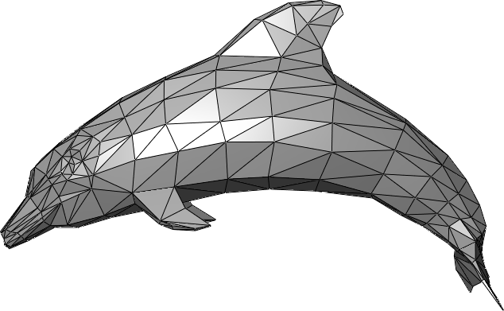
Recap: Shape rapresentations
Polygonal meshes

Slide 6
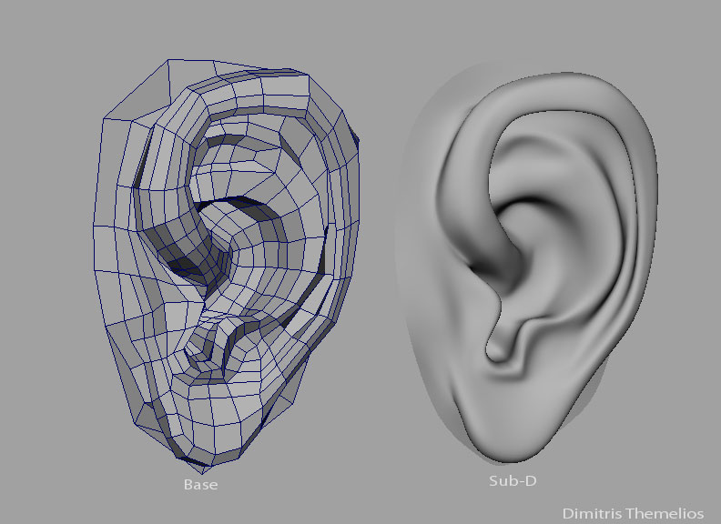
Recap: Shape rapresentations
Subdivision surfaces

Slide 7
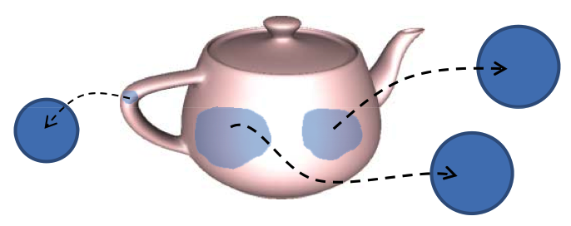
Recap: Manifoldness
A surface is a 2‐manifold if it is everywhere locally homeomorphic to a disk.
manifold
Non-manifold
Non-manifold

Slide 8
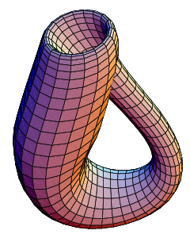
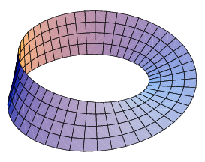
Recap: Orientability
A polygonal mesh is orientable, if the incident faces to every edge can be equally oriented
Notes
  An orientable surface has 2 sides
  Non manifold surfaces are non-orientable.
  Every non‐orientable closed mesh embedded in R³ intersects itself
  Manifold open mesh can be non-orientable
Klein bottle
Moebius strip

Slide 9
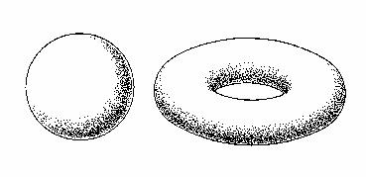
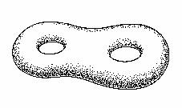
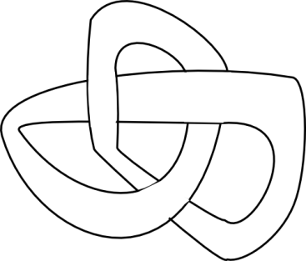

Recap: Genus
The Genus of a closed surface, orientable and 2-manifold is the maximum number of cuts we can make along non intersecting closed curves without splitting the surface in two.
0
1
2

Slide 10
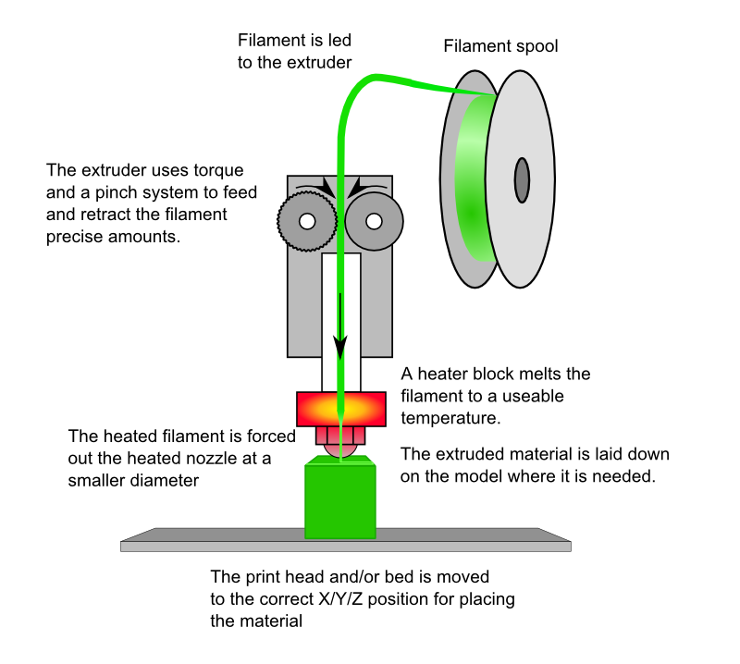
Recap: Addictive FDM

Slide 11
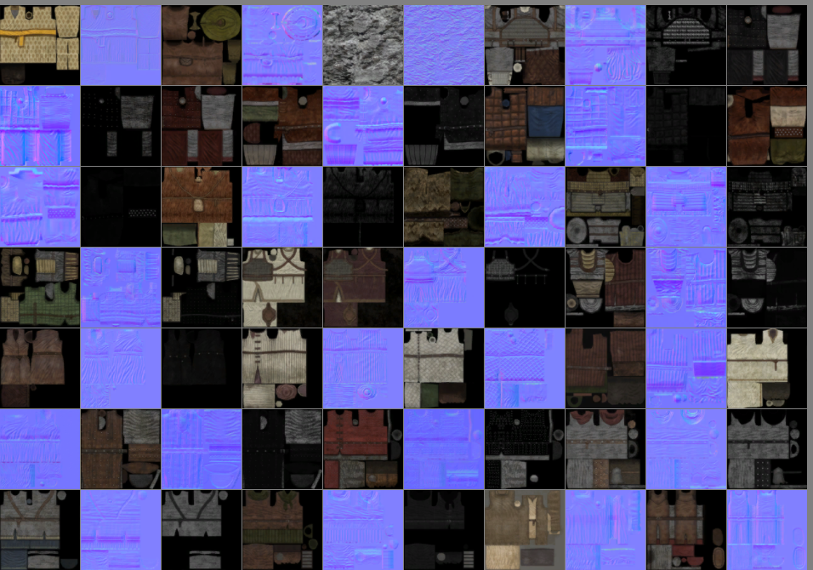
Texture maps!
One of the most common and important asset of a game
One of the most GPU RAM consumer

Slide 12

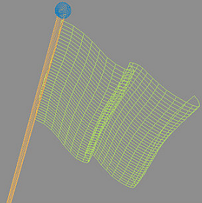
Texture mapping
+
=
3D geometry
(set of quadrilaterals )
RGB texture 2D
(here: color-map)

Slide 13
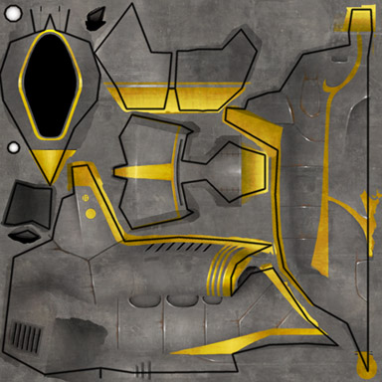
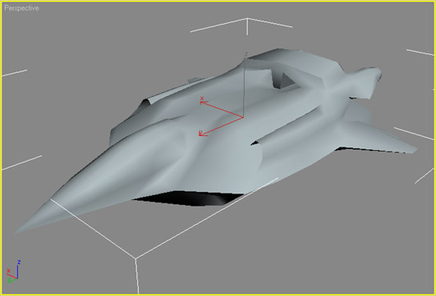
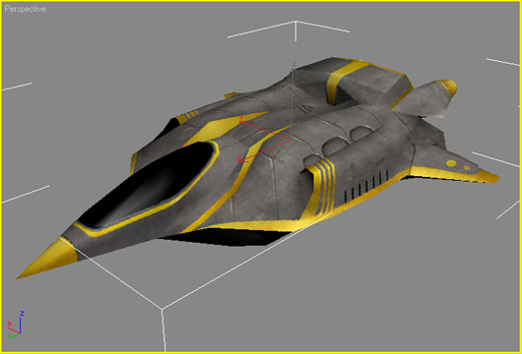
Example (color-map)
+
=

Slide 14
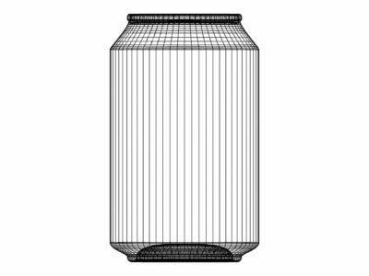
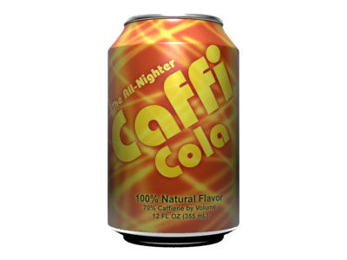
Example (color-map)

Slide 15
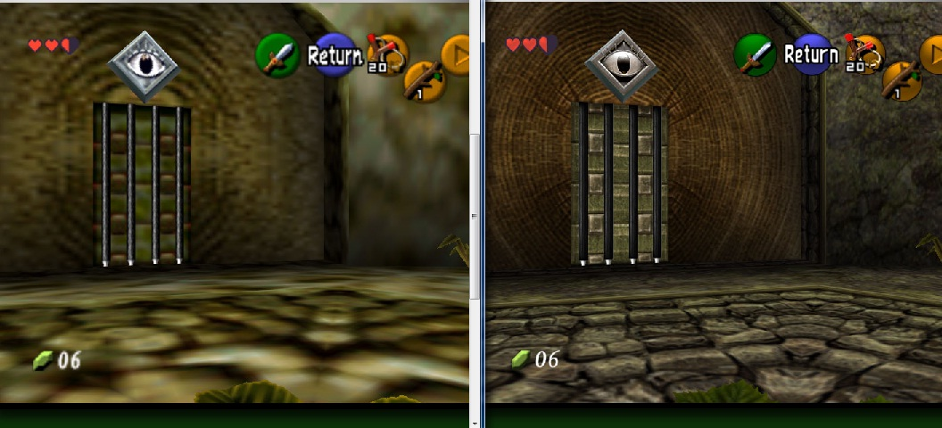
Textures in Games
The majority of visual richness perceived in the typical videogame is due to textures!
Textures resolution
have more impact (quality wise) than Meshes resolution!

Slide 16
Texture maps: data structures
Texture sheet =
the image projected on the surface (the mesh)
A texel = a sample of that signal
  Between samples: (bilinear) interpolation
«Texel»
Texture sheet

Slide 17
Textures: common terms
  Similar purpose to the per-vertex attributes!
  but…
    # texels >> # vertices
    More complex signals!

Slide 18
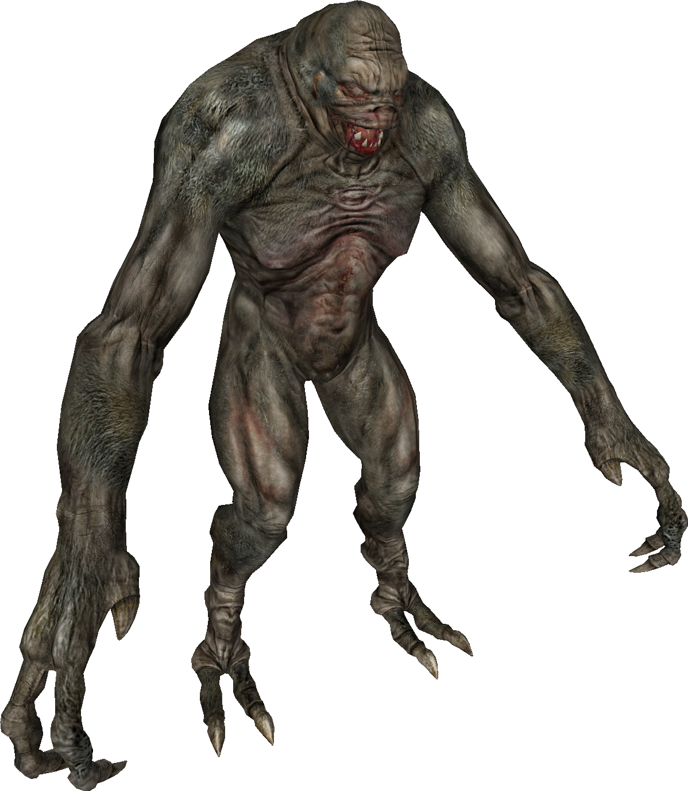
The power of textures
4953 Vertices , Textured

Slide 19
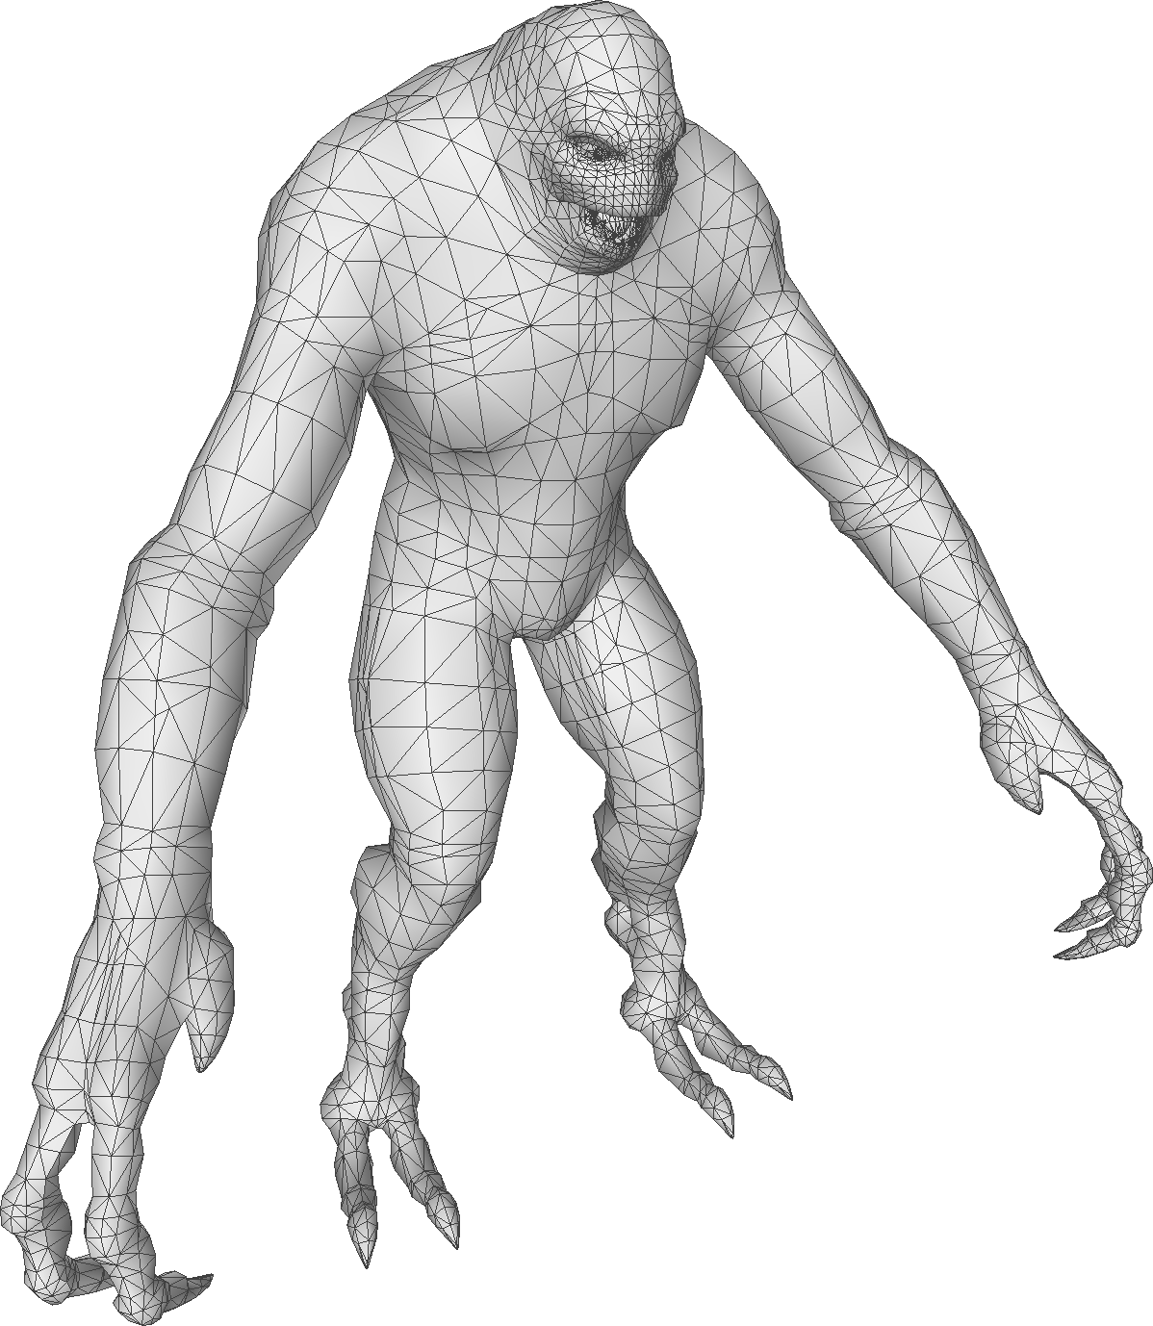
The power of textures
4953 Vertices

Slide 20
Recap:Attribute interpolation
Attributes inside fragments are interpolated:
  from attributes at vertices
  using barycentric coordinates of the fragment as weights

Slide 21
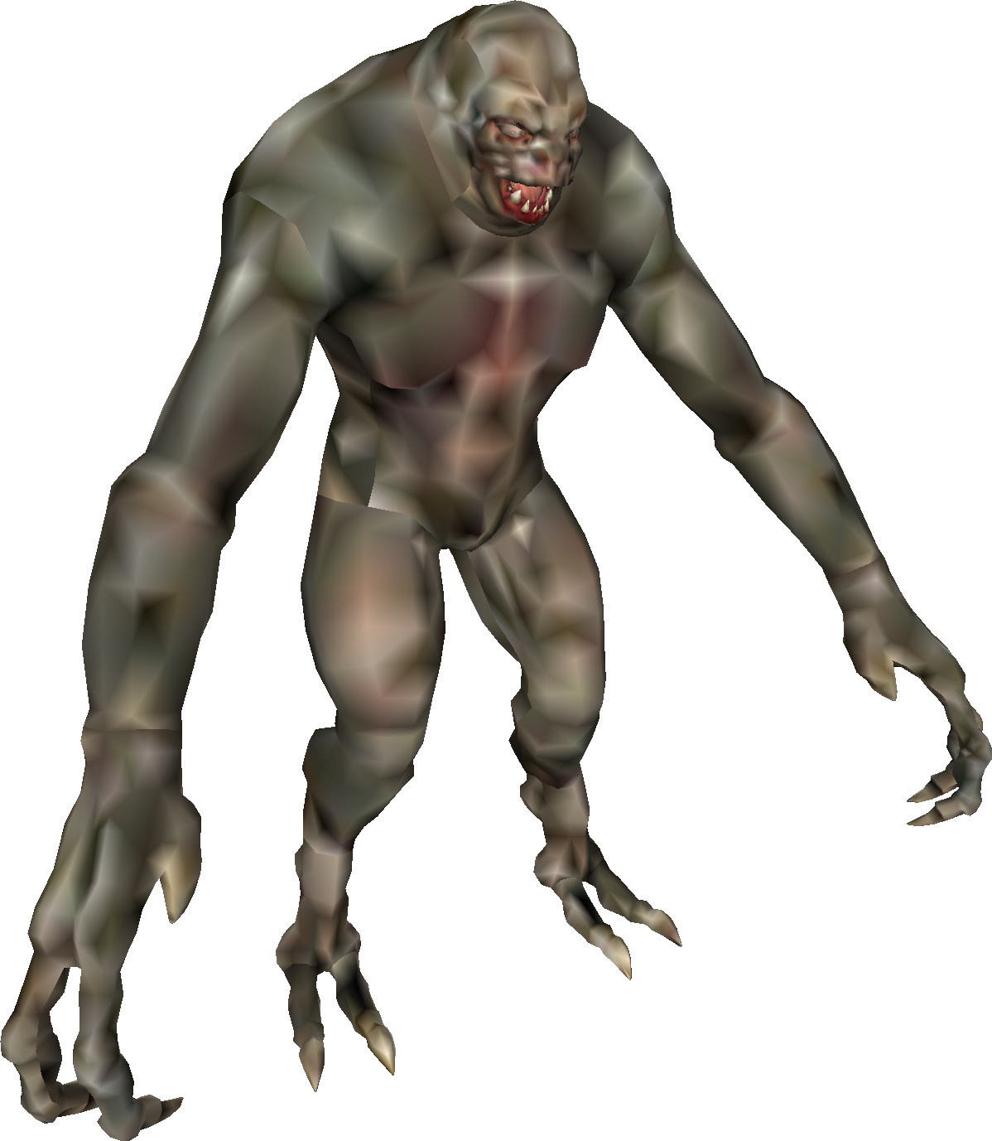
The power of textures
4953 Vertices , Per Vert color

Slide 22
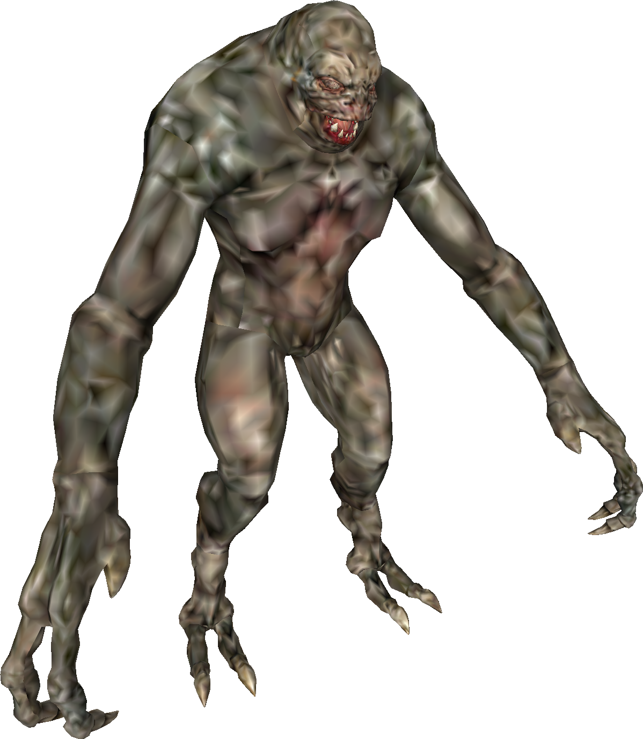
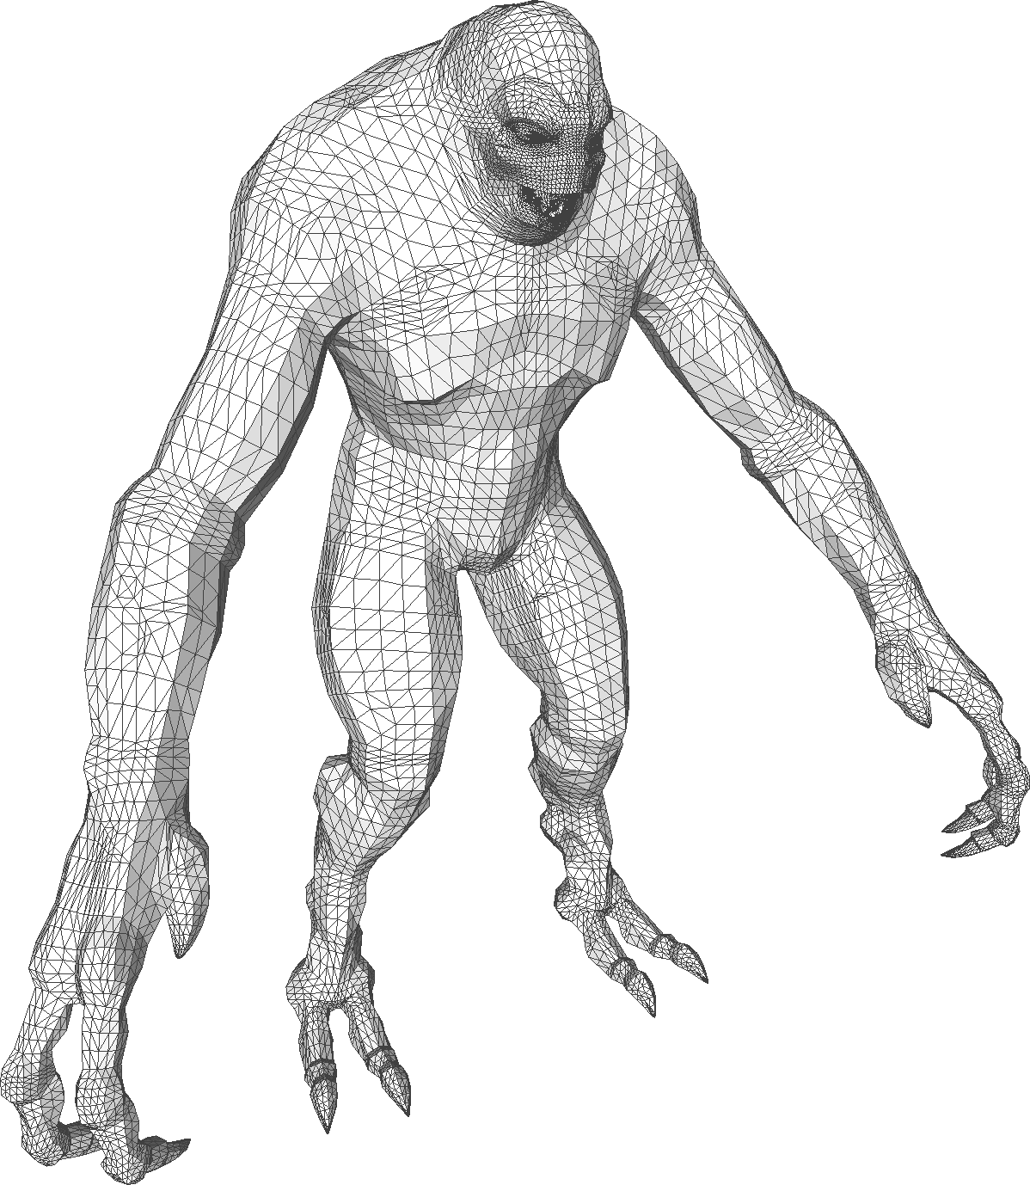
The power of textures
18055 Vertices

Slide 23
The power of textures
18055 Vertices , Per Vert color

Slide 24
The power of textures
4953 Vertices , Textured

Slide 25
Texture maps and Meshes
Not necessarly 1:1
  1:N -- several textures «sheets» associated to a mesh
  N:1 – more meshes on the same sheet
  If different part of mesh associated to different textures: decompose the object into sub-mesh
MESH
A
TEXTURE 1
BUMPMAP
MATERIAL
MESH
B
TEXTURE 2
COLORMAP

Slide 26
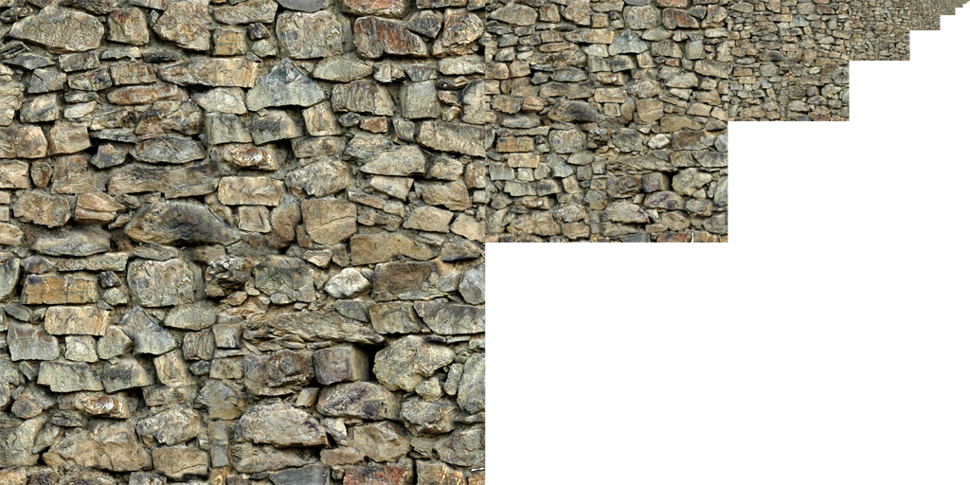
MIP map levels
Pre-filtering of textures
“LOD pyramid, for images”!
Hardware chooses the right level (for pixel)
Avoid subsampling artifacts
1x1
1024x1024
512x512
256x256

Slide 27
Texture maps as assets
Carachteristics:
  Size:
    resolution
    channels (eg: alpha?)
  MIP-map
    (available of not?)
  Compression?
    e.g. quantized “color-map”,
    or specific compression schemes
Recurrent constraints:
Power of 2 for side
  (requested by always fewer engines)
  Both in U and V
  (e.g.: 256x256 o 1024x512)
res < max
  (e.g.: max = 4096 o 2048)

Slide 28
Life of a Texture in a Game Engine
DISK
CENTRAL RAM
GPU RAM
IMPORT
LOAD
Image
File
Image
Object
TextureSheet
on GPU

Slide 29
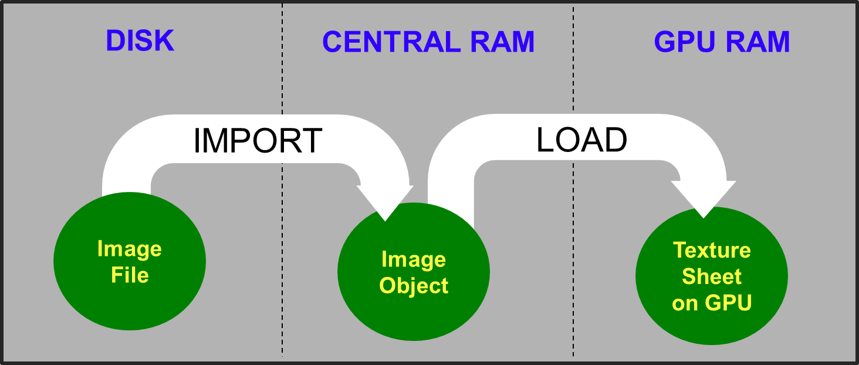
Texture Sheets: files format
Specialized for textures:
(most used option)
    .DDS
    («direct draw surface»)
    same format used in GPU. Thus:
    ☺ includes MIPmap levels (if wanted)
      ☹ compression: very lossy
      And bad compression rate
      (and fixed)
      ☺ GPU ready!
      Just read from disk &
      load on GPU memory
      (no decompress / recompress!)
For generic images:
    .JPG / .JPEG
      ☹ lossy,
      ☺ Good compression rate
      ☺ “photographic” images: best
      ☹ only 3 channels (no choice)
      ☹ 8 bit per channel (no choice)
    .PNG
      ☺ lossless
      ☹ < compression ratio
      ☺ drawings: best
      ☺ alpha channel also possible
      ☺ 16bits also possible

Slide 30
Texture maps as assets: file formats
asset on
disk / RAM
(maybe)
asset in
GPU RAM
(for sure)
For generic images
(decompress the entire image to access the pixels)
  ☺ compression: excellent
  ☹ loading: heavy:
    Decompress from RAM,
    (maybe) recompress in GPU-RAM
  ☹ MIP-map lvls etc:
  Controlled by the engine
For textures
(random accessibility to texels, without uncompressing the entire image)
  ☹ compression: bad
  ☺ loading: light
    direct copy
    Disc => RAM =>GPU RAM
  ☺ MIP-map lvls etc:
  Controlled by the artist

Slide 31
Texture Sheets: in GPU RAM
Rastered images, but with peculiarity …
  mipmap levels
  channels per texels: 1,2,3, or (usually) 4
  bits per channels:
  usually 8, fixed point («true-color»)
  – or compression
  resolution: powers of 2 (usually)

Slide 32
UV-Mapping of a mesh
A mapping : mesh surface→ 2D texture space is needed
  «parametrization» of the surface
Idea: store this mapping as attribute: (s,t) per vertex
  The «u-v mapping» of the mesh (u,v) == (s,t)
[0..1]²

Slide 33
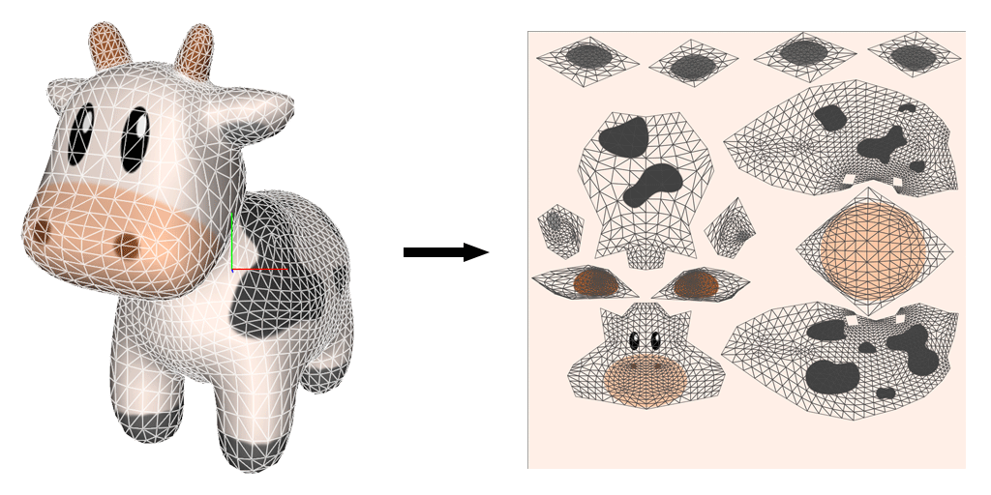
Modeling task: “u-v mapping” construction
u
Texture “atlas”
(composed of
several “charts”)
v

Slide 34
UV mapping: example
u
…
A
B
C
M
N
M
C
N = A
B
v
(vertex seam)
MESH
TEXTURE SPACE

Slide 35
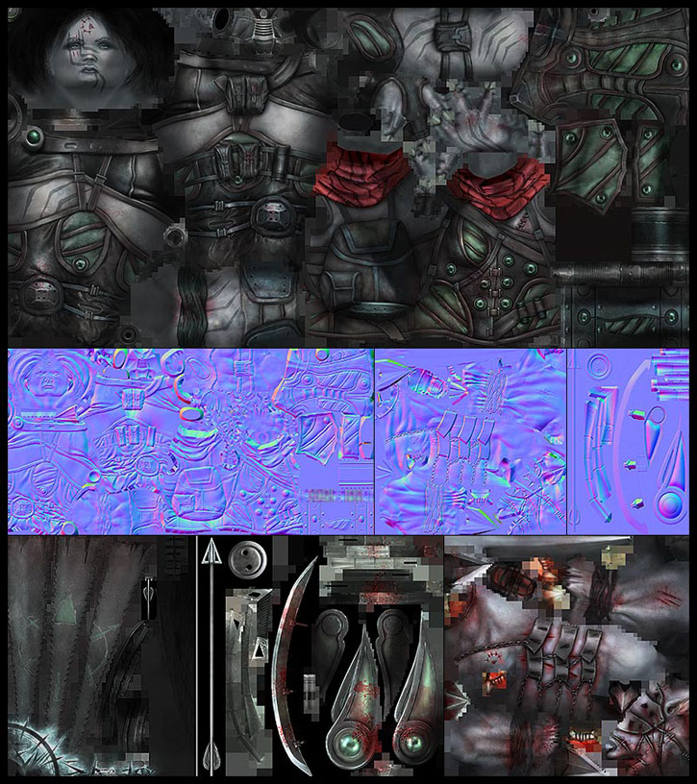
Texture space notation
Texture Space (or “parametric space" or "u-v space")
1.0
u
Texture 2D
eg: 512 texels
1.0
v
e.g.: 1024 texels
Texture Space = [0,1] x [0,1]

Slide 36
Two notations
Most diffused
(in game industry)
s-t
(es OpenGL)
u-v
(es DirectX)
t
(0,0)
1.0
1.0
u
s
1.0
(0,0)
1.0
v

Slide 37
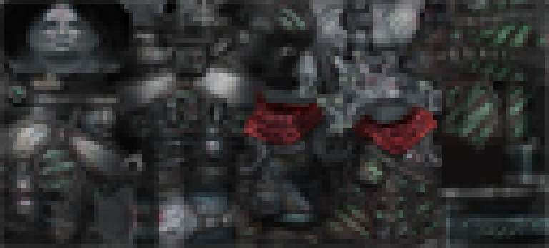
Texture space independent of resolution (or shape)
t
1.0
Convenient!
We can reduce texture sheets res (balancing quality / memory) without affecting the UV mapping.
Texture 2D
1024x512
s
t
1.0
1.0
128x64
s
1.0

Slide 38
Construction of UV-mapping: aka parametrization

Slide 39
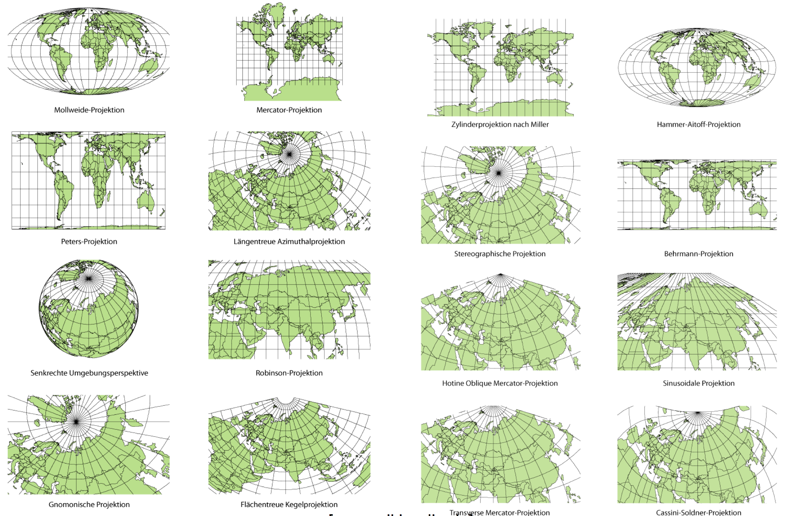
What is a parametrization?

Slide 40
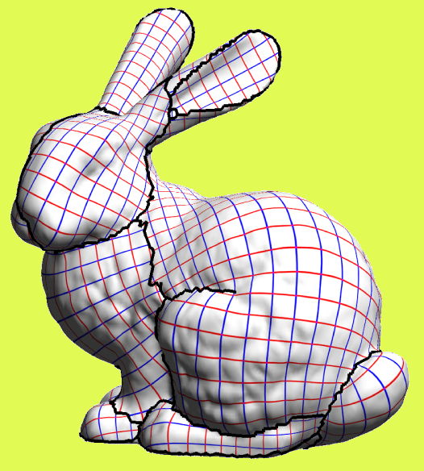
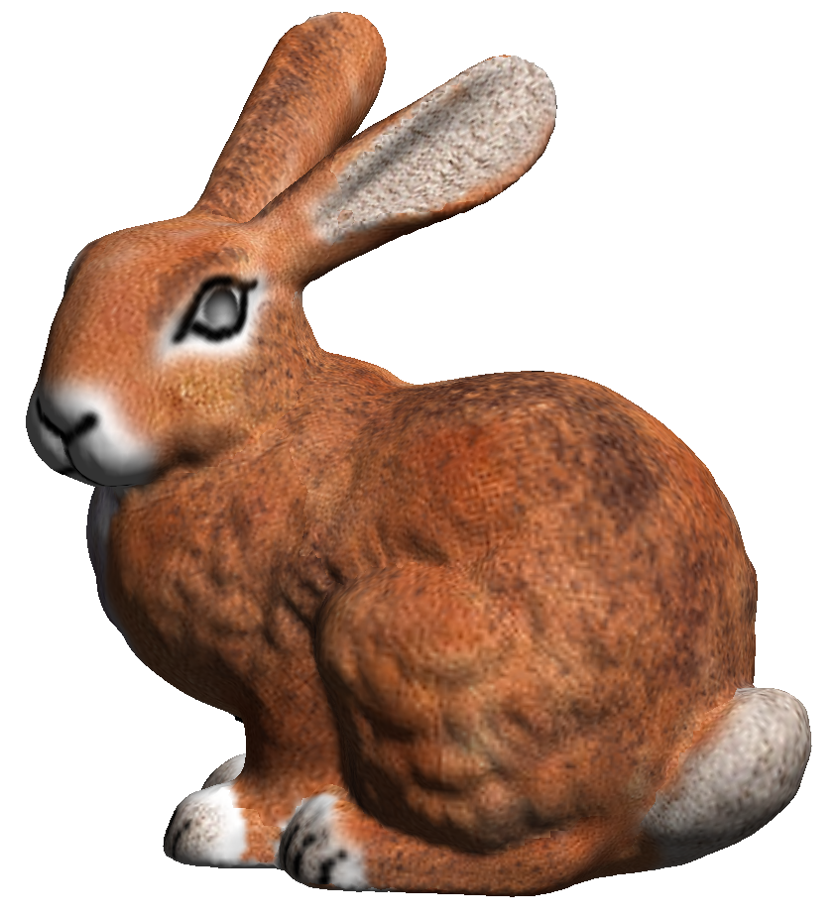
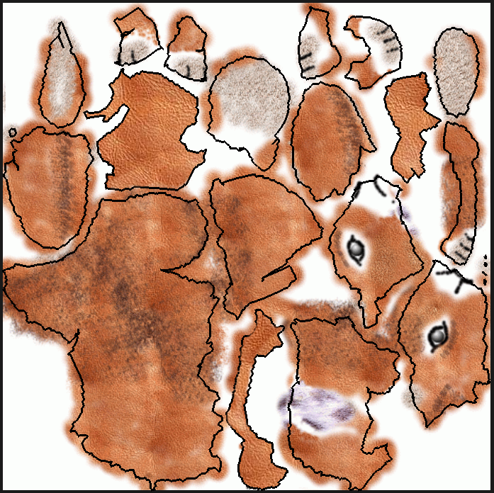
Parametrization for texture mapping
disk-like patches
texture charts
v
+
=
u
3D mesh
2D texture image
textured bunny

Slide 41
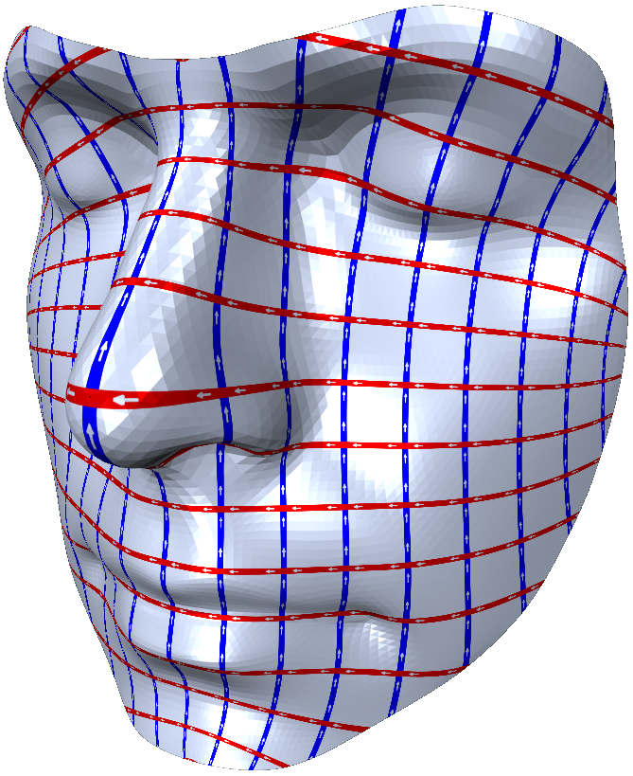
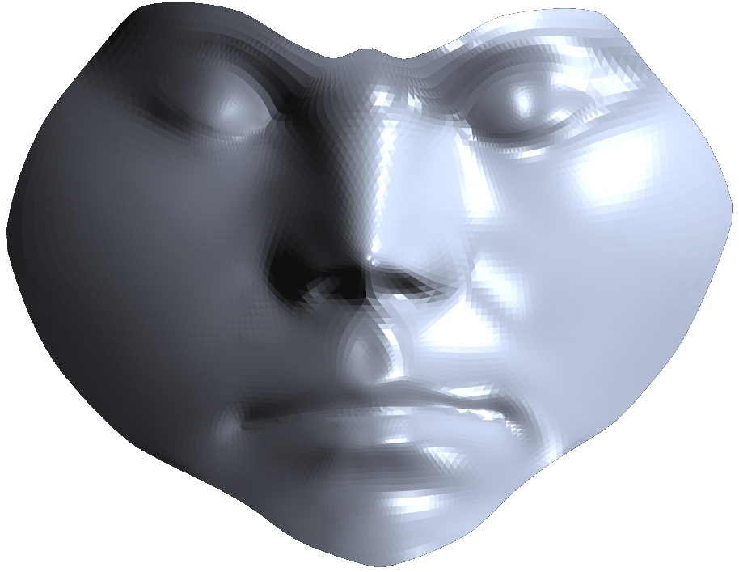
Small digression: Parametrization for remeshing
f
f ⁻¹

Slide 42
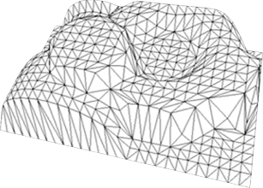
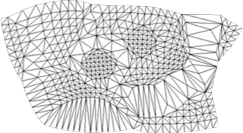
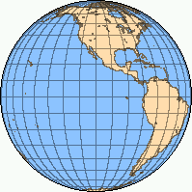
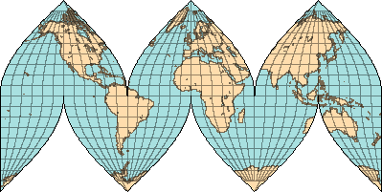
Parametrization: what we need?
A strategy to flatten a 3D surface on 2D domain
  Introducing as few distortion as possible
A strategy to introcuce cuts
3D
2D
3D
2D

Slide 43
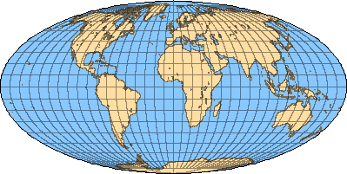
Cuts 1
Clearly needed for closed surfaces
2D surface disk
sphere in 3D

Slide 44
Cuts 2
Usually more cuts -> less distortion
2D surface
sphere in 3D

Slide 45
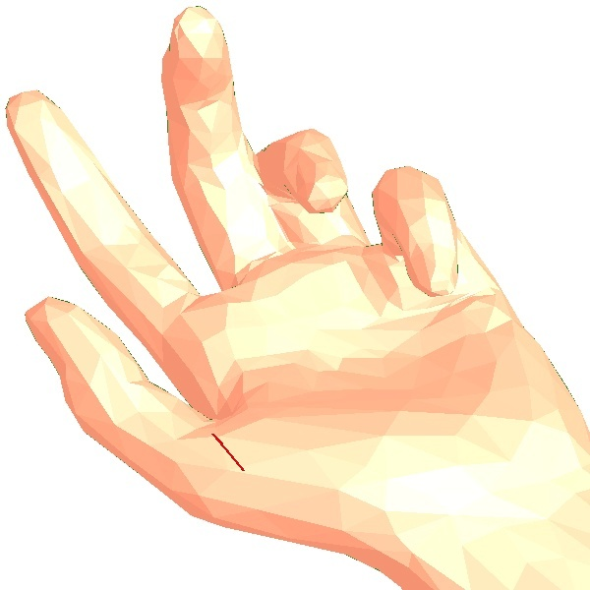
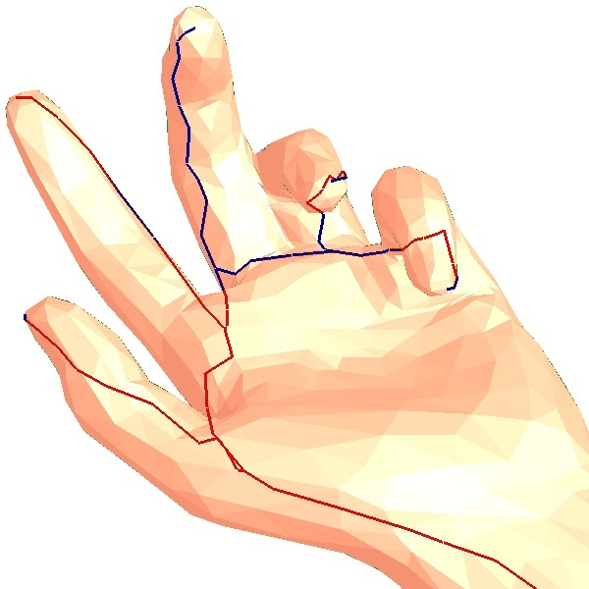
Cuts 3: closed surfaces
How many cuts?
for a genus 0 surface ?
any tree of cuts

Slide 46
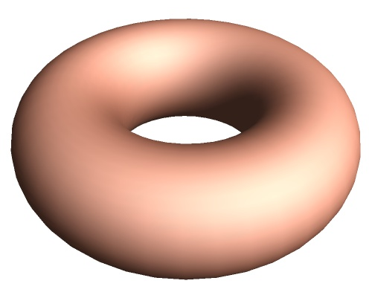
Cuts 3: closed surfaces
How many cuts?
for a genus 1 surface ?
two looped cuts

Slide 47
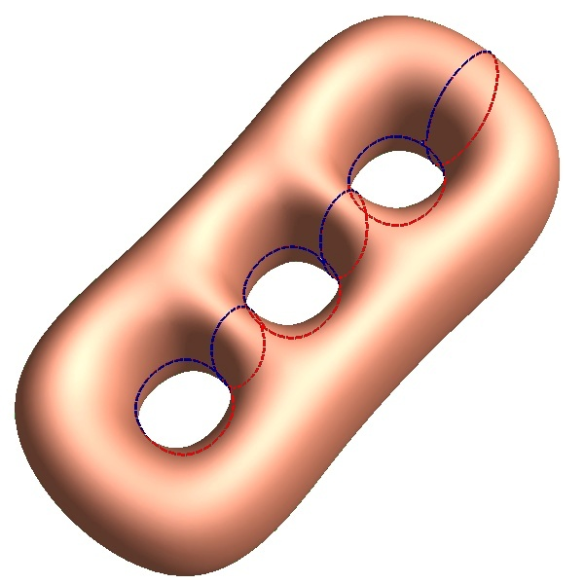
Cuts 3: closed surfaces
How many cuts?
for a genus 3 surface ?
6 looped cuts

Slide 48
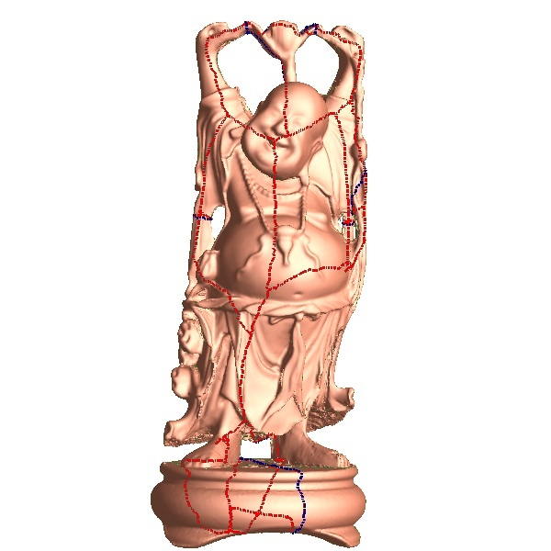
Cuts 3: closed surfaces
How many cuts?
genus 6
for a genus n surface ?
2n looped cuts

Slide 49
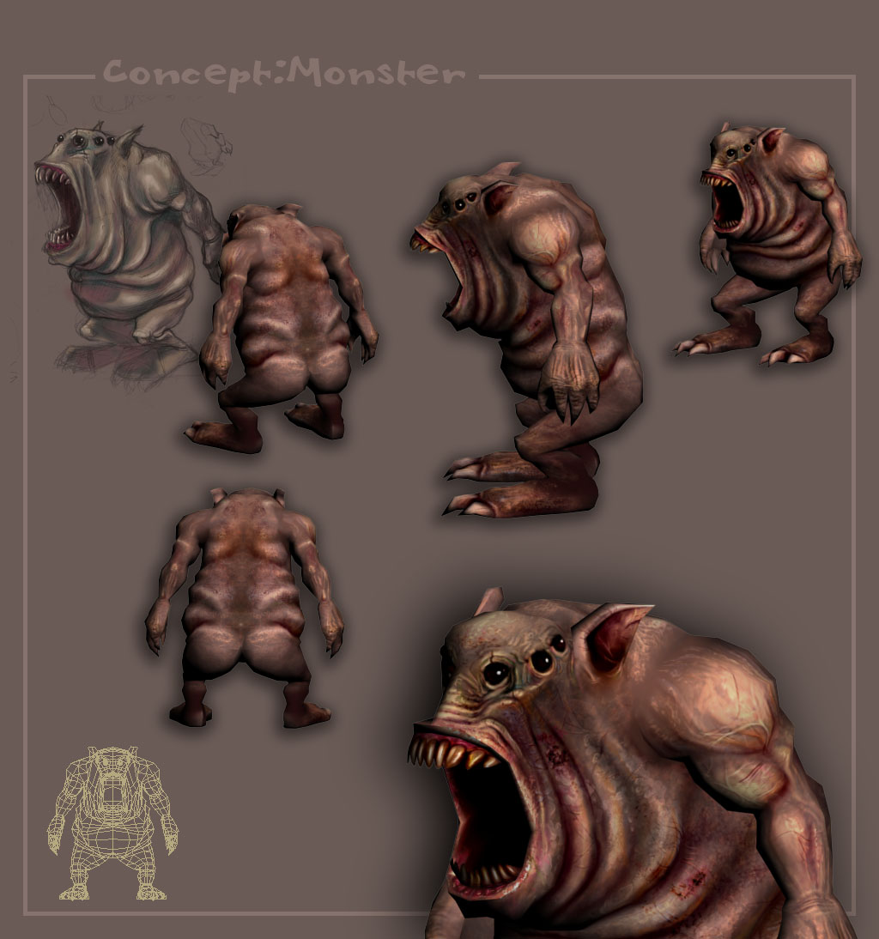
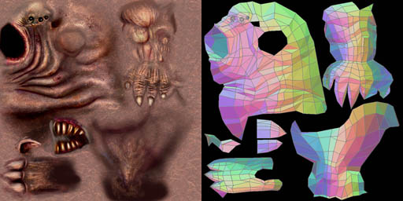
Manual Parametrization
Manual UV mapping
An advanced artistic skill

Slide 50
What is Distortion?
Angle preservation: conformal
Area preservation: equiareal
Area and Angle: Isometric

Slide 51
Distortion
  σ₁ and σ₂ describe local deformations
3D
UV
f
p
1
σ₂
σ₁
1

Slide 52
Isometric Mapping
  σ₁= σ₂=1
  preserves areas, angles and lengths
3D
UV
f
1
1
1
1

Slide 53
Conformal Mapping
  σ₁/ σ₂=1
  preserves angles
3D
UV
f
1
σ₁
σ₁
1

Slide 54
Equiareal Mapping
  σ₁⋅ σ₂=1
  preserves areas
3D
UV
f
1
1/σ₁
σ₁
1

Slide 55
Texture coordinates: Per Vertex
Compact representation
vert | X | Y | Z | U | V
V1 | x1 | y1 | z1 | u1 | v1
V2 | x2 | y2 | z2 | u2 | v2
V3 | x3 | y3 | z3 | u3 | v3
V4 | x4 | y4 | z4 | u4 | v4
V5 | x5 | y5 | z5 | u5 | v5
V1
V2
T1
V3
T3
T2
V4
V5
Tri: | Wedge 1: | Wedge 2: | Wedge 3:
T1 | V4 | V1 | V2
T2 | V4 | V2 | V5
T3 | V5 | V2 | V3

Slide 56


Texture coordinates: Per Vertex
How to handle seams?

Slide 57
Texture coordinates: Per Wedge
Per Wedge = per triangle per vertex
V1
vert | X | Y | Z
V1 | x1 | y1 | z1
V2 | x2 | y2 | z2
V3 | x3 | y3 | z3
V4 | x4 | y4 | z4
V5 | x5 | y5 | z5
V2
T1
V3
T3
T2
V4
V5
Tri: | Wedge 1: | u | v | Wedge 2: | u | v | Wedge 3: | u | v
T1 | V4 | u(T1,V4) | v(T1,V4) | V1 | u(T1,V1) | v(T1,V1) | V2 | u(T1,V2) | v(T1,V2)
T2 | V4 | u(T2,V4) | v(T2,V4) | V2 | u(T2,V2) | v(T2,V2) | V5 | u(T2,V5) | v(T2,V5)
T3 | V5 | u(T3,V5) | v(T3,V5) | V2 | u(T3,V2) | v(T3,V2) | V3 | u(T3,V3) | v(T3,V3)

Slide 58

Tileable Textures
B
A
A
B

Slide 59

Tileable textures

Slide 60

Tileable textures
Typical use
Very efficient in space

Slide 61
Signals typically stored in textures (in games)
Each texel a base-color (components: R-G-B)
  Texture is a “diffuse-map” / “color-map” / “RGB-map”
Each texel a transparency factor (components: α)
  Texture is an “alpha-map” o “cutout-texture”
Each texel contains a dist. From surface value
  Texture is a “bump-map” o “height-texture”
Each texel a normal (components: X-Y-Z)
  Texture is a “normal-map”

Slide 62

Cutout textures texels = alpha (transp. lvl)
Alpha map
RGB map

Slide 63



Cutout textures texels = alpha (transp. lvl)
  e.g.: drapes, beard...
texture

Slide 64




Cutout textures texels = alpha (transp. lvl)
  e.g.: trees, foliage

Slide 65



Texture mapping and Alpha Test
Eg: fur, fur coats
(repeated)
texture

Slide 66
Bump maps or Normal Map
Bump Map
    Details encoded by storing the differences between low-res and hi-freq
    As scalars (distance along the normal)
    Used for re-tessellation, or for parallax mapping
Normal Map:
    Details encoded by storing the normals of the hi-freq surface
    Modifying the lighting

Slide 67


Bump Map
Store the Distances of the detailed surfaces
from the low-poly mesh
  example -- a bump-map for a screw-head :
head
of the
screw
Detailed surfaces
(I would like to model)
0.2
0.6
0.4
low-poly mesh
(approximation of ^) (here: flat ☹ )
displacement map
(scalar)
0
0
0
0
0
0
0
.1
.5
.6
.6
.7
.5
.4
.2
0
0
0
0
0
0
0

Slide 68
Bump Map
Bump Mapped
Color Only

Slide 69
Normal Map
Store Vectors from the low-poly mesh
to the detailed surfaces
“subsquare”!
Not an height field
Detailed Lighting
(I would like to model)
low-poly mesh (here: flat ☹ )
Normal map
(vectorial)

Slide 70




Normal Map
+
=
Low-poly mesh
(uv-mapped!)
Normal Map
lots of cheap
geometric detail
(apparently)

Slide 71

Normal Map
Same geometry (a sphere)
Different Normal-Maps

Slide 72

Solid Textures

Slide 73

Solid Textures
Volumetric voxellized Texture: 3D array of texels
1 texel == 1 voxel
  E.g. each voxel one color RGB → solid RGB textures
As all the textures:
  In video RAM
  Fast access during rendering
Model color onto volume
  surface + internal
  useful, e.g., for fractures
Note: no need of UV-mapping!
  Texture indexed by geometric mesh (rescaled)
Problem: ram space
  Cubic wrt the resolution

Slide 74
Recap: Texture mapping
+
=
3D geometry
(set of quadrilaterals )
RGB texture 2D
(here: color-map)

Slide 75
Recap: Life of a Texture in a Game Engine
DISK
CENTRAL RAM
GPU RAM
IMPORT
LOAD
Image
File
Image
Object
TextureSheet
on GPU

Slide 76
Recap: Parametrization for texture mapping
disk-like patches
texture charts
v
+
=
u
3D mesh
2D texture image
textured bunny

Slide 77
Recap: Texture coordinates: Per Vertex
Compact representation
vert | X | Y | Z | U | V
V1 | x1 | y1 | z1 | u1 | v1
V2 | x2 | y2 | z2 | u2 | v2
V3 | x3 | y3 | z3 | u3 | v3
V4 | x4 | y4 | z4 | u4 | v4
V5 | x5 | y5 | z5 | u5 | v5
V1
V2
T1
V3
T3
T2
V4
V5
Tri: | Wedge 1: | Wedge 2: | Wedge 3:
T1 | V4 | V1 | V2
T2 | V4 | V2 | V5
T3 | V5 | V2 | V3

Slide 78
Recap: Texture coordinates: Per Wedge
Per Wedge = per triangle per vertex
V1
vert | X | Y | Z
V1 | x1 | y1 | z1
V2 | x2 | y2 | z2
V3 | x3 | y3 | z3
V4 | x4 | y4 | z4
V5 | x5 | y5 | z5
V2
T1
V3
T3
T2
V4
V5
Tri: | Wedge 1: | u | v | Wedge 2: | u | v | Wedge 3: | u | v
T1 | V4 | u(T1,V4) | v(T1,V4) | V1 | u(T1,V1) | v(T1,V1) | V2 | u(T1,V2) | v(T1,V2)
T2 | V4 | u(T2,V4) | v(T2,V4) | V2 | u(T2,V2) | v(T2,V2) | V5 | u(T2,V5) | v(T2,V5)
T3 | V5 | u(T3,V5) | v(T3,V5) | V2 | u(T3,V2) | v(T3,V2) | V3 | u(T3,V3) | v(T3,V3)

Slide 79
Recap: Tileable textures

Slide 80
Recap:Cutout textures texels
  e.g.: drapes, beard...
texture

Slide 81
Recap: Bump Map
Bump Mapped
Color Only

Slide 82
Recap: Normal Map
+
=
Low-poly mesh
(uv-mapped!)
Normal Map
lots of cheap
geometric detail
(apparently)

Slide 83
Computer Graphics
Textures
University of Technology Sydney
Teacher: Nico Pietroni

