Slide 1
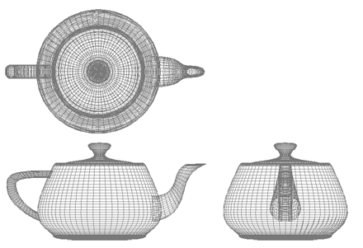

Computer Graphics
Shaders
University of Technology Sydney
Teacher: Nico Pietroni

Slide 2
Recap: CPU vs GPU
CPU
GPU
CONTROL
ALU
ALU
ALU
ALU
CHACHE
Transistors:
<20% ALU
>80% control
→ More flexibility
Transistors:
~90% ALU
~10% control
→ More power!
1.4 G transistors → 1 TeraFLOP

Slide 3
Recap: Transform Stage: summary
In principle, there are four transformation matrices:
y
v0
T_{m} modeling matrix
T_{v} view matrix
T_{p} projection matrix
T_{vp} viewport matrix
v1
z
v0
v1
v2
x
object Coordinates
v2
screen Space
Tv
Tvp
y
y
1
v1
v1
v
v0
Tm
Tp
v0
-1
v1
v2
v1
v2
-z
-n
z
v2
x
v0
v0
x
1
v2
u
view Coordinates
(a.k.a. eye Coordinates)
-1
clip
Coordinates
world Coordinates

Slide 4
Recap: Rasterization-Based HW-Supported Rendering:some rules
Each vertex is transformed
  Projected from 3D space (object space)
  to 2D space (screen space)
  Independently from other vertices
    (must be done in parallel!)
  Independently of the primitive it belongs to
Each primitive is rasterized in 2D
  primitive = triangle, segment, point
    There is a distinct rasterizer for each type of primitive
  independently from the other primitives
  To rasterize = to produce corresponding fragments
Each fragment in position [X,Y] is processed
  independently from the other fragments
  independently from the primitive that has generated it
  Output of computation: a pixel of the screen buffer (RGB)
    At position [X,Y] (preset from rasterization, computation decides just RGB)
in parallel
(in pipeline)

Slide 5
Recap: Rasterization based on bounding box
Compute Bounding Box
  Round to integer...
  ...divisible by N (e.g. 2)
Process each NxN (e.g. 2x2) block
  Test each fragment in block
  If inside triangle then produce fragment

Slide 6

Recap: Back-face Culling
We can early discard all back-facing faces of a closed and opaque surface:
  just check face normal against view direction

Slide 7
Recap: occlusion Z-buffer algorithm: properties
rendering is “order independent” ☺!!!
it works in all cases ☺
  even on:
per fragment operation
suitable to HW implementation ☺
5 | 5 | 5 | 5 | 5 | 5 | 5 | 63
5 | 5 | 5 | 5 | 5 | 5 | 63 | 63
5 | 5 | 5 | 5 | 5 | 63 | 63 | 63
5 | 5 | 5 | 5 | 63 | 63 | 63 | 63
4 | 5 | 5 | 7 | 63 | 63 | 63 | 63
3 | 4 | 5 | 6 | 7 | 63 | 63 | 63
2 | 3 | 4 | 5 | 6 | 7 | 63 | 63
63 | 63 | 63 | 63 | 63 | 63 | 63 | 63

Slide 8
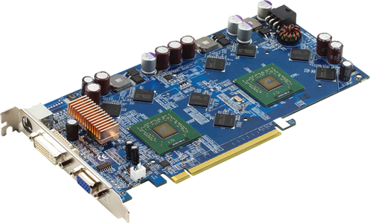
Transform: where we apply them
Projected
vertices
(points in R²)
Final
pixels
(screen-buffer)
computaions
per vertex
set-up
rasterizer
fragments
(potential pixels)
Vertices
(points in R³)
Computations
per fragment
y
PROGRAMMABLE!
v0
v1
v1
v0
z
v2
x
v2

Slide 9
Transform: where we apply them
Projected
vertices
(points in R²)
Final
pixels
(screen-buffer)
computaions
per vertex
set-up
rasterizer
fragments
(potential pixels)
Vertices
(points in R³)
Computations
per fragment
Short program per vertex
Short program per fragment
y
v0
v1
v1
v0
z
v2
x
v2

Slide 10
Transform: where we apply them
Projected
vertices
(points in R²)
Final
pixels
(screen-buffer)
computaions
per vertex
set-up
rasterizer
fragments
(potential pixels)
Vertices
(points in R³)
Computations
per fragment
Short program per vertex
Short program per fragment
y
v0
v1
v1
v0
RUN IN PARALLEL Per-Vertex/ Per-Pixel
z
v2
x
v2

Slide 11
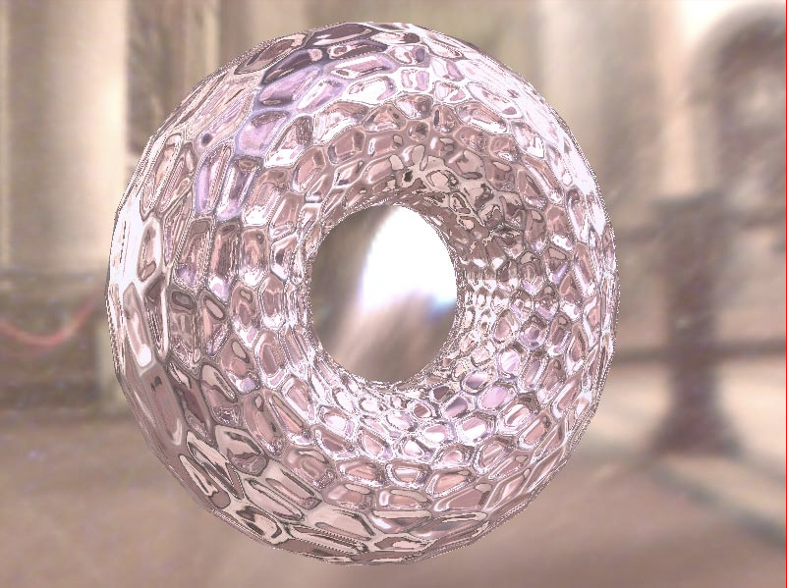


Shader Gallery

Slide 12
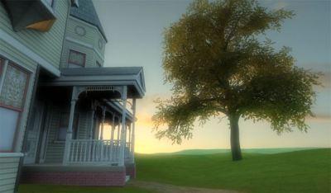
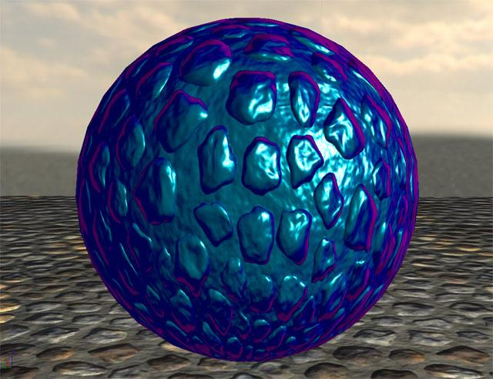
Shader Gallery

Slide 13
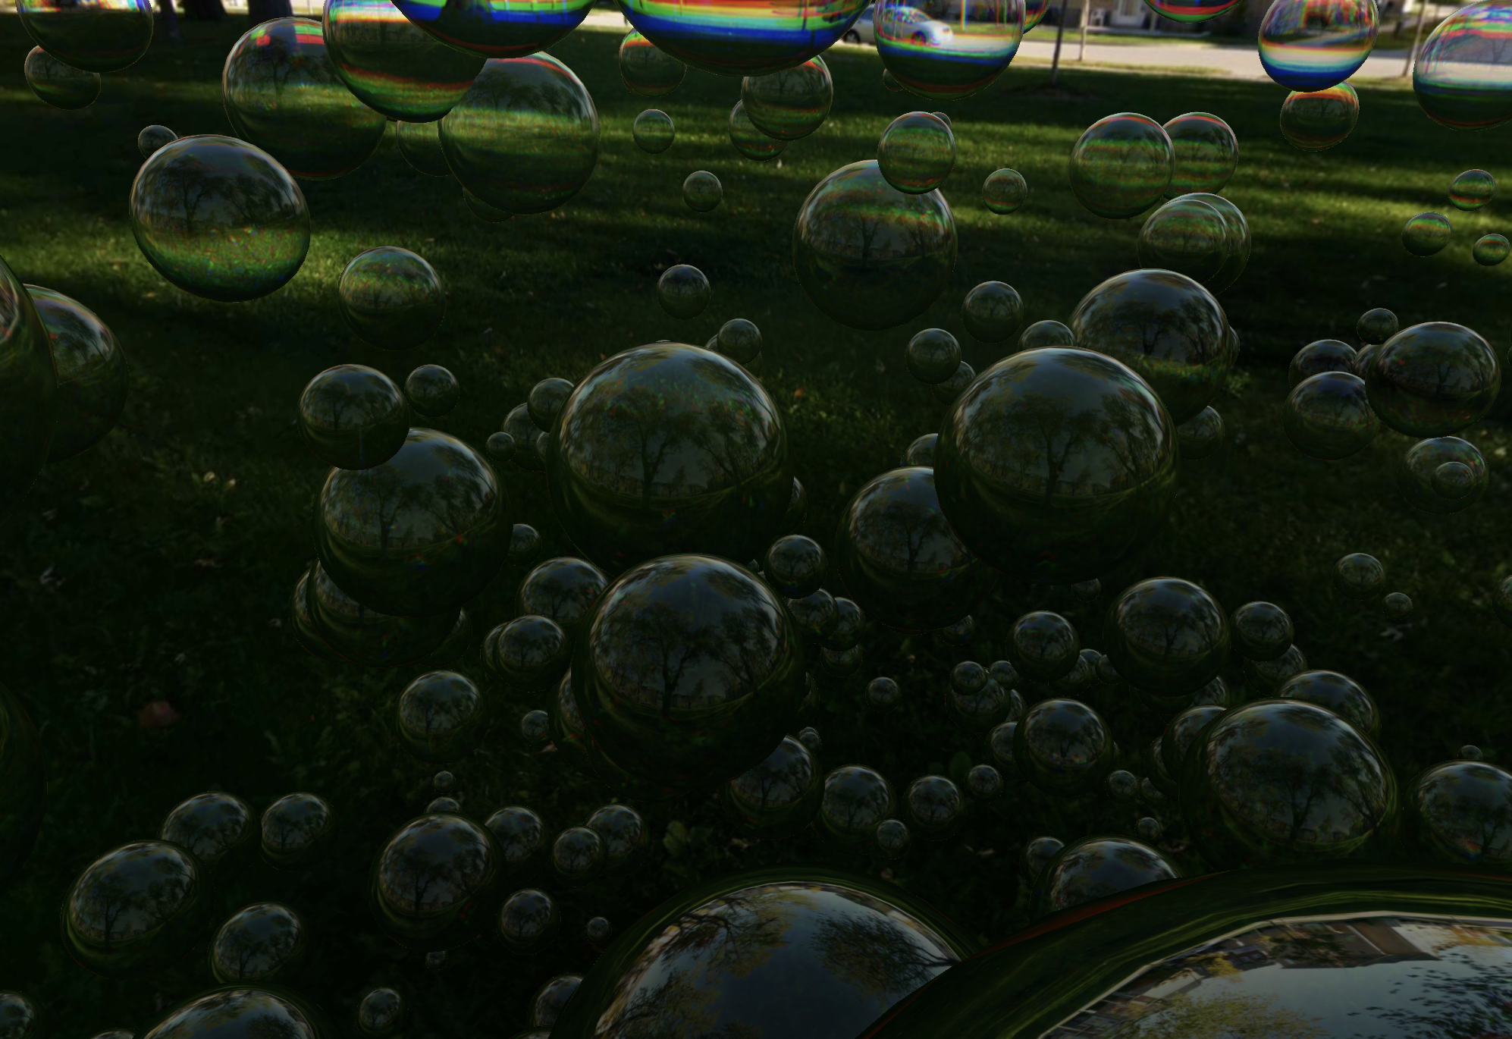
Shader Gallery : Demo Three.js

Slide 14
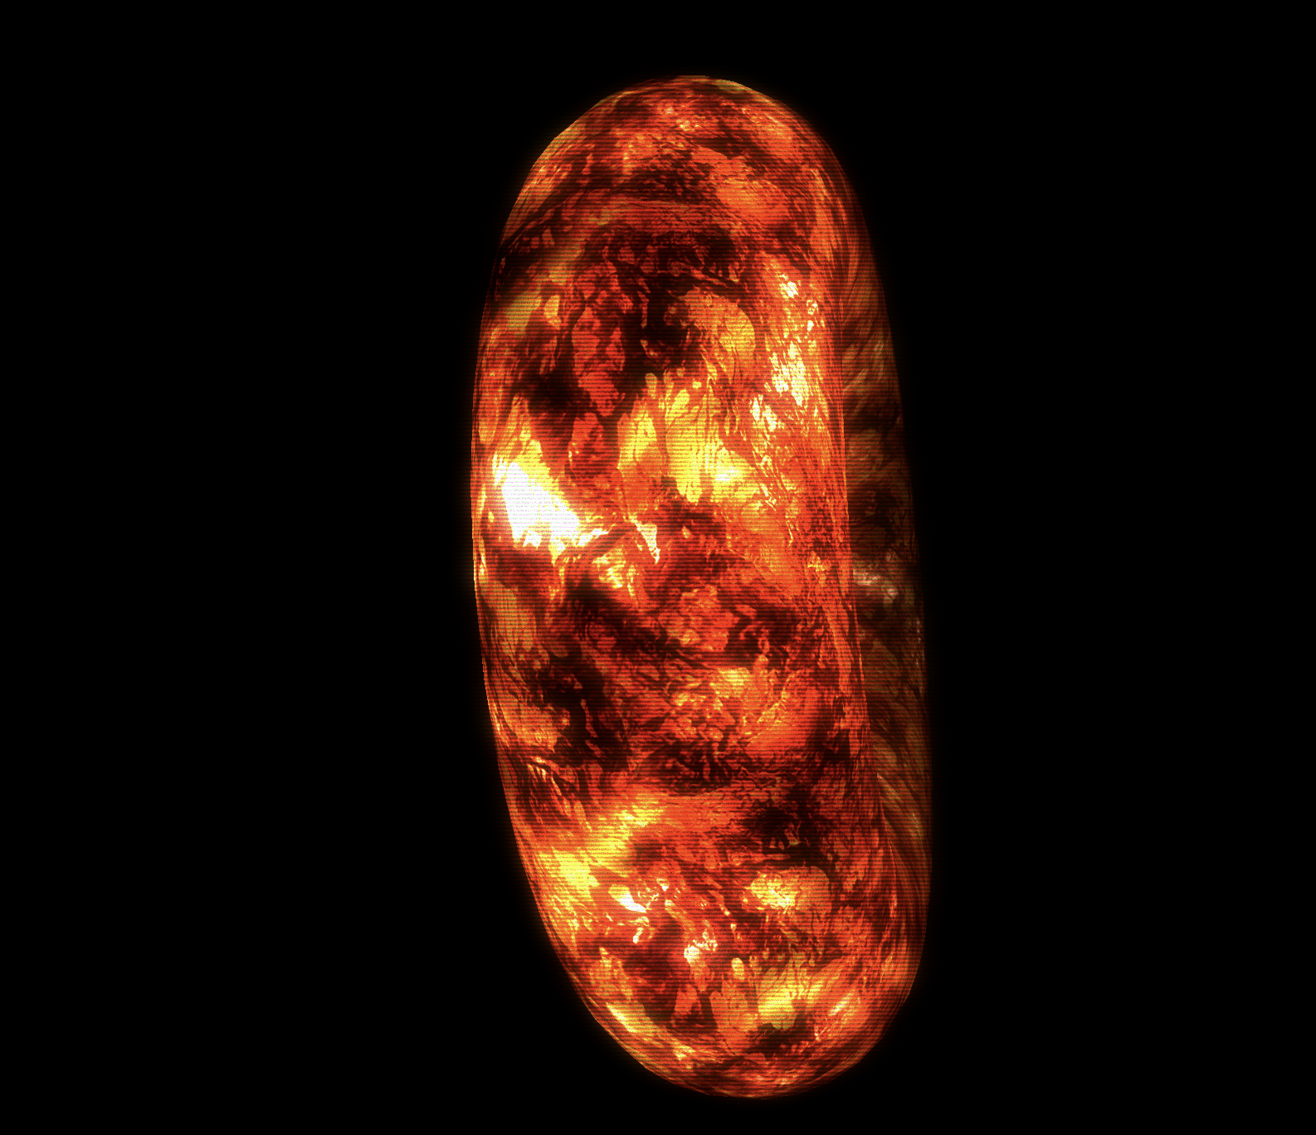
Shader Gallery : Demo Three.js

Slide 15
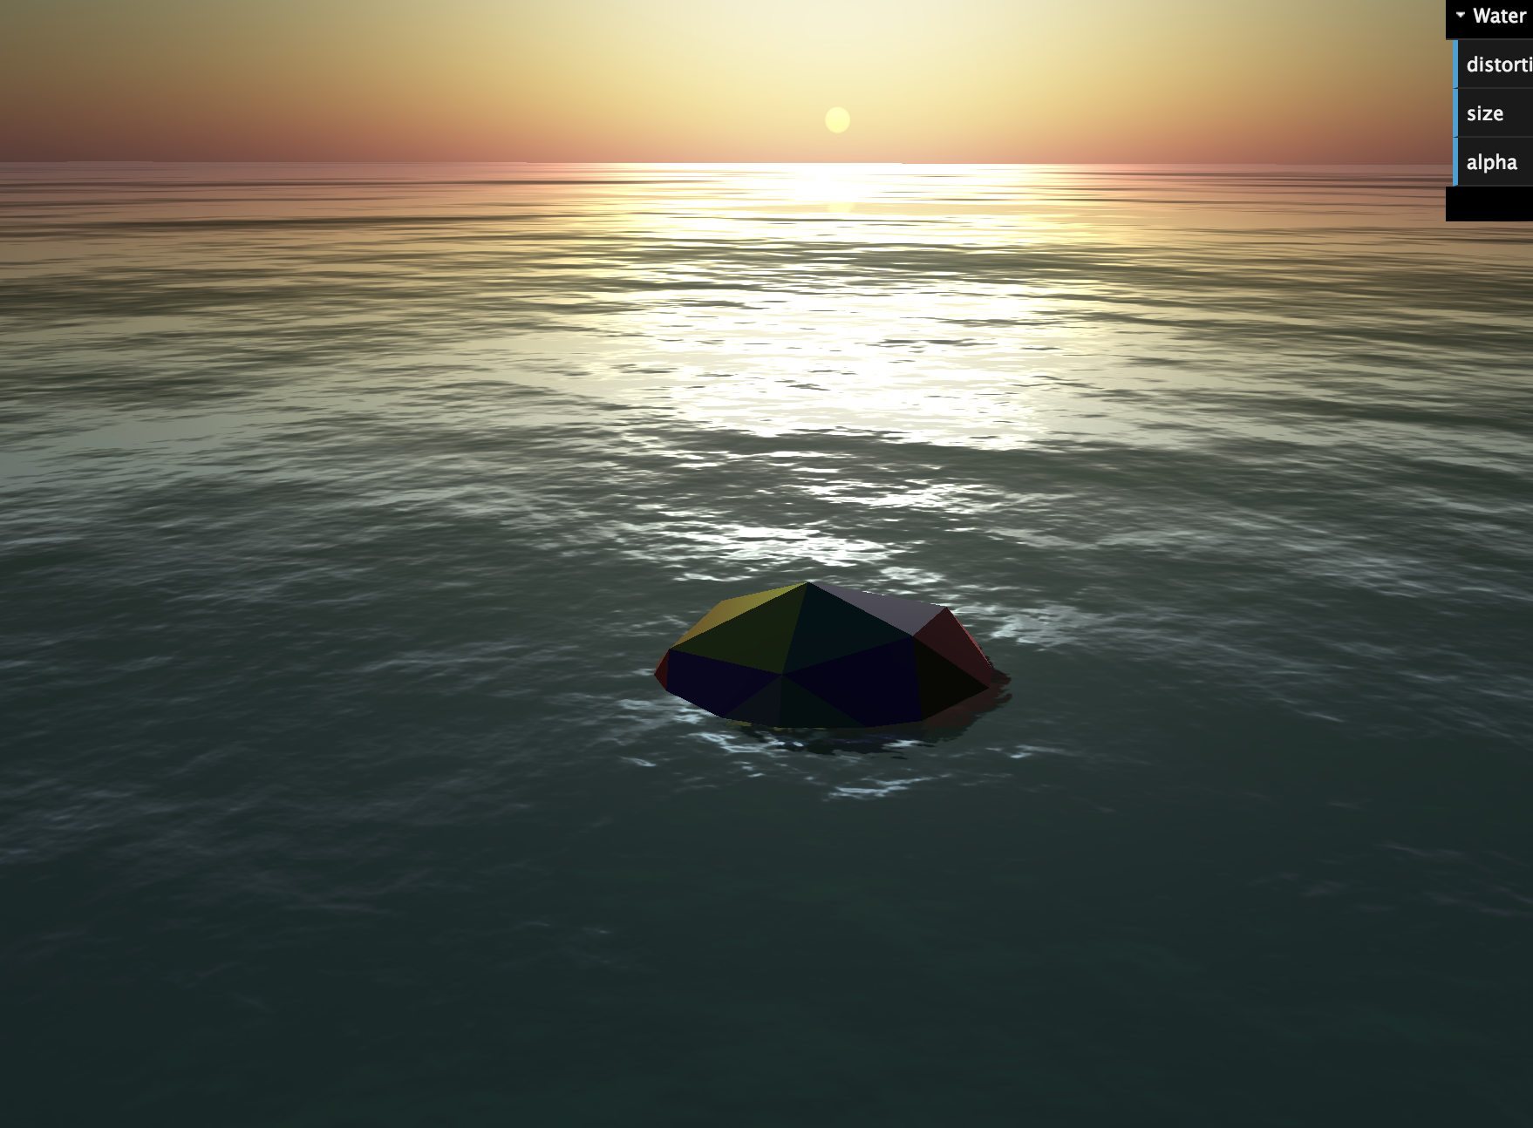
Shader Gallery : Demo Three.js

Slide 16
GLSL
Similar to C
  functions
    Including the main
    Many predefined functions
    Parameters are passed by value (no pointers!)
  variables
    There are some "built-in” variables
  Flow control:
    For loops: use wisely, the compiler transform it by loop unrolling!
    NO While
    (if): preferable using conditional assignments x = (...)?a:b;
  Precompile directives
    #define, #if #else #endif #elif, …)

Slide 17
GLSL
Basic Types:
  Scalars:
    float, int, bool
  Vectors:
    vec2, vec3, vec4 (float)
    ivec2, ivec3, ivec4 (integers)
    bvec2, bvec3, bvec4 (booleans)
  Matrices:
    mat2, mat3, mat4
  Samplers: To access to textures
  Array:
    vec4 points[10];

Slide 18
Minimal shaders
Minimal vertex shader:
  “simply pass down the vertices”
Minimal fragment shader:
  “give the same color to all fragments”

Slide 19
Minimal Vertex Shader
Projected
vertices
(points in R²)
Final
pixels
(screen-buffer)
computaions
per vertex
set-up
rasterizer
fragments
(potential pixels)
Vertices
(points in R³)
Computations
per fragment
void main(void)
{
vec3 p = position;
vec4 modelViewPosition= modelViewMatrix * vec4(p,1.0); gl_Position=projectionMatrix * modelViewPosition;
}
GLSL
Built-In:
Vertex Pos
Built-In:
ModelView
Built-In:
Projection

Slide 20
Recap: pipeline maths detail
In principle, there are four transformation matrices:
y
v0
T_{m} modeling matrix
T_{v} view matrix
T_{p} projection matrix
T_{vp} viewport matrix
v1
z
v0
v1
v2
x
object Coordinates
v2
screen Space
Tm
Tvp
y
y
1
v1
v1
v
v0
Tv
Tp
v0
-1
-u
v1
v2
v1
v2
-z
-n
z
v2
x
v0
v0
x
v2
view Coordinates
(a.k.a. eye Coordinates)
-1
clip
coordinates
world Coordinates

Slide 21
Transform: where we apply them
Projected
vertices
(points in R²)
Final
pixels
(screen-buffer)
computaions
per vertex
set-up
rasterizer
fragments
(potential pixels)
Vertices
(points in R³)
Computations
per fragment
T_{m}, T_{v} & T_{p}
T_{vp}
y
v0
v1
v1
v0
z
v2
x
v2

Slide 22
Minimal Vertex Shader
Projected
vertices
(points in R²)
Final
pixels
(screen-buffer)
computaions
per vertex
set-up
rasterizer
fragments
(potential pixels)
Vertices
(points in R³)
Computations
per fragment
void main(void)
{
vec3 p = position;
vec4 modelViewPosition= modelViewMatrix * vec4(p,1.0); gl_Position=projectionMatrix * modelViewPosition;
}
GLSL
Return: the final position of the vertex

Slide 23
Affine Transformations
They can all be expressed as
multiplications by a matrix
always
Homogeneous coords
of starting point
Homogeneous coords
of target point

Slide 24
Representation in homogenoeus coordinates
Points:
Vectors:
1
0

Slide 25
Reminder: product Matrix – Vector
“row x column”
i.e. dot products
with row vectors
A
·
B
·
A
B
·
=
C
C
·
D
D
·

Slide 26
Minimal Fragment Shader
Projected
vertices
(points in R²)
Final
pixels
(screen-buffer)
computaions
per vertex
set-up
rasterizer
fragments
(potential pixels)
Vertices
(points in R³)
Computations
per fragment
void main(void)
{
gl_FragColor = vec4(1.0, 0.0, 0.0, 1.0);
}
GLSL
Return: the final pixel color

Slide 27
GLSL Basic Operations
A vector with 3 coordinates x,y,z,
used to store both points and vectors
Base types:
operations:
vec3
float
A scalar
vec3 a , b ;
float k;
vec3 c = a + b; // sum of vectors
vec3 d = a * b; // product comp. x comp.
vec3 e = k * a; // product vector x scalar
float f = dot( a, b ); // dot product
vec3 g = cross( a , b ); // cross product

Slide 28
Remind: Affine space: Operations
Sum (point , vector ) → point
Subtraction (point , point) → vector
point
( a + v )
vector
v
point
a
point
b
remember:
“tip minus tail”
of the arrow
vector
(b – a )
point
a

Slide 29
Remind: point + vector = translation
Offset vector
y
y
x
x

Slide 30
Remind: Multiply vector scalar : uniform scaling
y
y
x
x

Slide 31
Remind: Dot Product
Two vectors and of unitary length
Dot product measure the angle between them
Dot =1
Dot > 0
Dot = 0
Dot < 0
Dot = -1

Slide 32
Remind: Cross Product
Cross Product of 2 vectors is a vector!
How to compute:
  C_{x} = a_{y}b_{z} − a_{z}b_{y}
  C_{y} = a_{z}b_{x} − a_{x}b_{z}
  C_{z} = a_{x}b_{y} − a_{y}b_{x}
Length : |a| |b| sin(θ)
  Depends of the length of the two vectors and the sing of the angle

Slide 33
GLSL Basic Operations
A vector with 3 coordinates x,y,z,
used to store both points and vectors
Base types:
operations:
vec3
float
A scalar
vec3 a , b ;
float k;
float c = length( a ) ; // Norm of a vector
vec3 d = normalize( a ); // Make the vector length = 1

Slide 34
GLSL: parameters
attribute vec3 baseColor;
uniform float delta;
varying vec3 color;
attribute:Global variables that may change per vertex, that are passed from the OpenGL application to vertex shaders. This qualifier can only be used in vertex shaders. For the shader this is a read-only variable.
uniform:Global variables that may change per primitive, that are passed from the OpenGL application to the shaders. This qualifier can be used in both vertex and fragment shaders. For the shaders this is a read-only variable.
varying:used for interpolated data between a vertex shader and a fragment shader. Available for writing in the vertex shader, and read-only in a fragment shader.

Slide 35
Varying interpolation
attribute vec3 baseColor;
varying vec3 color;
void main(void) {
gl_Position = gl_ModelViewProjectionMatrix * gl_Vertex;
color = baseColor ;
}
VERTEX
Shader
L
I
N
K
varying vec3 color;
void main(void) {
gl_FragColor = vec4( color , 1.0);
}
FRAGMENT Shader

Slide 36
Linking vertex and fragment shader
Vertex Shader:
  input:
    attributes
  output:
    varyings
    gl_Position (vec4)
Fragment Shader:
  input:
    varyings
  output:
    gl_FragColor (vec4)
    gl_Depth (float)
    (optional)
LINK

Slide 37
Attributes in the pipeline: terminology
set-up
point
rasterizer
Z
1 Projected
vertex
(points in R²)
Final
pixels
(screen-buffer)
set-up
triangle
rasterizer
fragments
(potential pixels)
computaions
per vertex
Computations
per fragment
1 Vertex
(points in R³)
set-up
segment
rasterizer
Here we can make computations on attributes, generating
varying
For each fragment
we have values
interpolating
the varyings
computed per vertex
We associate
Attributes
to vertices
e.g.: RGB color
Here varyings
are
interpolated

Slide 38
Interpolation, extrapolation
Given a vector space A with elements a,b,c…
  i.e.: on a,b,c… we have the following operations:
    product with real numbers
    sum between elements of A
    With the usual properties (associativity, etc.)
Then: means:
  d = k₀ a + k₁ b + k₂ c “d is a linear combination of a,b,c (with weights k₀ k₁ k₂ )”
  if k₀ + k₁ + k₂ = 1 “d is an interpolation of and k₀ , k₁ , k₂ >= 0 a,b,c (with weights k₀ k₁ k₂ )”
  if k₀ + k₁ + k₂ = 1 “d is an extrapolation of with at least one <0 a,b,c (with weights k₀ k₁ k₂ )”

Slide 39
Interpolation within a line
V₂
V₁
with
or
or

Slide 40
Interpolation within a line
0.0 v₁ + 1 v₂
0.1 v₁ + 0.9 v₂
0.66 v₁ + 0.33 v₂
0.5 v₁ + 0.5 v₂
≪ x is an
Interpolation
of v1 and v2 ≫
0.75 v₁ + 0.25 v₂
V₂
A line segment with endpoints v₁
and v₂ is the locus of points x
that satisfy
x = a v₁ + b v₂
for some scalars
a and b positive with a + b = 1
V₁
1 v₁ + 0 v₂

Slide 41
Interpolation within a triangle
V₃
V₂
V₁
with
or
or
Locus of points x such that... ≫

Slide 42
Interpolation within a triangle
V₃
V₂
A triangle with vertices v₁ v₂ v₃
is the locus of points x
satisfying
x = a₁ v₁ + a₂ v₂ + a₃ v₃
for some
non negative a₁ a₂ a₃ scalars
s.t. a₁ + a₂ + a₃ = 1
V₁

Slide 43
For instance
0 v₁ + 0 v₂ + 1 v₃
0.33 v₁ + 0.33 v₂ + 0.33 v₃
(center of mass)
0 v₁ + 1 v₂ + 0 v₃
V₃
0.5 v₁ + 0.5 v₂ + 0 v₃
(midpoint of edge v₁ v₂)
0.65 v₁ + 0.2 v₂ + 0.15 v₃
V₂
V₁

Slide 44
Therefore...
V₃
V₂
given a₁ a₂ a₃ positive scalars
with a₁ + a₂ + a₃ = 1
→
x = a₁ v₁ + a₂ v₂ + a₃ v₃
is a point of the triangle
V₁

Slide 45
… and vice-versa…
V₃
V₂
Given point p inside triangle
→
there exist unique a₁ a₂ a₃ s.t.
p = a₁ v₁ + a₂ v₂ + a₃ v₃
and a₁ a₂ a₃ are all positive and sum 1
V₁
a₁ a₂ a₃ are the baricentric coordinates of p wrt triangle

Slide 46
Barycentric coordinates
V₃
p
V₂
V₁
p has barycentric coordinates
(a₁ a₂ a₃) if and only if
p = a₁ v₁ + a₂ v₂ + a₃ v₃

Slide 47
Attribute interpolation
Attributes inside fragments are interpolated:
  from attributes at vertices
  using barycentric coordinates of the fragment as weights

Slide 48

Baricentric coordinates Physical interpretation
p has baricentric coordinates
(a₁ a₂ a₃) iff
it is the baricenter of:
V₃
p
V₂
V₁
a₃ Kg
a₂ Kg
a₁ Kg

Slide 49
Attributes in rasterization
Two tasks of rasterizer:
  1 Find fragments composing the primitive
    fragments inside triangle,
    or fragments composing a segment
  2 Interpolate attributes for these fragments
    using barycentric coordinates
The rasterizer produces fragments with associated attributes
  (that interpolate attributes of vertices)

Slide 50
Varying interpolation

Slide 51

Ambient Lighting
void main()
{
vec4 modelViewPosition= modelViewMatrix * vec4(position,1.0);
gl_Position=projectionMatrix * modelViewPosition;
}
VERTEX
Shader
void main (void)
{
float gray = 0.7;
gl_FragColor = vec4(gray,gray,gray, 1.0);
}
Constant light
FRAGMENT Shader

Slide 52
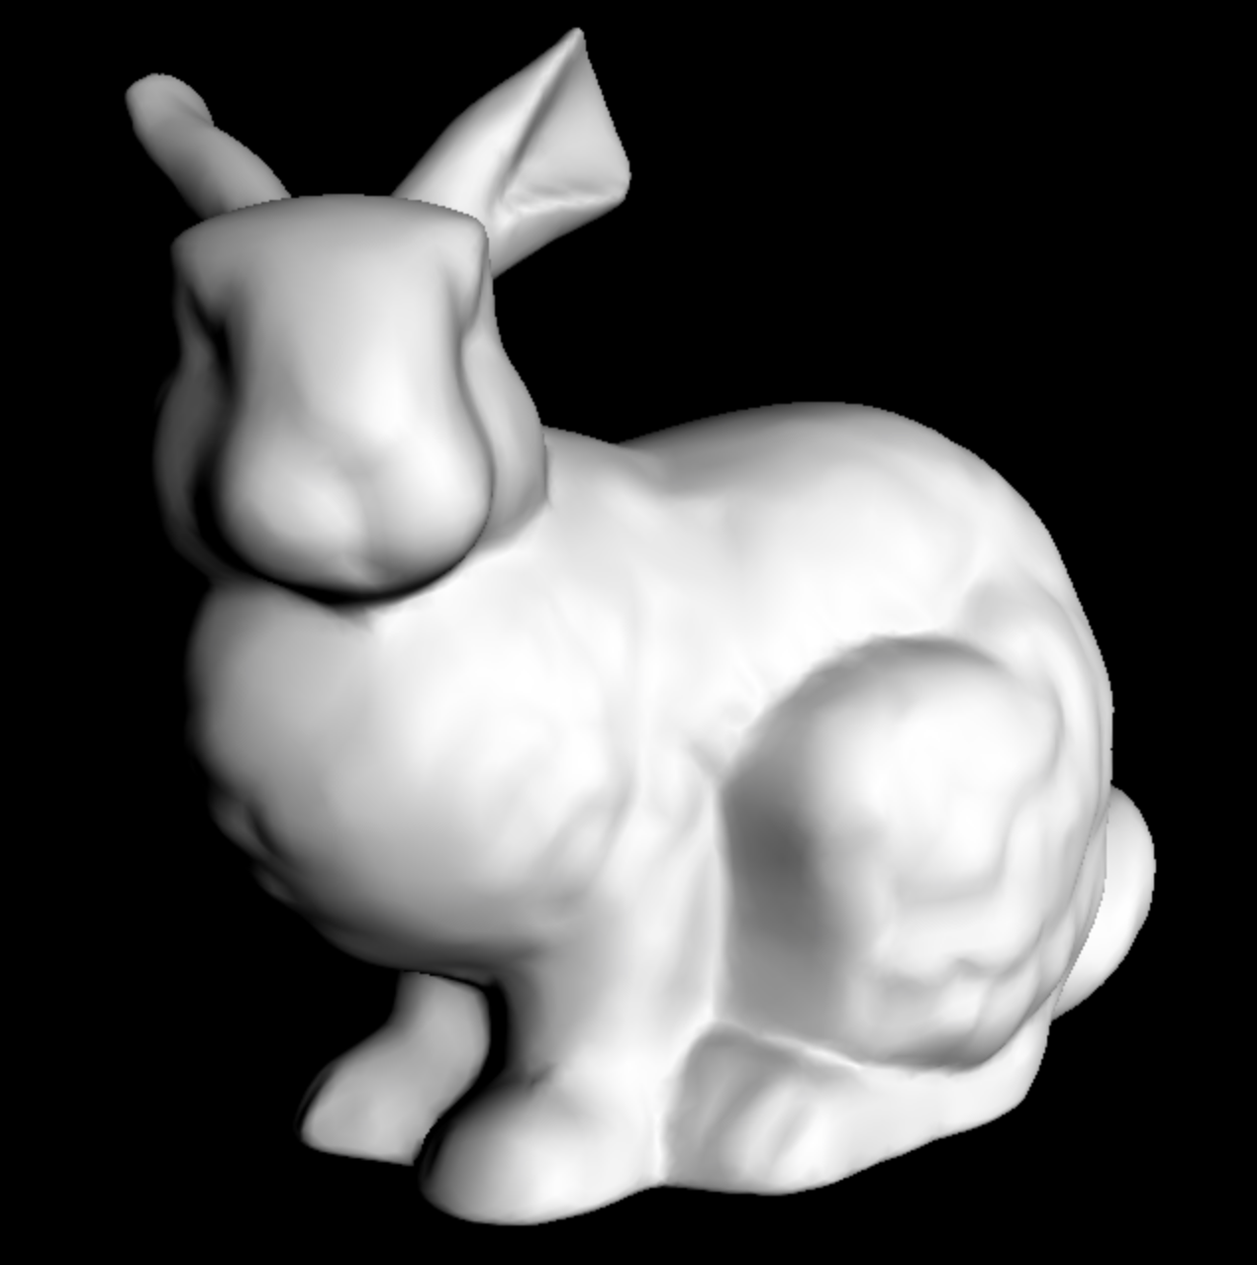
Diffuse Lighting
varying vec3 vNormal;
void main()
{
vNormal = normal;
vec4 modelViewPosition= modelViewMatrix * vec4(position,1.0);
gl_Position=projectionMatrix * modelViewPosition;
}
Interpolate per Fragment Normal
VERTEX
Shader
varying vec3 vNormal;
void main (void)
{
vec3 light = vec3( 0.5, 0.2, 1.0 );
light = normalize( light );
float gray = dot(light,vNormal);
gl_FragColor = vec4(gray,gray,gray, 1.0);
}
Then use to compute lighting
FRAGMENT Shader

Slide 53
What This Shader is Implementing?
varying vec3 vNormal;
void main()
{
vNormal = normal;
vec4 modelViewPosition= modelViewMatrix * vec4(position,1.0);
gl_Position=projectionMatrix * modelViewPosition;
}
Interpolate per Fragment Normal
VERTEX
Shader
varying vec3 vNormal;
void main (void)
{
vec3 light = vec3( 0.5, 0.2, 1.0 );
light = normalize( light );
float gray = dot(light,vNormal);
gl_FragColor = vec4(gray,gray,gray, 1.0);
}
Then use to compute lighting
FRAGMENT Shader

Slide 54
Reminder.. Phong Shading
Idea: instead of interpolating color after lighting, interpolate normal before lighting!
*
Per-fragment Shading
(a.k.a. “Phong shading” )
Bui-Tuong Phong , 1973
*
1- Interpolate normal in the face
2- Re-normalize
3- Apply lighting
*
*
* Warning: do not mistake Phong Shading (a shading)
with Phong Lighting Model (model of illumination)

Slide 55
Phong shading: where?
rasterizer
points
Projected vertices
& varyings
Fragments
& interpolated varyings
Screen
buffer
Vertices
& their attributes
rasterizer triangles
computations
per vertex
computations
per fragment
rasterizer
lines
including:
properties of material
and normal
transform
both
normal
and
position
interpolate
normal
including:
trasformed normal
including: interpolatednormal
re-normalize and apply
lighting
to obtain
fragment color

Slide 56
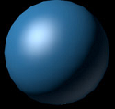
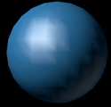

Reminder.. Comparison
Per-vertex Lighting - (a.k.a. "Gouraud Shading")
  less expensive:
    apply lighting once per vertex – usually: #vertices << #fragments
Per-fragment* Lighting – (a.k.a. " Phong Shading“)
  better results
    especially with high shininess
(*) sometimes (with abuse) called: per-pixel lighting
Flat shading
Goraund shading
Phong Shading

Slide 57
Phong Shading
varying vec3 vNormal;
void main()
{
vNormal = normal;
vec4 modelViewPosition= modelViewMatrix * vec4(position,1.0);
gl_Position=projectionMatrix * modelViewPosition;
}
Interpolate per Fragment Normal
VERTEX
Shader
varying vec3 vNormal;
void main (void)
{
vec3 light = vec3( 0.5, 0.2, 1.0 );
light = normalize( light );
float gray = dot(light,vNormal);
gl_FragColor = vec4(gray,gray,gray, 1.0);
}
Then use to compute lighting
FRAGMENT Shader

Slide 58

Other Effects (see example code)

Slide 59
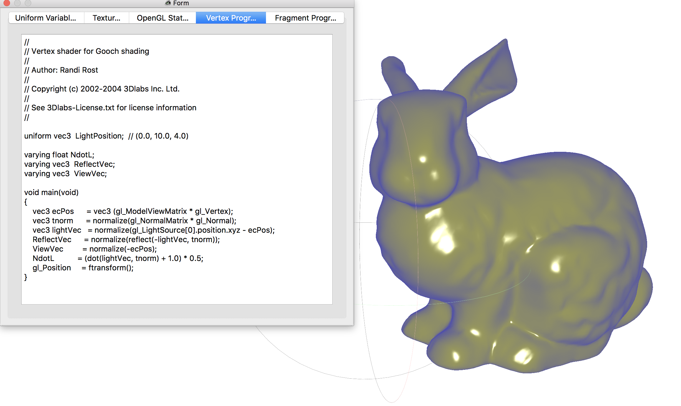
Other Effects (meshlab)

Slide 60
Defining shaders in the HTML
<head>
<script type="x-shader/x-vertex" id="vertexShader">
</script>
<script type="x-shader/x-fragment" id="fragmentShader">
</script>
</head>
...
void main()
{ ...
}
GLSL
...
void main()
{ ...
}
GLSL
HTML5

Slide 61
Using Shaders as mesh’s material
A particular kind of material that use shaders
<script>
var s_material= new THREE.ShaderMaterial();
s_material.vertexShader=document.getElementById( 'vertexShader' ).textContent
s_material.fragmentShader=document.getElementById( 'fragmentShader' ).textContent
mesh = new THREE.Mesh( geometry, s_material );
</script>
JavaScript
Identifiers to the shader programs
From now on when render this mesh will
Use the material with the defined shaders

Slide 62
Setting Attributes (ex:one float per vertex)
Number of vertices of a mesh
Initialize the values
<script>
var numVert=geometry.attributes.position.count;
var vertexDisplacement = new Float32Array(numVert);
var positions = geometry.getAttribute('position');
for (var i=0 ; i< vertexDisplacement.length; i+=1)
{
vertexDisplacement[i]=...;
}
geometry.addAttribute('vertexDisplacement',new THREE.BufferAttribute(vertexDisplacement,1));
</script>
JavaScript
Add the Uniform

Slide 63
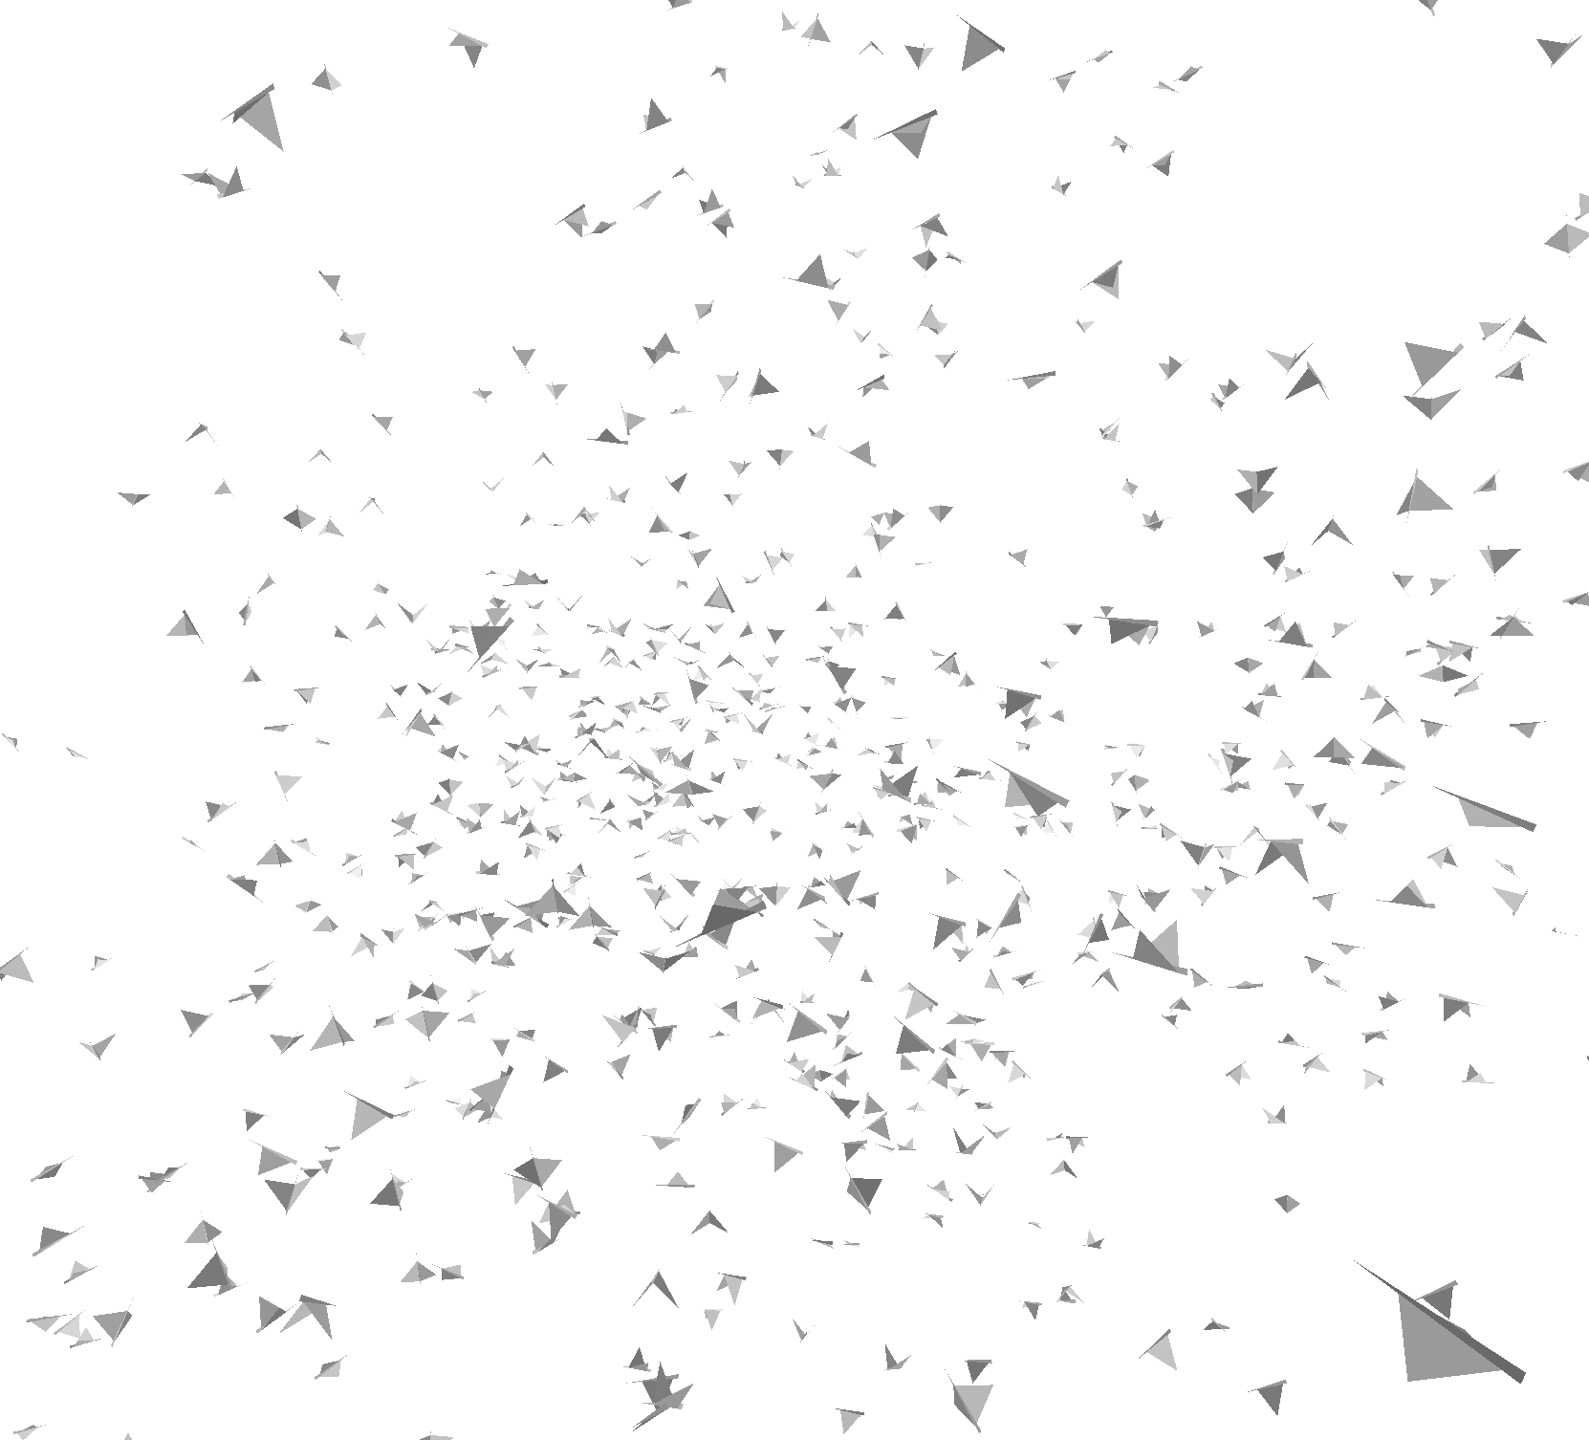
GP GPU : Demo Three.js

Slide 64
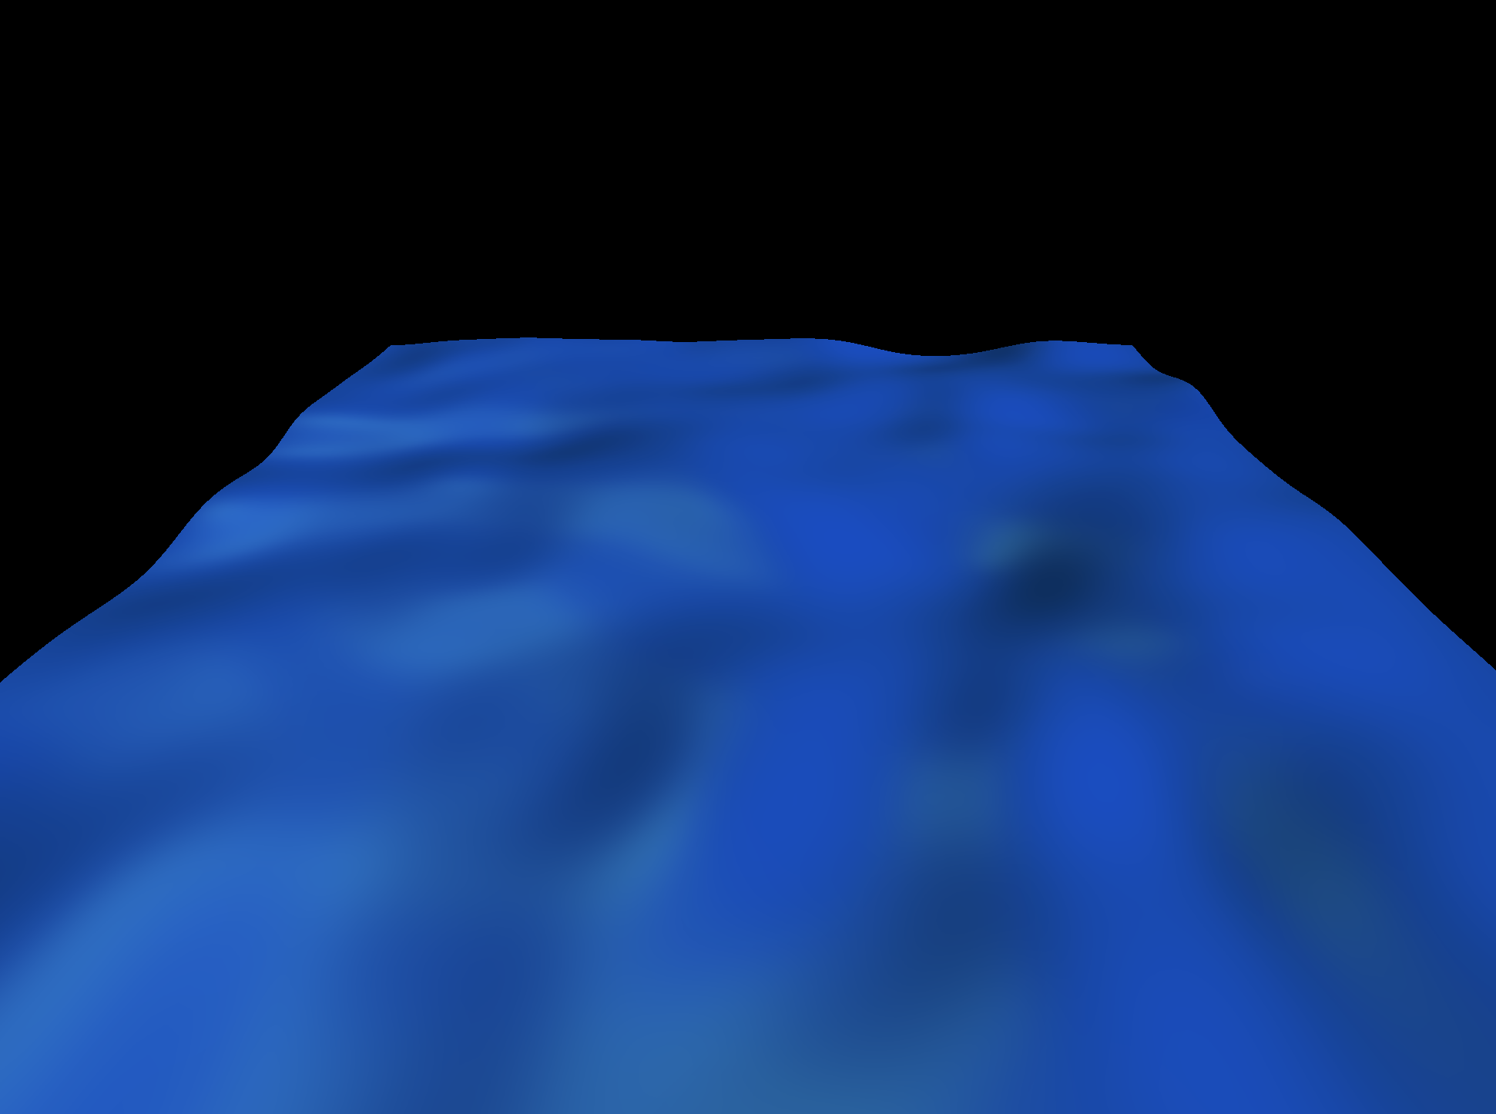
GP GPU : Demo Three.js

Slide 65
Recap: Transform: where we apply them
Projected
vertices
(points in R²)
Final
pixels
(screen-buffer)
computaions
per vertex
set-up
rasterizer
fragments
(potential pixels)
Vertices
(points in R³)
Computations
per fragment
Short program per vertex
Short program per fragment
y
v0
v1
v1
v0
RUN IN PARALLEL Per-Vertex/ Per-Pixel
z
v2
x
v2

Slide 66
Recap: Minimal Vertex Shader
Projected
vertices
(points in R²)
Final
pixels
(screen-buffer)
computaions
per vertex
set-up
rasterizer
fragments
(potential pixels)
Vertices
(points in R³)
Computations
per fragment
void main(void)
{
vec3 p = position;
vec4 modelViewPosition= modelViewMatrix * vec4(p,1.0); gl_Position=projectionMatrix * modelViewPosition;
}
GLSL
Built-In:
Vertex Pos
Built-In:
ModelView
Built-In:
Projection

Slide 67
Recap:Minimal Fragment Shader
Projected
vertices
(points in R²)
Final
pixels
(screen-buffer)
computaions
per vertex
set-up
rasterizer
fragments
(potential pixels)
Vertices
(points in R³)
Computations
per fragment
void main(void)
{
gl_FragColor = vec4(1.0, 0.0, 0.0, 1.0);
}
GLSL
Return: the final pixel color

Slide 68
Recap: GLSL: parameters
attribute vec3 baseColor;
uniform float delta;
varying vec3 color;
attribute:Global variables that may change per vertex, that are passed from the OpenGL application to vertex shaders. This qualifier can only be used in vertex shaders. For the shader this is a read-only variable.
uniform:Global variables that may change per primitive, that are passed from the OpenGL application to the shaders. This qualifier can be used in both vertex and fragment shaders. For the shaders this is a read-only variable.
varying:used for interpolated data between a vertex shader and a fragment shader. Available for writing in the vertex shader, and read-only in a fragment shader.

Slide 69
Recap: Varying interpolation
attribute vec3 baseColor;
varying vec3 color;
void main(void) {
gl_Position = gl_ModelViewProjectionMatrix * gl_Vertex;
color = baseColor ;
}
VERTEX
Shader
L
I
N
K
varying vec3 color;
void main(void) {
gl_FragColor = vec4( color , 1.0);
}
FRAGMENT Shader

Slide 70
Recap: Baricentric coordinates
Physical interpretation
p has baricentric coordinates
(a₁ a₂ a₃) iff
it is the baricenter of:
V₃
p
V₂
V₁
a₃ Kg
a₂ Kg
a₁ Kg

Slide 71
Recap: Defining shaders in the HTML
<head>
<script type="x-shader/x-vertex" id="vertexShader">
</script>
<script type="x-shader/x-fragment" id="fragmentShader">
</script>
</head>
...
void main()
{ ...
}
GLSL
...
void main()
{ ...
}
GLSL
HTML5

Slide 72
Recap: Using Shaders as mesh’s material
A particular kind of material that use shaders
<script>
var s_material= new THREE.ShaderMaterial();
s_material.vertexShader=document.getElementById( 'vertexShader' ).textContent
s_material.fragmentShader=document.getElementById( 'fragmentShader' ).textContent
mesh = new THREE.Mesh( geometry, s_material );
</script>
JavaScript
Identifiers to the shader programs
From now on when render this mesh will
Use the material with the defined shaders

Slide 73
Computer Graphics
Shaders
University of Technology Sydney
Teacher: Nico Pietroni

