Slide 1
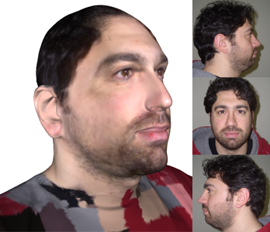
Reconstructing head models from photograph for individualized 3D-audio processing
Matteo Dellepiane, Nico Pietroni, Nicolas Tsingos, Manuel Asselot, Roberto Scopigno

Slide 2
Overview
What is HRTF
HRTF from head 3D model
Our solution
Results and future work

Slide 3
HRTF: what, why, how...
WHAT:
HRTF (Head Related Transfer Function) describes how a given sound wave input (parameterized as frequency and source location) is filtered by the diffraction and reflection properties of the head before the sound reaches the ear.
HRTF depends mainly on the shape of the ears and (secondarily) of the face. So it’s individual and it can vary a lot from one subject to the other

Slide 4
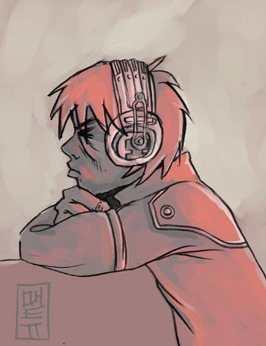
HRTF: what, why, how...
WHY:
In order to perform realistic 3D sound rendering it’s necessary to know in advance the HRTF of the user, and apply it as a “filter”.
Main applications: everything related to realistic rendering, for example videogames

Slide 5
HRTF: what, why, how...
HOW:
There are two main methods to calculate HRTF:
Anechoic chamber measurements
Scattering calculation from 3D models

Slide 6
HRTF: what, why, how...
Anechoic chamber measurements:
reference method
precise
you need anechoic chamber
not easy to perform.

Slide 7
HRTF: what, why, how...
Scattering calculation:
Finite element methods
very precise
veeeery slow
needs watertight and very “clean” models

Slide 8
HRTF: what, why, how...
Scattering calculation:
“Instant GPU sound scattering”
[Tsingos et al.]
accurate enough
very fast
indipendent from model topology
only “first bounce” calculated

Slide 9
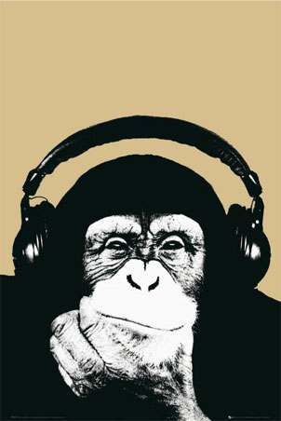
Our Target
How to provide 3D information?
BEST SCENARIO: the user provides some material, and receives his individual HRTF “by mail”. This HRTF is applied for every videogame or application he uses, in order to provide best realism.
Needs:
Robust method
Precise reconstruction
Least possible intervention by the user

Slide 10
HRTF from head 3D model
How to provide 3D information?
Measures
3D Scanning
very precise (nearly 0.3 mm error)
3D scanner technology is still expensive
humans are not the best subjects for scanning

Slide 11
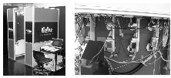
How to get 3D model of Head&Ears?
3D SCANNING “Improved 3D Head Reconstruction System based on Combining Shape-From-Silhouette with Two-Stage Stereo Algorithm” [Fujimura et al.] or using 3D laser scanning
Accurate and automatic
Very resembling results.
Precise
29 digital cameras and 3 projectors!!!
Notes:
hybrid algorithm combining Shape-From-Silhouette with Active Stereo to produce of 3D head reconstruction

Slide 12
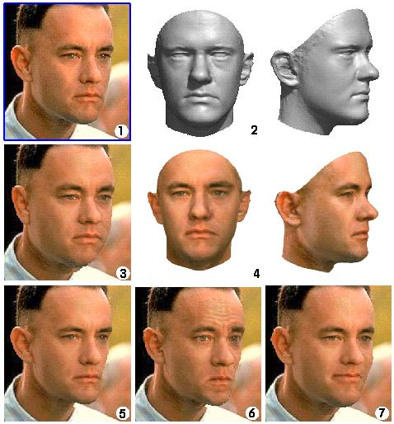
How to get 3D model of Head&Ears?
IMAGE-BASED TECHNIQUES:
“A morphable model for synthesis of 3D faces” [Blanz et al.]
Accurate and automatic
Very resembling results.
No estimation of ears shape.
Scaling issue.
Notes:
Uses a database of 200 scanned faces morphables (setting corrispondences)
Coefﬁcients of the 3D model are optimized along with a set of rendering parameters such that they produce an image as close as possible to the input image.

Slide 13
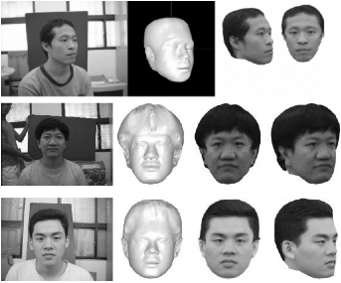
How to get 3D model of Head&Ears?
IMAGE BASED:
“Photo-realistic 3D Head Modeling Using Multi-view Images”
They perform two-pass bundle adjustments to reconstruct a photo-realistic 3D head model: compute several feature points of a target 3D head and use them to modify a generic head.
Reconstruct the whole head
from few photos
Automatic
Low accuracy
No estimation of ears shape.
Scaling issue.
Notes:
They perform two-pass bundle adjustments to reconstruct a photo-realistic 3D head model: compute several feature points of a target 3D head and use them to modify a generic head.

Slide 14
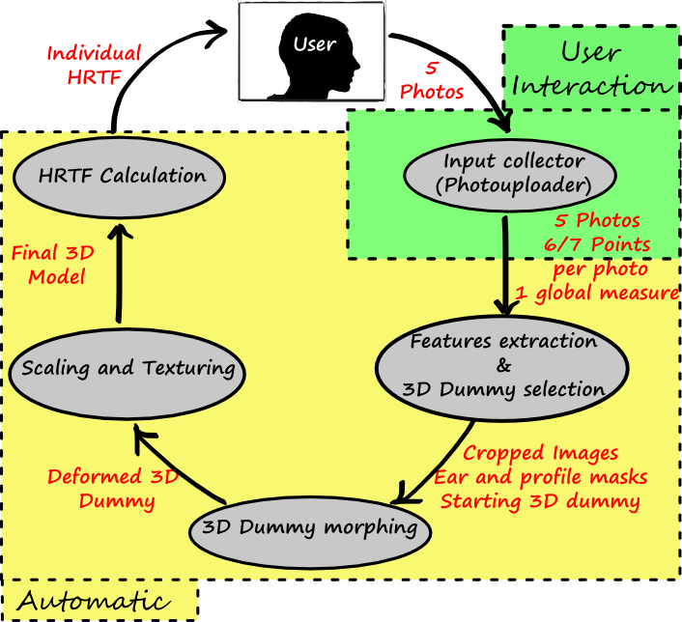
Our Solution: overview

Slide 15
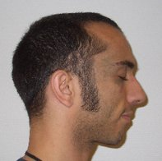
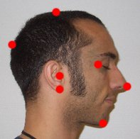
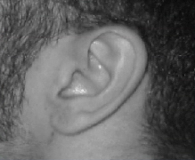
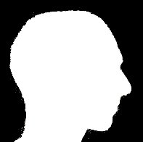
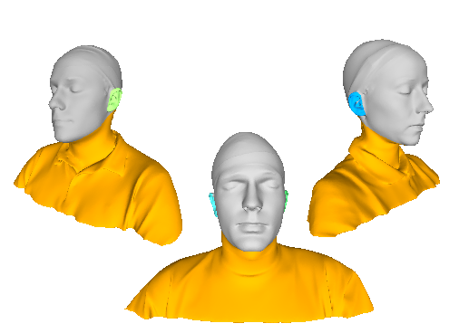
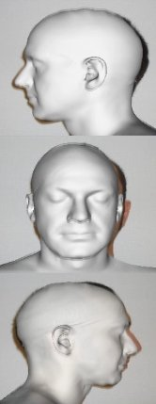
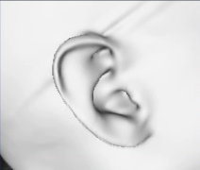
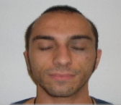
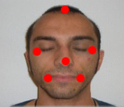
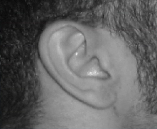
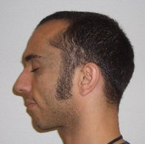
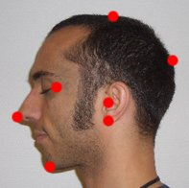
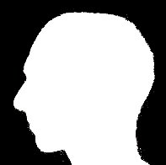
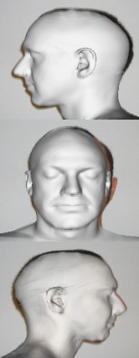
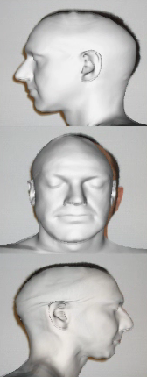
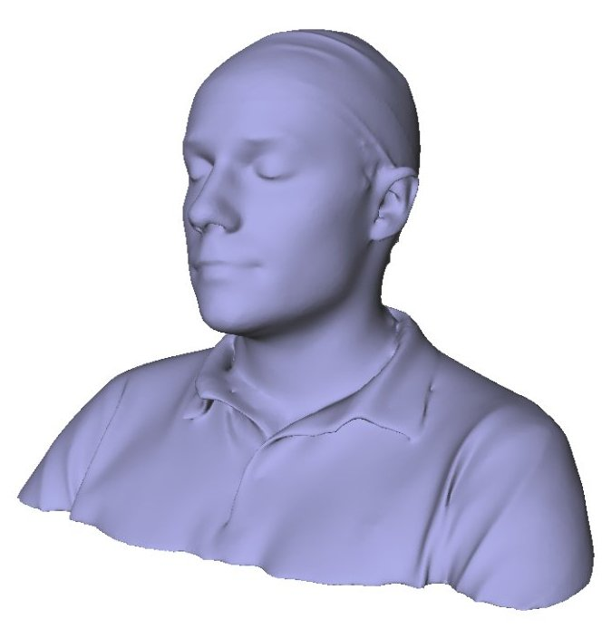
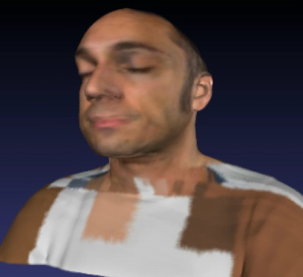
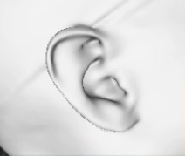
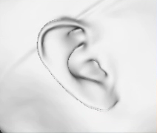
Gathering the 3d model
Dummy selection
Photos + keypoints
Features extraction
Rigid alignement
Single-view morph
Merging to a multi-view morph
Ears Morph
Texturing

Slide 16
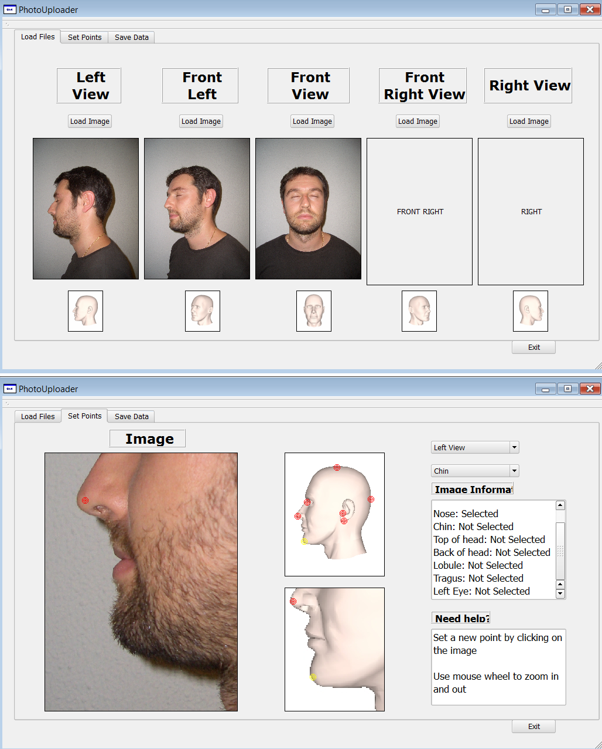
photouploader
NEEDS:
3 photos
6/7 key-points
per image
Global scaling factor (nose length)

Slide 17
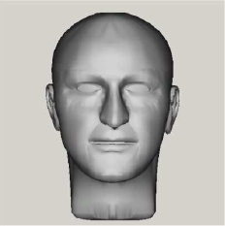
Features extraction
Regarding face, some work has been done, and can be used to extract features for the face and head.
[Au et al, Synthesizing 3D Facial Models from Photograph]
Regarding ear, most of the work on ear biometry is in the field of detection and security, so the extracted features are not directly related to ear shape. Moreover, proposed biometric measures are not easy to be used due to great differences between ears, and difficulty in finding reference points.
[Jeges,Mate, Model based human ear localization and feature extraction]

Slide 18
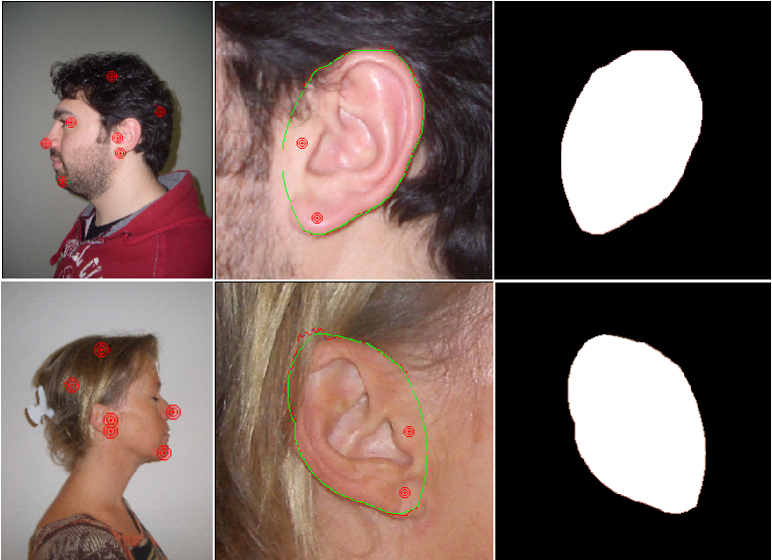
Features extraction
Contours extraction algorithm using snakes.

Slide 19
Dummy selection
Choose the dummy that best fits (using morphing) extracted ears.

Slide 20
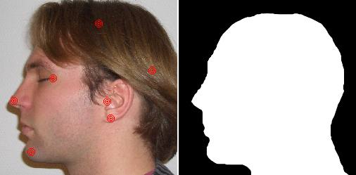
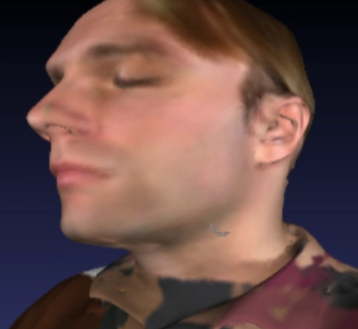
Dummy morphing
Overview:
INPUT:
3 extracted masks of head photos (dx,sx,front) aligned with the dummy head.
one cropped image for each of ears and his extracted masks.
OUTPUT:
Recontructed colored Dummy model with particular attention to ear reconstruction.
Placement of virtual microphones for HRTF calculation.

Slide 21
Morphing to target shape
We use a variant of “Texture Design Using a Simplicial Complex of Morphable Textures” [Wojciech Matusik]
Overlap the edge-detection of input image with the edge detection of rendered geometry.
Calculate image Warping by minimizing an energy function in order to align features.
Project warpings back to 3D model

Slide 22
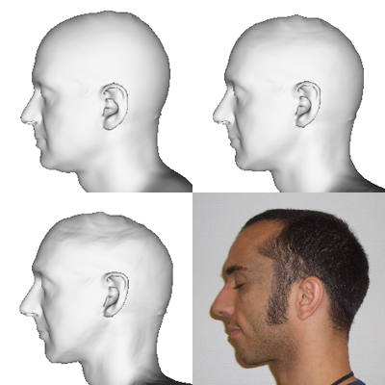
Head Morphing
Same approach with some difference:
We choose to use the image mask for robustness.
Adding keypoints matching to energy function.

Slide 23
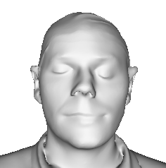
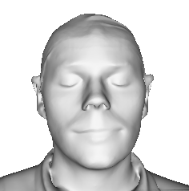
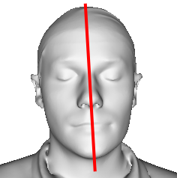
Dummy reconstruction
Symmetrization:

Slide 24
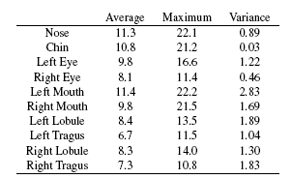
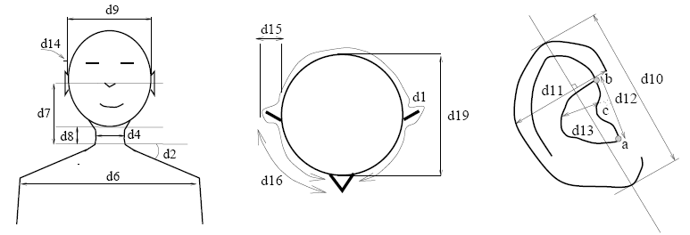
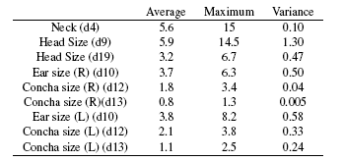
Geometric validation
Scanned vs reconstructed

Slide 25
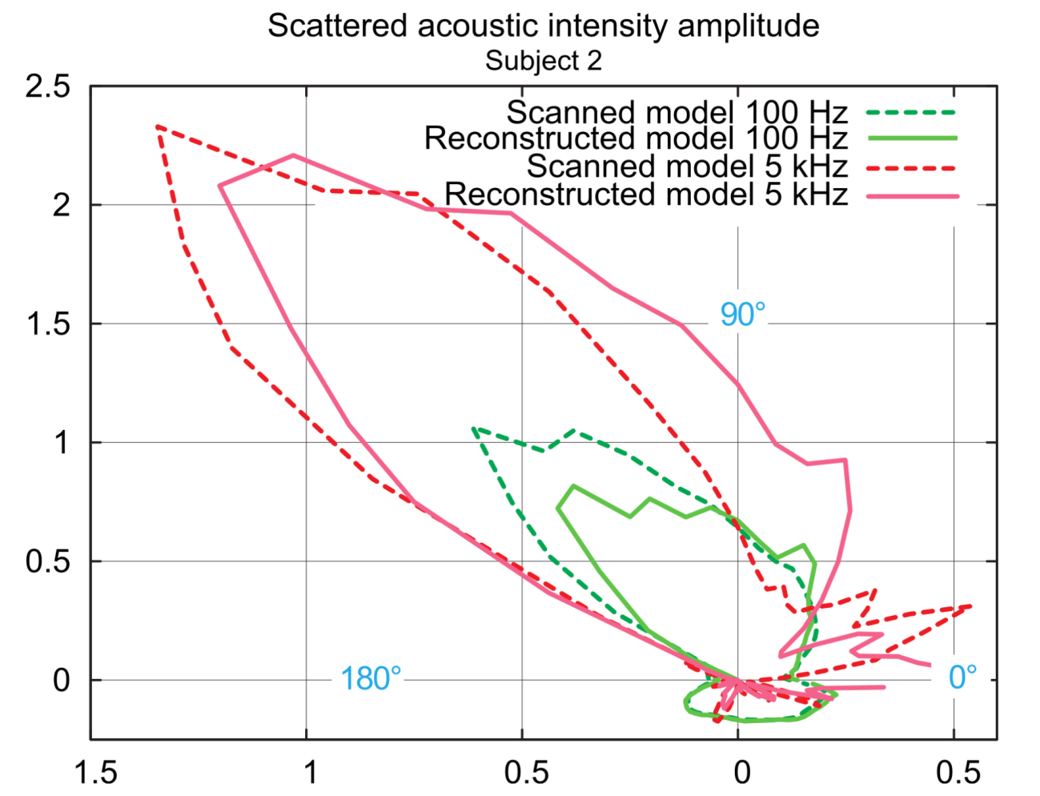
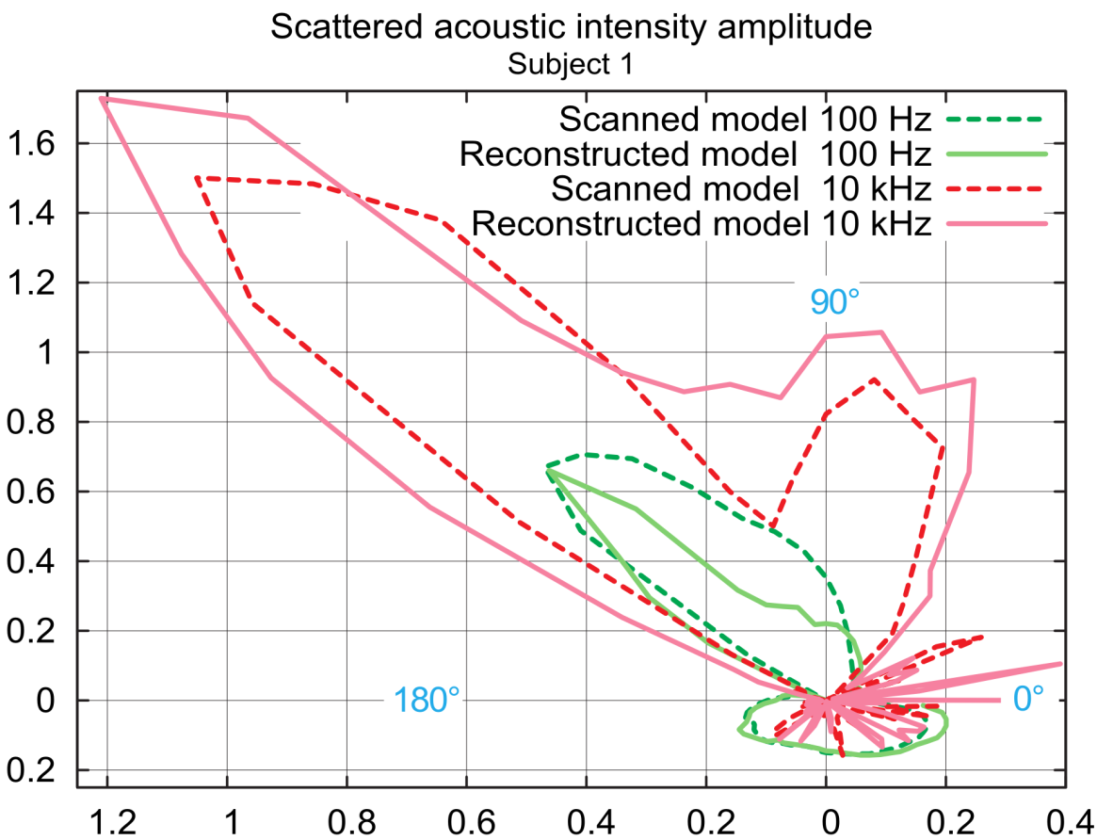
Preliminary assessment of HRTF
Scanned vs reconstructed

Slide 26
Video

Slide 27
Conclusions
AUTOMATIC HRTF calculation.
robust.
Low input from the user.
Quick (5 min for reconstruction + 4 hours scattering calculation)

Slide 28
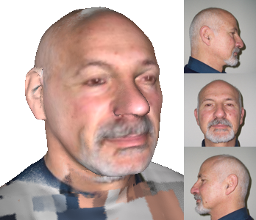
Future work
Improve avatar generation.
GPU morphing implementation.
Improvement of Dummy library.
Perception tests

Slide 29
Reconstructing head models from photograph for individualized 3D-audio processing
Matteo Dellepiane, Nico Pietroni, Nicolas Tsingos, Manuel Asselot, Roberto Scopigno

Slide 30
QUESTIONS?

