Slide 1
Practical quad mesh simplification
Marco Tarini Nico Pietroni Paolo Cignoni Daniele Panozzo Enrico Puppo
FP01: Tuesday, 13:30

Slide 2
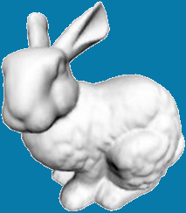
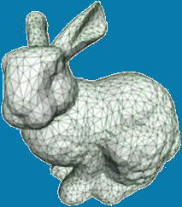
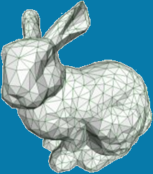
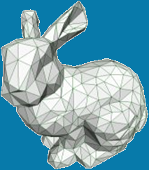
(Triangular) Mesh Simplification
64K tri
500 tri
Adaptivity
(more faces where needed)
Fine granularity
(continuous LOD)
Good meshing quality
(e.g. reasonable face shapes)

Slide 3
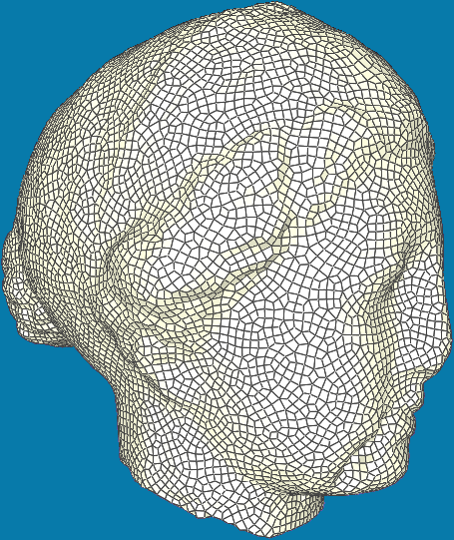
Quad Mesh Simplification
?
?
?
12K quads
Adaptivity
(more faces where needed)
Fine granularity
(continuous LOD)
Good meshing quality
(e.g. reasonable face shapes)

Slide 4
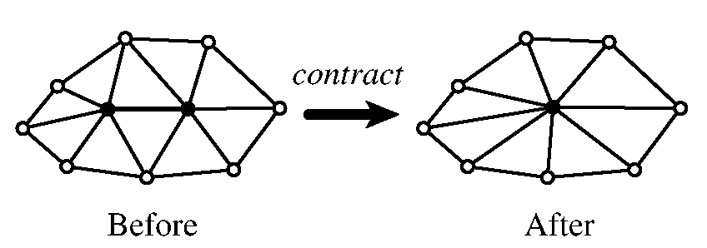
Local operations approach
Simplification
Select Local Operation
64K tri
Perform Local Operation
500 tri
e.g: QSlim [Garland and Heckbert - Vis 98]. Survey on: [Cignoni et al. - C&G 98]

Slide 5
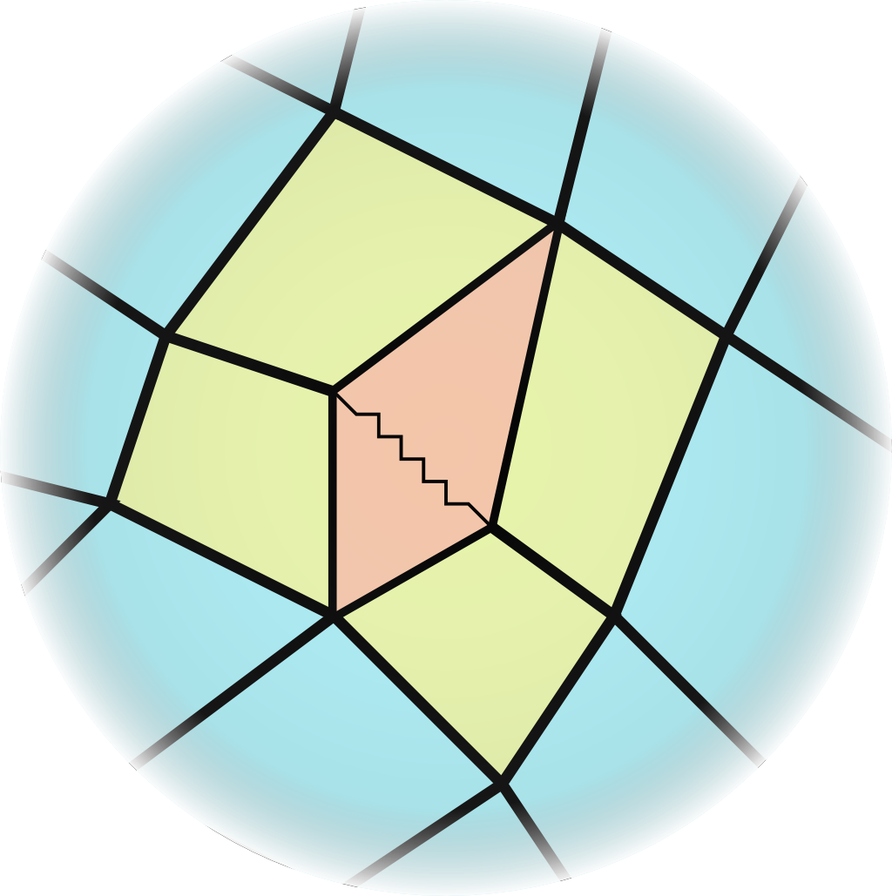
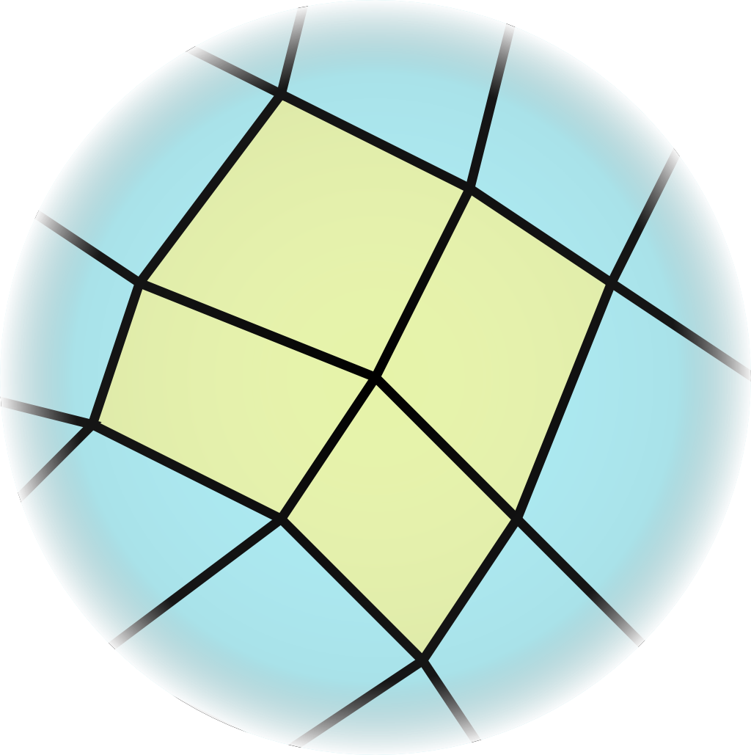
Local operations… for quads
Quad-collapse
(a local coarsening operation for quad-meshes)
a.k.a. “quad-close” [Kinney - IMR 97], “quad-collapse” [Daniels – Siggr Asia 08], “quadvertex merge” [Daniels – EGSP 09]

Slide 6
Local operations approach
8K quads
Simplification
Select Local Quad Operation
Perform Local Operation
?

Slide 7
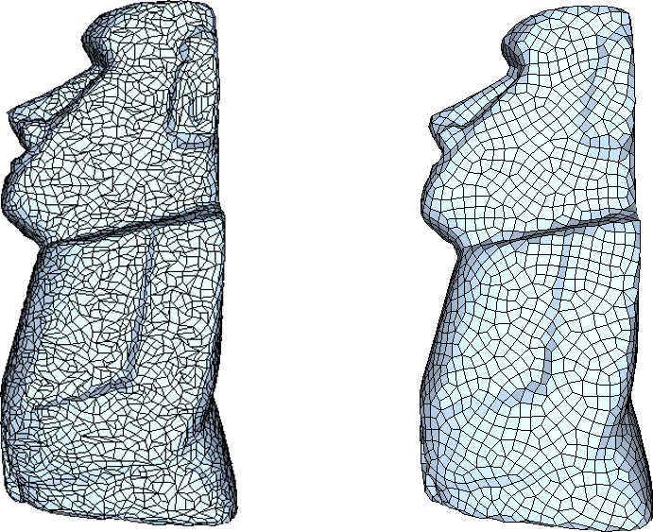
Quad-mesh simplification
Why more difficult than tri-meshes?
Quad structure is more delicate
Regularity here is far more important
far from flat
concave
self-intersecting
VS

Slide 8
Quad Mesh Simplification
?
?
?
12K quads
Adaptivity
(more faces where needed)
Fine granularity
(continuous LOD)
Good meshing quality
(regular quad remeshing!)
!!!

Slide 9
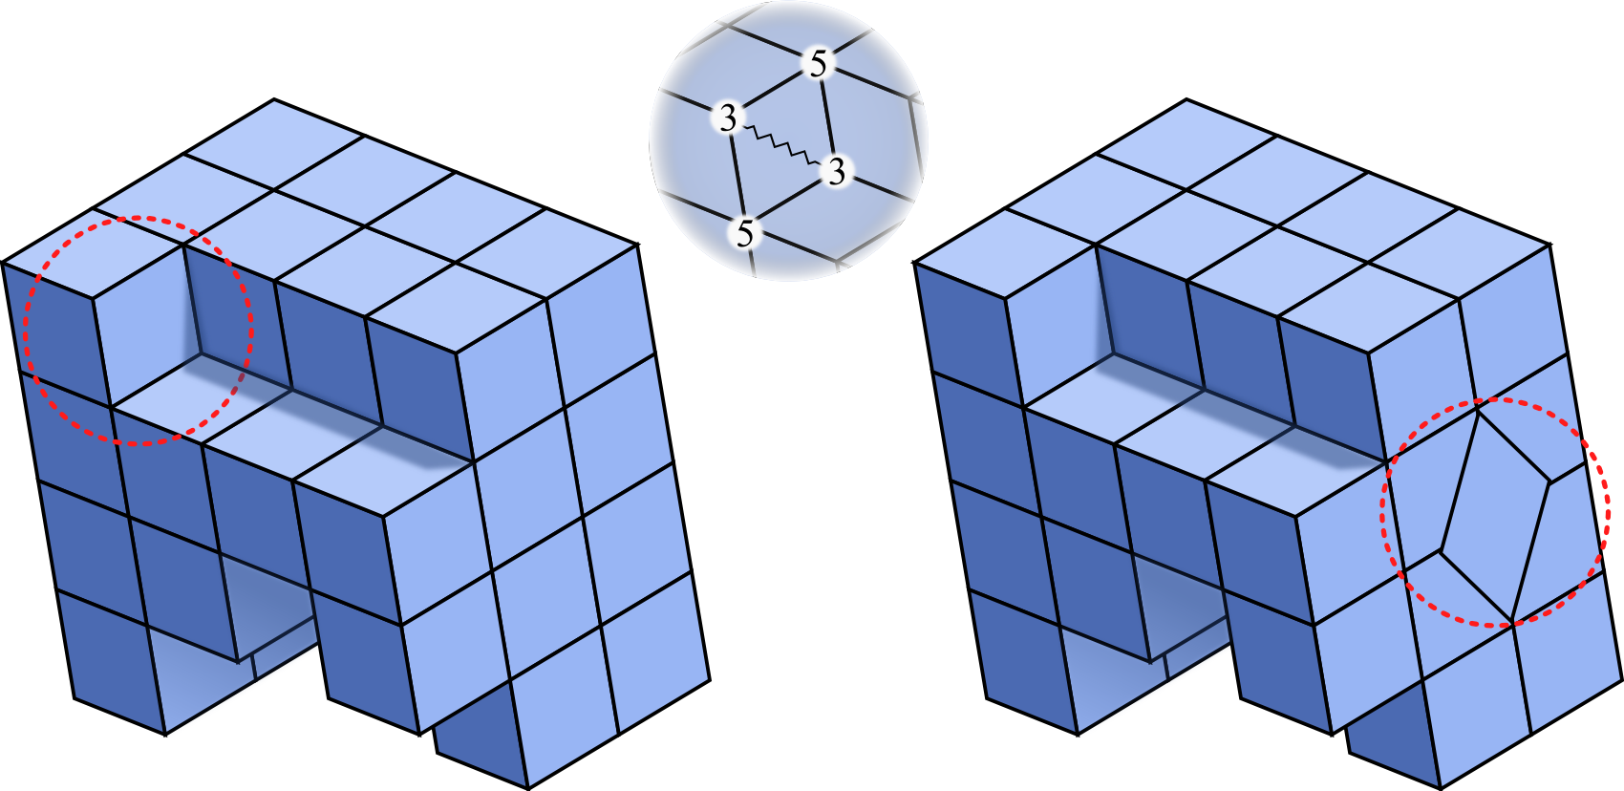
How to get regular quad mesh
Seek valency-four vertices?

Slide 10
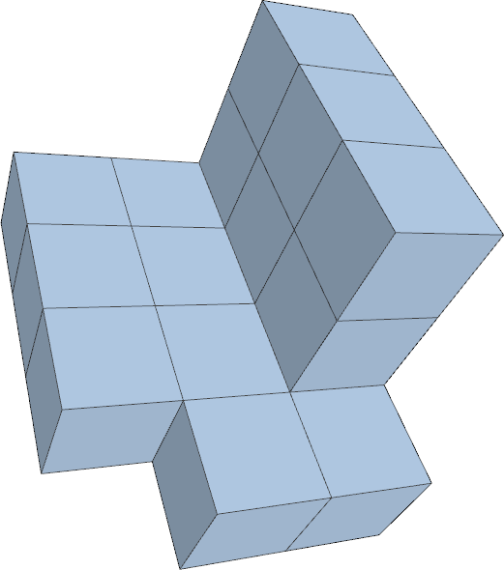
How to get regular quad mesh
Valency four vertices good… in zero (Gaussian) curvature regions only!
Ideal valency:
Zero curvature ==> 4
Pos curvature ==> less than 4
Neg curvature ==> more than 4

Slide 11
How to get regular quad mesh
Seek valency four vertices?
Seek vertices with curvature-dependent val?
Seek “homeometry”:
all edges same length k
all diagonals same length 2 k

Slide 12
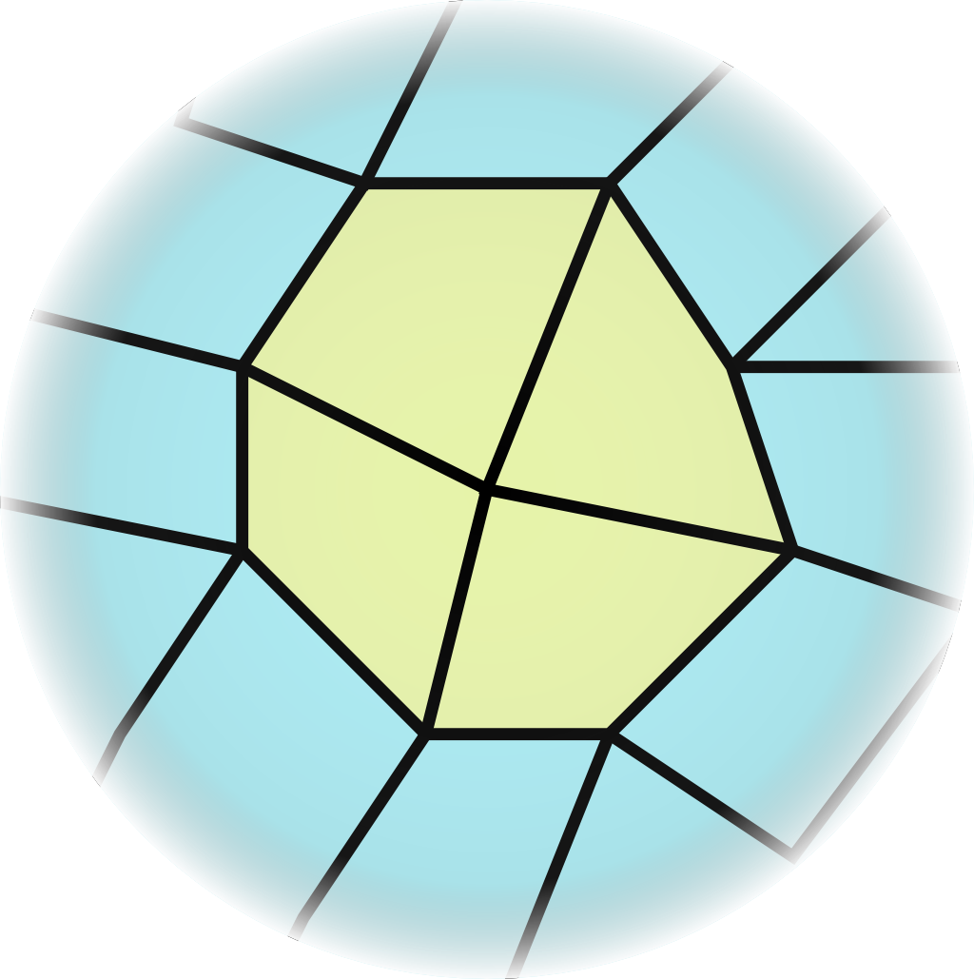
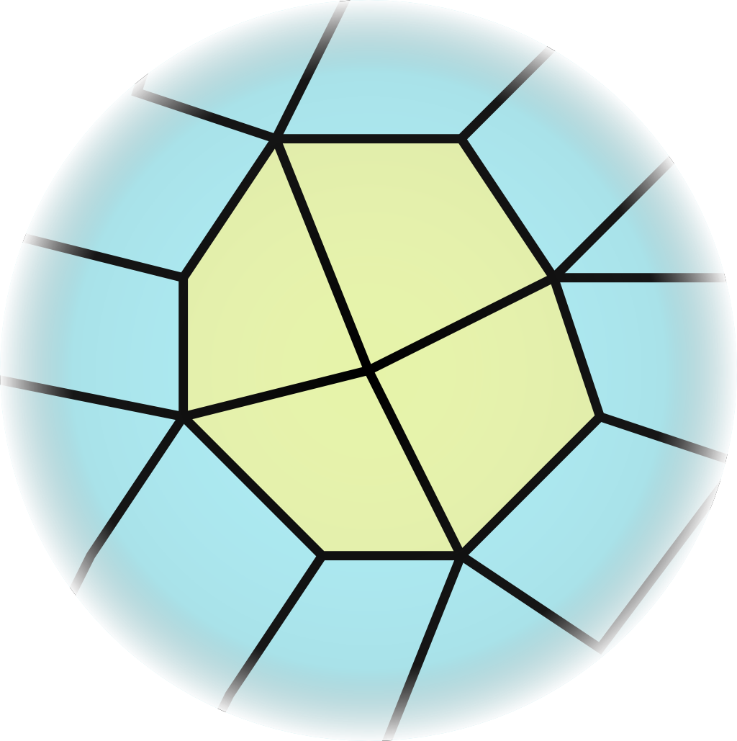
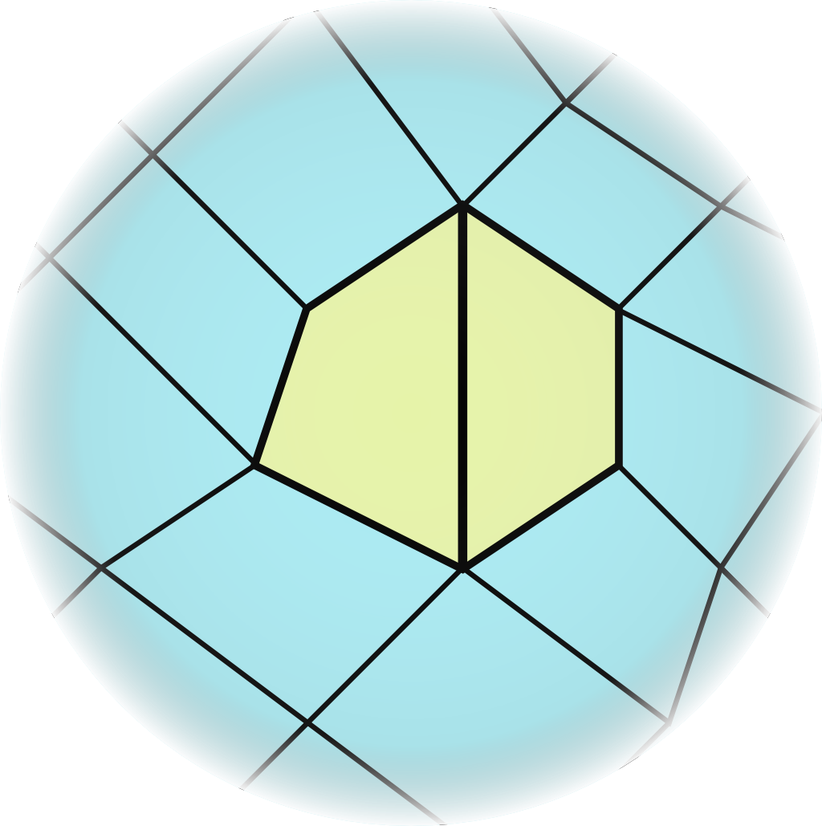
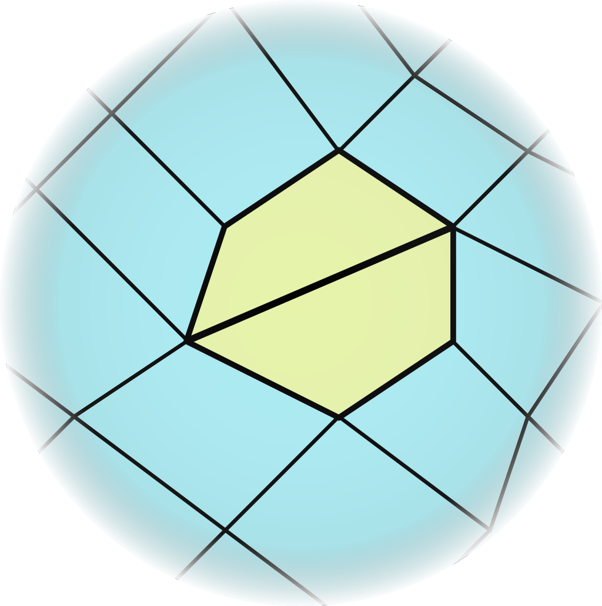
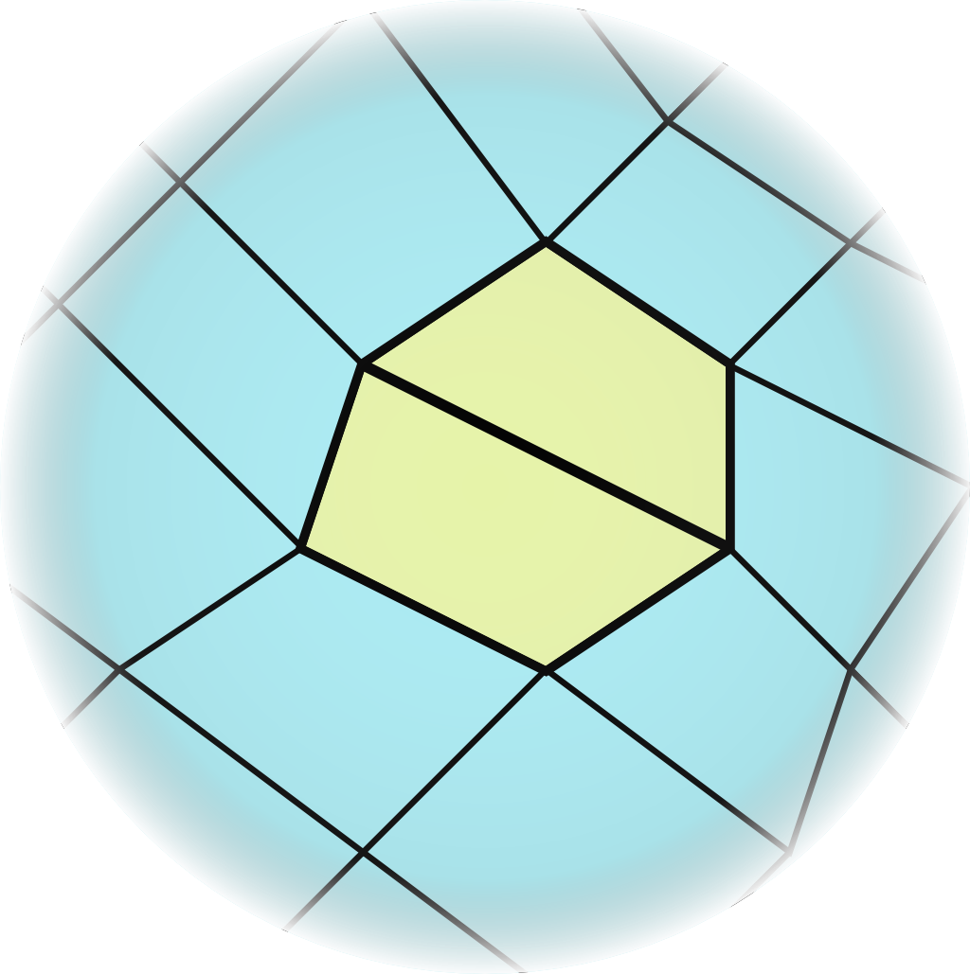
Local operations for quads
Optimization operations
vertex rotations:
edge rotations:

Slide 13
Local operations for quads
Coarsening operations
quad collapse:

Slide 14
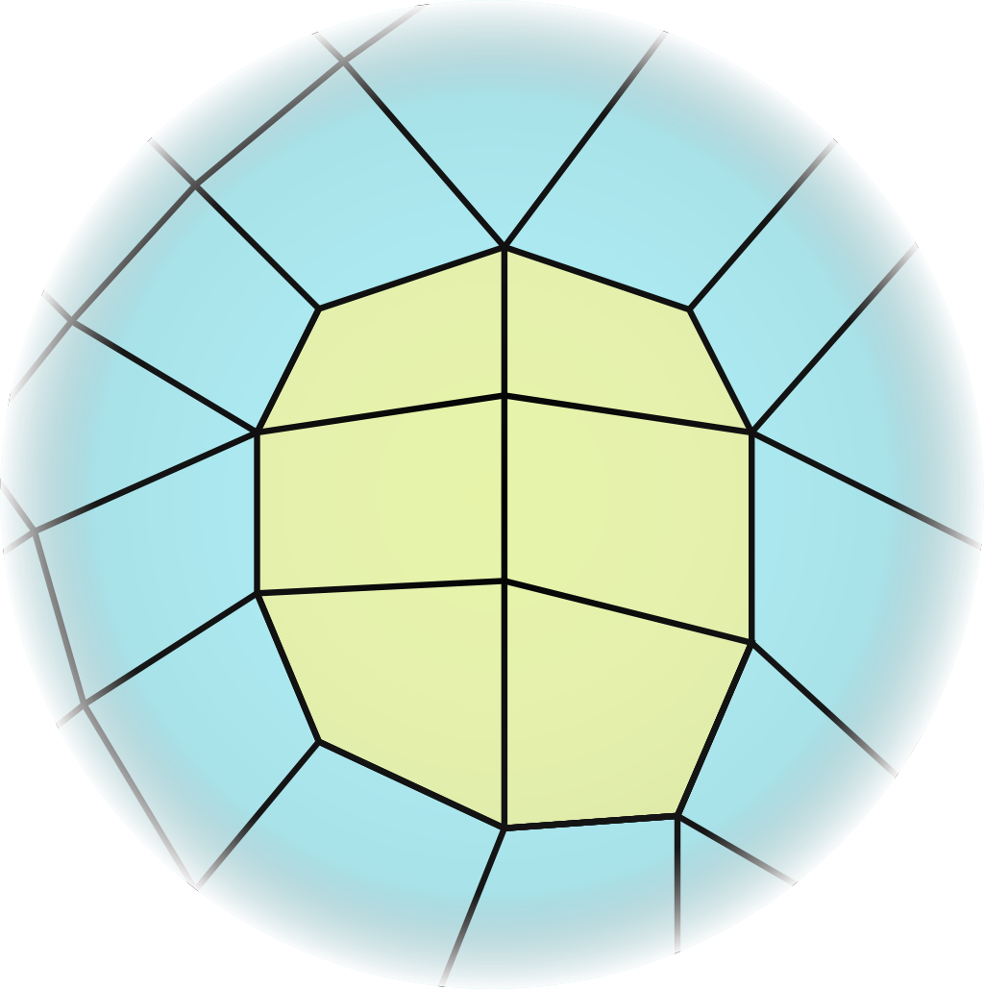
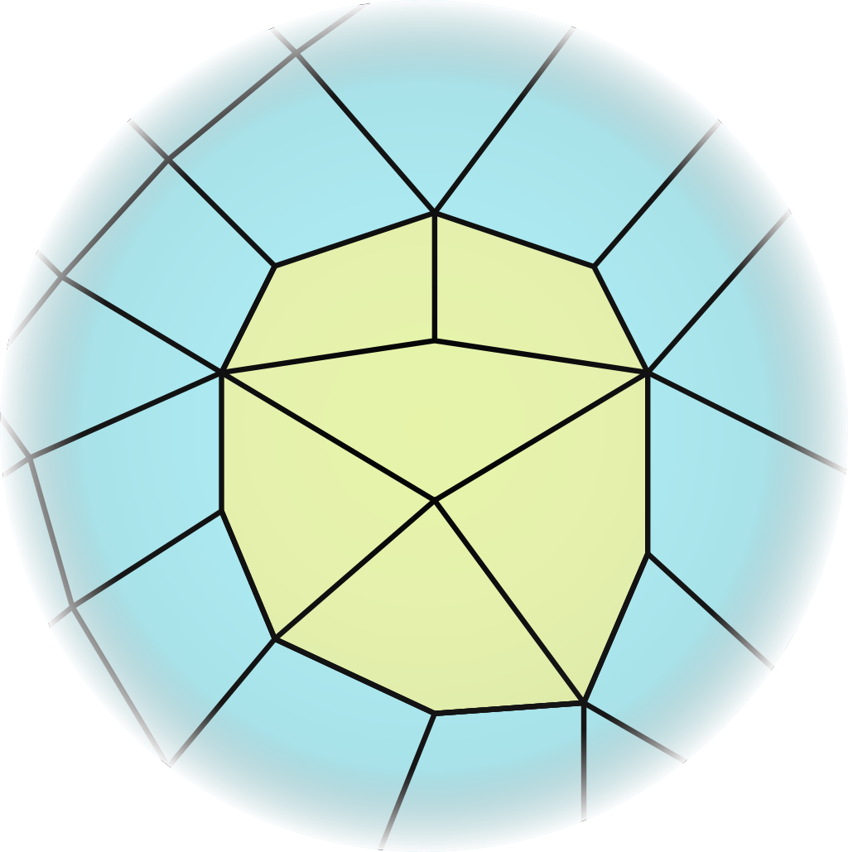
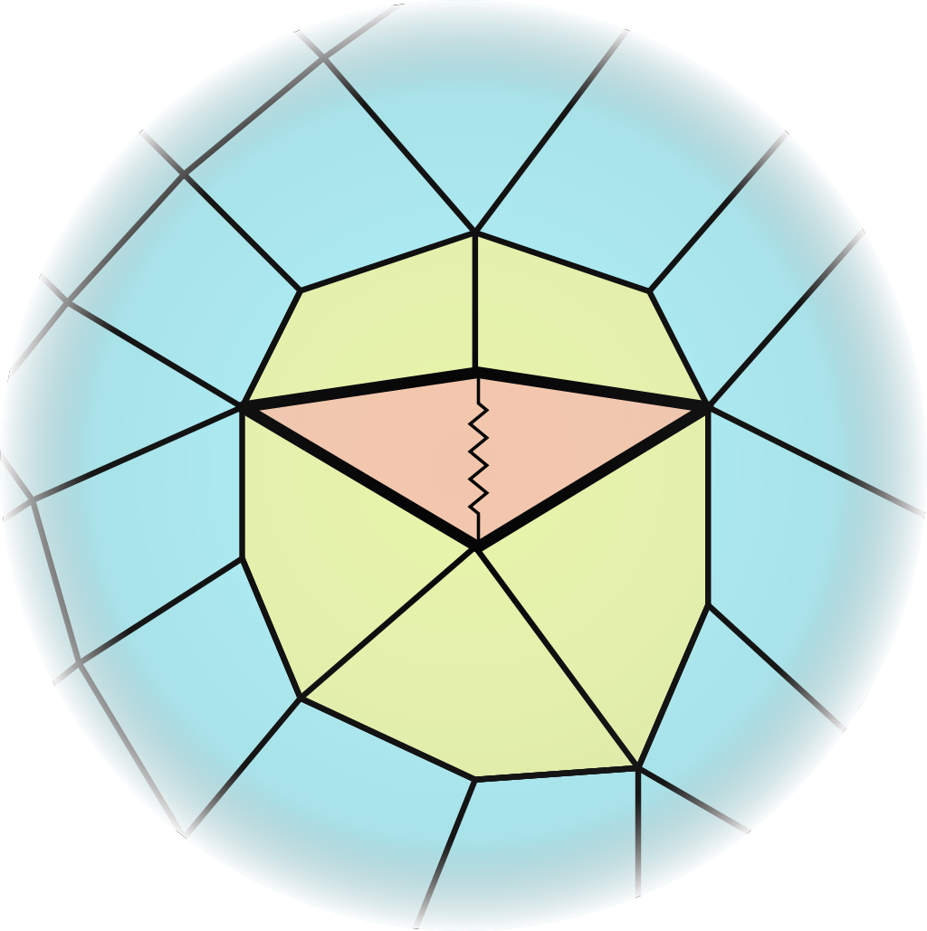
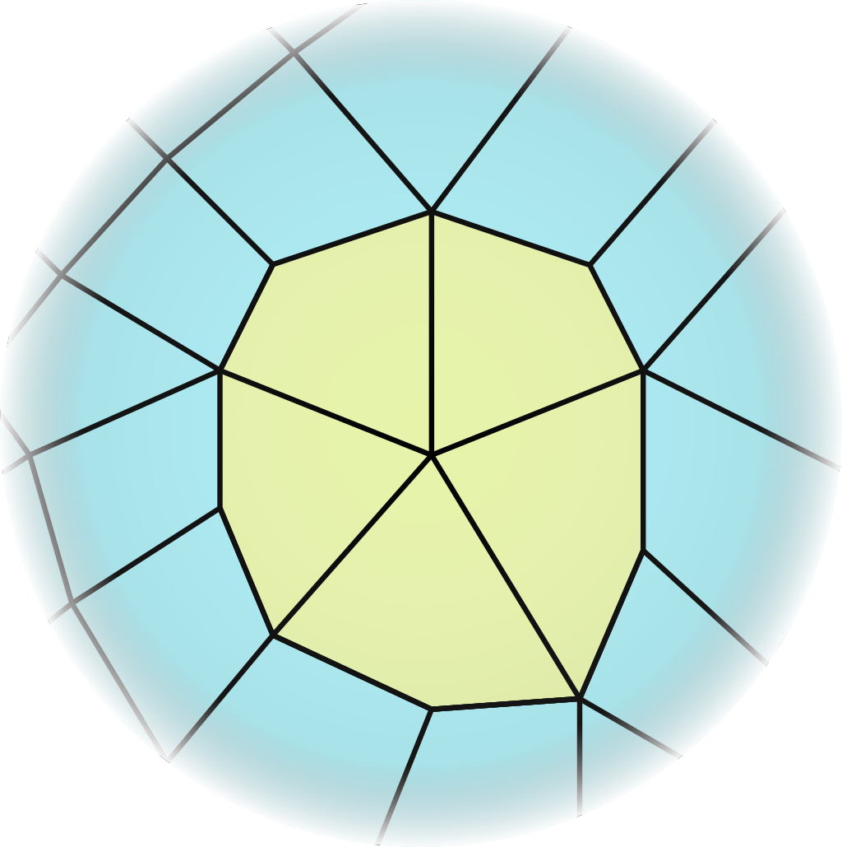
Local operations for quads
Coarsening operations
quad collapse:
edge collapses:

Slide 15
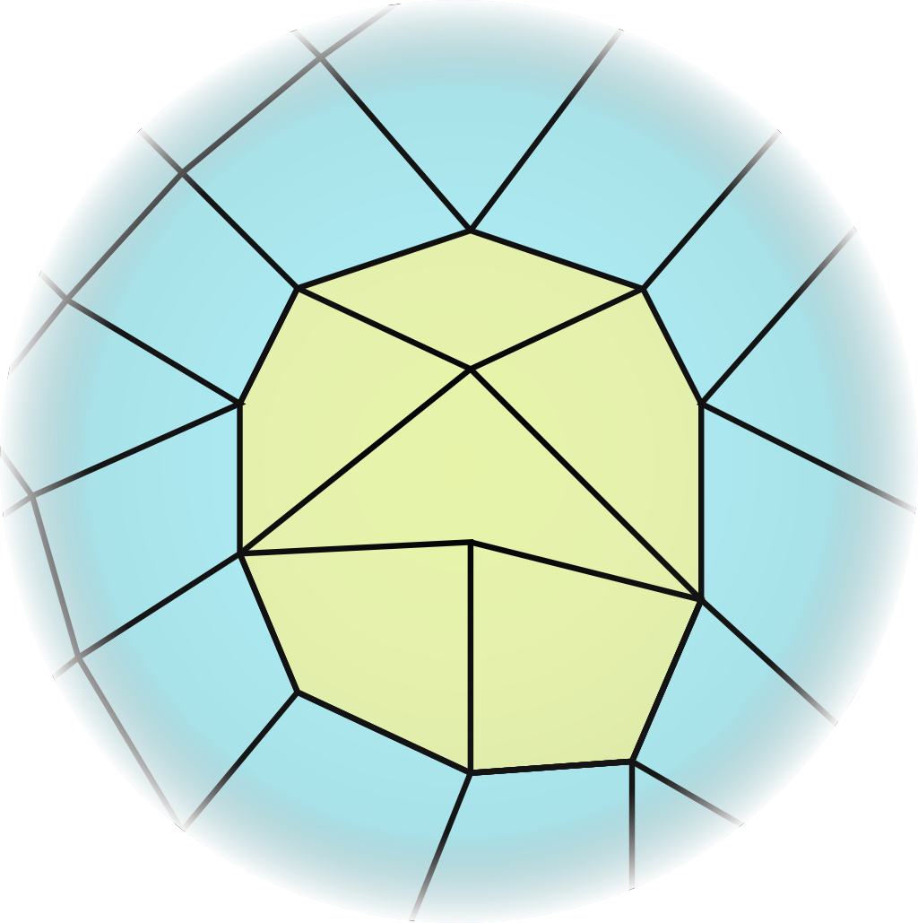
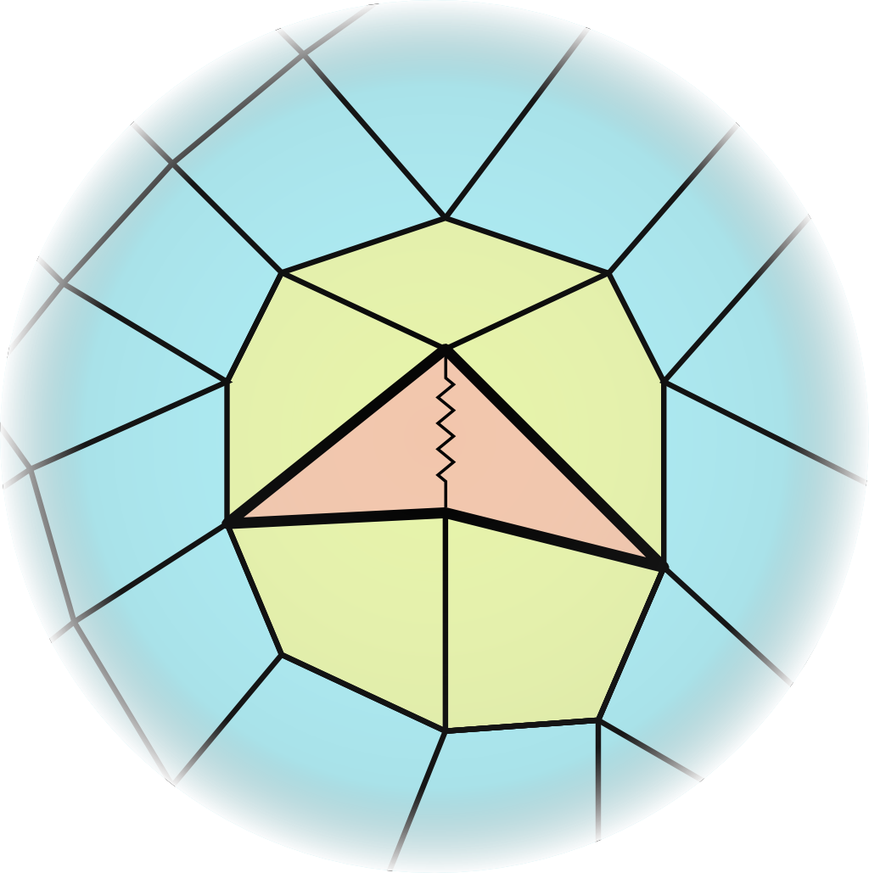
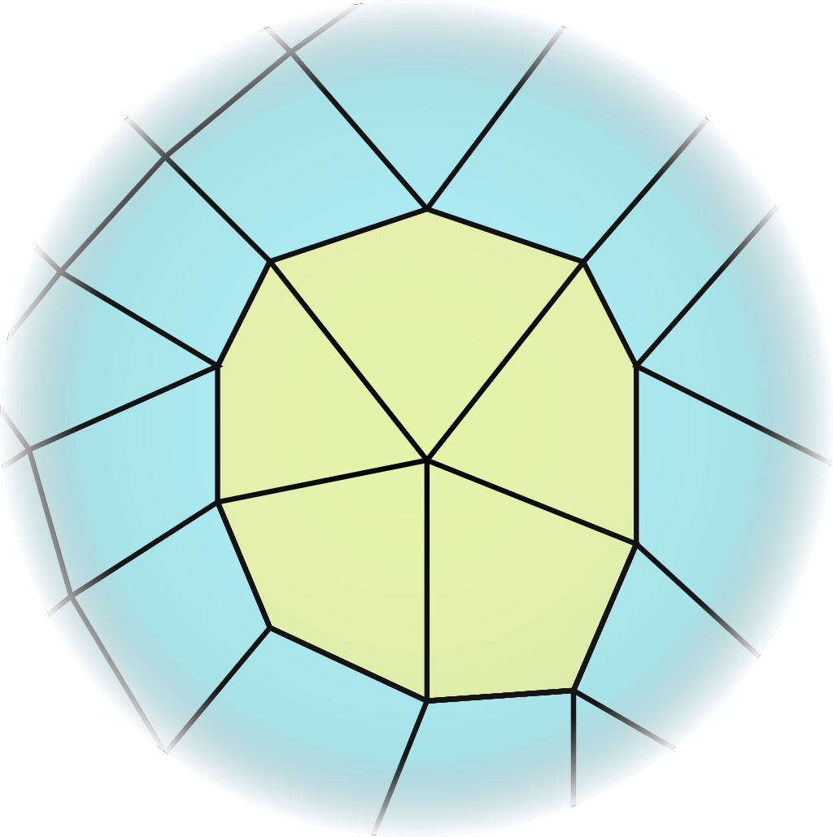
Local operations for quads
Coarsening operations
quad collapse:
edge collapses:

Slide 16
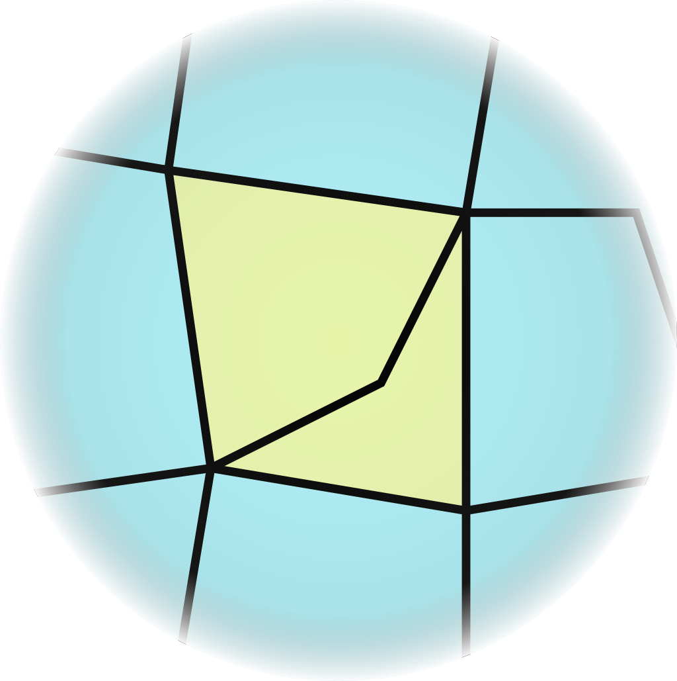
Local operations for quads
Ensuring consistency
avoidance of degenerate configurations
“Doublet”:
2

Slide 17
Local operations for quads
Are “doublets” really degenerate?
Sometimes a doublet is the best solution

Slide 18
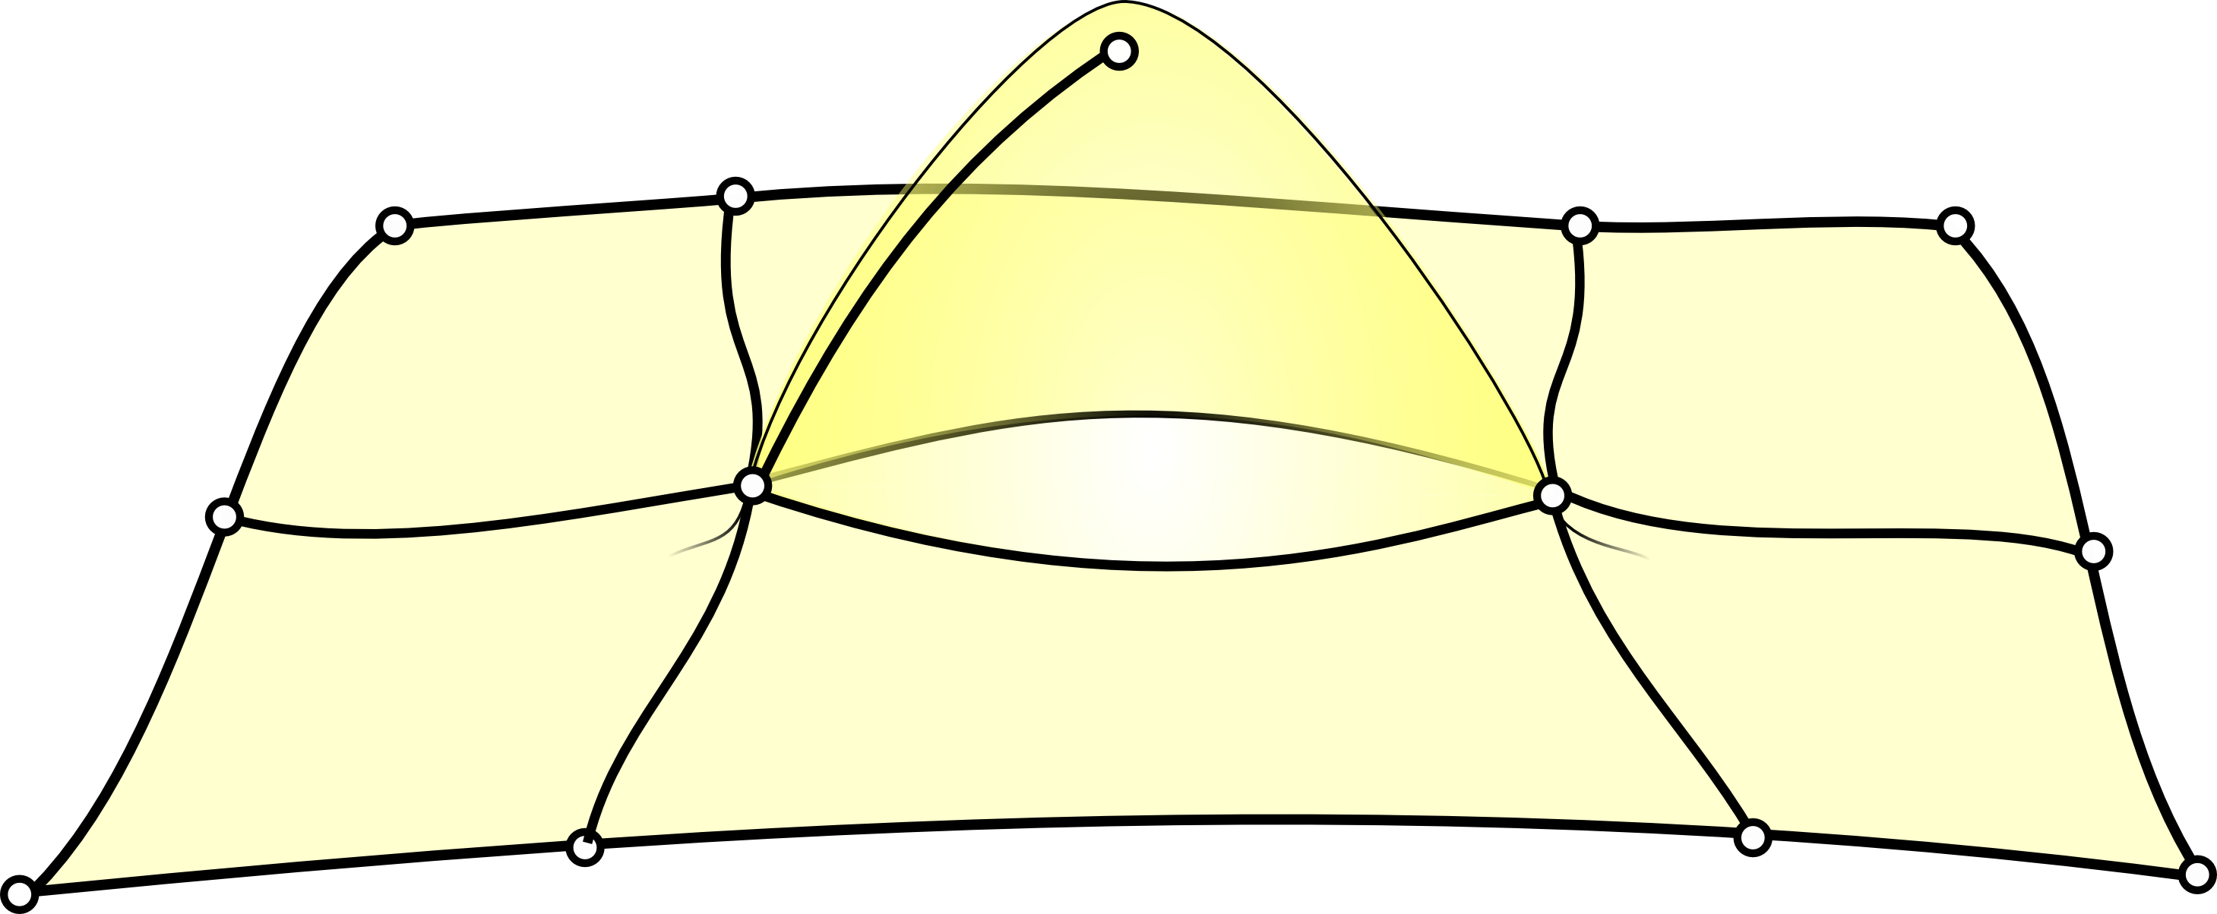
Local operations for quads
“Singlet”:

Slide 19
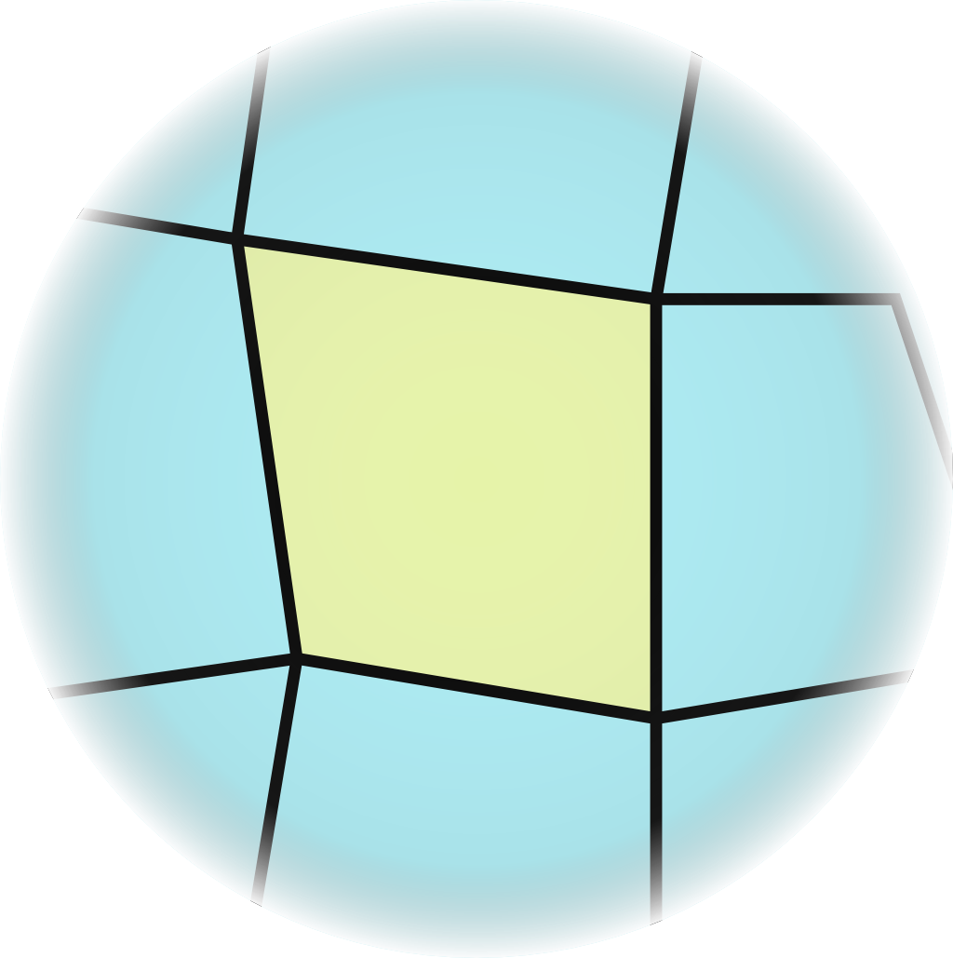
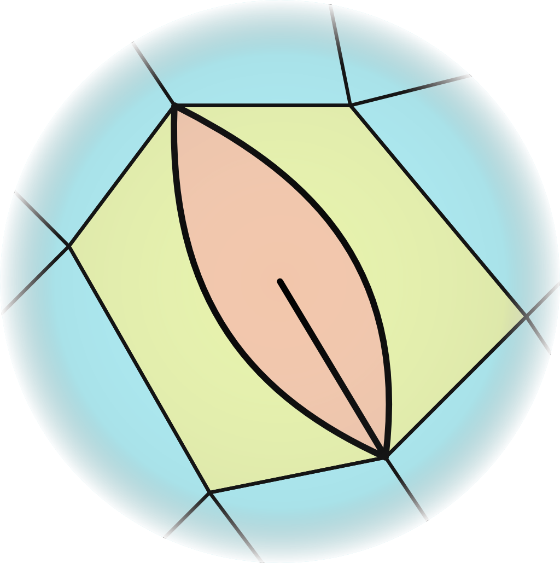
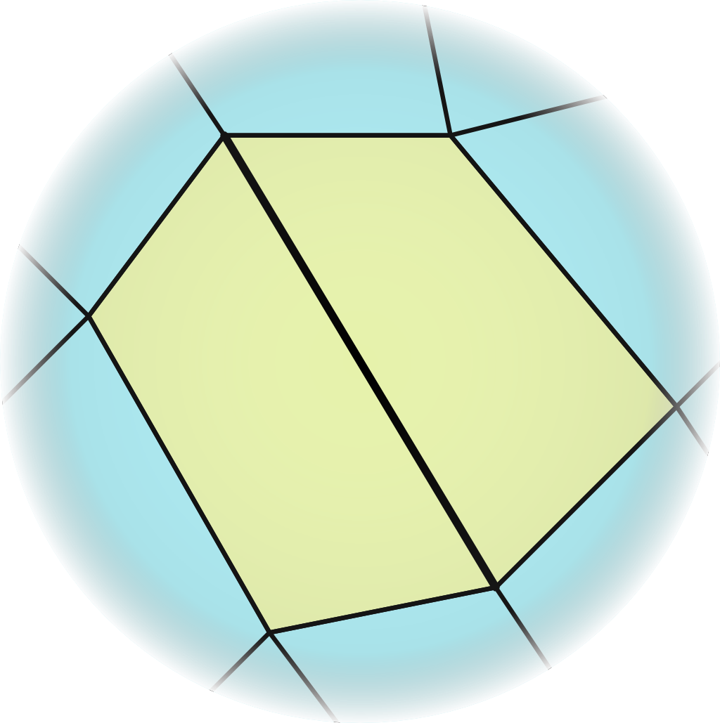
Local operations for quads
Cleaning operations
doublet removal:
singlet removal:

Slide 20
Local operations for quads
Coarsening operations:
Optimization operations:
diag. collapse
vertex rotate
edge collapses
edge rotates

Slide 21
Local operations approach
Simplification
Guidance:
homeometry
all edges same length
all diags √2 of that length
Select Local Operation
Perform Local Operation
?

Slide 22
Local operations for quads
Coarsening operations:
Optimization operations:
diag. collapse
vertex rotate
edge collapses
edge rotates

Slide 23
Selecting an operation
While there is a ameliorating Optimization Op,
perform it
Select a Coarsening Op:
collapse shortest edge / diag (diag lengths are divided √2)
After any Op, check for inconsistency
apply corresponding Cleaning Op

Slide 24
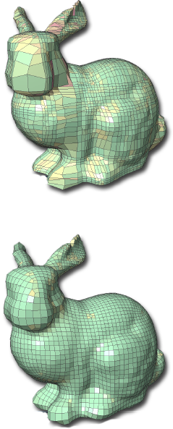
Tangent space smoothing
Optimize vertices positions to increase homeometry
“Tangent space”:
move vertices in tangent plane only (i.e. don’t let them leave the surface)
Known to improve meshing quality
used as a post-process
We use it to improve guidance
elements that can’t be made homeometric by smoothing are good candidates for the next collapse/rotate operation
[Daniels et al – 2008]

Slide 25
Local operations approach
Simplification
Select Local Op.
Perform it
Tangent space
smoothing
?

Slide 26
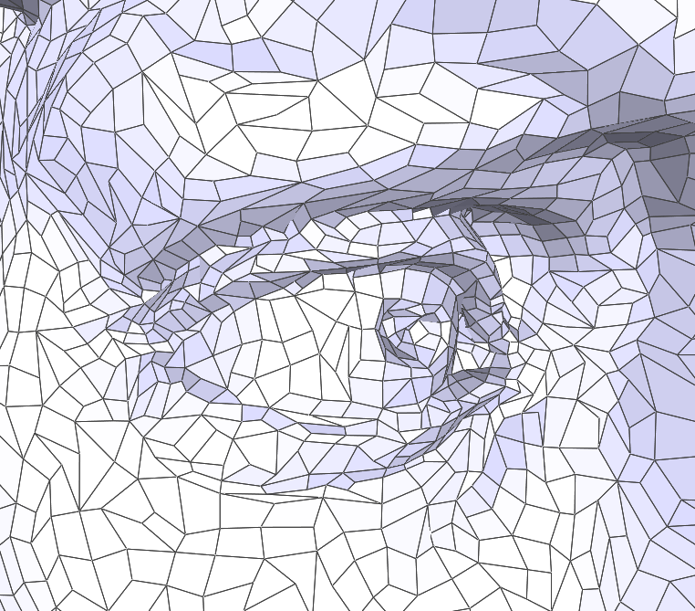
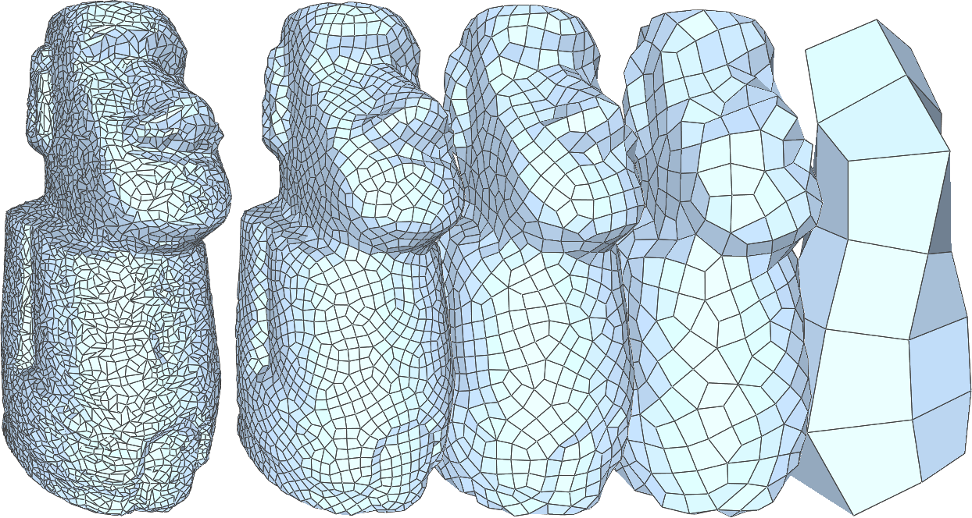
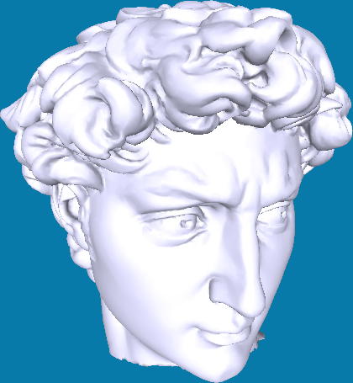
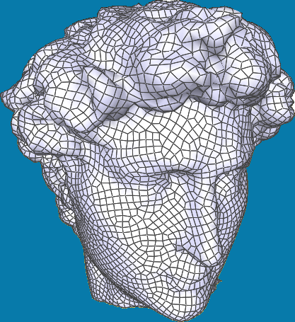
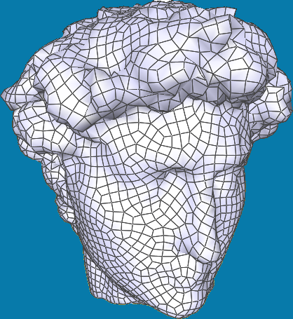
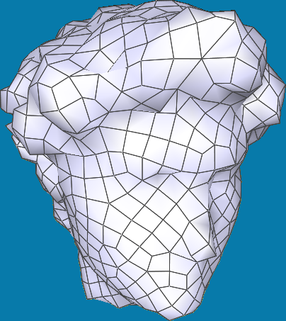
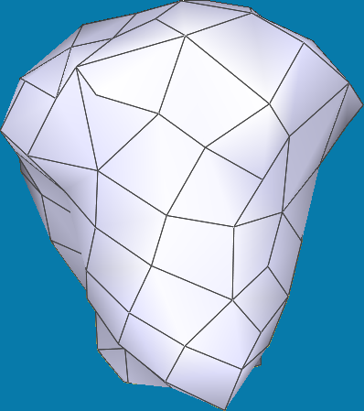
Good meshing with local operations

Slide 27
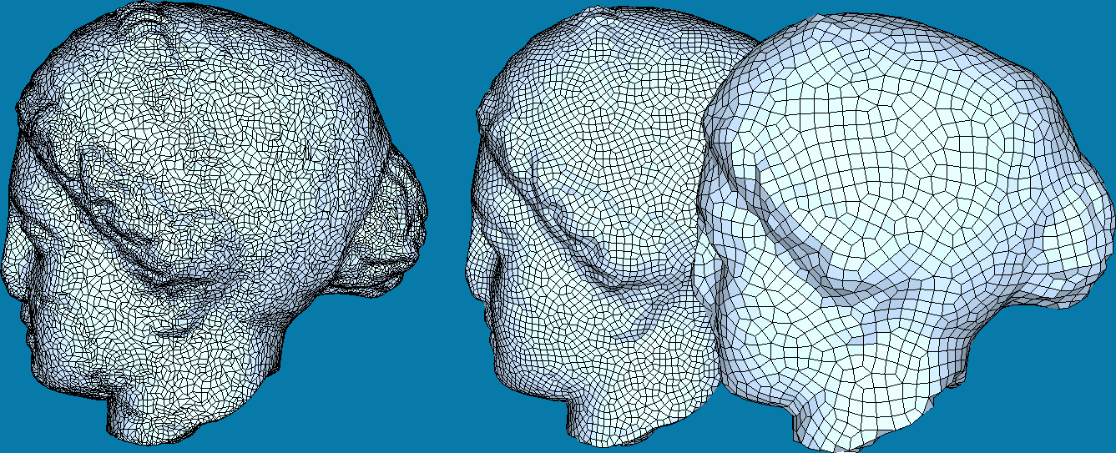
Quad Mesh Simplification
Adaptivity
(more faces where needed)
Fine granularity
(local operations)
Good meshing quality
(good quad meshing)
!!!
Ok
Ok

Slide 28
Adding adaptivity
Simplification
Purely length- based criteria!
Select Local Op.
Perform it
Tangent space
smoothing

Slide 29
Adding adaptivity
Both elements:
selection of next operation
tangent space smoothing
are purely length based!
Easy to add adaptive element size
according to a predefined importance measure

Slide 30
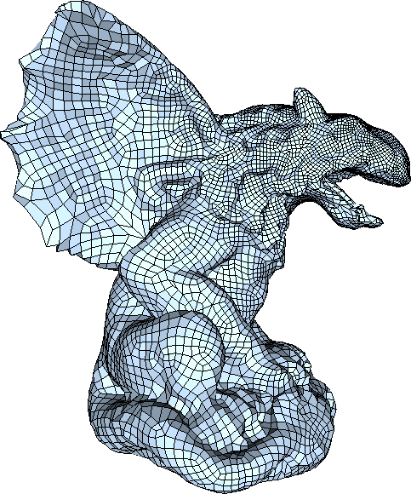
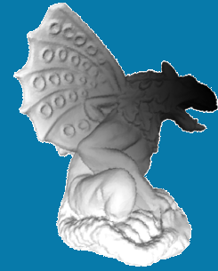
Adding adaptivity
Additional input:
importance field
“here, elements be 50% of avrg size”
“here, elements be 180% of avrg size”

Slide 31
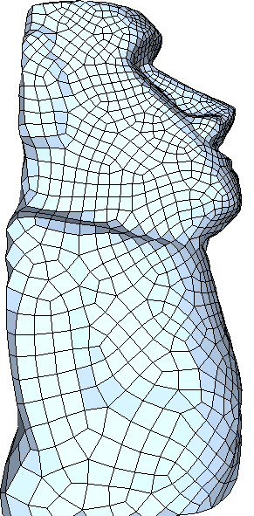
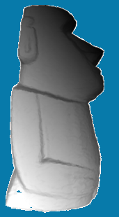
Adding adaptivity
Additional input:
importance field
“75% lengths, please”
“120% lengths, please”

Slide 32
Adding adaptivity
Instead of:
careful selection and placing of elements (according to introduced error)
Decouple:
determine ideal tessellation densities
macro control: region-wise, not element-wise
a priori
still focus on good tessellation quality
micro control: element-wise
during simplification

Slide 33
Feature lines preservation
Where that doesn’t work is near feature lines
matching edges to feature lines still requires micro control
Additional input:
set of feature lines
“preserve these lines as edges,
please”

Slide 34
Adding feature-line preservation
Simplification
Here, snap to lines also
Select Local Op.
Perform it
Tangent space
smoothing

Slide 35
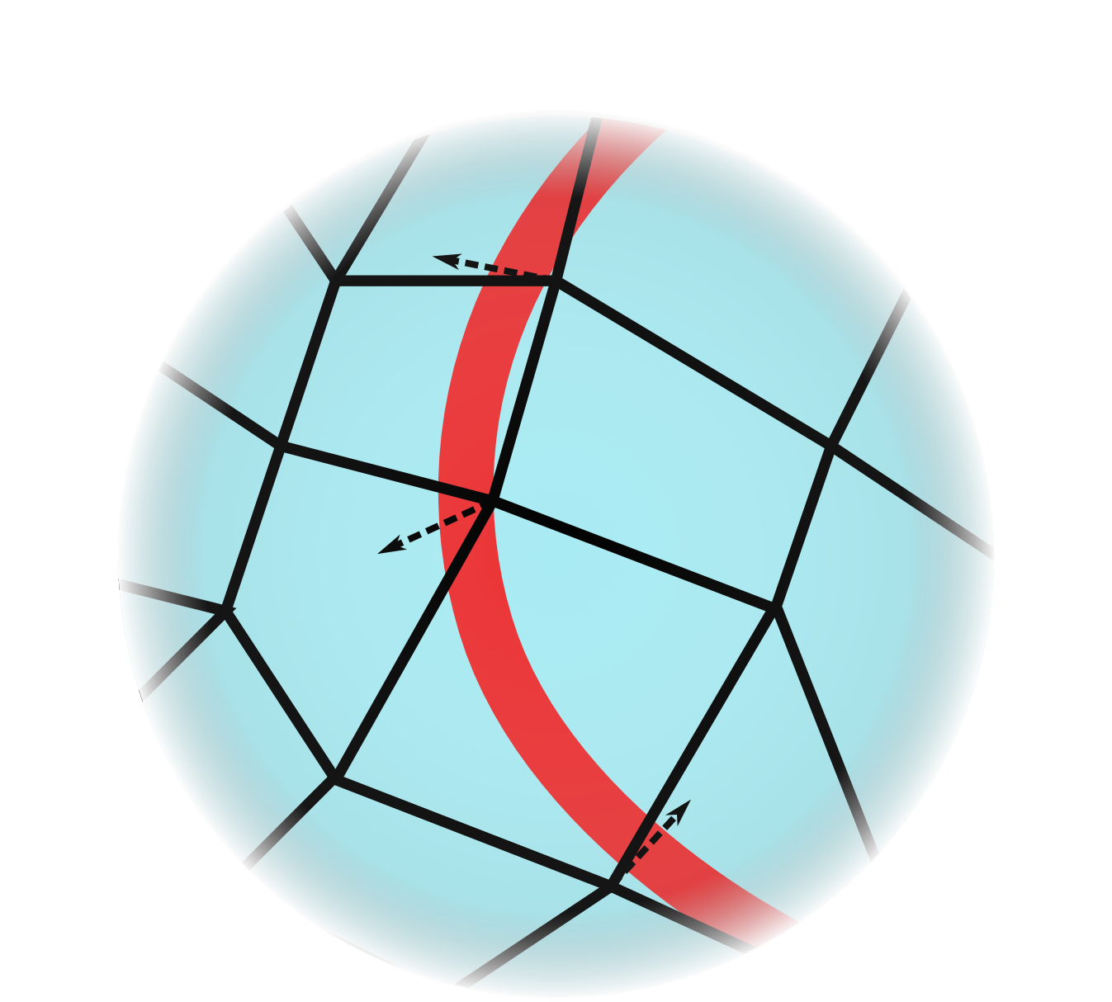
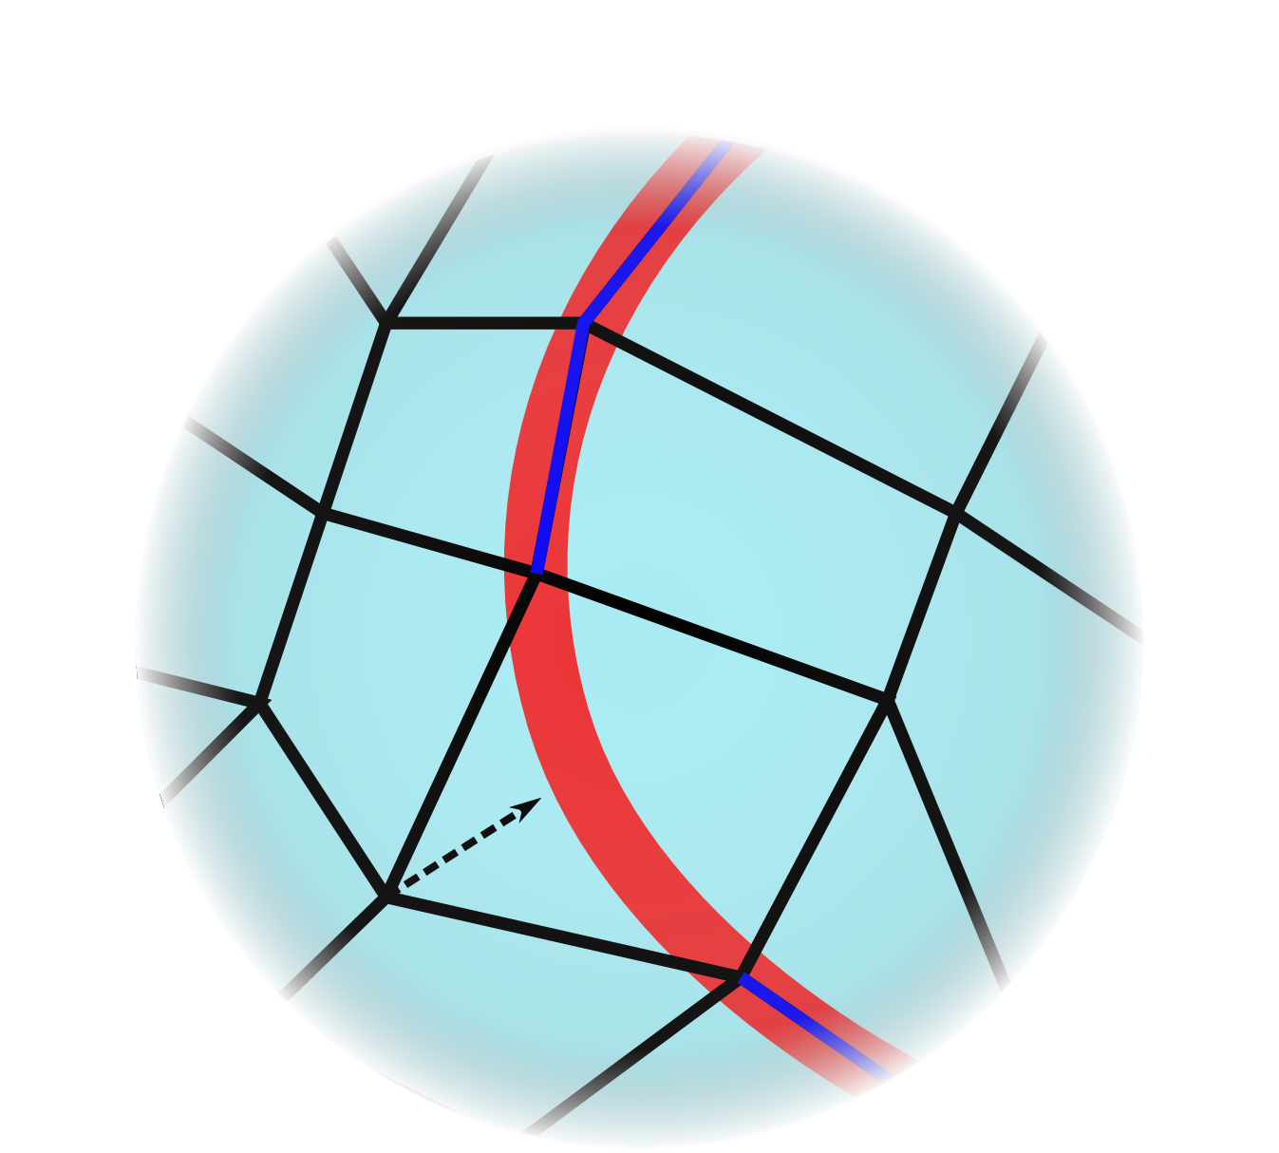
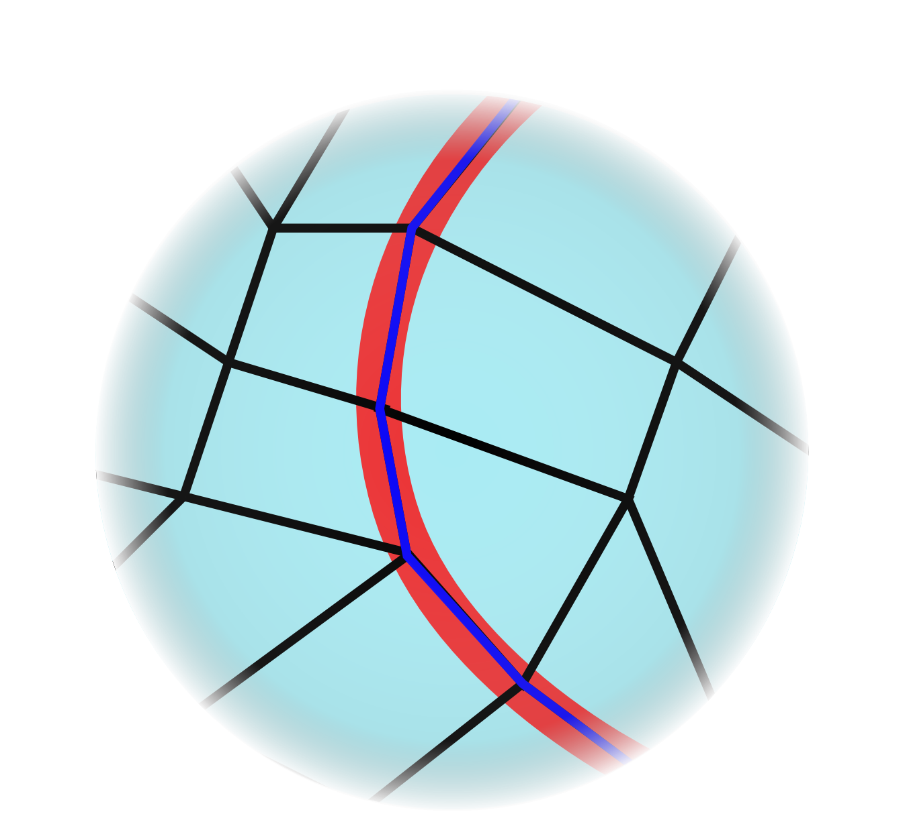
Adding feature-line preservation
Snap vertices (proximity based)
Additional snapping (avoid matching diagonals)
1
2

Slide 36
Adding feature-line preservation
set of feature lines
“preserve these lines as edges,
please”
without
with

Slide 37
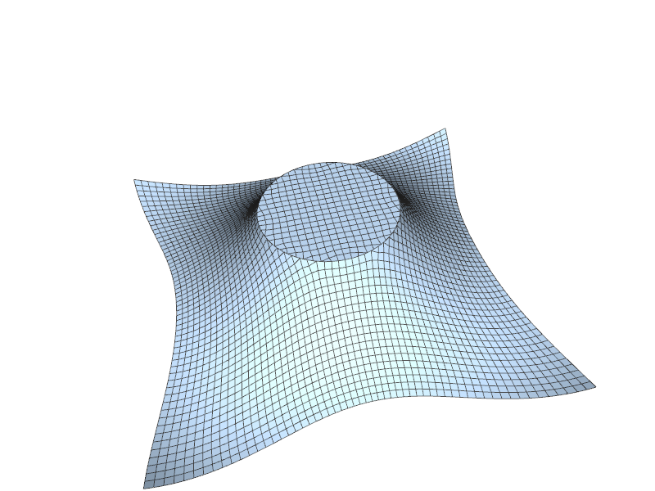
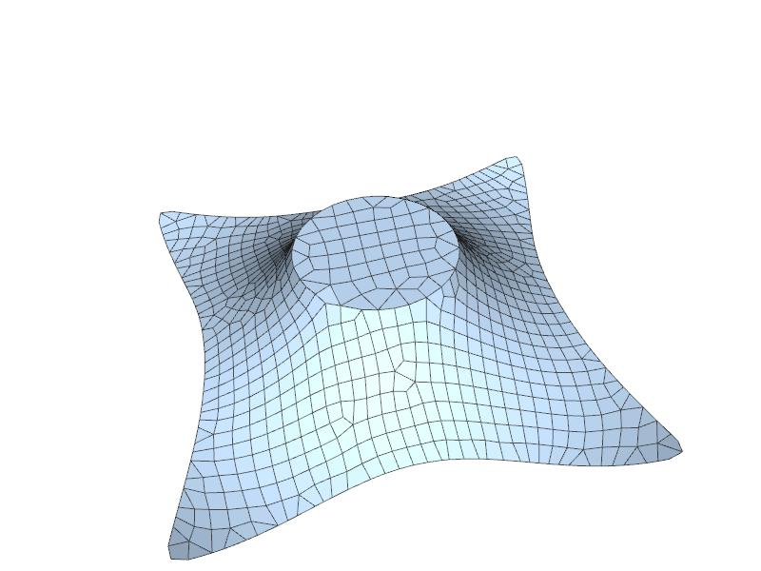
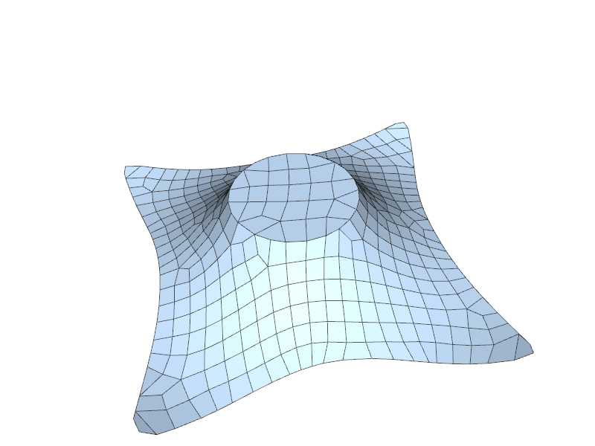
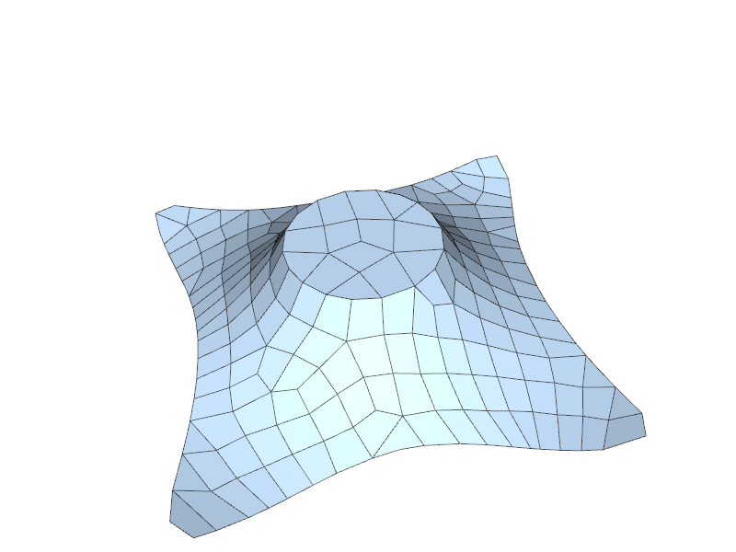
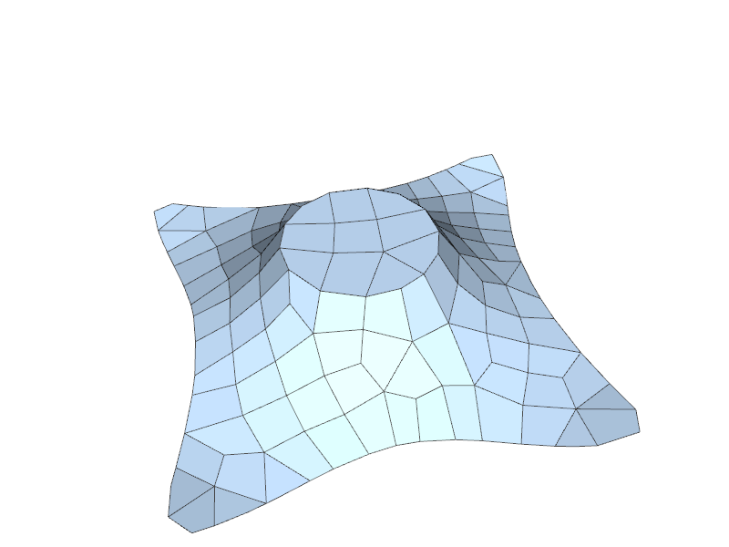
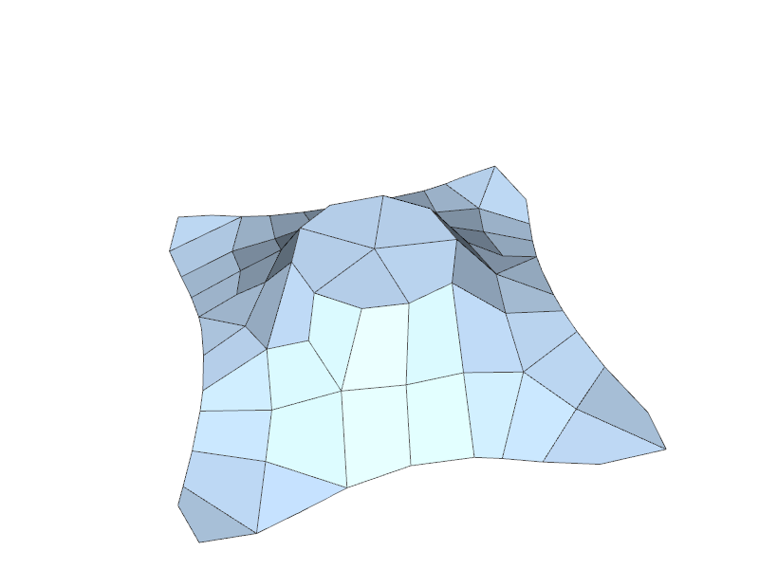
Adding feature-line preservation

Slide 38
Comparison VS [Daniels et al 2009]

Slide 39
Comparison VS [Daniels et al 2009]

Slide 44
Practical quad mesh simplification
FP01: Tuesday, 13:30

Slide 46
Bonus algorithm
From tri-mesh to quad-mesh
merge most tri into “good quad” (heuristic)
make left-over tri “crawl” over surface
result (x1 vertices!)
Catmull Clark (x6 vertices!)
input tri mesh

Slide 47
Future work
Make edges follow curvature direction
Allow for quad anisotropy
Pentagonal mesh simplification
no, just kidding :D

