Slide 1



Global Parametrization of Range Image Sets
Nico Pietroni Marco Tarini
Olga Sorkine Denis Zorin

Slide 2
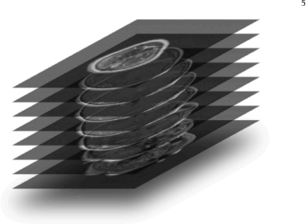
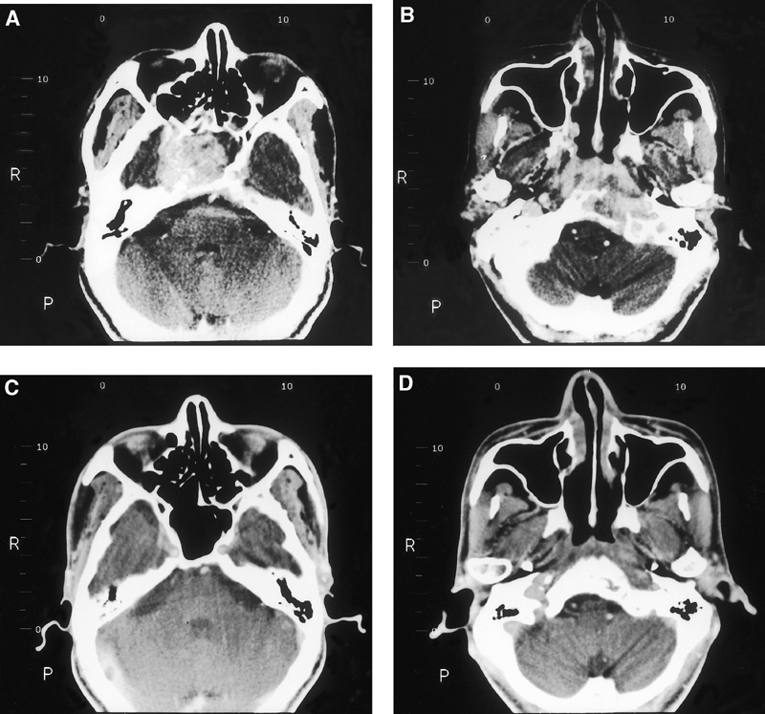
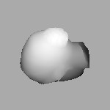
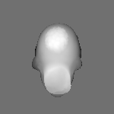
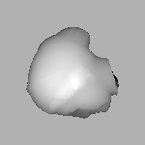
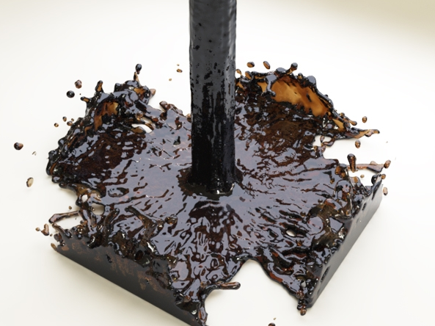
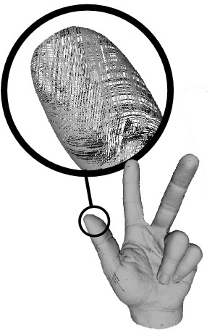
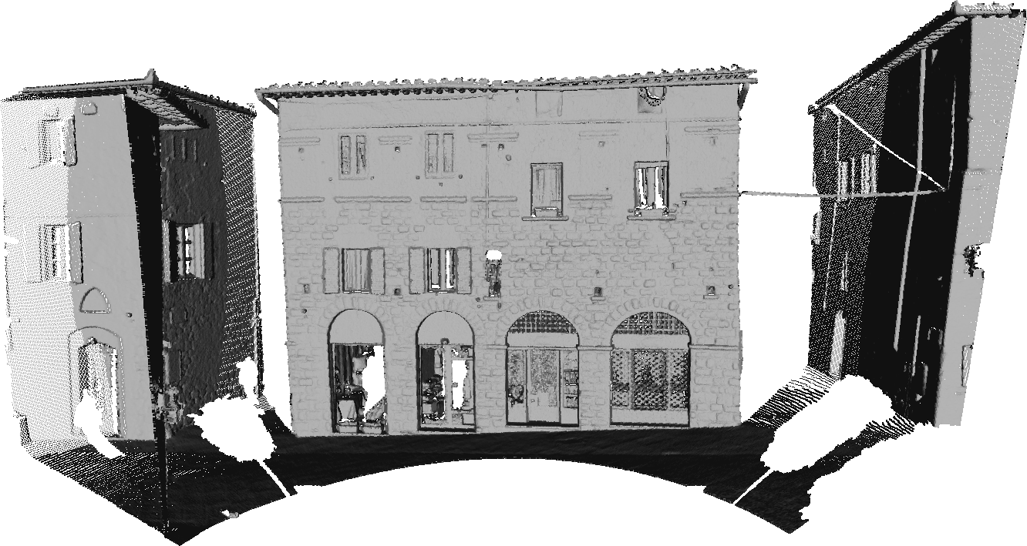
Introduction
Geometry comes in many forms
  volumetric data (CT/MRI/simulation)
  range images
  Implicit surfaces
  ....

Slide 3
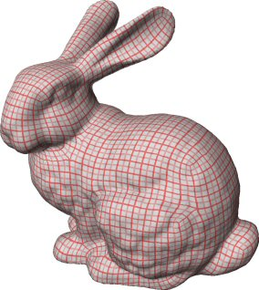
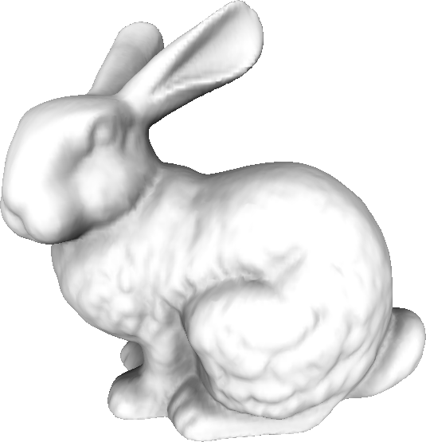
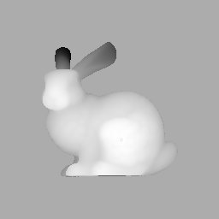
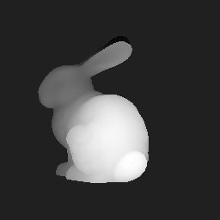
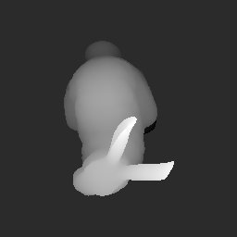
The Classic Pipeline
geometric data
mesh
parametrization

Slide 4
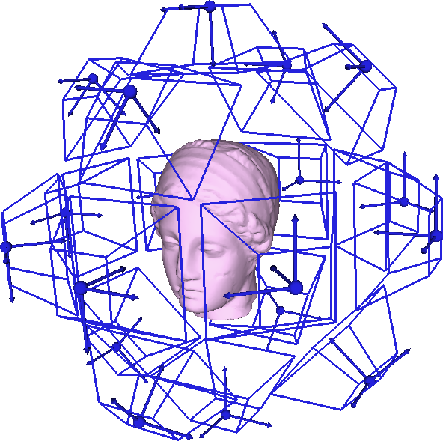
The main Idea
Projections to planes define a manifold atlas
  can solve equations,
  e.g., for parametrization
  chart maps are simple
  projection = rendering
  with z-values

Slide 5
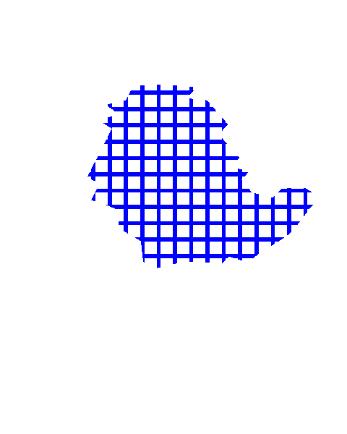
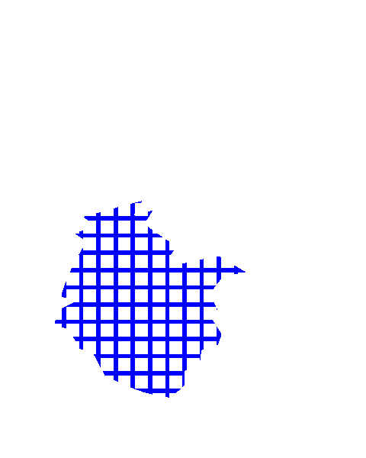
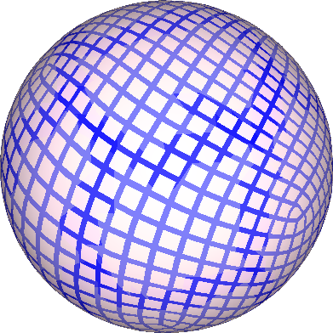
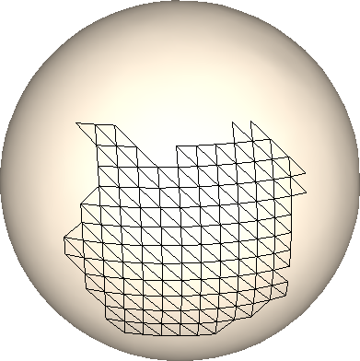
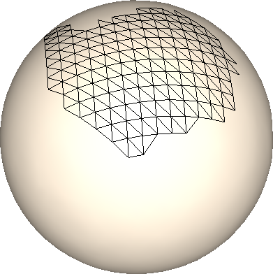
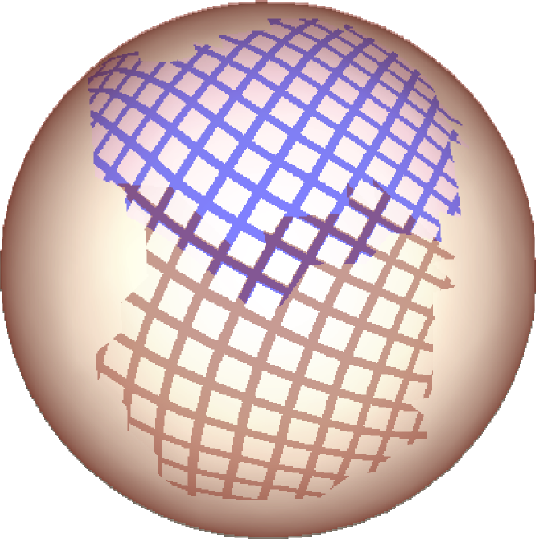


The main Idea
Projections to planes define a manifold atlas
can solve equations, for parametrization
chart maps have a simple structure

Slide 6
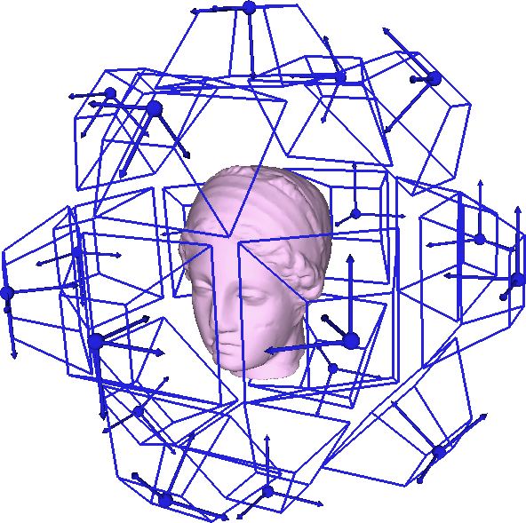
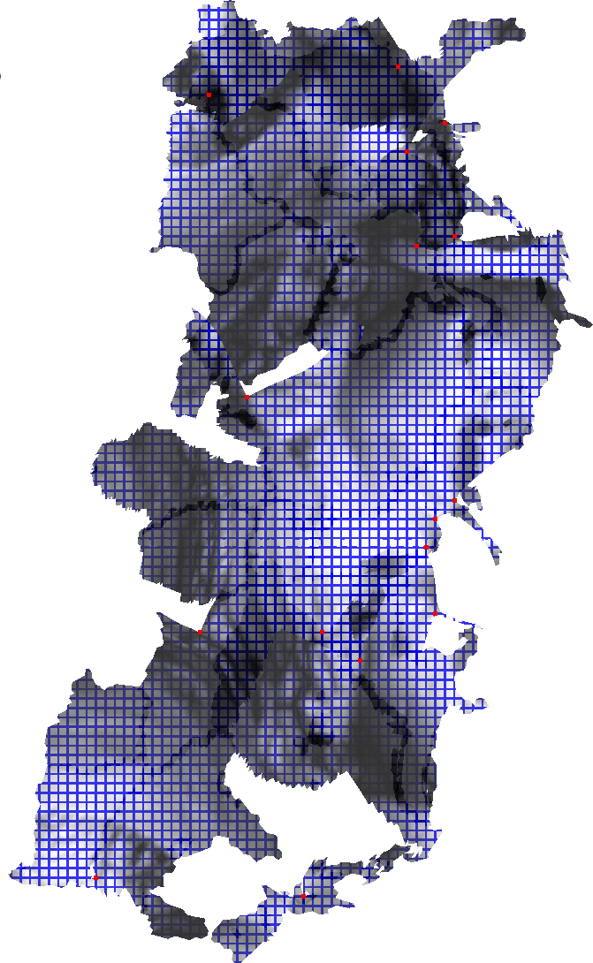
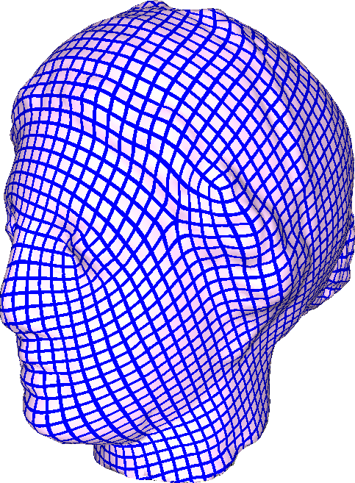
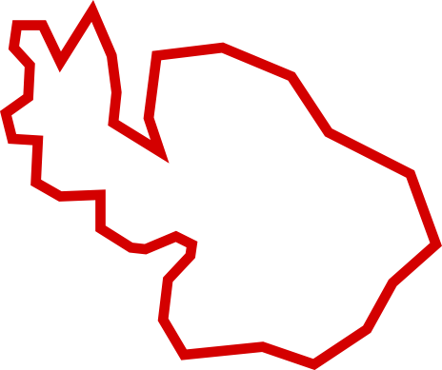
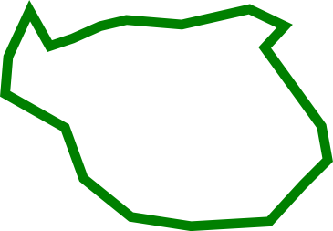
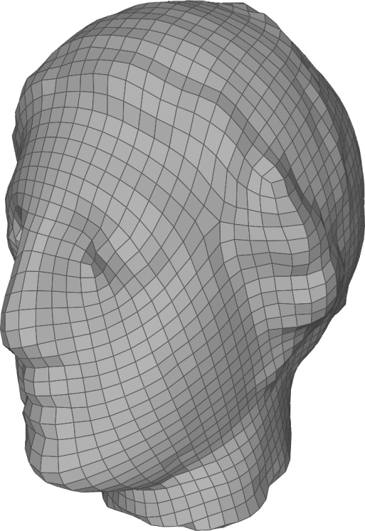


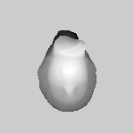
The main Idea
Input

Slide 7
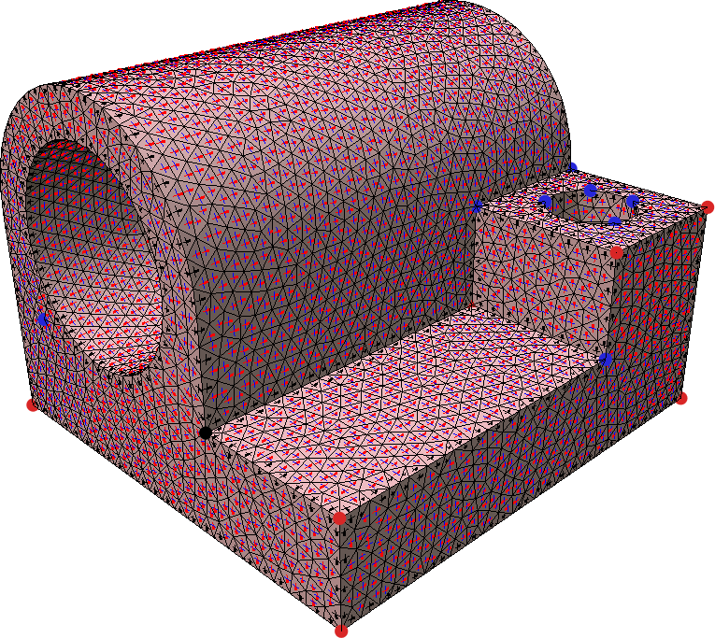
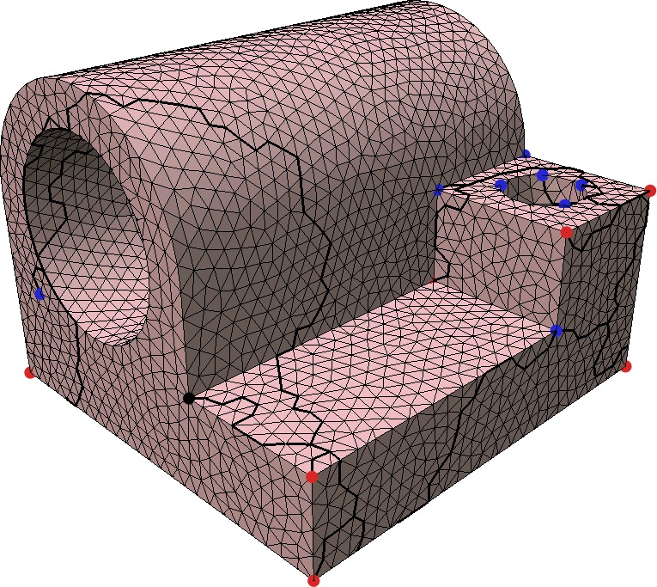
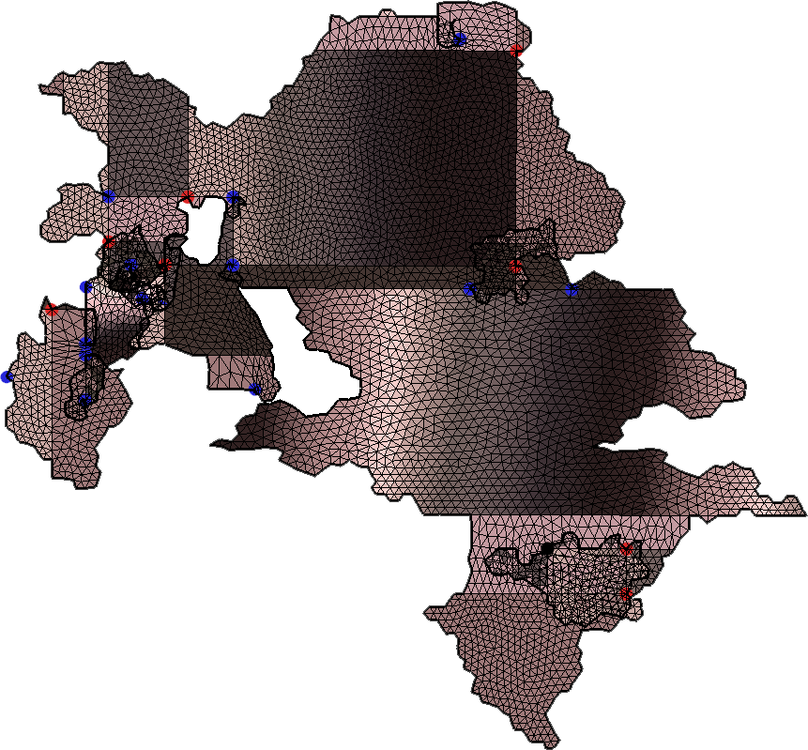
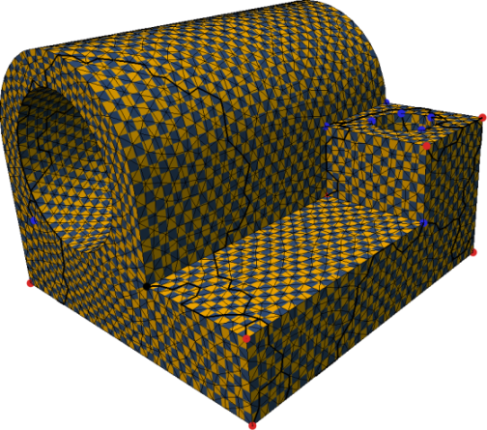
Global Parametrization
cross-field
cut through singularities
domain
image
parametrization
Bommes et Al. Mixed Integer Quadrangulation SIGGRAPH 2009
Kälbrerer et al. Quad-Cover: Surface Parameterization using Branched Coverings EUROGRAPHICS 2007
Ray et al. Periodic global parameterization ACM Trans. Graph. 2006.

Slide 8

Global Parametrization:Cuts
Definition by cutting
  cut the mesh to a disk, map to the plane
  need conditions at seams to make integer isoparametric lines continue across the seam smoothly

Slide 9
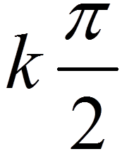
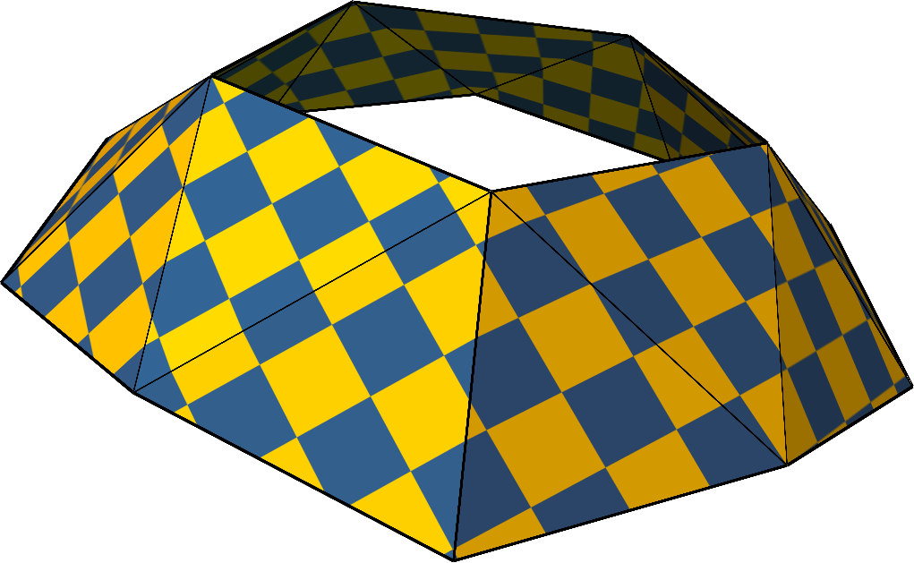




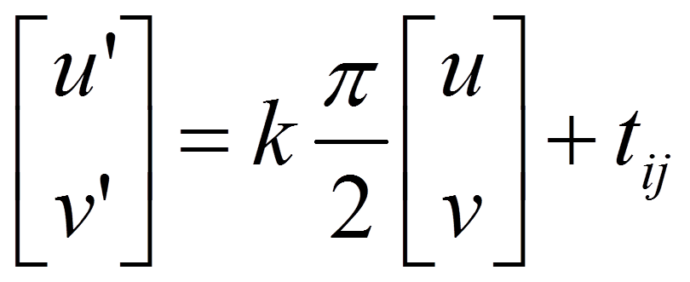
Global Parametrization:Cuts
Definition in terms of a manifold structure
  admissible transition maps are:
    rotations + integer translations
  integer

Slide 10
Mixed Integer Formulation
Optimization problem
  energy per triangle
  constraints per edge belonging to cuts
  mixed-integer problem
  subject to edge constraints along cuts
  variables u ,v and integer t_{ij}

Slide 11
Manifold: Global Parametrization
edge overlap
vertex overlap
  Triangles are not open
  Use arbitrarily small extension
  2 kinds of overlaps

Slide 12
Range Images: Global Parametrization
edge overlap
vertex overlap
  Different meshes involved
  3 kinds of overlaps
  Face Overlap
face overlap

Slide 13
The Overlap Configurations
Three overlap types
  face overlap only possible for triangles from different images
  overlap = proximity in space and orientation
edge overlap
vertex overlap
face overlap

Slide 14
Overlaps:1D Example
Steps
  project the curve to lines to get charts
  transition maps ¿_{ij}
  Per overlap constraint
  Minimize an energy, subject to :
P₃
P₂
P₁
integer jump

Slide 15
Overlaps: real scenario
Similarly…
  Overlapping triangles in 3d maps to different positions in parametric space
  BUT They related by transition functions X
  Linear Constraint with integer variable
integer jump

Slide 16
Weights: 1D Example
1
Integration of weights on Parametric domain.
Values of w(t) = 1/number of overlapping range images at t
P₃
1
2
2
3
P₂
P₁

Slide 17
Weights: real scenario
Integration domains are not disjoint
  weight = 1/number of overlapping triangles
1
2
1
1
3
2
2
1
1

Slide 18
Cycle condition: 1D Example
Cycle conditions
  jumps are not independent
  Cycle condition
  Linear constraint
¿^{jk}
¿^{ki}
¿^{ij}

Slide 19
Cycle condition: real scenario
Cycle condition
  3 faces overlapping each other creates cycles
  Cycle condition as a linear constraint

Slide 20
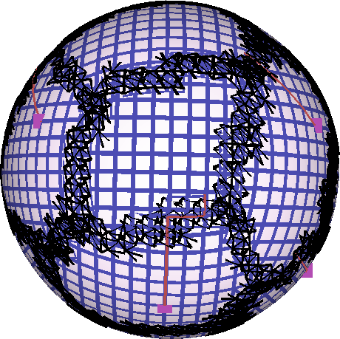
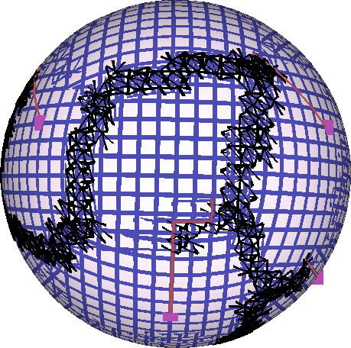
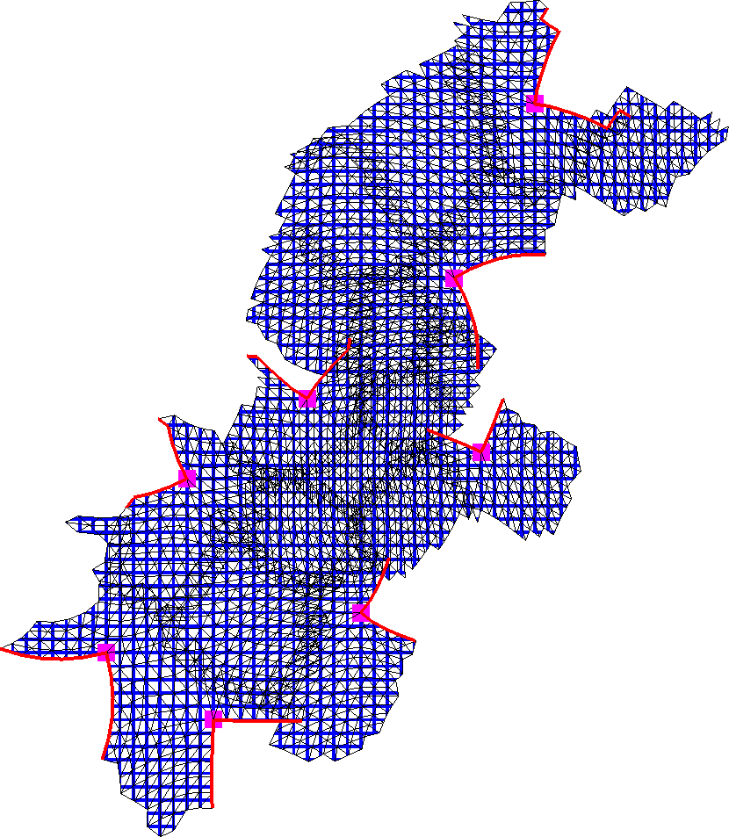
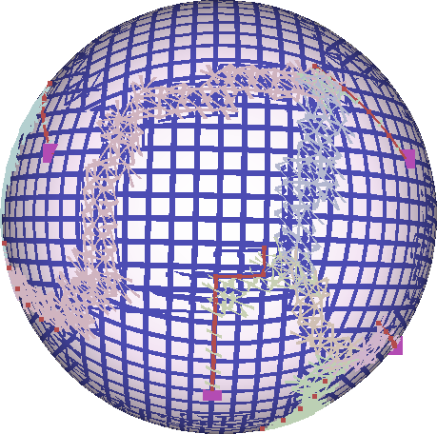
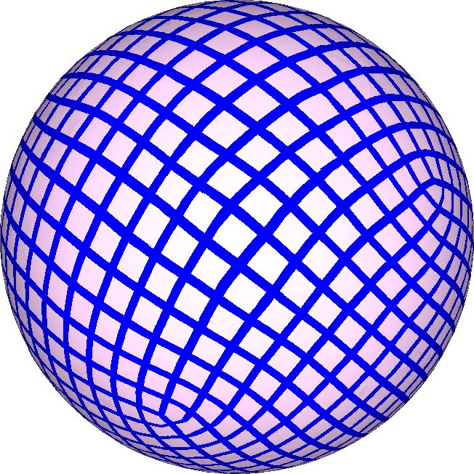
Constraints/Integer Variables Elimination
14276 Integer Variables
4316 Integer Variables
14 Integer Variables
Parametrization

Slide 21
Summary
Variables
  param coords: treat each range image as a mesh
  translation variables: assigned to overlaps as determined by the elimination procedure
Constraints
  symmetrized Galerkin constraints (as explained in the paper)
Energy
  weighted version of Quadcover/MIQ

Slide 22
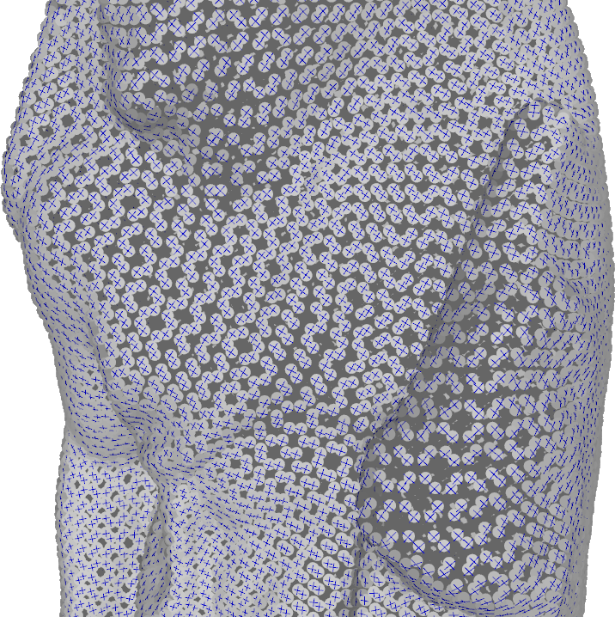
Field Optimization
Similar to MI field optimization
  A value per triangle
  Laplacian-like energy for each pair of neighbors
  Neighbors = overlapping triangles

Slide 23
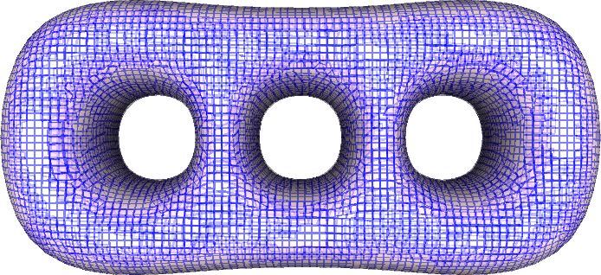
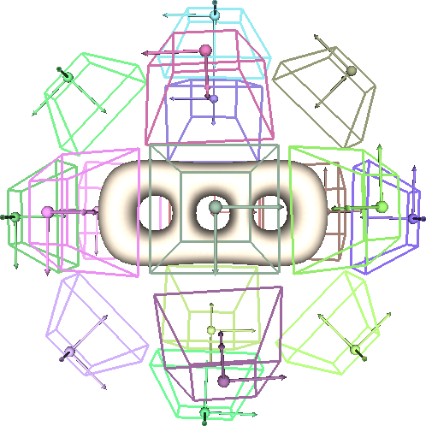
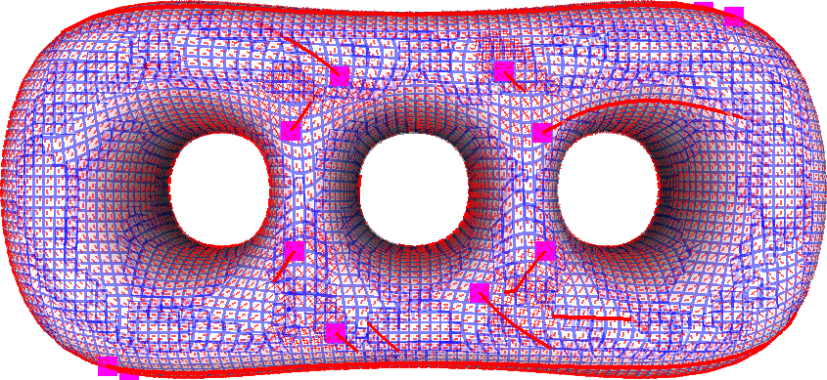
An Illustrative Example
Sampling result
Geometry and cameras
Field singularities and cuts

Slide 24
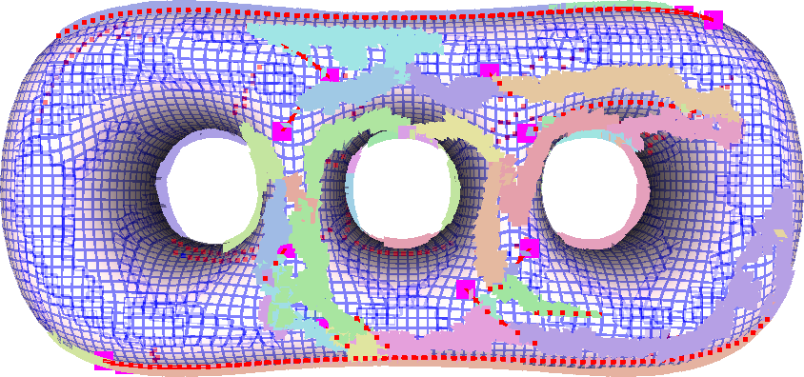
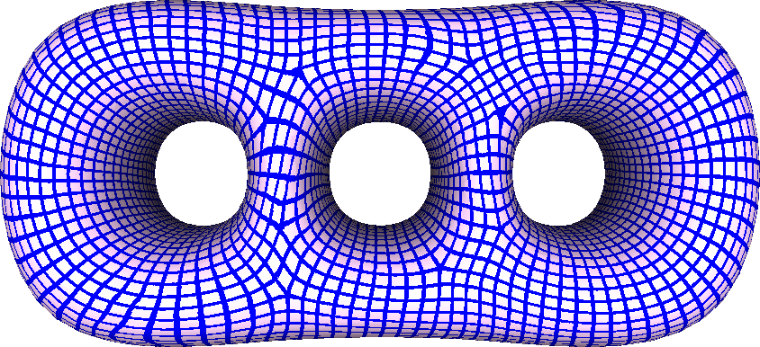
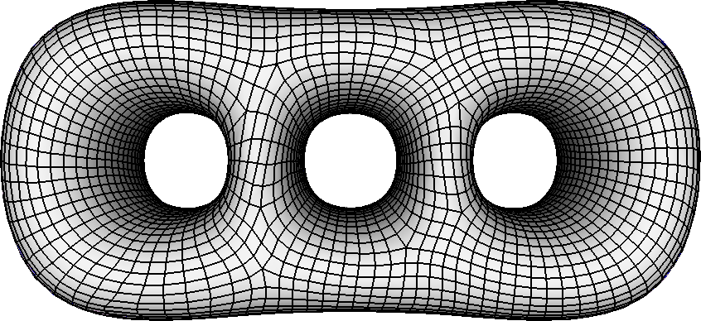
An Illustrative Example
Reduce constraints/variables
solve mixed-integer problem
quadrangulate by tracing integer parameter lines

Slide 25
Global Parametrization of Range Image Sets
RESULTS

Slide 26
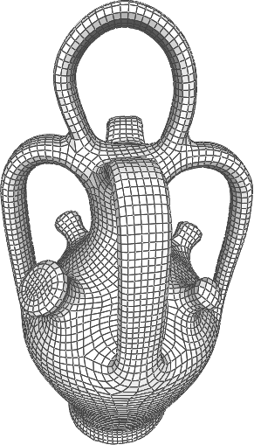
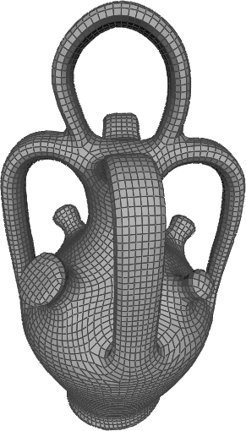
Screen Space vs Manifold Mesh
Distribute views on a sphere
Use depth peeling
Get OPENGL Depth Buffer
Compared with a method for manifold triangle mesh
mixed-integer quadrangulation
our method
Data courtesy of Carlos Hernadèz
Bommes et Al. Mixed Integer Quadrangulation SIGGRAPH 2009

Slide 27
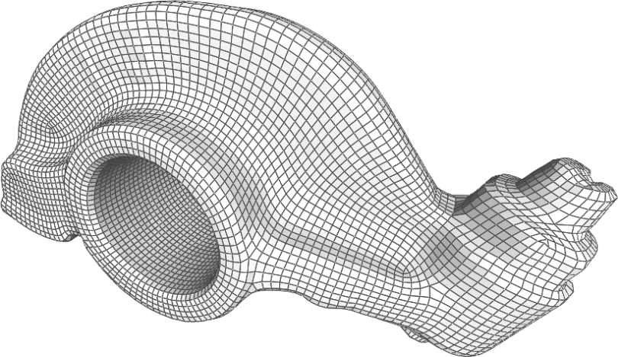
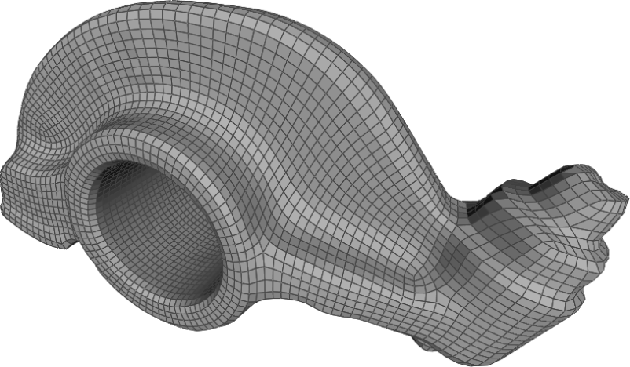
Screen Space vs Manifold Mesh
Distribute views on a sphere
Use depth peeling
Get OPENGL Depth Buffer
Compared with a method for manifold triangle mesh
mixed-integer quadrangulation
our method
Bommes et Al. Mixed Integer Quadrangulation SIGGRAPH 2009

Slide 28

Point Clouds
Point clouds can be rendered using point based techniques (splats) and then parameterized.
Data courtesy of AIM@Shape

Slide 29

Polygon Soup
Artificially made difficult
  each triangle randomly perturbed

Slide 30

Non Manifold
Not sensitive to small flaws

Slide 31







Implicit Surfaces
Molecular models are rendered by using QUTEMOl
Tarini et Al. Ambient Occlusion and edge cueing to enhance real time molecular visualization IEEE VISUALIZATION 2006

Slide 32

Real Range Scans
Using original camera positions
Using original range images

Slide 33

Real Range Scans
Data coming from range images has merged and resampled in screen space

Slide 34

Big Meshes
Coarse quad meshes from high resolution ones
Number of triangle of original mesh effects only the acquisition of range images
8M triangles
2M triangles

Slide 35
Conclusions and Future Work
  Global parametrization with a simple unified interface to many geometry types
  Even a basic projection manifold construction procedure works well; but better ones can be designed
  Currently, no handling of sharp features, no attempts at hole filling or water-tightness etc
  Can use high-order bases, take advantage of regular sampling on range images, domain decomposition for hi-res solves…

Slide 36







Thanks!
Global parametrization of Range Image Sets
Nico Pietroni Marco Tarini Olga Sorkine Denis Zorin

Slide 37


Limitations
Noisy data
Incomplete coverage

Slide 38




















Cycles with identity transforms
Cycles with two identity transforms
  Set the remaining one to zero
Cycles with one identity transform
  Build a graph, each connected component needs a single variable

Slide 39
Constraint elimination
4 steps
  Set to identity along a spanning tree
  Set to identity for all cycles with two identities
  Build a graph with nodes = overlap constraints and edges present iff two constraints are a part of a cycle with one identity
  Build a spanning tree in each component, eliminate

Slide 40
Constraint elimination
2-id cycles used
1-id cycles used
parametrization

Slide 41
Hausdorff spaces
In addition to cycle conditions need to make sure that the overlaps result in Hausdorff space
  any 2 points have disjoint neighborhoods
  not an exotic problem when the manifold is obtained by gluing
  a type of local transitive closure on the overlap graph

