Slide 1
Simple Quad Domains for Field Aligned Mesh Parametrization
Marco Tarini Enrico Puppo
Daniele Panozzo Nico Pietroni Paolo Cignoni
Visual Computing Lab
ISTI-CNR, Pisa, Italy
Università dell’Insubria Varese, Italy
Università degli Studi di Genova, Italy

Slide 2
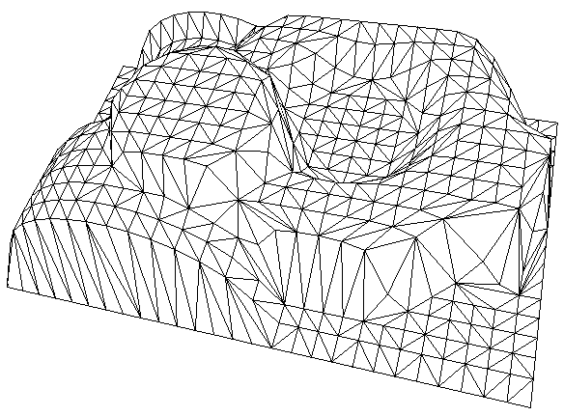
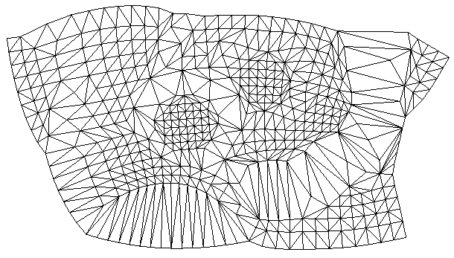
In theory…
parameterization: bijective mapping between a surface and a (planar) domain
f ⁻¹
f
S
D

Slide 3
Intro
parameterizations are extra-useful tools for:
(semi-)regular remeshing
texture mapping
geometry processing in general
physical simulations
much much more…
Good quality needed!
angle + areas preserving
globally smooth
feature aligned
transition functions across cuts
f ⁻¹
Some Planar Domain
surface
f

Slide 4
Intro: good parameterizations
bijectivity
conformality
area preservation
“global smoothness”
i.e. continuity of ∇f_{u} and ∇f_{v} … up to rotations by K pi/4
feature alignment
alignment of ∇f_{u} and ∇f_{v} to geometric features
“cuts” ok, if “tamed”
i.e. discontinuity of f ⁻¹ ok, if good transition functions
}
isometry

Slide 5
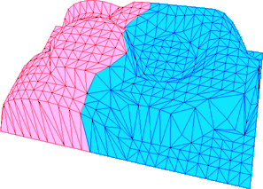
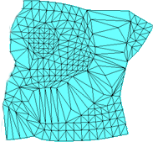
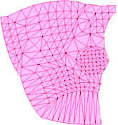
Intro: “tamed” cuts
f ⁻¹
D
S
f
t
Transition function:
integer translation +
“integer” rotation

Slide 6
Intro
Given this, find this and this
f ⁻¹
Some Planar Domain
surface
f

Slide 7
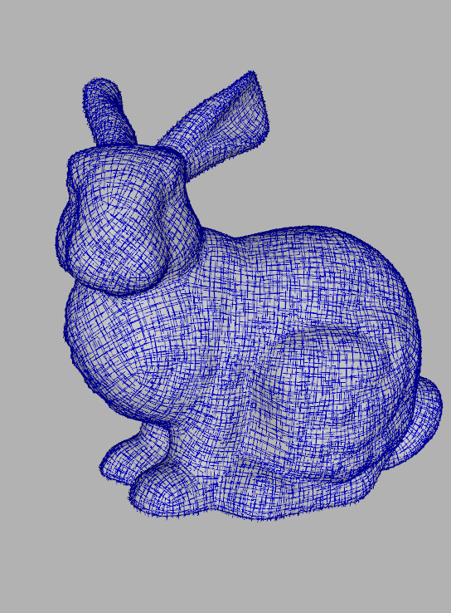
Intro: the recent breakthrough
define an input cross field over S
find f such that ∇f_{u} , ∇f_{v} match it!
(plus, enforce good transition functions across cuts)
Ray, Li, Levy, Scheffer, Alliez Periodic global parametrization
Kälberer, Nieser, Polthier QuadCover
Bommes, Zimmer, Kobbelt Mixed Integer Quadrangulation

Slide 8
Intro: a trend in parametrization
disregard (!)
bijectivity
conformality
area pres.
“global smoothness”
feature alignment
“cuts” ok, if “tamed”
}
make ∇f_{u} , ∇f_{v} match an input cross field defined on the surface
isometry
constraint transition func. of f
Ray, Li, Levy, Scheffer, Alliez Periodic global parametrization
Kälberer, Nieser, Polthier QuadCover
Bommes, Zimmer, Kobbelt Mixed Integer Quadrangulation

Slide 9
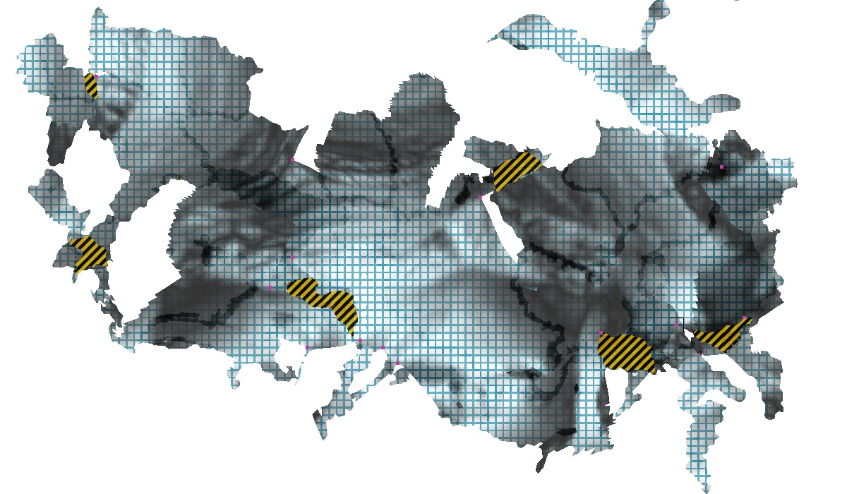
the typical result
S
D
f ⁻¹
f
Ray, Li, Levy, Scheffer, Alliez Periodic global parametrization
Kälberer, Nieser, Polthier QuadCover
Bommes, Zimmer, Kobbelt Mixed Integer Quadrangulation

Slide 10
A typical U-V Domain
irregular borders!
tentacles!
useful tool for:
(semi-)regular remeshing
texture mapping
geometry processing in general
physical simulations
much much more…
overlaps!

Slide 11
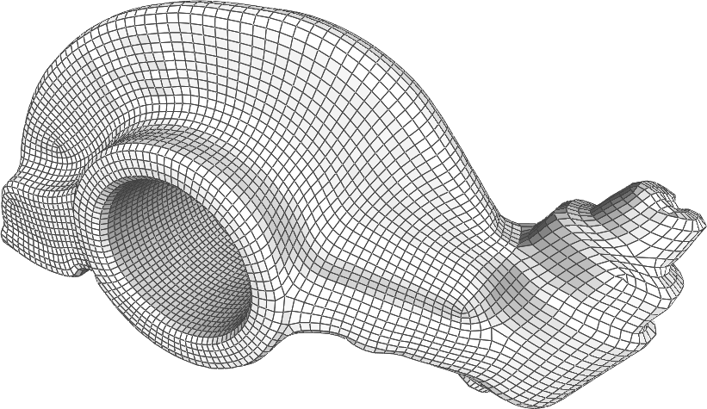
A typical U-V Domain
Is it really ideal for semi-regular remeshing?
misaligned irregular vertices
(bad, for example, for reverse engeneering)

Slide 12
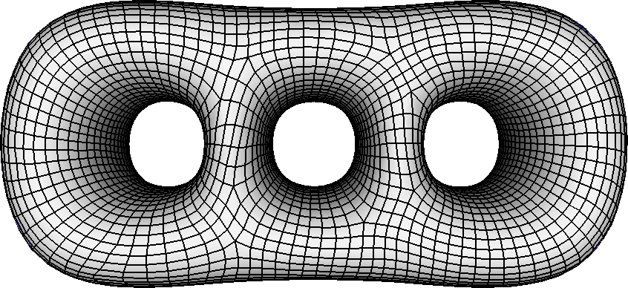
A typical U-V Domain
Is it really ideal for semi-regular remeshing?
misaligned irregular vertices
(bad, for example, for reverse engeneering)

Slide 13
A typical U-V Domain
irregular borders!
tentacles!
useful tool for:
(semi-)regular remeshing
texture mapping
geometry processing in general
physical simulations
much much more…
overlaps!

Slide 14
Objective: simplicity of Domain
“Simplicity” of Domain
a concept encapsulating:
simple shape of the domain
that few cuts are used
simple cut shape (e.g. lines)
simple transition functions
total bijectivity
f ⁻¹
Planar Domain
surface
f

Slide 15
Objective
go for Simplicity of Domain
keep usual objectives too
isometry, global smoothness, alignment, good cuts
keep “start from cross-field” idea

Slide 16
Similarly motivated recent work:
D.Bommes, T.Lempfer, L.Kobbelt. Global structure optimization of quadrilateral meshes. CGForum 2011
A. Myles., N.Pietroni, D.Kovacs., D.Zorin Feature-aligned t-meshes. Siggraph 2010
C-H Peng, E Zhang, Y. Kobayashi, P. Wonka: Connectivity Editing for Quadrilateral Meshes SiggAsia 2011

Slide 17
Instead of
irregular borders!
tentacles!
overlaps!

Slide 18
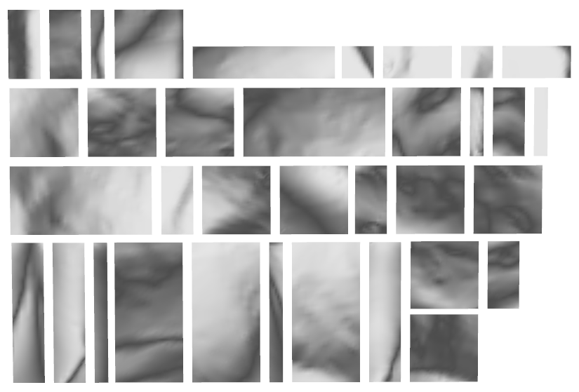
Proposed domain
useful tool for:
(semi-)regular remeshing
texture mapping
geometry processing in general
physical simulations
much much more…
a collection of rectangles
as few as possible
integer sized
side-to-side adjacency (no t-junctions!)
two-manifold connectivity (but no 3D embedding)
1:1 side-to-side transitions

Slide 19
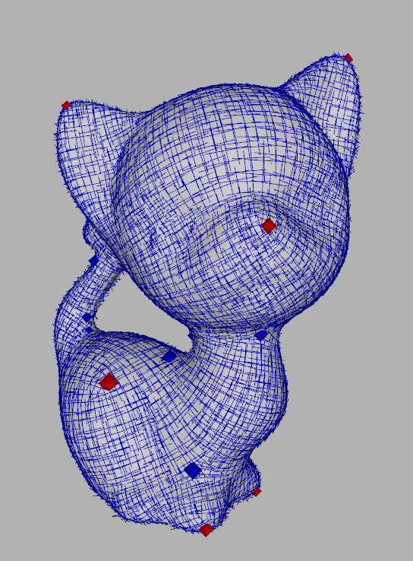
Problem statement
Given this, find this and this
f ⁻¹
f
Surface + CrossField
Simple 2D domain

Slide 20
Start from a cross field…
Irregular point

Slide 21
Start from a cross field…
start cutting form an irregular point
continue cutting following the crossfield
end cut in another irregular point
repeat from 1
==> you built a “graph of separatrices”!

Slide 22
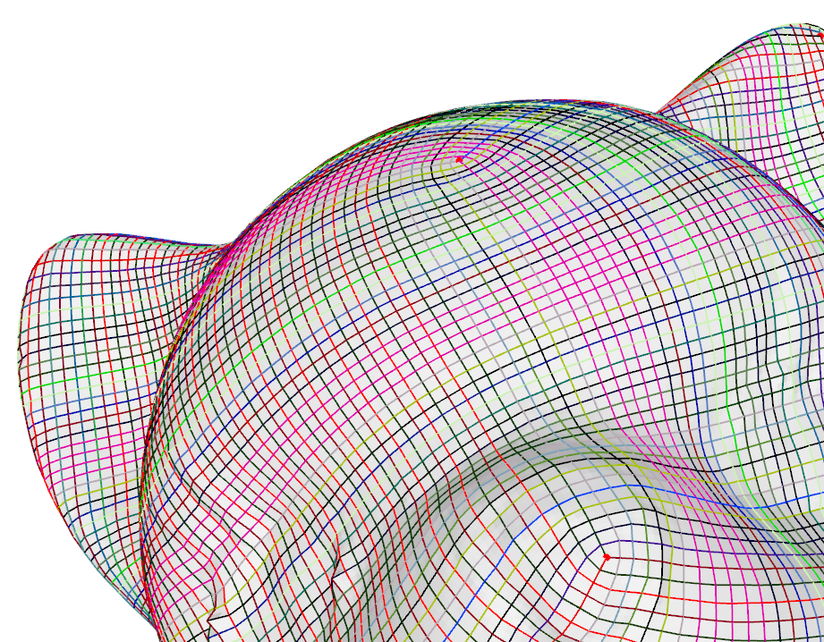
Start from a cross field…
…end up with confetti! :-(

Slide 23
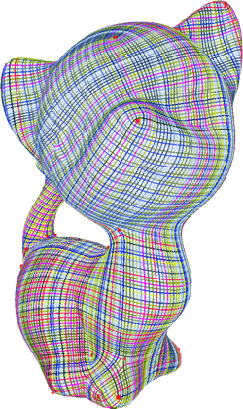
Method overview
Extract the Graph of Separatrix from the Input Cross-Field
1
Input Cross-Field
Initial Graph of Separatrices

Slide 24
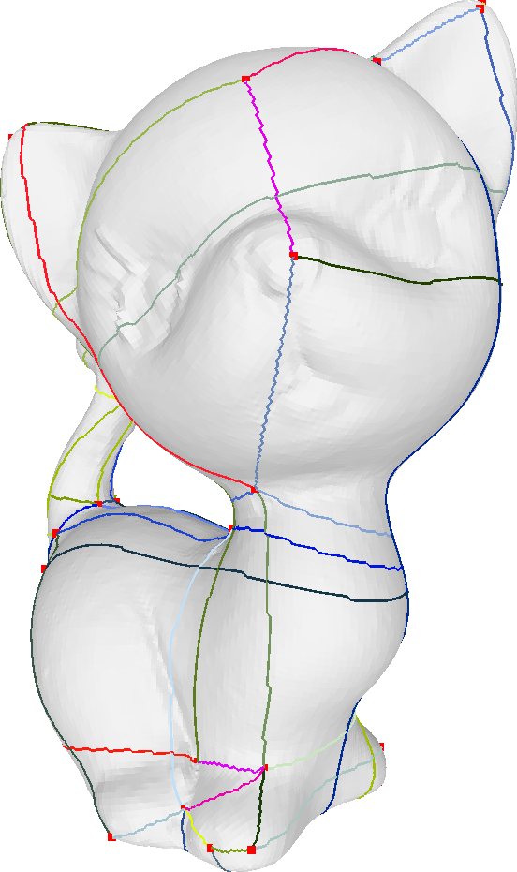
Method overview
Semplify the graph of separatrices
this defines a new cross field!
similar to old
BUT: reciprocally aligned irregular points
1
2
Input Cross-Field
Initial Graph of Separatrices
Simplified Graph of Separatrices

Slide 25
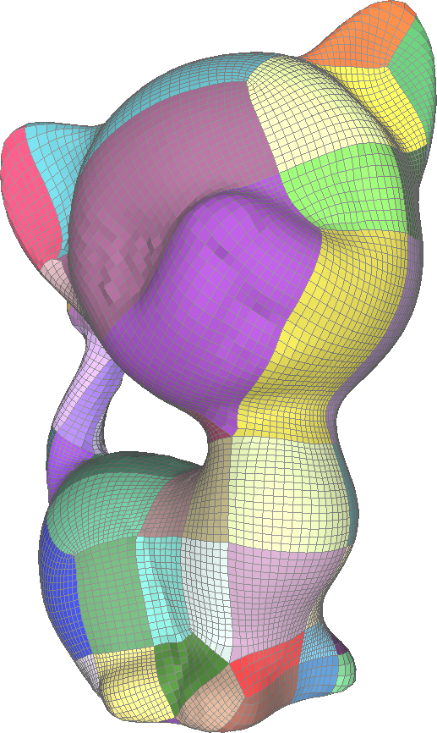
Method overview
Final global optimization and smoothing
includes re-tuning positions of irregular points!
1
2
3
Input Cross-Field
Initial Graph of Separatrices
Simplified Graph of Separatrices
Global Parametrization

Slide 26
Method overview
1
2
3
Input Cross-Field
Initial Graph of Separatrices
Simplified Graph of Separatrices
Global Parametrization

Slide 27
Workflow Overview
How to do this?
1
Input Cross-Field
Initial Graph of Separatrices
Simplified Graph of Separatrices
Global Parametrization

Slide 28
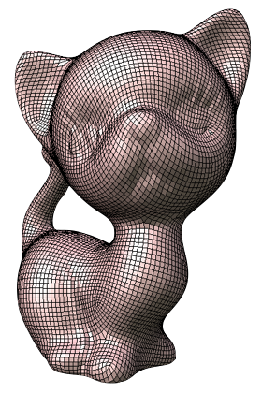
Workflow Overview
Initial semiregular quad-mesh
0
Discretize the cross field:
build a quad resampling (use [Bommet at Al 2009] )
1
1
Input Cross-Field
Initial Graph of Separatrices
Simplified Graph of Separatrices
Global Parametrization

Slide 29
Workflow Overview
Initial semiregular quad-mesh
0
1
2
3
Input Cross-Field
Initial Graph of Separatrices
Simplified Graph of Separatrices
Global Parametrization

Slide 30
Method overview
next: GRAPH SIMPLIFICATION ALGORITHM
1
2
Input Cross-Field
Initial Graph of Separatrices
Simplified Graph of Separatrices
Global Parametrization

Slide 31
Graph of Separatrices
surface S
q₁₂
q₂
q₁
q₁₃
q₁₁
q₇
q₉
q₀
q₃
q₆
q₈
q₁₀
q₅
q₄
Irregular Point
of original cross field
Cross-over
Separatrix
following original cross field

Slide 32
Graph Simplification
surface S
q₁₂
q₂
q₁
q₁₃
q₁₁
q₇
q₉
q₀
q₃
q₆
q₈
q₁₀
q₅
q₄
Opening Move ( ++ )
Continuation Move
Continuation Move
. . .
Continuation Move
Closing Move ( -- )
one
simplification
cycle

Slide 33
Opening Move

Slide 34
Opening Move

Slide 35
Continuation Move

Slide 36
Continuation Move
?
ok!

Slide 37
Continuation Move
ok!

Slide 38
Continuation Move

Slide 39
Continuation Move
before

Slide 40
Continuation Move
after

Slide 41
Continuation Move
after
cross-field
α (“drift”)

Slide 42
Energy associated to a separatrix
total drift
strive to follow original field
===> “change cross-Field the least”
total lenght
strive to make them short
===> “simplify graph the most”
the only parameter
(we used K = 5)
note: it’s scale independent! ☺

Slide 43
After many Continuation Moves…

Slide 44
Closing Move

Slide 45
Closing Move

Slide 46
Graph Simplification
Opening Move ( ++ )
Continuation Move
Continuation Move
. . .
Continuation Move
Closing Move ( -- )
Opening Move ( ++ )
Continuation Move
Continuation Move
. . .
Continuation Move
Closing Move ( -- )
...
simplification
cycle 1
simplification
cycle 2

Slide 47
Searching the solution space
States:
consistent
inconsistent
Potential moves:
opening
continuation
closing
Strategies
depth first (backtracking mechanism)
greedy (most appealing moves first)
pruning (refuse overall energy increases)
dynamic prog. (mark already seen states)

Slide 48
Method overview
GRAPH SIMPLIFICATION ALGORITHM
results
1
2
Input Cross-Field
Initial Graph of Separatrices
Simplified Graph of Separatrices
Global Parametrization

Slide 50
Simplification Results

Slide 52
Method overview
Initial semiregular quad-mesh
0
1
2
3
Input Cross-Field
Initial Graph of Separatrices
Simplified Graph of Separatrices
Global Parametrization

Slide 53
Workflow Overview
Initial semiregular quad-mesh
next: FINAL SMOOTHING PHASE
0
1
2
3
Input Cross-Field
Initial Graph of Separatrices
Simplified Graph of Separatrices
Global Parametrization

Slide 54
Final smoothing: objective
A
A
A
A
B
B
B
B
misaligned singularities
aligned singularities
re-optimized
graph simplification
final smoothing
Initial Graph
Simplified Graph
Final Parametrization

Slide 55
Final Optimization Phase: summary
Responsible for
relax param inside patches
smooth lines between patches
optimize positions of singularities !
How to:
“quincux” strategy
exploit domain simplicity!

Slide 56
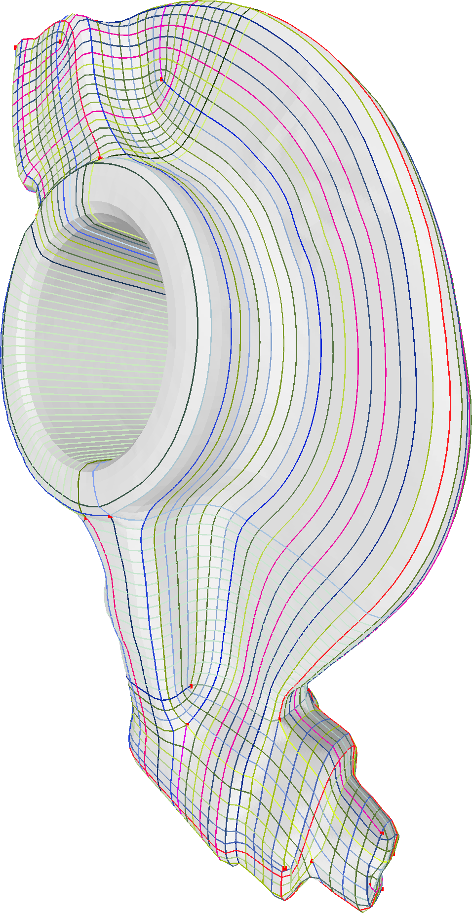
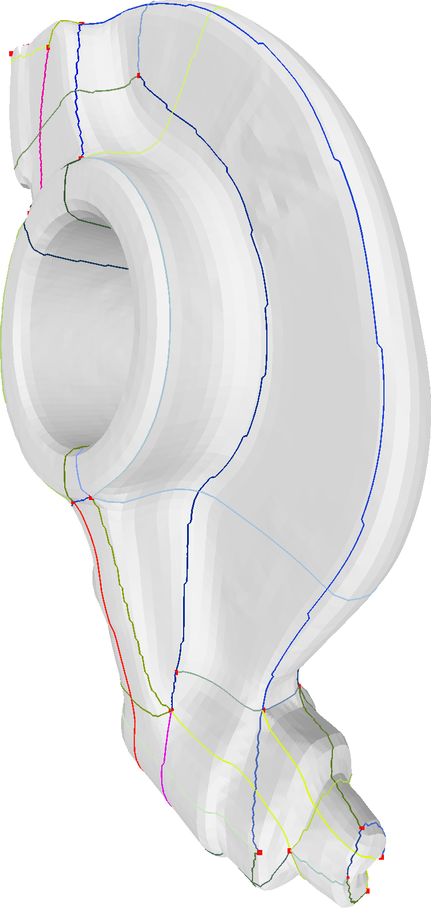
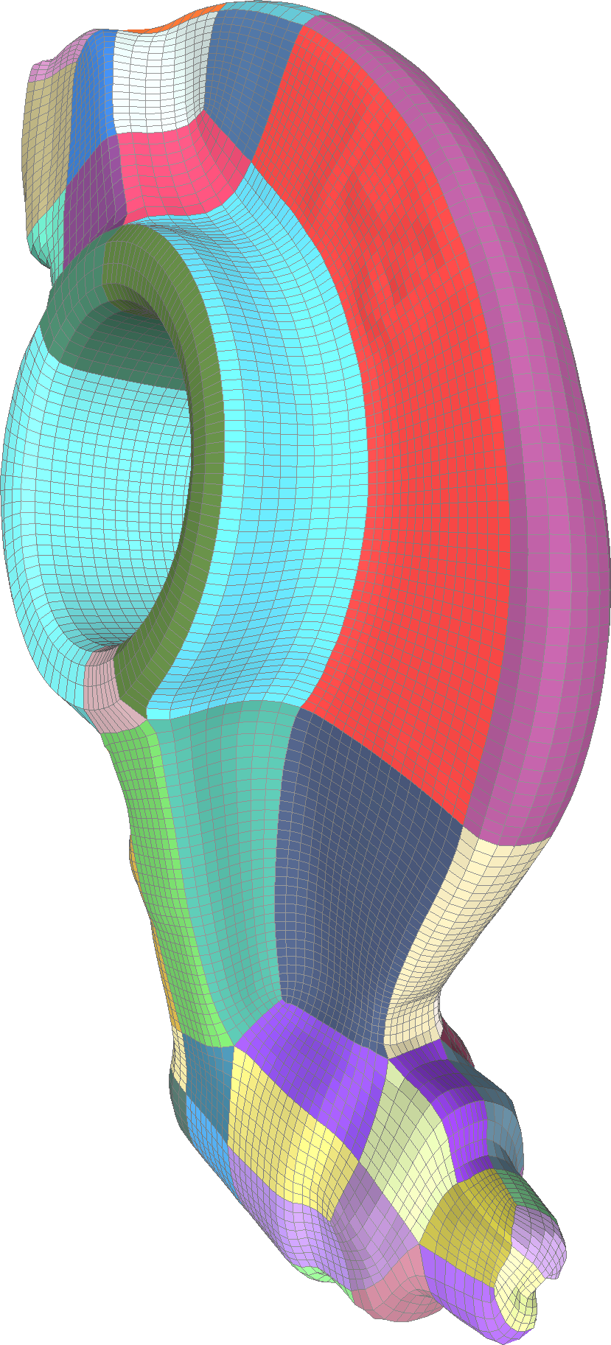
Results
4524 rectangular regions
98 rectangular regions

Slide 57
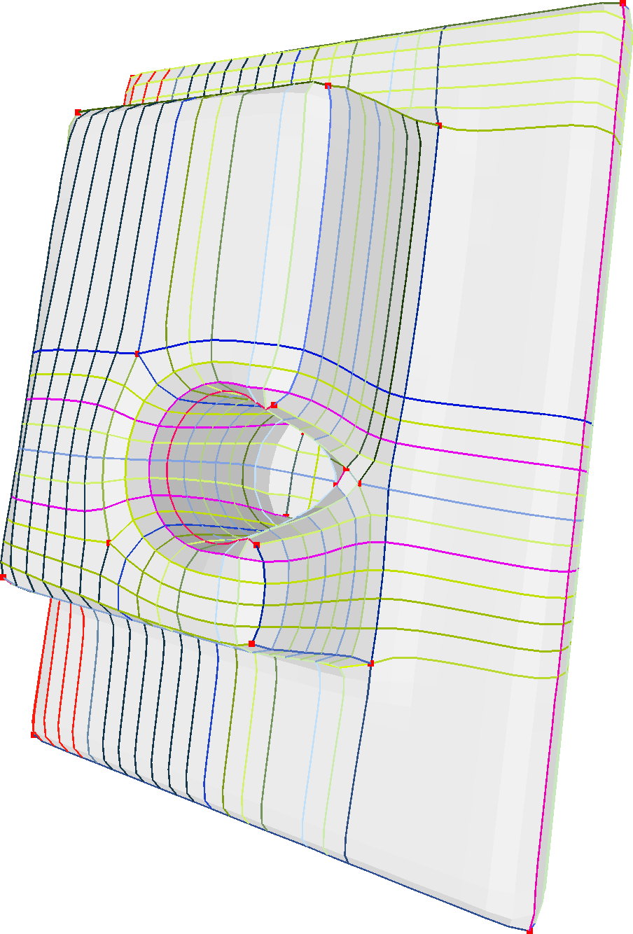
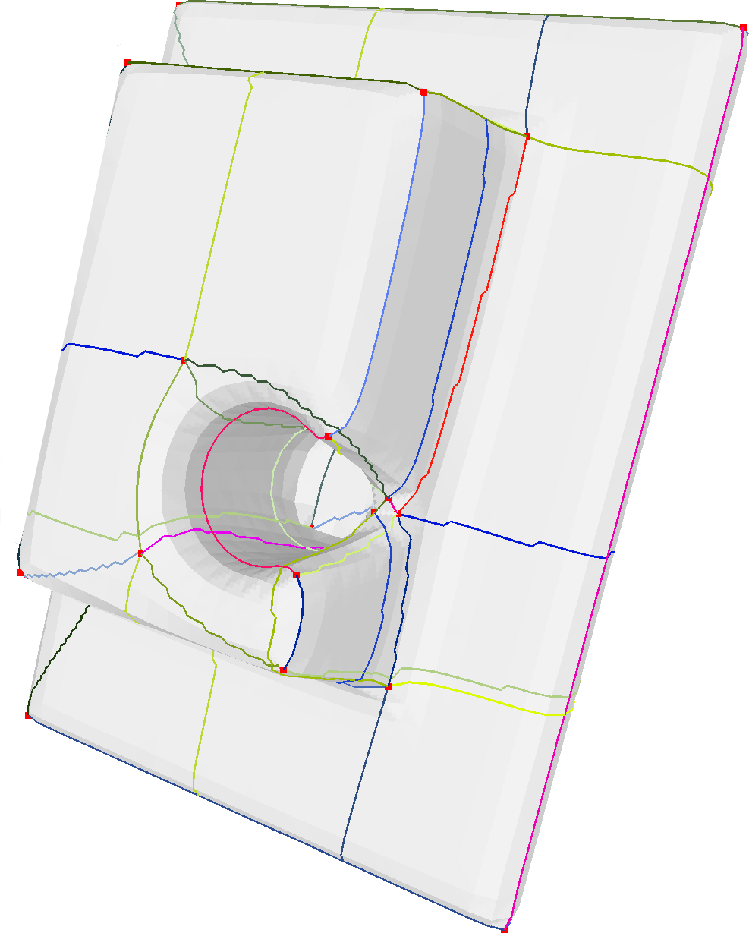
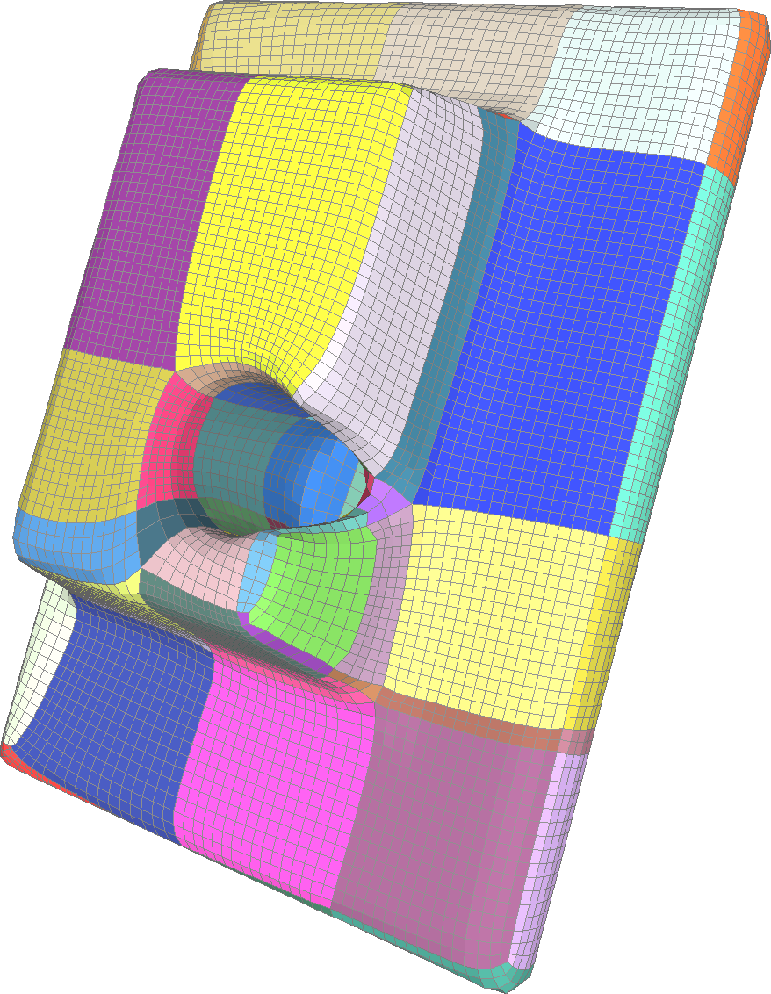
Results
1368 rectangular
regions
82 rectangular
regions

Slide 58
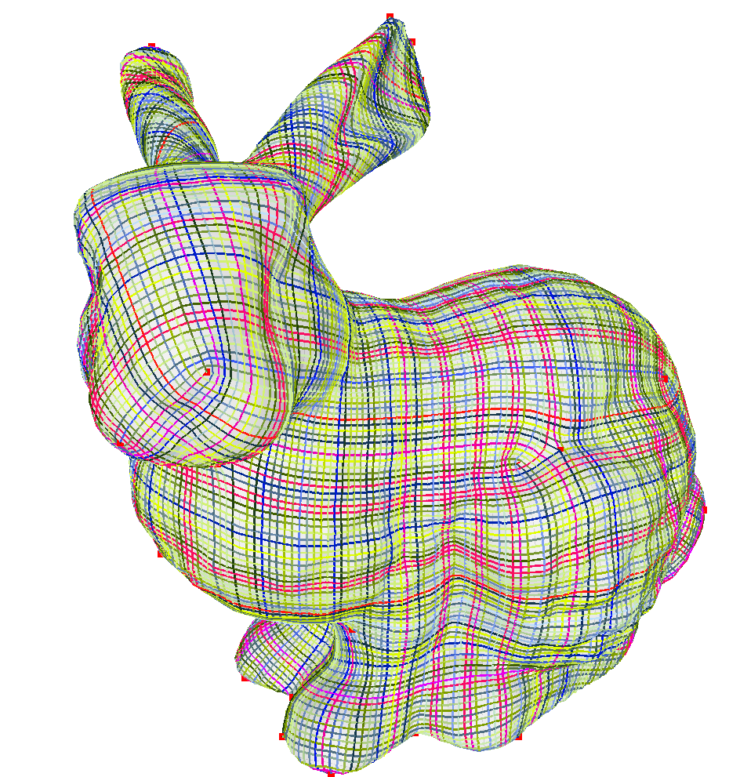
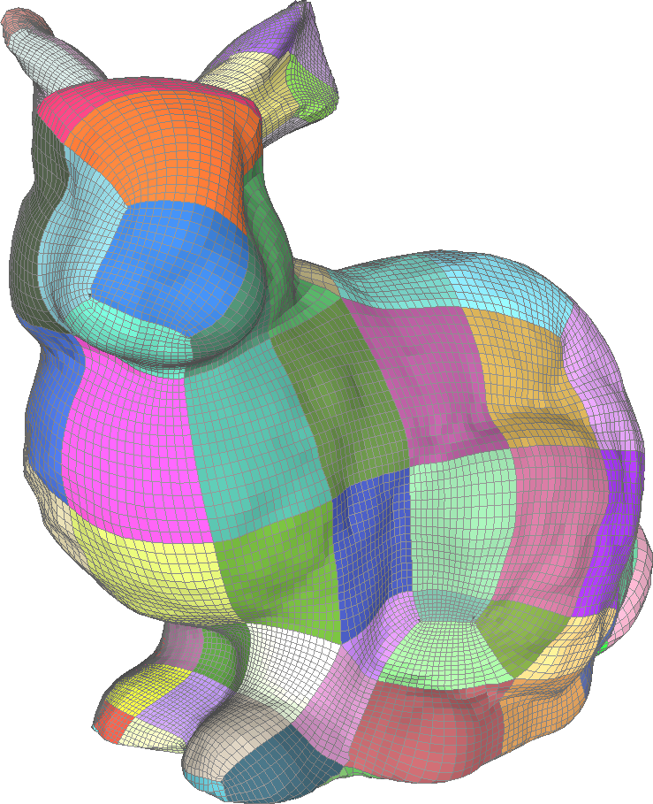
Results
33973 rectangular regions
124 rectangular regions

Slide 59
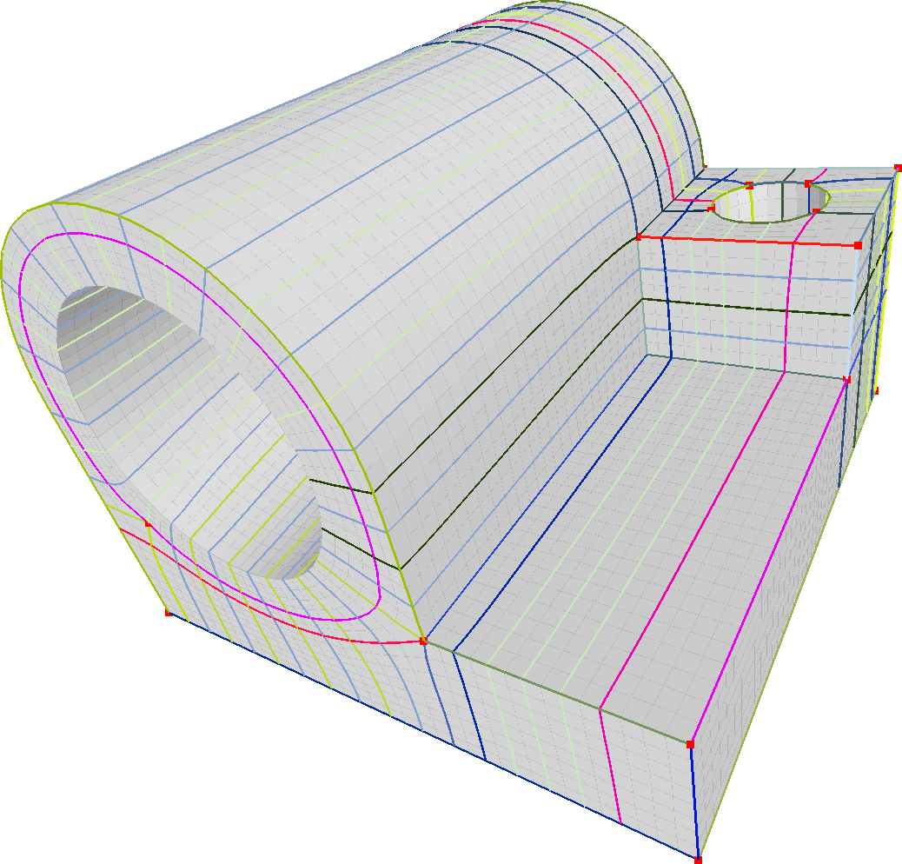
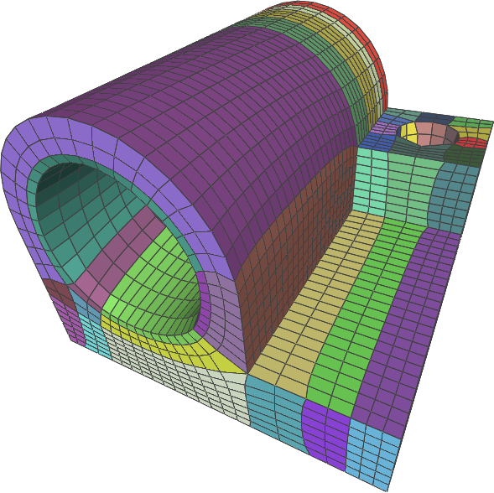
Results
498 rectangular regions
112 rectangular regions

Slide 60
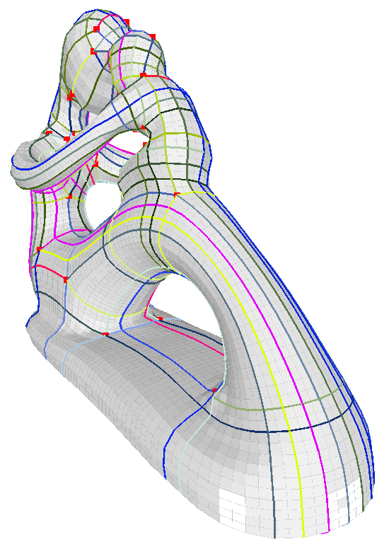
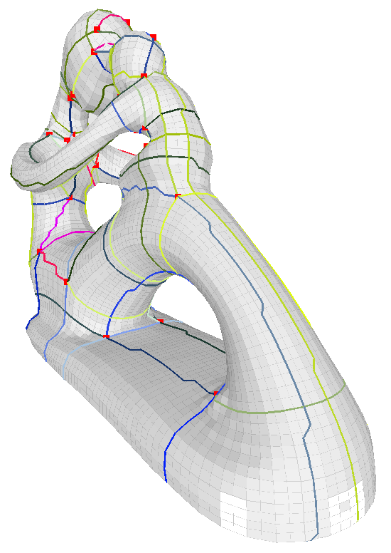
Results
2387 rectangular regions
150 rectangular regions

Slide 61
Summary
Concept:
Domain simplicity is important for usability of parameterizations!
Our main result:
Drastic simplifications of domains typically achieved
The catch:
Reliance on quality of input cross field. E.g.: superfluous/too-misplaced singularities ==> grief

Slide 62
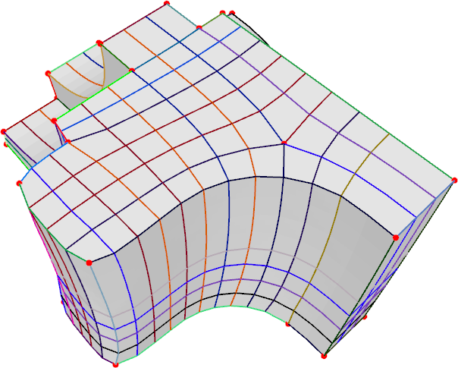
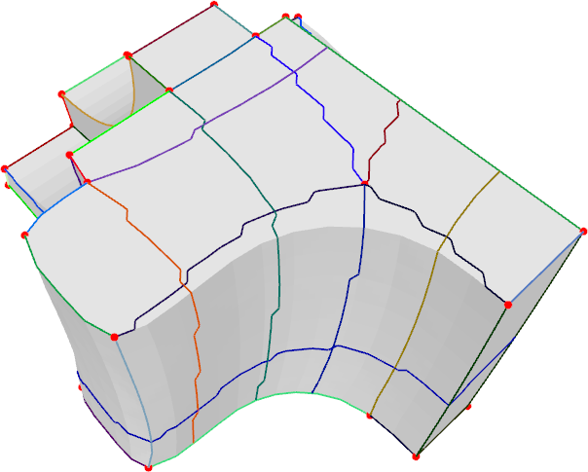
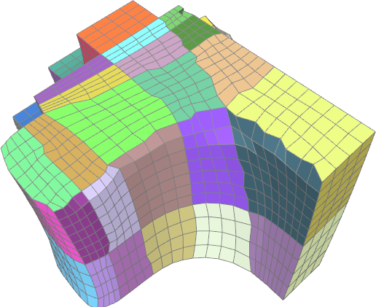
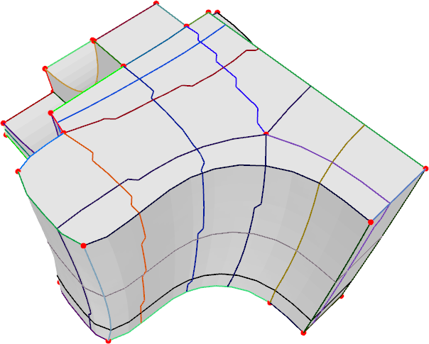
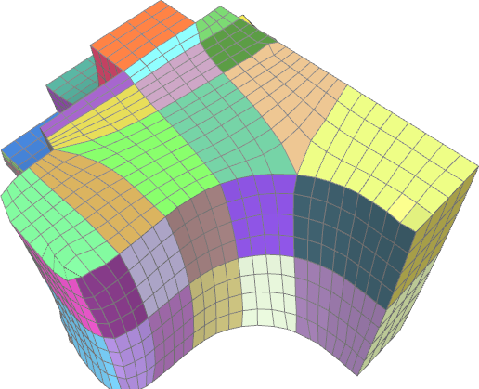
What about crease lines?
don’t?
preserve?
recover them
while smoothing

Slide 63
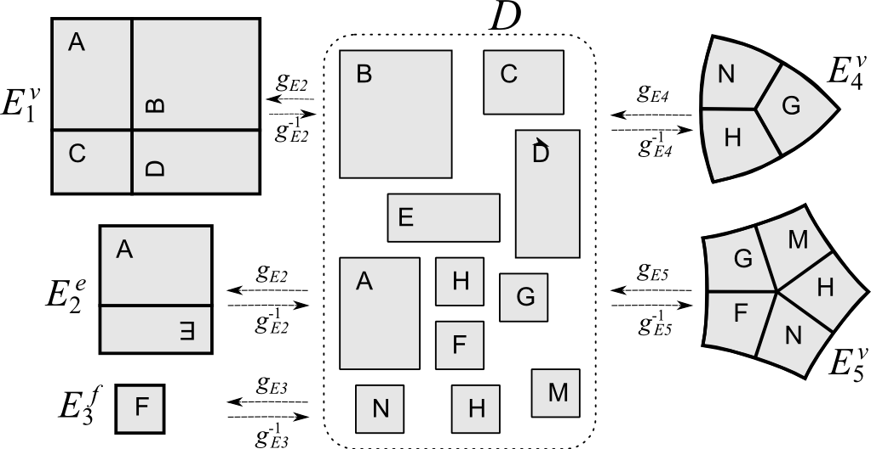
Interpolation domains
interpolation domains
interpolation domains
parameterization domain

Slide 64
Interpolating points over the domain
parameterization domain

Slide 65
Workflow in practice
0
Discretize the cross field:
build a quad resampling (use [Bommet at Al 2009] )
1
Input Cross-Field
Initial semiregular quad-mesh
2
3
Initial Separatrices Graph
Simplified Graph
Global Parametrization

Slide 66
Workflow in practice
0
1
Input Cross-Field
Initial semiregular quad-mesh
2
3
Initial Separatrices Graph
Simplified Graph
Global Parametrization

Slide 67
Workflow in practice
0
1
Input Cross-Field
Initial semiregular quad-mesh
2
3
Initial Separatrices Graph
Simplified Graph
Global Parametrization

