Slide 1
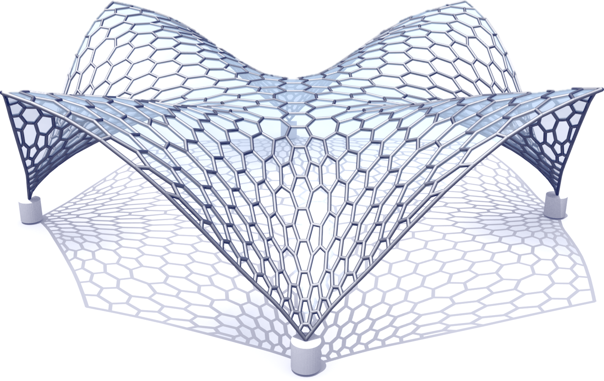
Statics Aware Grid Shells
Nico Pietroni¹, Davide Tonelli², Enrico Puppo³,
Maurizio Froli², Roberto Scopigno¹ and Paolo Cignoni¹
1) ISTI, CNR, Italy
2) University of Pisa
3) University of Genova

Slide 2
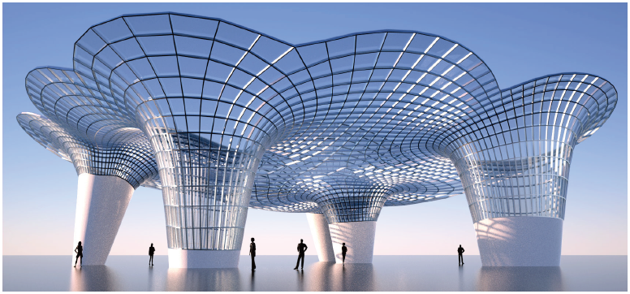
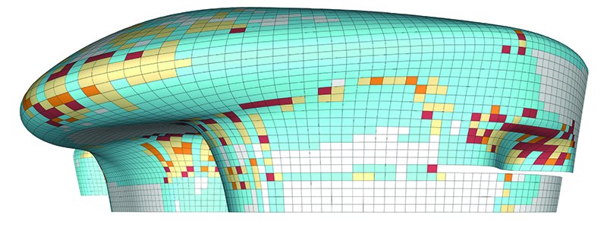
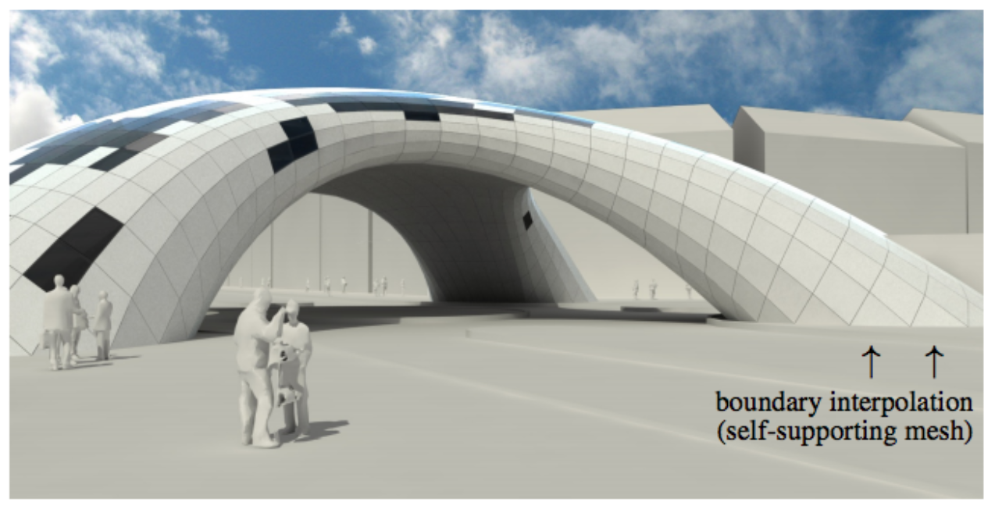
Architectural Geometry
Geometry Processing for architecture
Flat (or single curvature) Glass Paneling
Constrained exploration of mesh
Improving static performances
[Y-L Yang et al, SIGASIA 11]
[EIGENSATZ M et al, SIG 2010]
[Tang et al, SIG 2014]

Slide 3
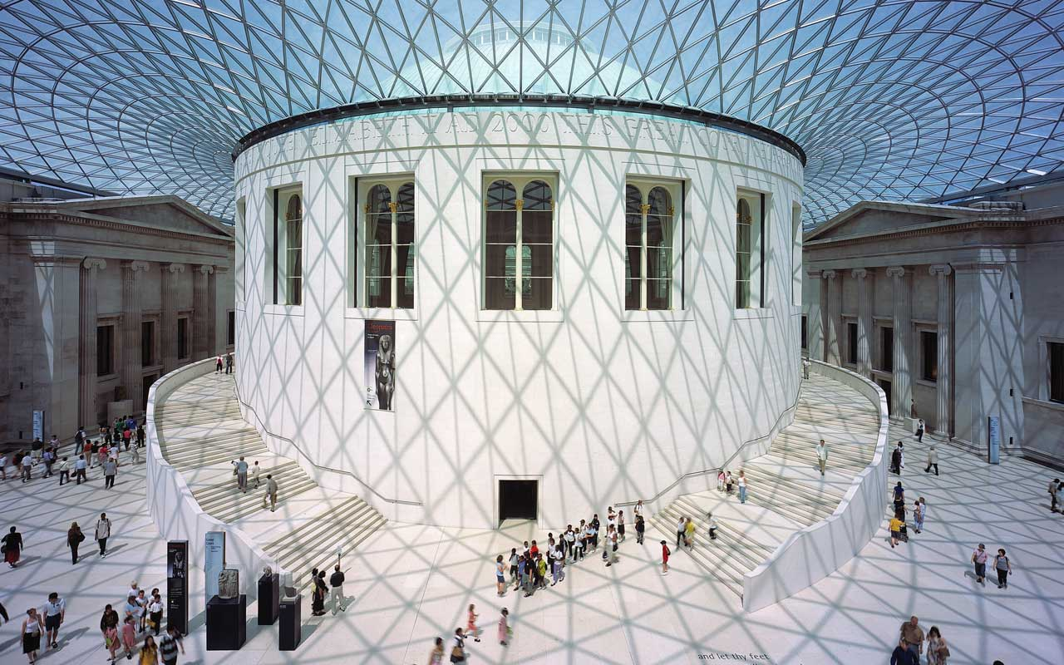
Grid Shells
Grid-shell structures are a modern response to the ancient need of covering long span spaces.
supporting structure is made of beams
covering panels only act as load
British Museum

Slide 4
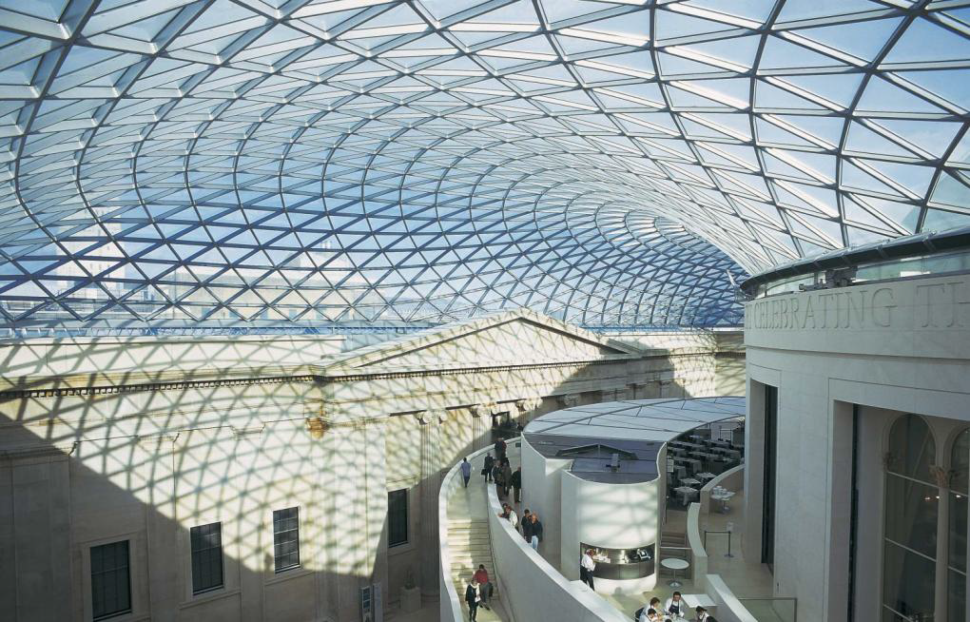
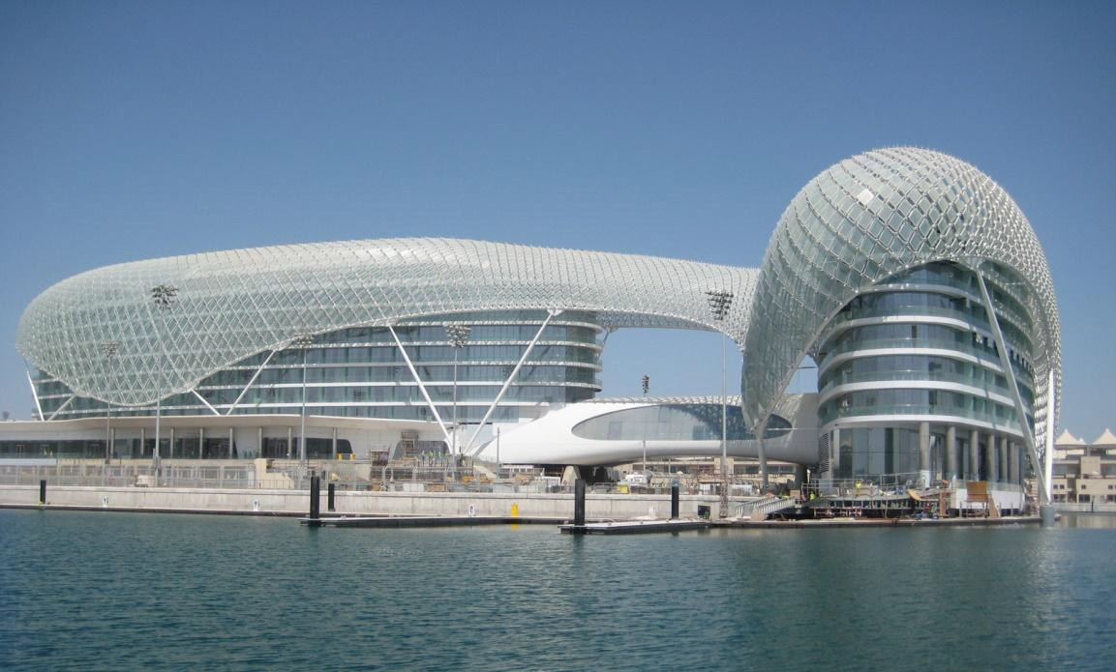
Grid Shells (tris)

Slide 5
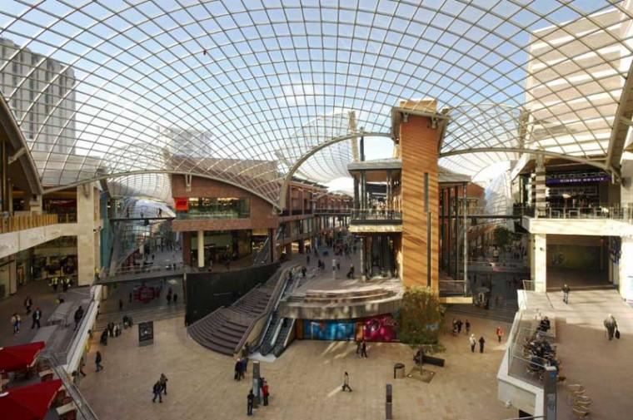
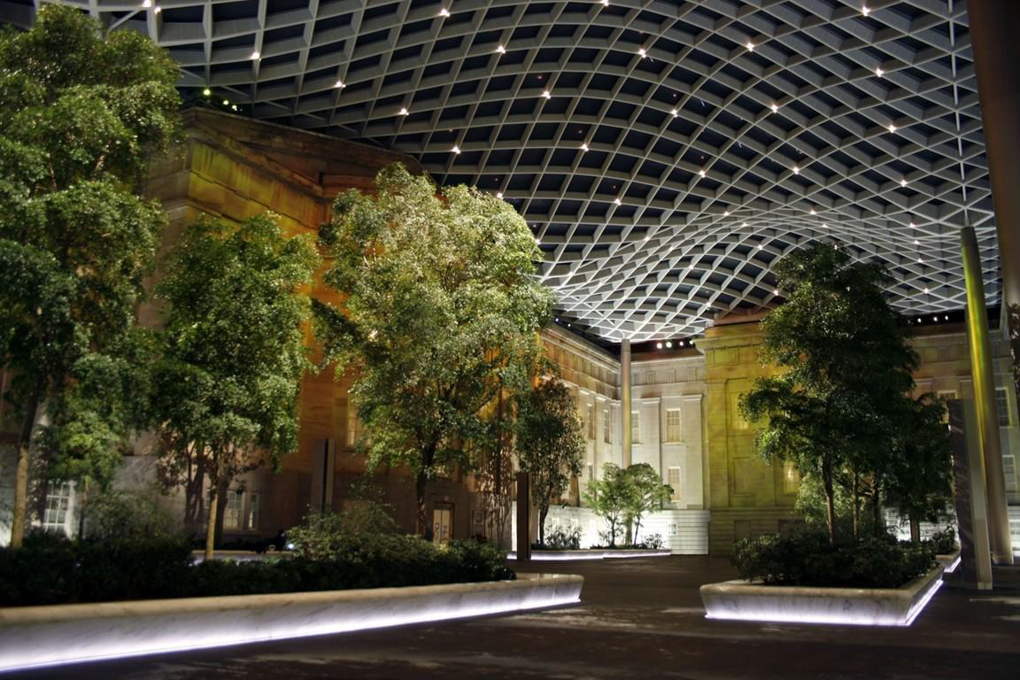
Grid Shells (quads)

Slide 6

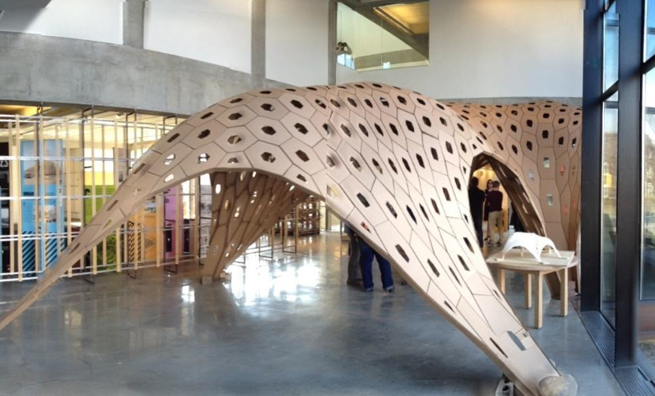
Grid Shells (hexagon ..)

Slide 7
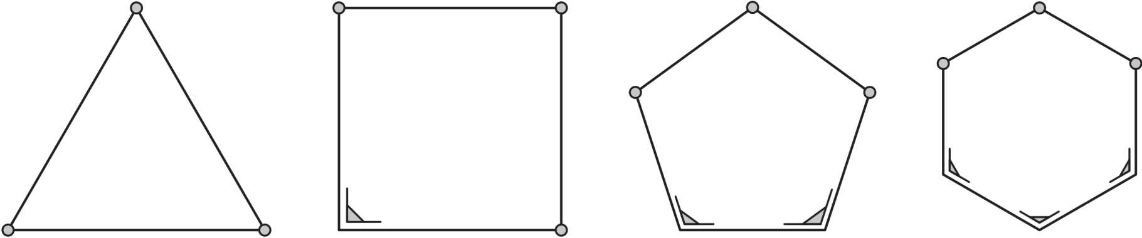
Why Triangles?
Triangle- based grid-shells seem unbeatable from the point of view of strength
Locally triangle is the most rigid polygon
every deformation of a triangle imposes a compression in the beams

Slide 8
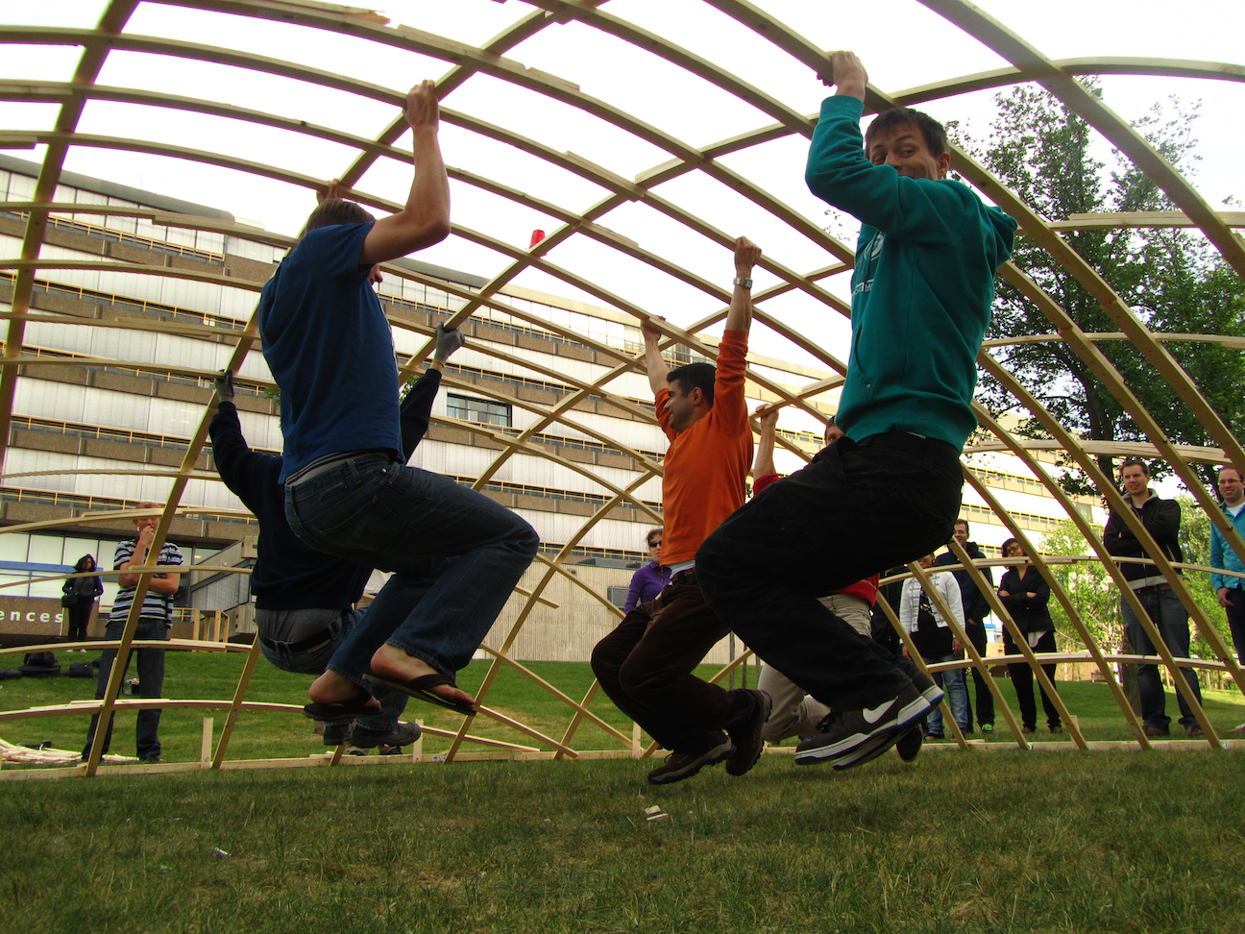
Statics of a Grid Shells
Considering the base shape,
with Finite Element Analysis
we obtain Cauchy tensor field
that we will exploit later
Robustness of a grid-shell
structure is strictly related
to the distribution of load
among its beams

Slide 9
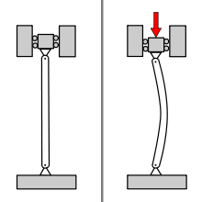
Behaviour of a Grid Shells
Non Linear Buckling Analisys
Linear
Critical
load
λ
δ

Slide 10
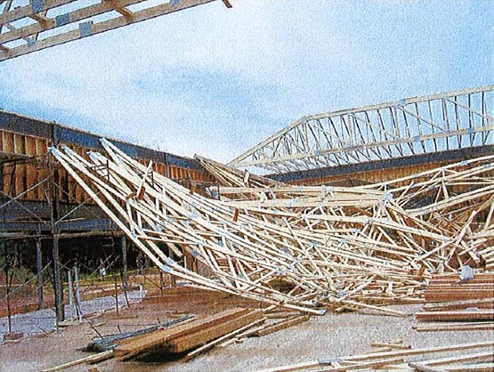
Behaviour of a Grid Shells
Non Linear Buckling Analisys
Linear
Critical
load
λ
δ

Slide 11
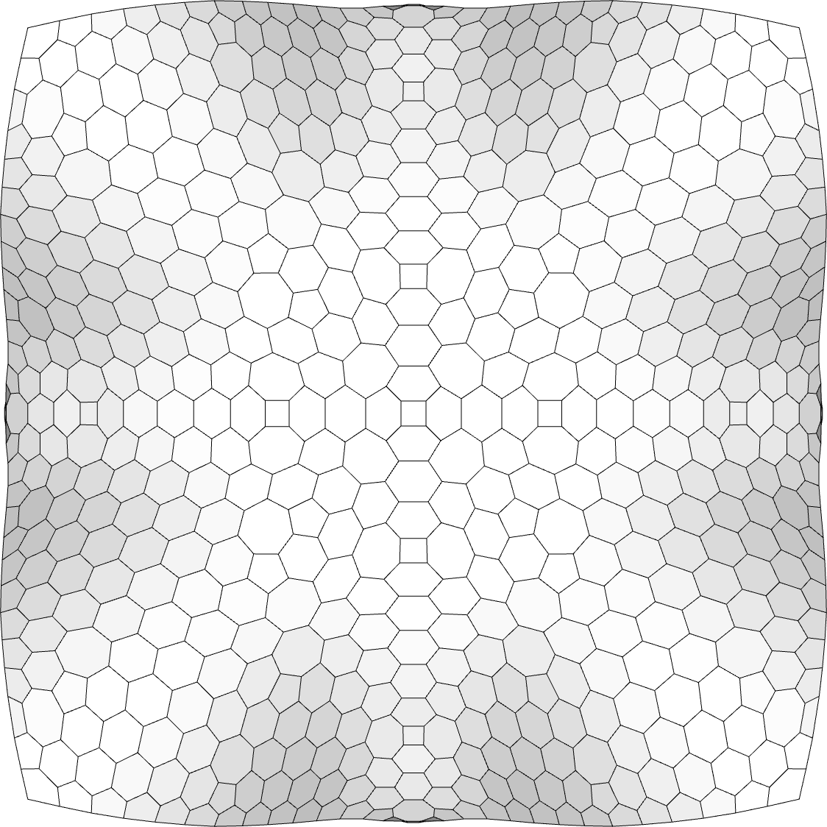
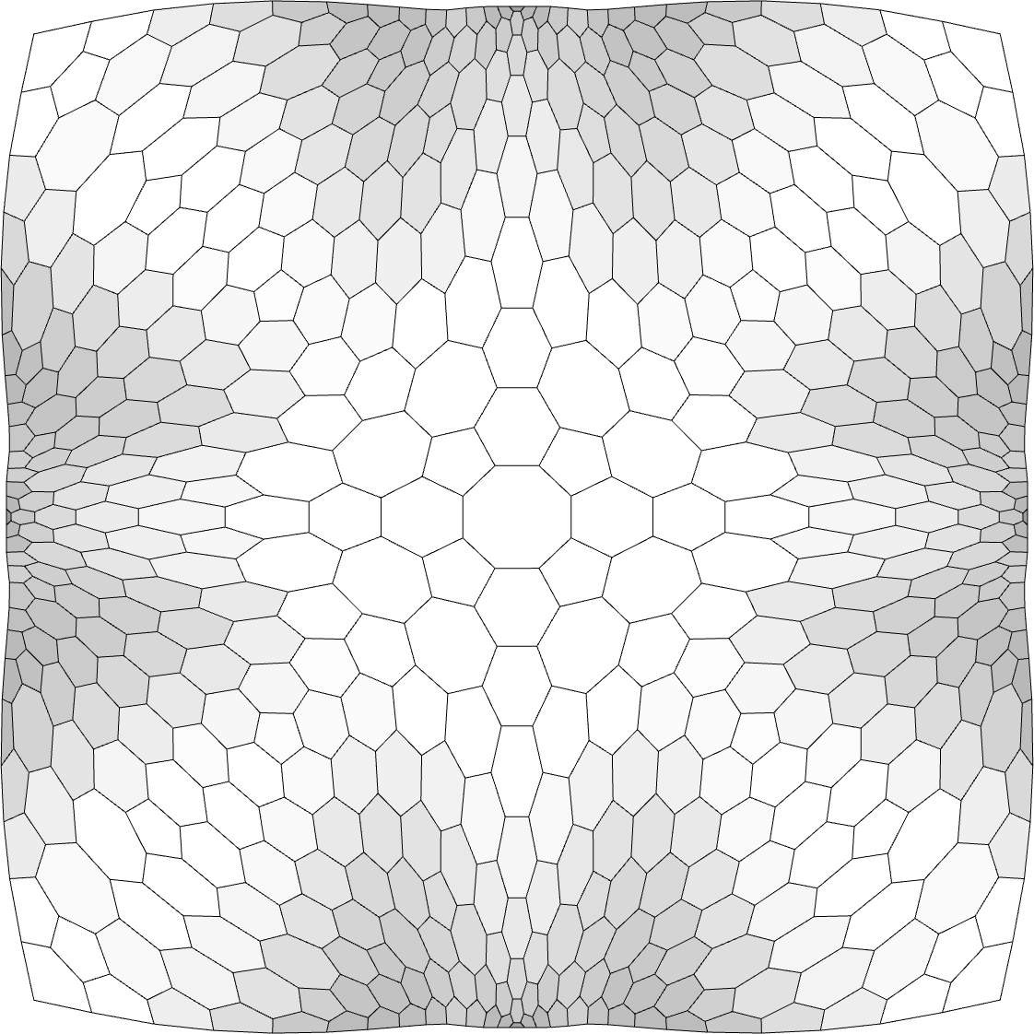
Improving Grid Shell:
Adaptive Tessellation
Optimize static performances by changing the meshing
Keeping the overall weight constant
Concentrate cells in region with higher stress
Elongate cells along stress directions
Notes:
Due to the complex non-linear and combinatorial nature of the problem, finding an optimal connectivity may be a very hard, non feasible task. In fact, even a small change in connectivity may drastically change the distribution of load.
Rather than setting the problem as an optimization, we tackle it in a different way. We first study the statics of a continuous shell corresponding to the input surface; this provides us a stress field encoding how tensions propagate through the surface. We use this stress field to infer preferred density and anisotropy of a grid-shell covering the same surface. To this aim, we study the relations between an ideal regular grid-shell subject to a constant stress field, in order to understand the laws that relate locally the density and anisotropy of forces to the size and anisotropy of elements of the mesh.

Slide 12
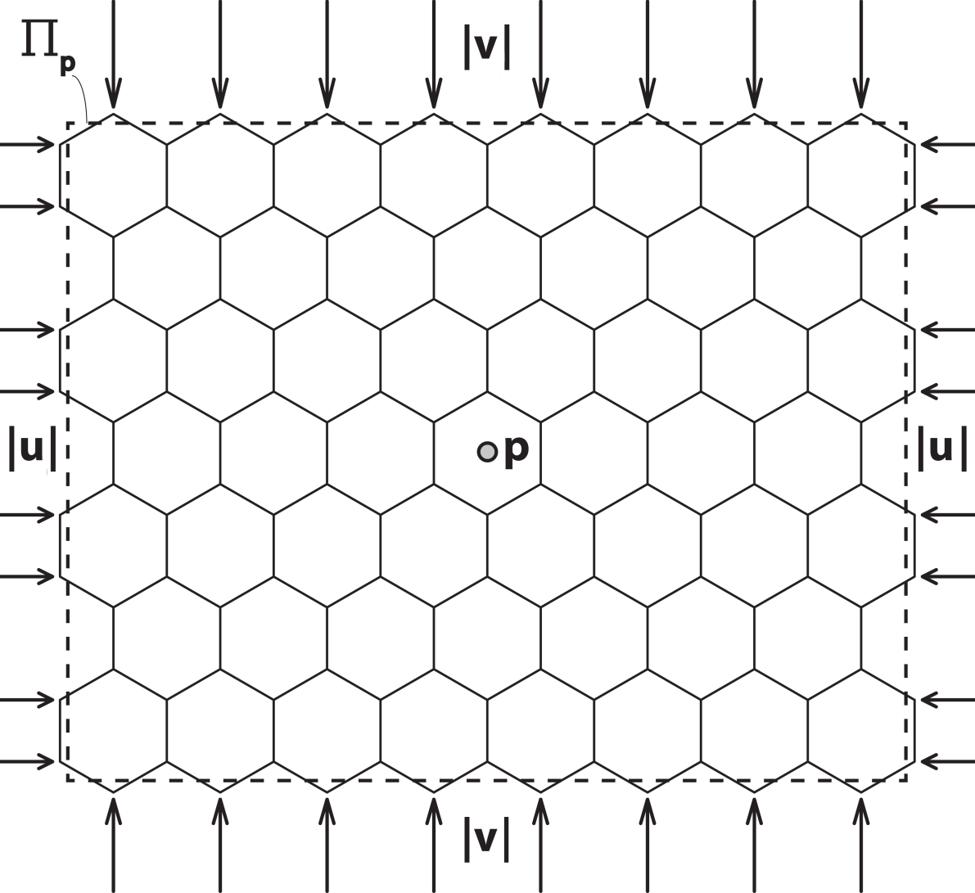
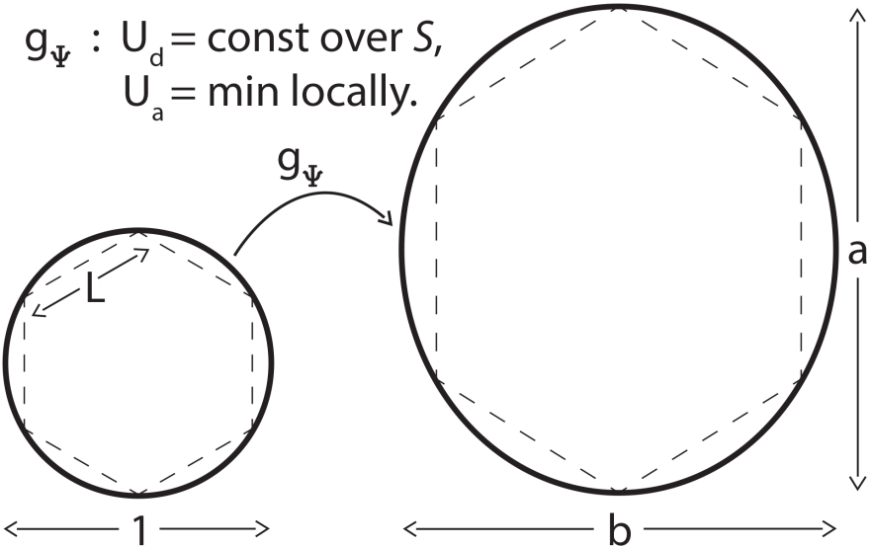
Varying Tessellations
Evaluating Strain Energy
of a uniform tessellation
under external loads
Objective
  density strain energy U_{d} (|u|, L) is kept constant
  anisotropy strain energy U_{a}( v/u , a/b ) is minimized for the local stress ratio |v|/|u|
Notes:
Consider an hexagonal grid aligned with the principal directions subject to orthogonal forces
Under the action of these forces we assume that the hexagonal grid can shrink or stretch out, both isotropically or anisotropically, according to the ‘transfer’ criterion defined in the following and provided that each hexagon keeps in-scribed within an ellipse of radii a and b measured
For given forces u,v we want to set L in the isotropic case, and b/a in the anisotropic case, such that the density strain energy Ud (|u|, L) is kept constant over the entire surface S, while the anisotropy strain energy
Ua( v/u , a/b ) is minimized for the local stress ratio |v|/|u|

Slide 13
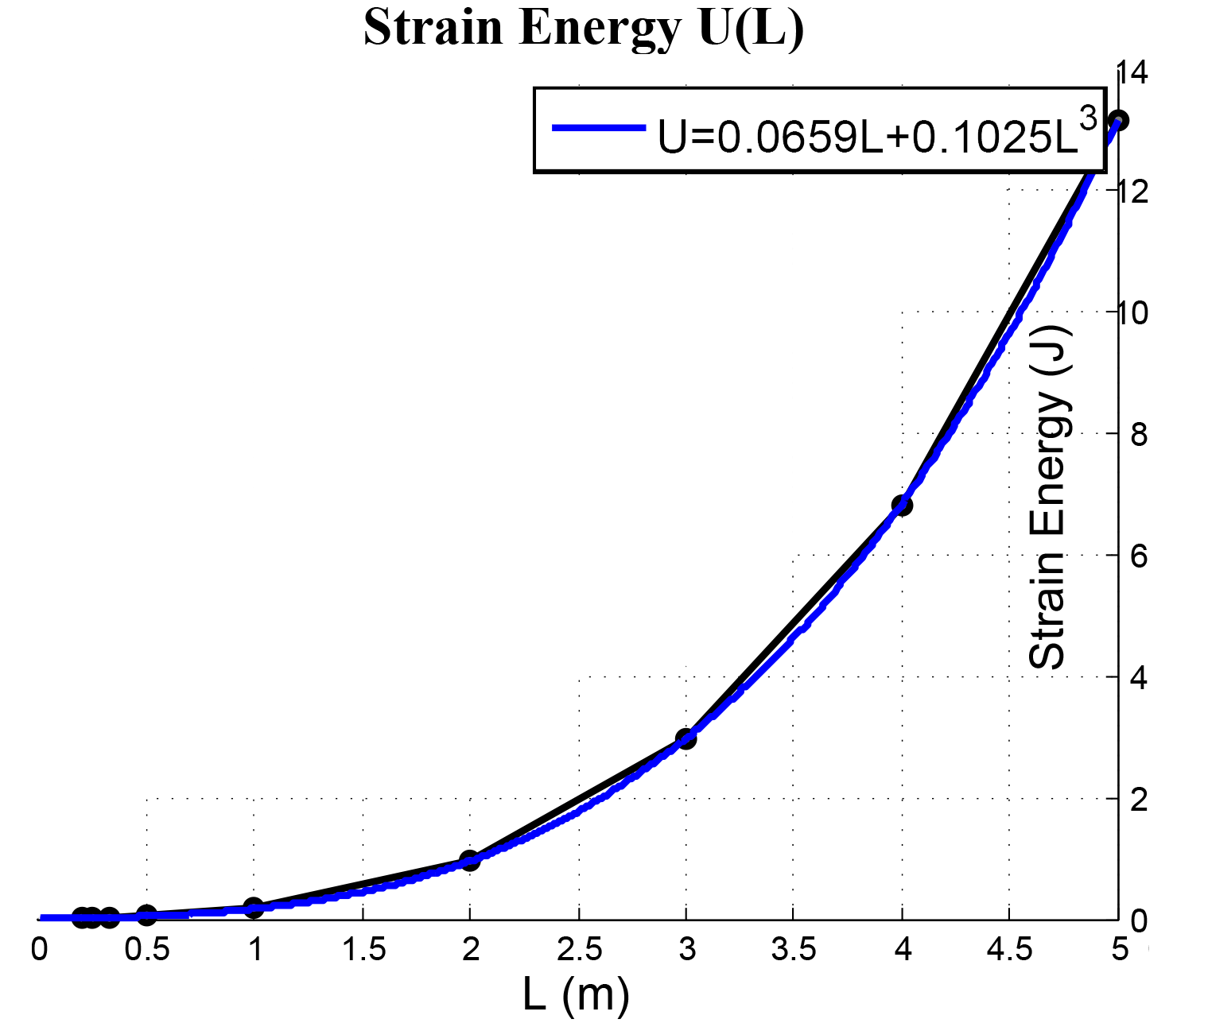
Varying Density
Uniform Grid under external constant isotropic loads
constant size bars
cubic behavior
Notes:
Plot of the strain deformation energy as a function of the isotropic grid edge length L.
In other words the strain energy is roughly proportional to the cube of the length of the bars

Slide 14
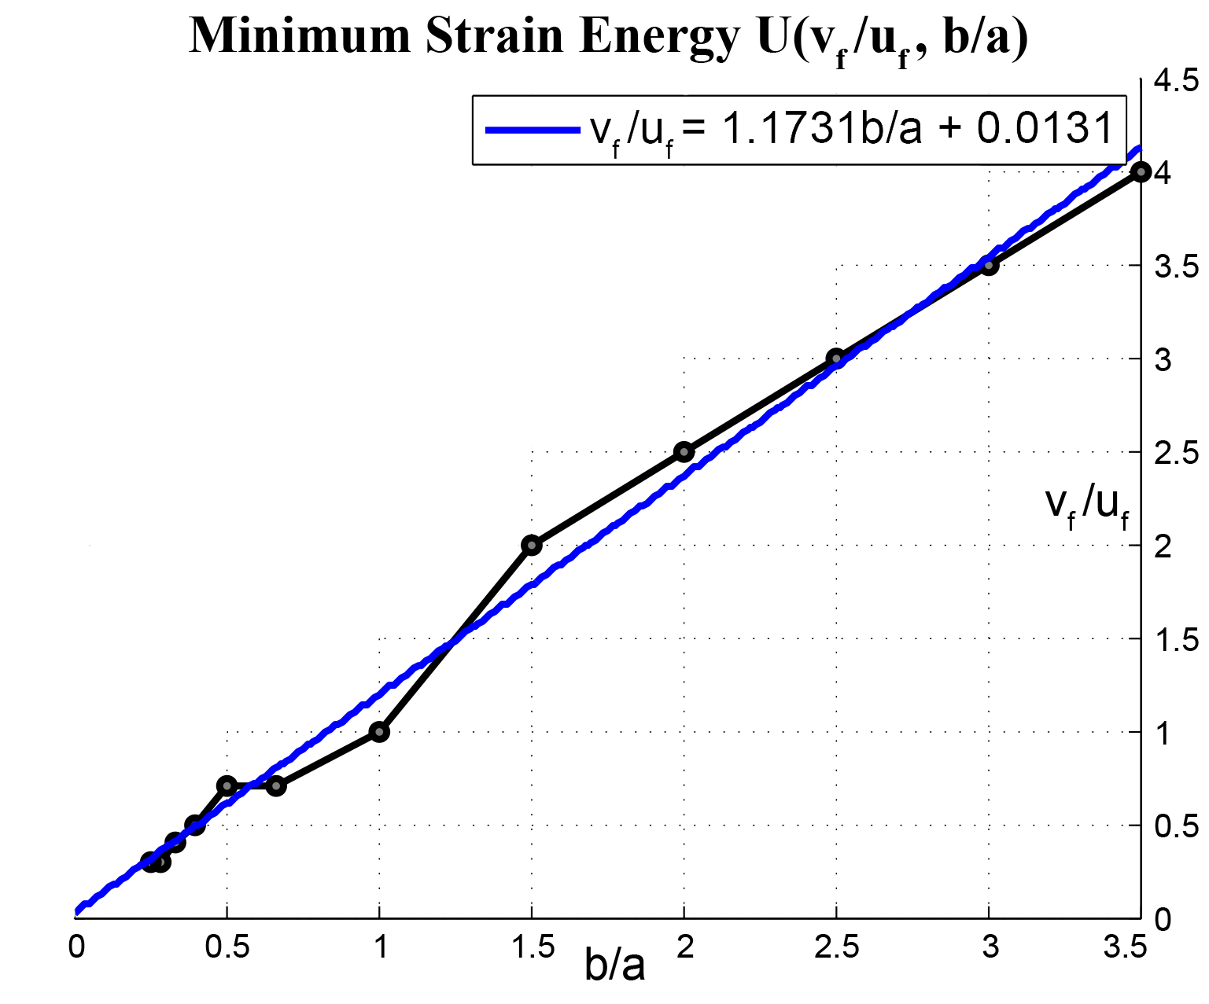
Varying Shape
Anisotropy Load keeping the overall force value constant
Anisotropic cell
Get the best ratio of cell
anisotropy for a given
force anisotropy
Linear Ratio
Notes:
Consider a hex grid subject to an anisotropic state of stress and the problem is that of associating a
suitable ratio b/a to each cell, in such a way that the anisotropy strain energy Ua(v/u ,b/a) results locally minimized.
strain energy Ua has been computed for several couples of ratios v/u and b/a , paying attention to keep the sum of the forces constant and also the total length constant.
Evalutating the strain energy for all these couple result in a function that has its minima along a line
This means that minimum anisotropy strain energy is achieved when the force ratio and the geometric ratio b are roughly the same

Slide 15
Deformation Metric
The two relations allow us to introduce a
non-Euclidean metric g_{Ψ} to compute optimal cells
Notes:
In an anisotropic hexagonal grid, loaded as in fig the strain energy U depends both on the ratio Fy/Fx between
vertical and horizontal forces (their sum Fy + Fx being constant) and on the ratio b/a between the radii of the ellipse
circumscribed to cell.

Slide 16
Deformation Metric
The two relations allow us to introduce a
non-Euclidean metric g_{Ψ} to compute
optimal cell size and shape
Notes:
In an anisotropic hexagonal grid, loaded as in fig the strain energy U depends both on the ratio Fy/Fx between
vertical and horizontal forces (their sum Fy + Fx being constant) and on the ratio b/a between the radii of the ellipse
circumscribed to cell.

Slide 17
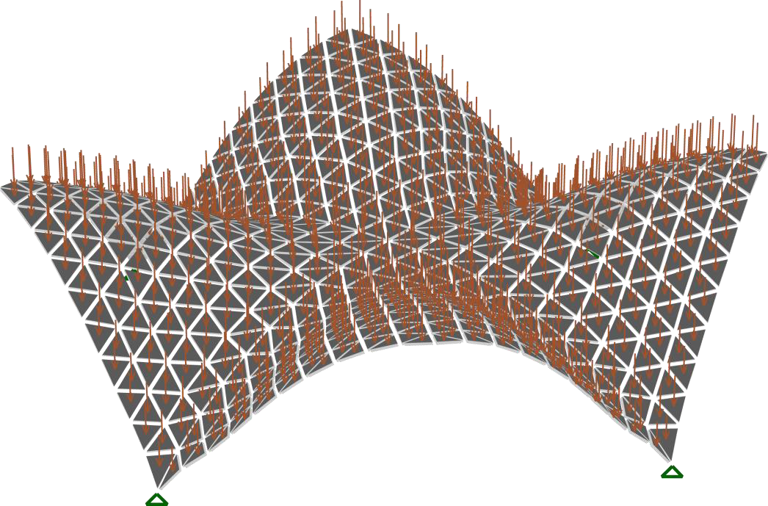
The whole pipeline
Start with an initial surface
  Constraints for load distribution to the ground
  Uniform weight load
  FEM analysis
Notes:
Finite Element method

Slide 18
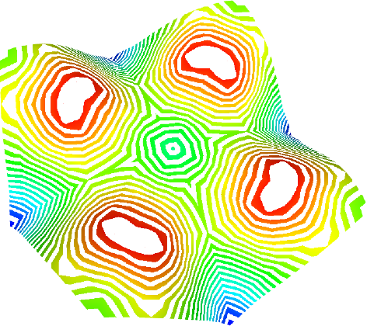
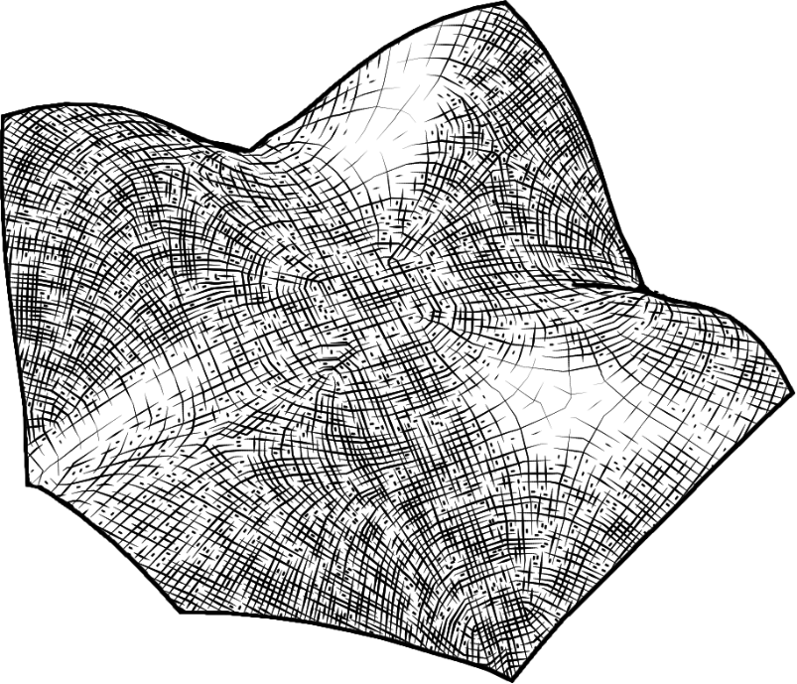
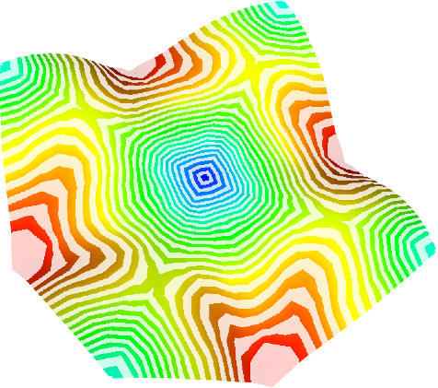
The input
From the FEA
  double orthogonal line field
  an anisotropy scalar field
  a density scalar field

Slide 19
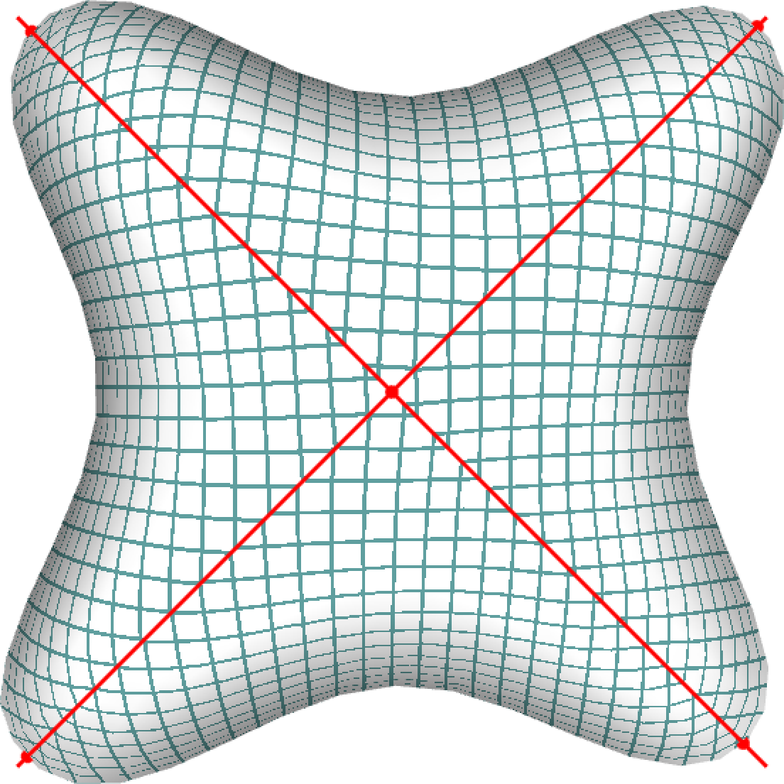
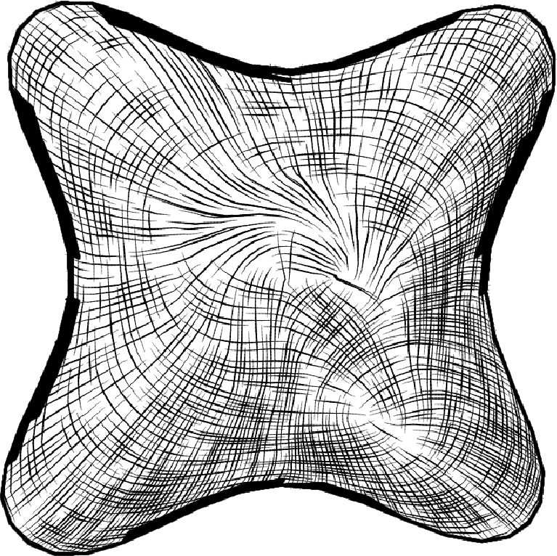
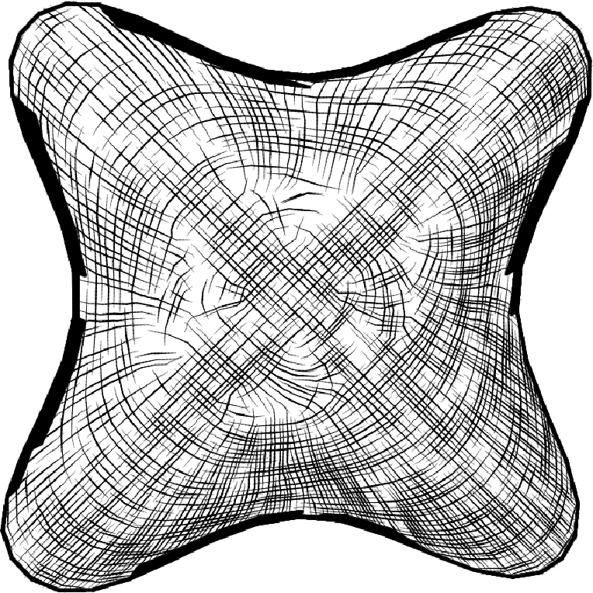
Optimization: cleaning input fields
Use symmetric mapping
Average directions
Smooth using constraints along symmetry lines

Slide 20
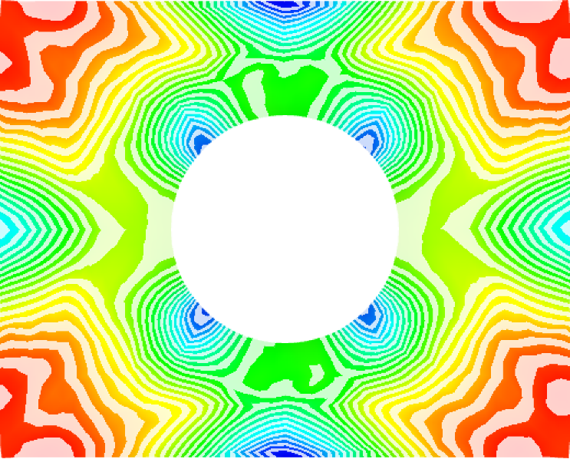
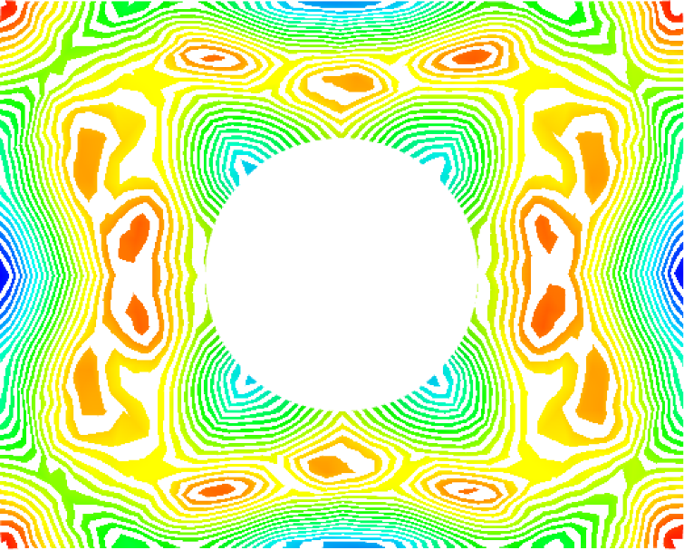
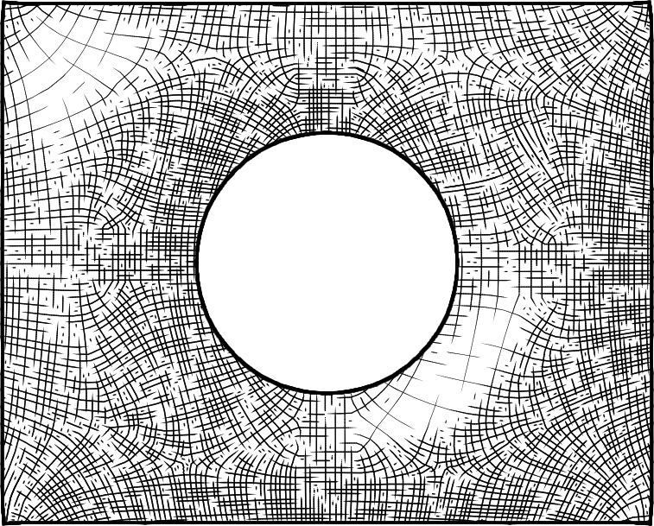
Meshing
We follow the frame field approach [Panozzo et al. 2014] and we perform the meshing in a space deformed where the g_{Ψ} metric, defined by the previous relation, become euclidean.
g_{Ψ}

Slide 21
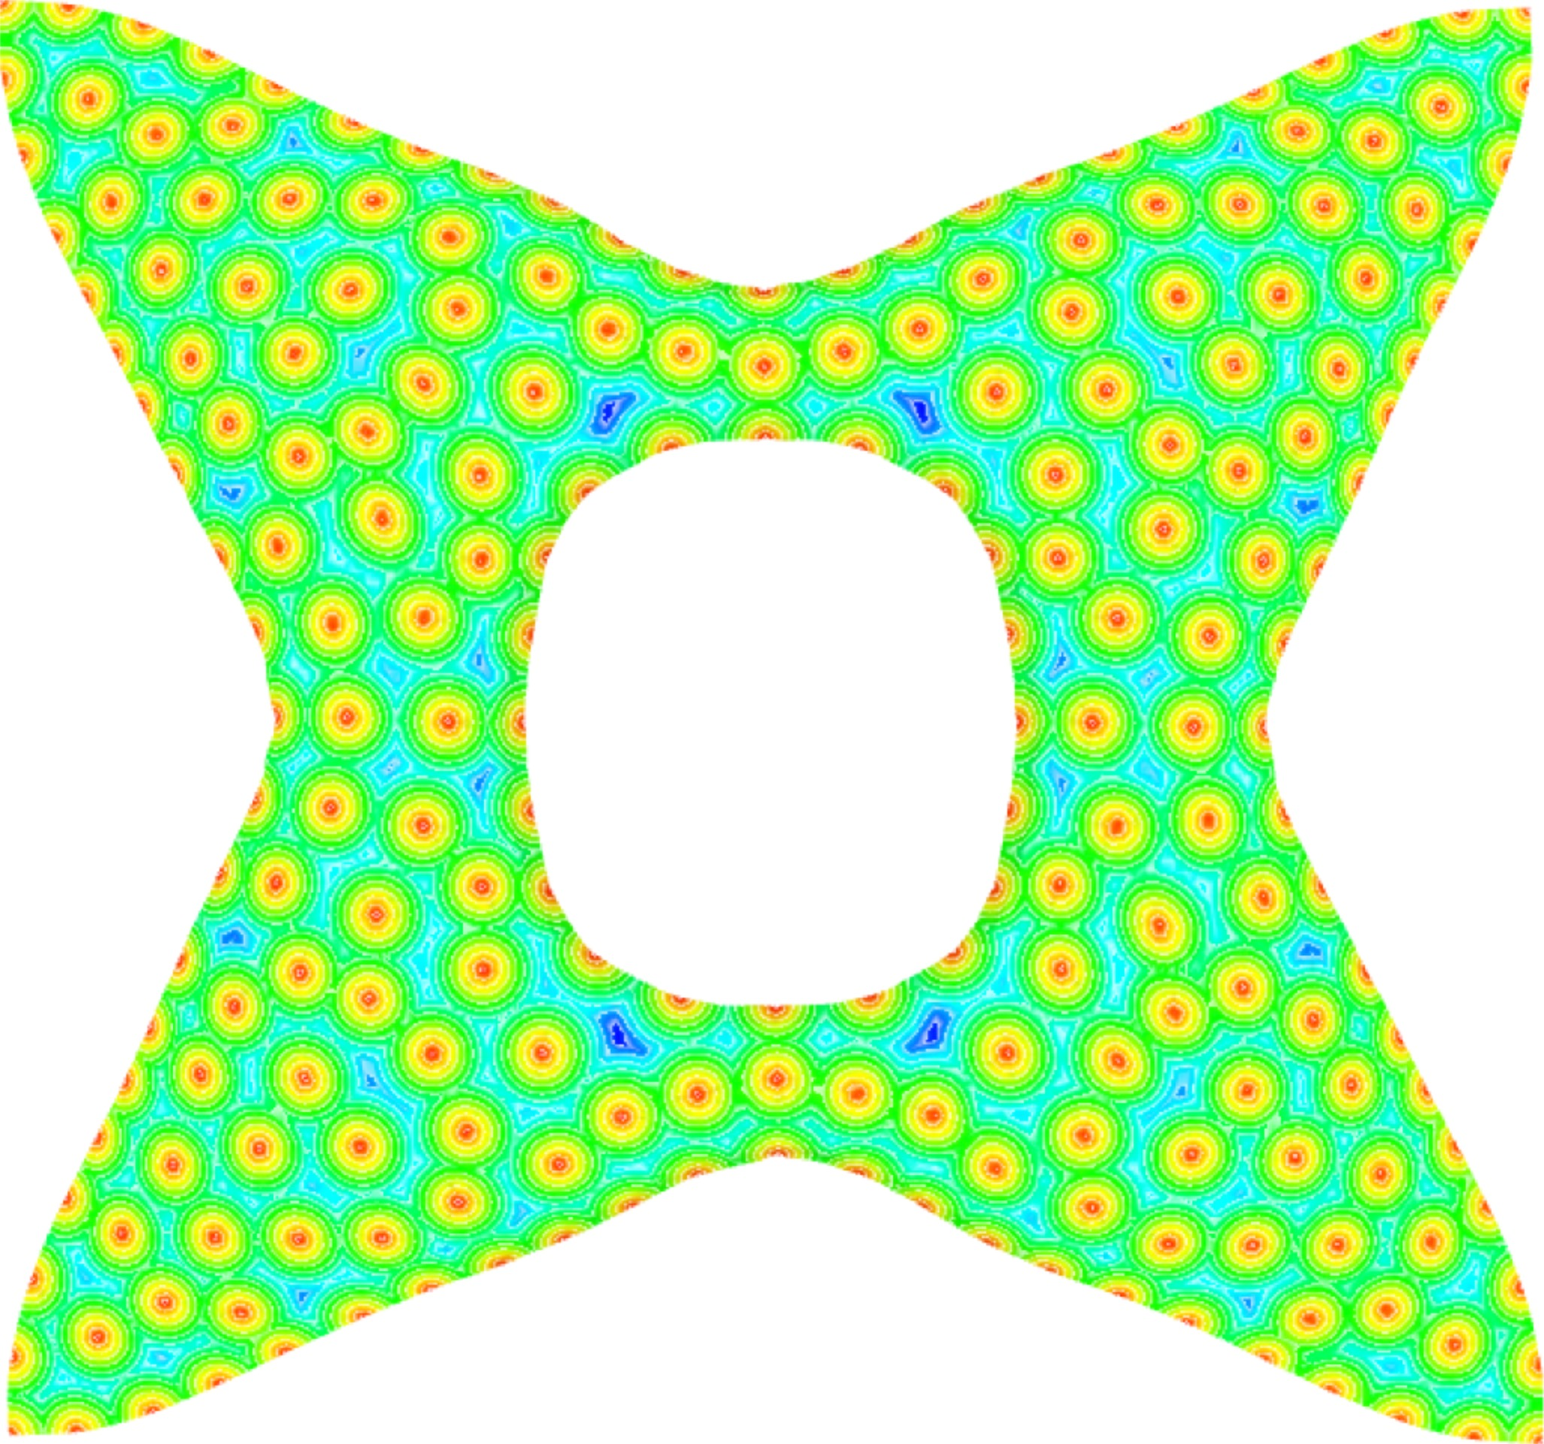
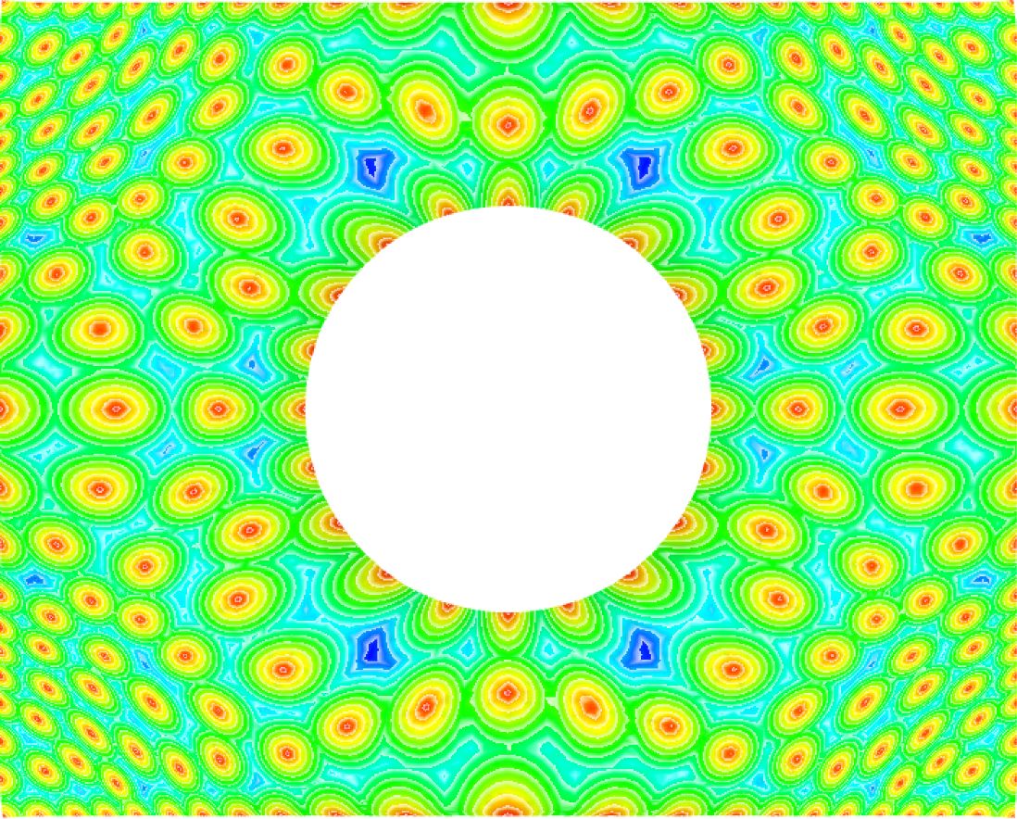
Meshing
We follow the frame field approach [Panozzo et al. 2014] and we perform the meshing in a space deformed where the g_{Ψ} metric become Euclidean.

Slide 22
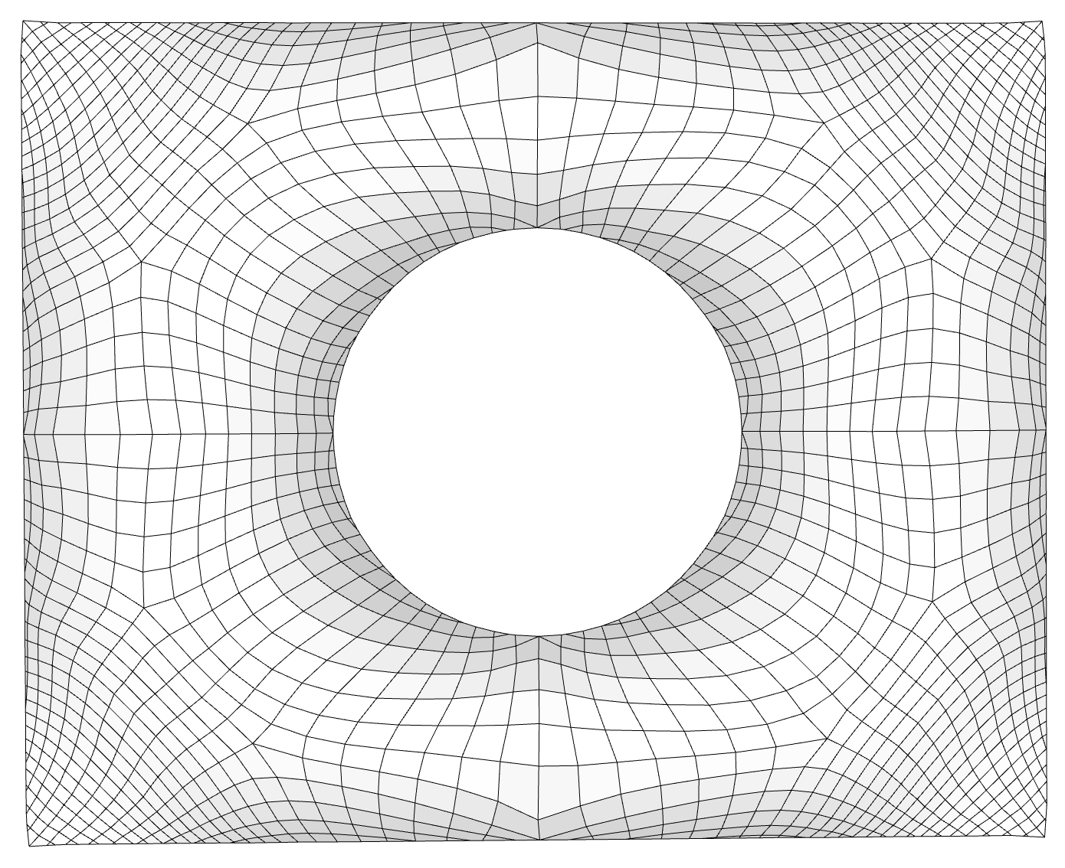
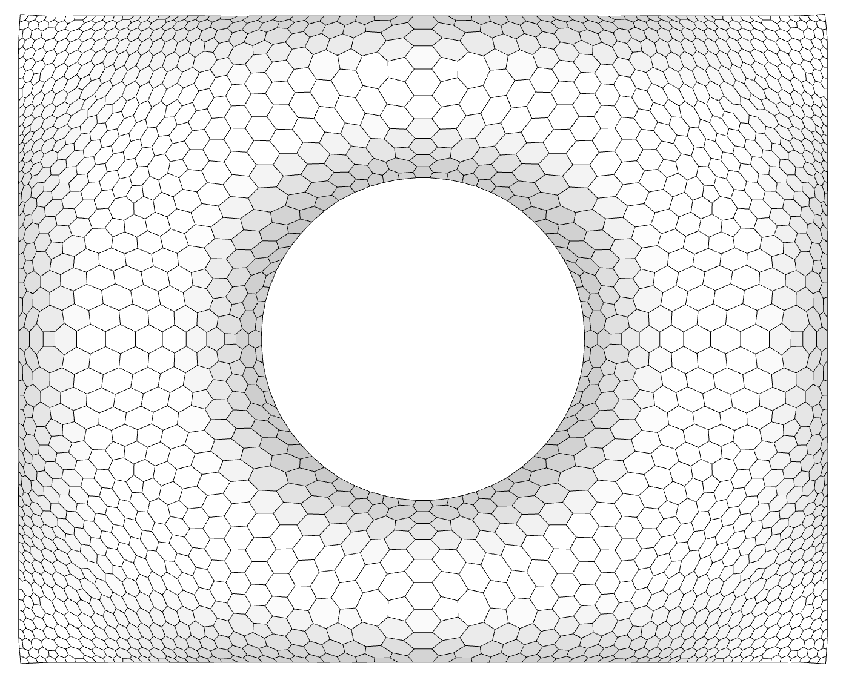
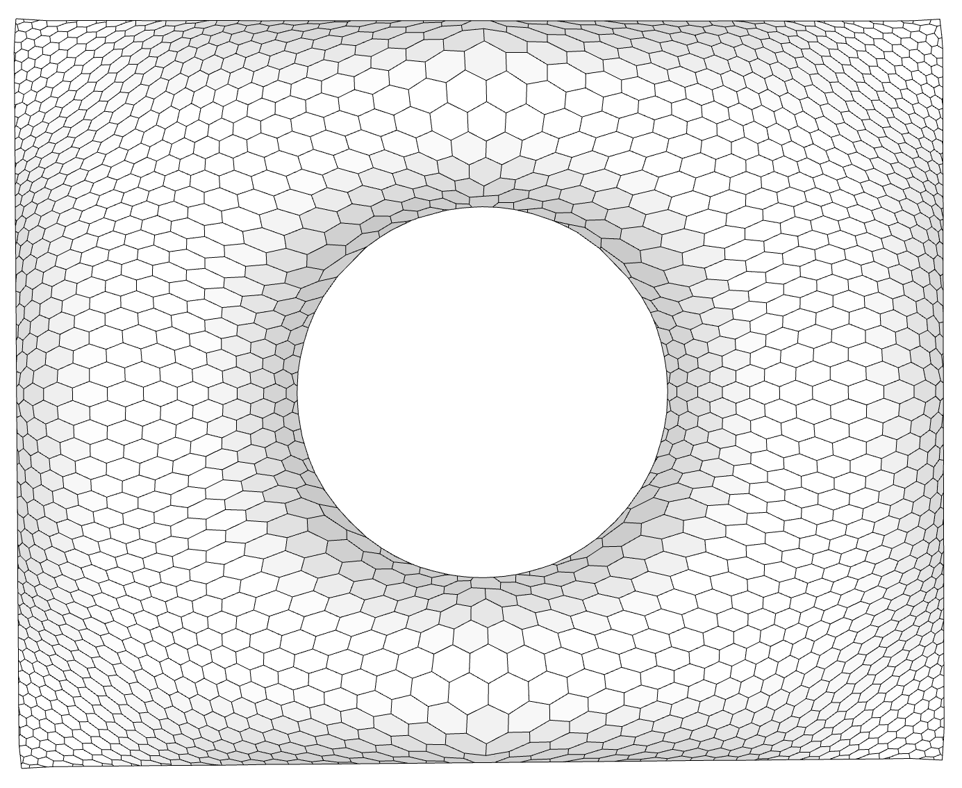
Independent from meshing technique
The deformation approach allows to exploit different meshing techniques:
Quad meshing using [BZK09]
Hexagonal meshing using [LLW14]
Hex dominant regularized CVT tessellation

Slide 23
Field curvature vs field stress

Slide 24
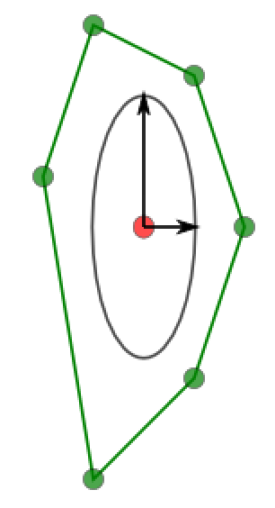
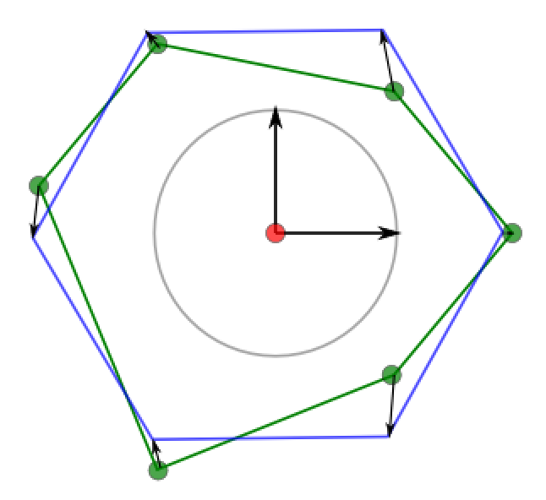
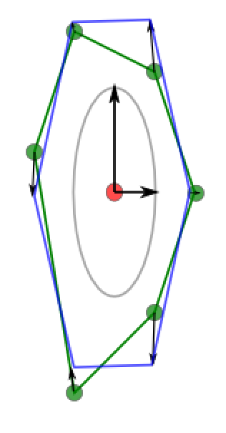
Regularized CVD
Start from a Centroidal Voronoi Diagram
Compute PCA of the initial polygon
Align a regular polygon in deformed space
Local-Global Optimization
Achieve better shape and planarity

Slide 25
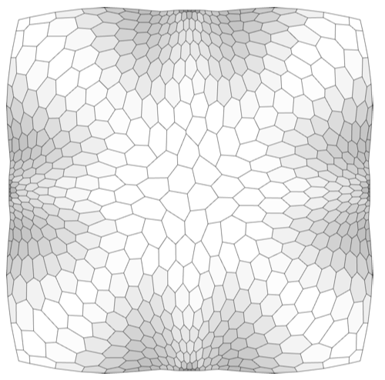
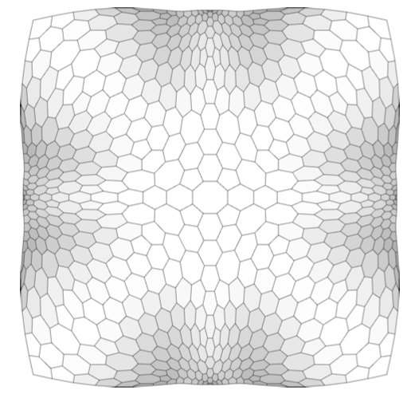
Regularized CVD: opt. result
Non Optimized
Optimized

Slide 26
Optimization: planarity

Slide 27
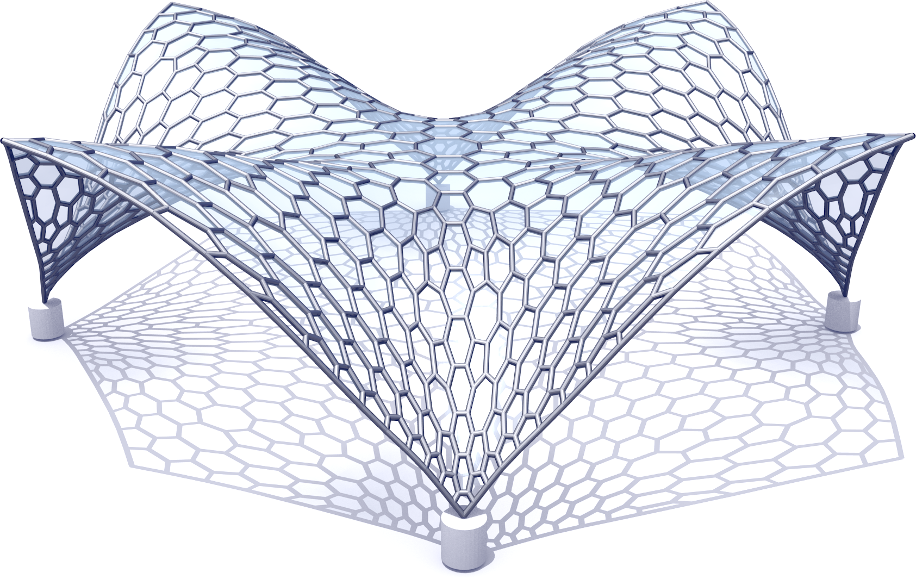
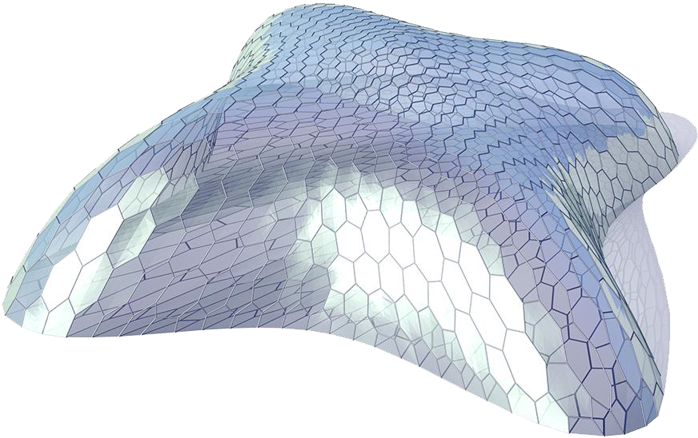
Meshing
Produce an anisotropic, density-varying meshing

Slide 28
Static of a Grid Shell
The non-linear buckling multiplier λ
  measures the ability of a structure to support a load equal to a multiple of its weight before collapsing
The nodal displacement μ
  which measures the maximum distance with respect to the reference shape when the structure is under load
Notes:
Mark Pauli
mold reuse
The emergence of large-scale freeform shapes in architecture poses big challenges to the fabrication of such structures. A key problem is the approximation of the design surface by a union of patches, socalled panels, that can be manufactured with a selected technology at reasonable cost, while meeting the design intent and achieving the desired aesthetic quality of panel layout and surface smoothness. The production of curved panels is mostly based on molds. Since the cost of mold fabrication often dominates the panel cost, there is strong incentive to use the same mold for multiple panels. We cast the major practical requirements for architectural surface paneling, including mold reuse, into a global optimization framework that interleaves discrete and continuous optimization steps to minimize production cost while meeting user-specified quality constraints. The search space for optimization is mainly generated through controlled deviation from the design surface and tolerances on positional and normal continuity between neighboring panels. A novel 6-dimensional metric space allows us to quickly compute approximate inter-panel distances, which drastically improves the performance of the optimization and enables the handling of complex arrangements with thousands of panels. The practical relevance of our system is demonstrated by paneling solutions for real, cuttingedge architectural freeform design projects.

Slide 29
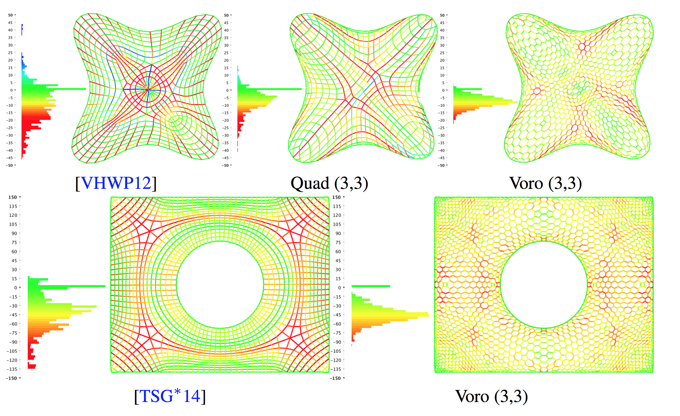
Results Load Distribution
Notes:
[VHWP12] VOUGA E., HÖBINGER M., WALLNER J., POTTMANN H.: Design of self-supporting surfaces. ACM Trans. Graph. 31, 4 (2012), 87:1–87:11
[TSG∗14] TANG C., SUN X., GOMES A., WALLNER J., POTTMANN H.: Form-finding with polyhedral meshes made simple. ACM Trans. Graph. (2014)

Slide 30
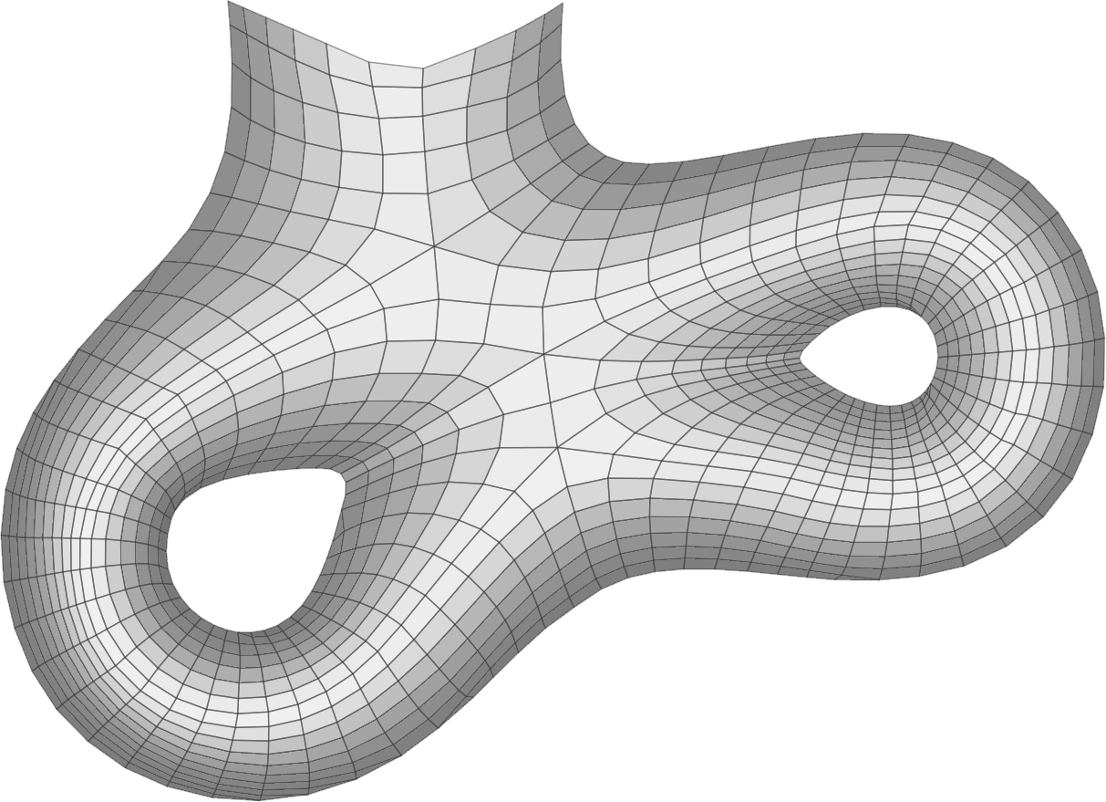
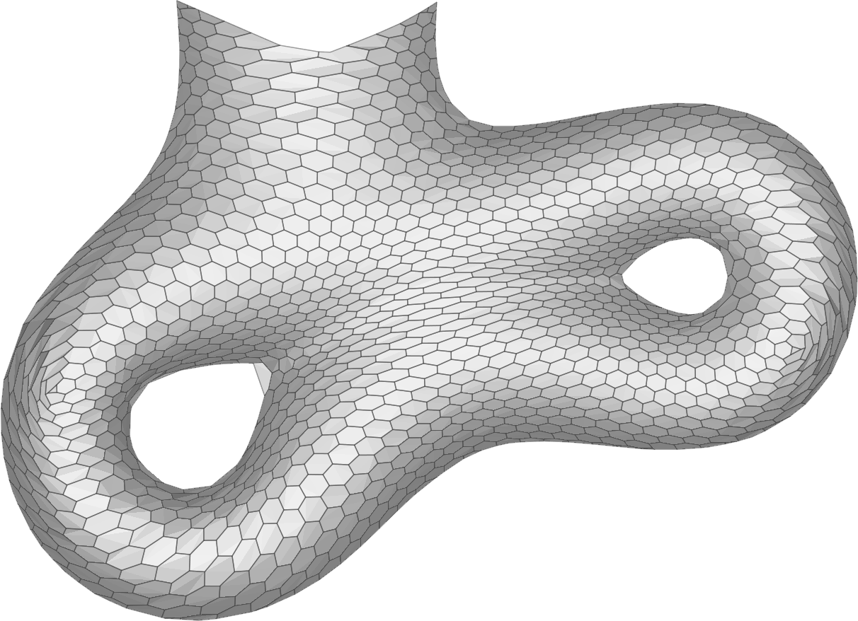
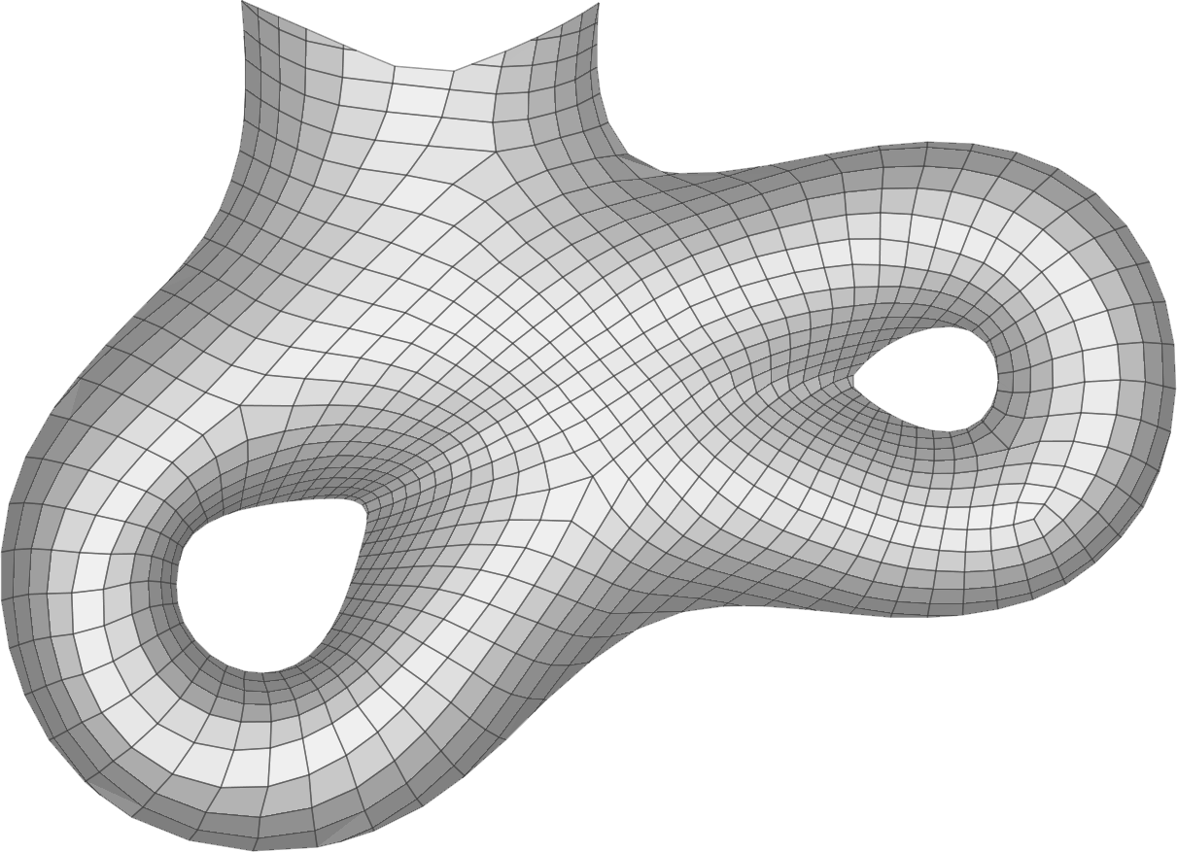
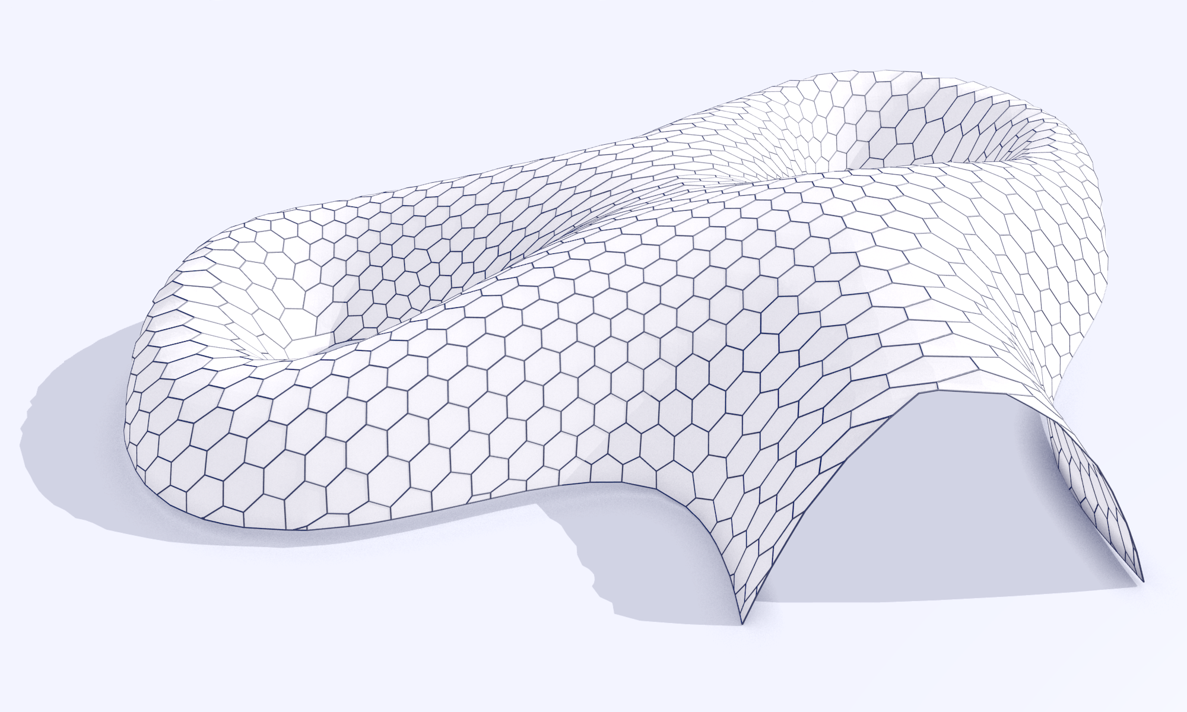
Results: Aquadom
[VHWP12]
Static Aware HEX
Static Aware QUAD
λ= 1.38
μ=164.1
λ= 2.72
μ=117.1
λ= 2.34
μ=129.9

Slide 31
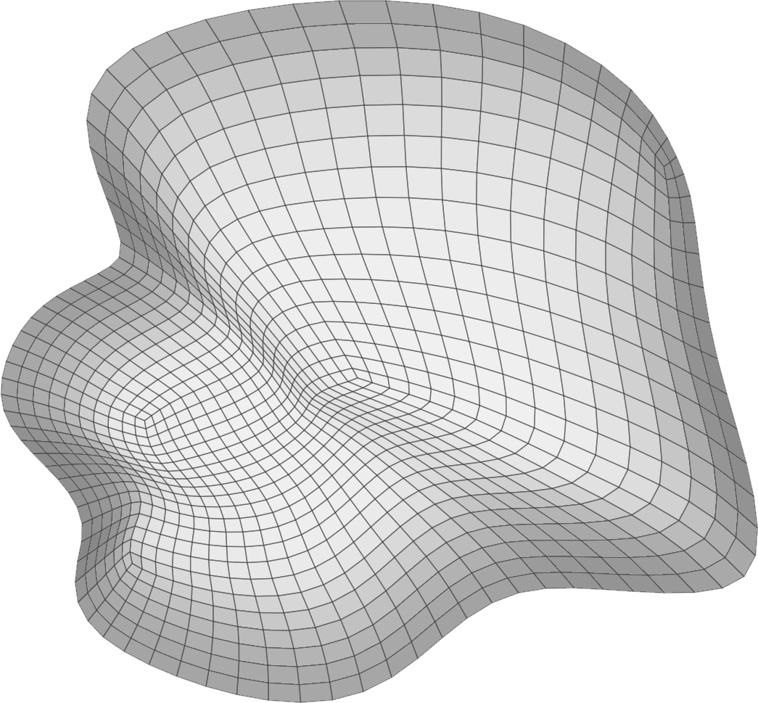
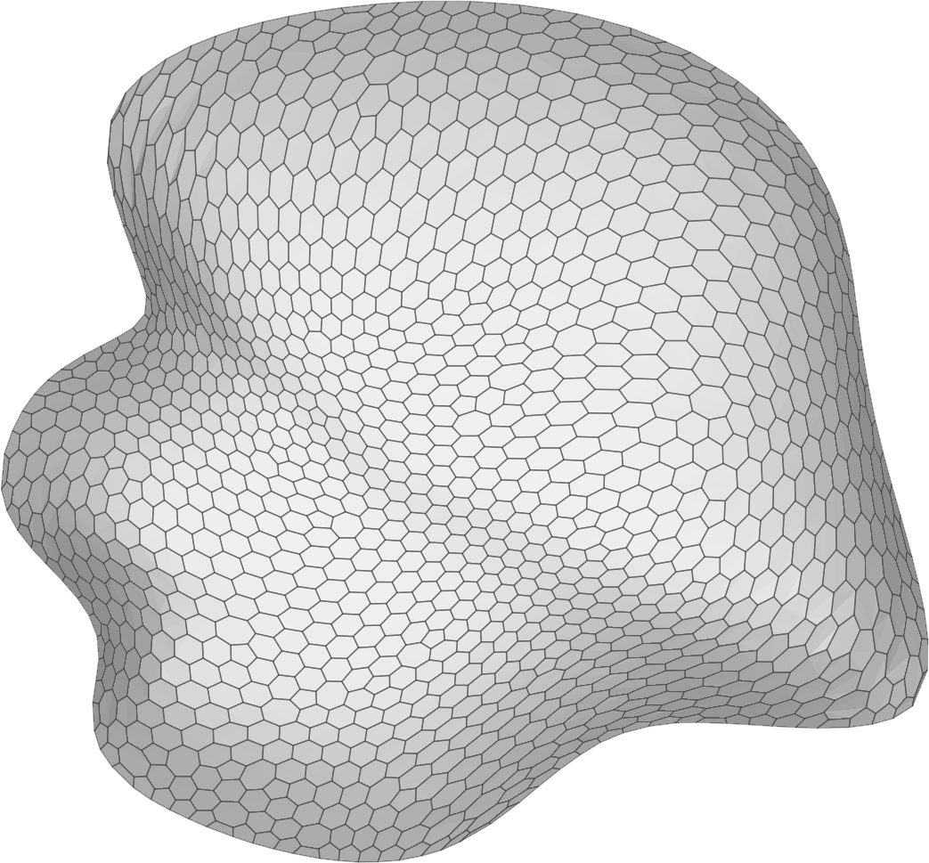

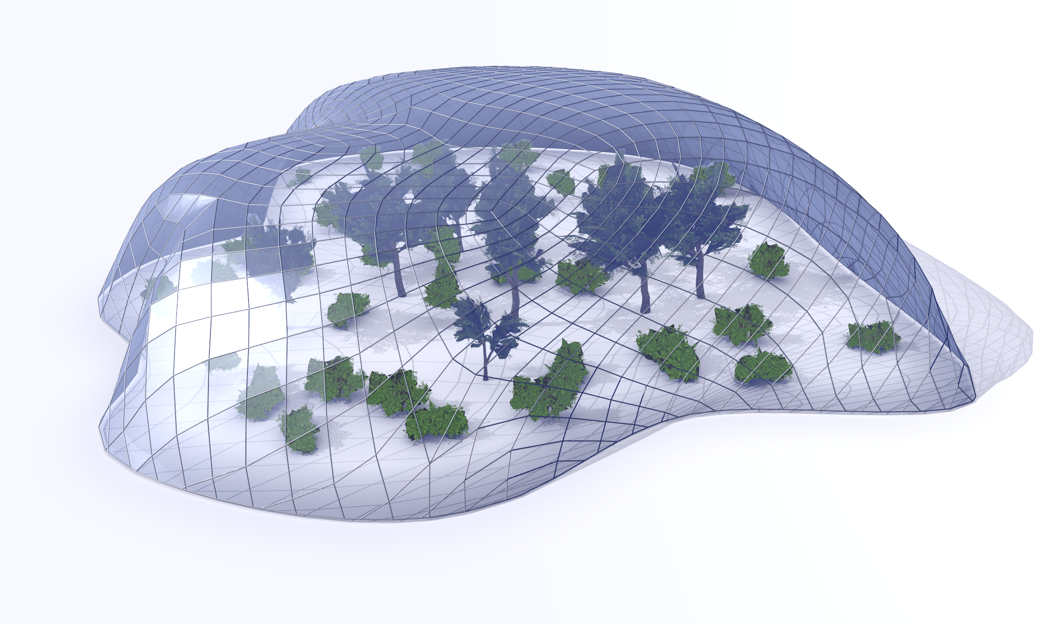
Results: Botanic
[TSG*14]
Static Aware HEX
Static Aware QUAD
λ= 0.83
μ=335.4
λ= 1.48
μ=171.6
λ= 1.65
μ=198.7

Slide 32





Fabricated Model
2mx2m Scale Model
3D Printed Joints
Laser Cut Panels

Slide 33


Fabricated Model
2mx2m Scale Model
3D Printed Joints
Laser Cut Panels

Slide 34



Fabricated Model
The scale model was loaded
and deformation measured
in sample points.
The scale model showed a
behavior quite similar
to the one predicted by
the simulations

Slide 35
Conclusions
Statics analysis is effective to define better topologies for grid shells
The deformation induced by making the g_{Ψ} metric Euclidean can be used for building good adaptive meshing (using existing algorithms!)
The regularized CVD meshing is particularly adequate to create meshes that well adapt to this deformed space

Slide 36
Thanks
Questions?
Contact:
  paolo.cignoni@isti.cnr.it
Models and meshes available at:
  http://vcg.isti.cnr.it/Publications/2015/PTPFSC15/

Slide 37

Future work
Optimize for assebly
Keep the beam structure as rigid as possible
Minimize assembly cost
Mario Deuss .et al:
Assembling Self-Supporting Structures
ACM TOG 2014

