Slide 1
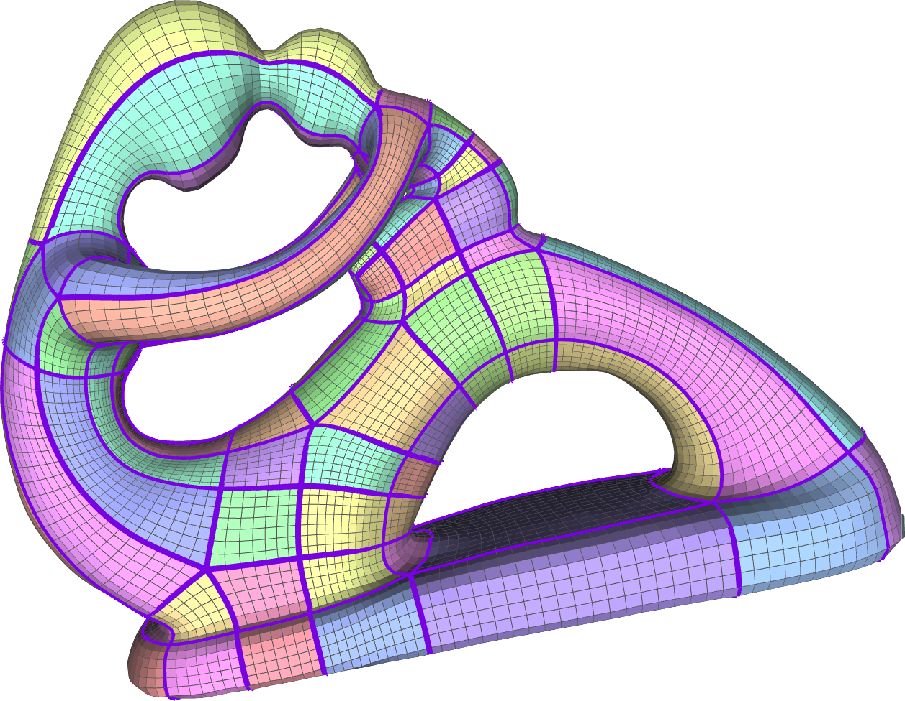
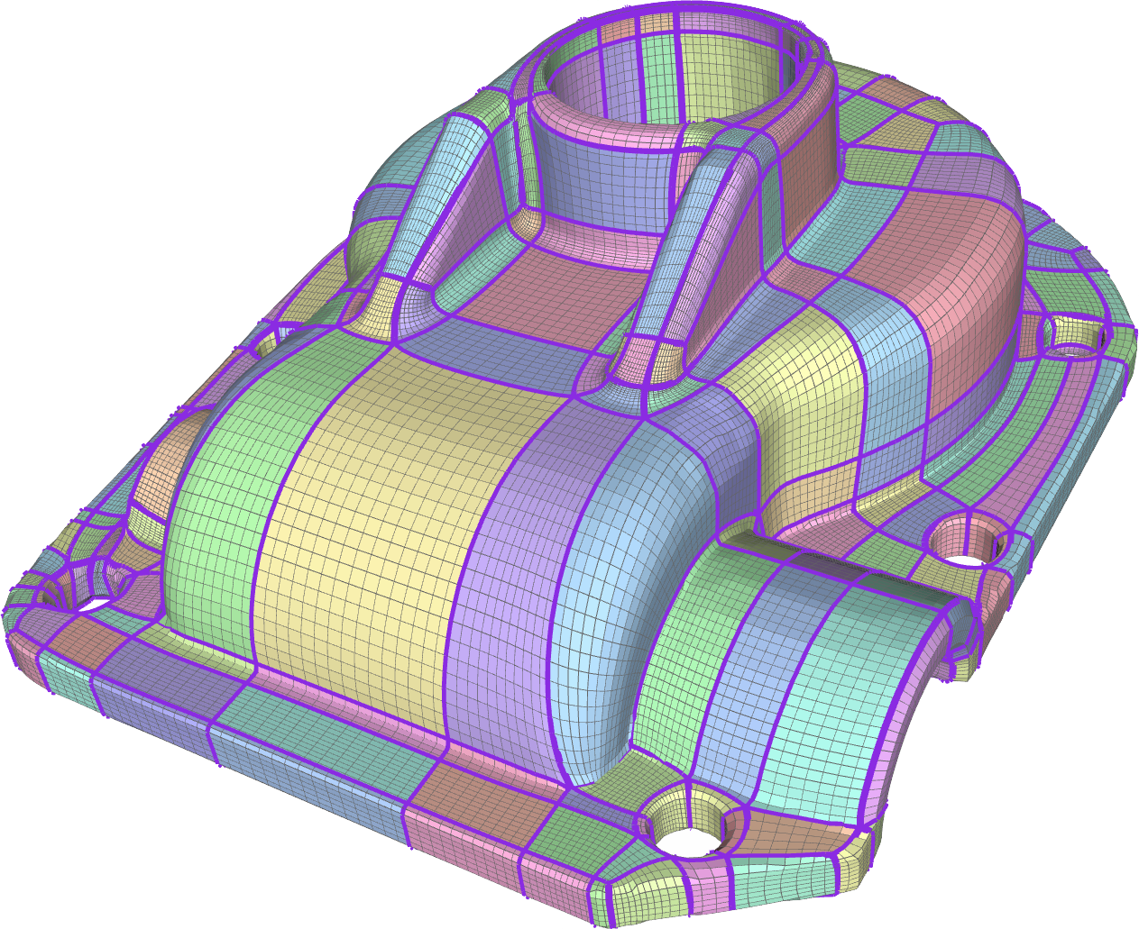
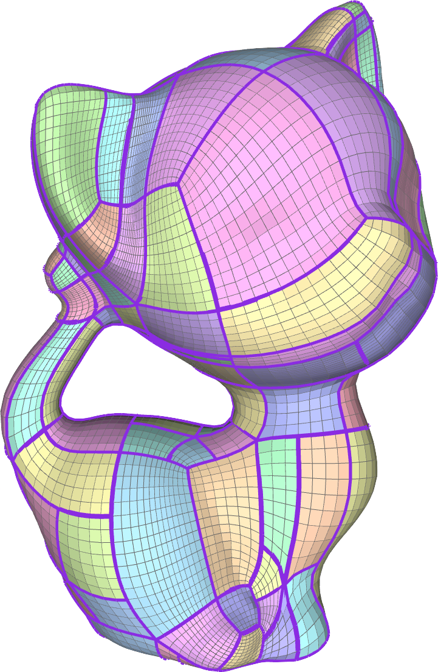
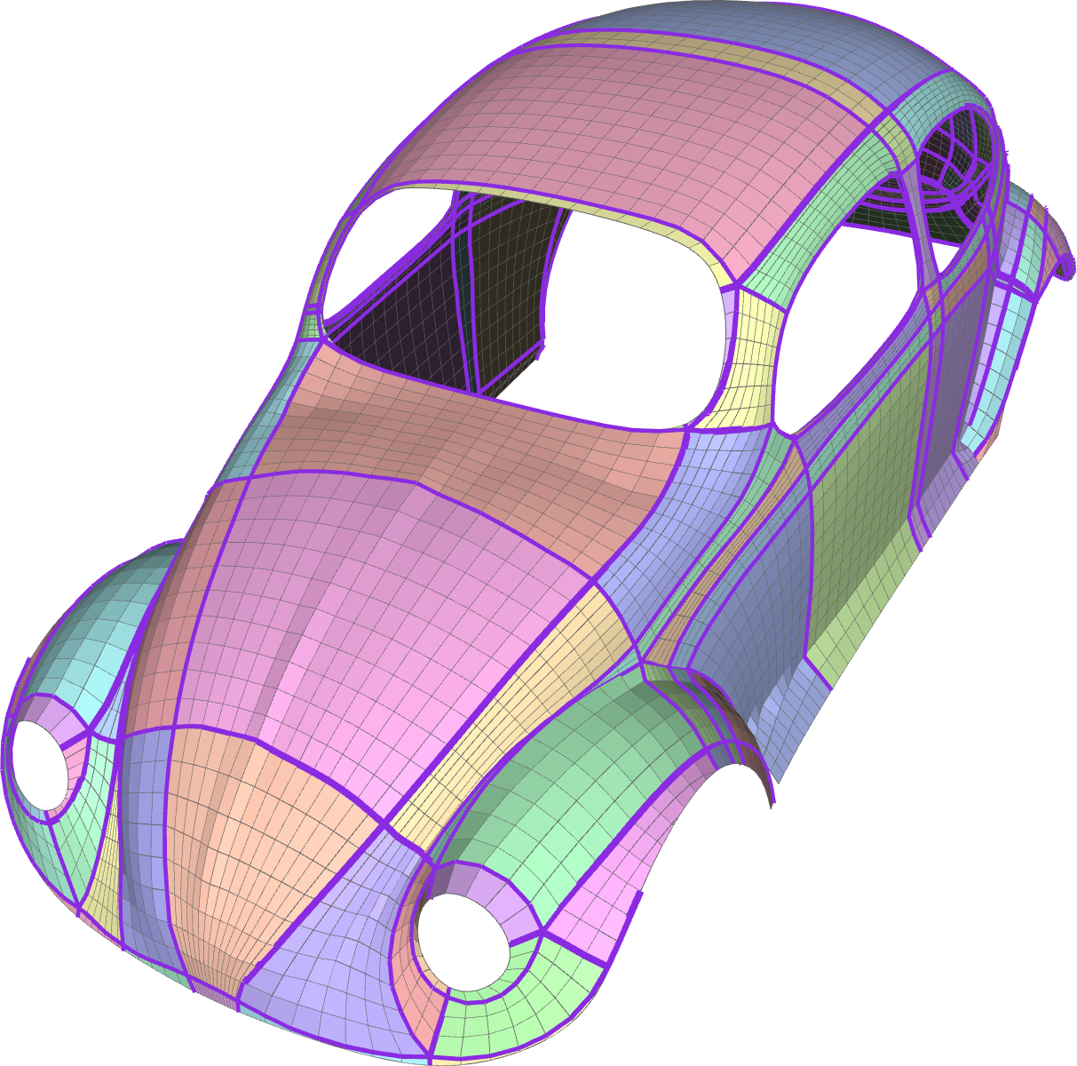
Tracing Field-Coherent Quad Layouts
Nico Pietroni¹, Enrico Puppo², Giorgio Marcias¹, Roberto Scopigno¹, Paolo Cignoni¹
¹Visual Computing Lab - National Research Council of Italy
²University of Genova
nico.pietroni@isti.cnr.it

Slide 2
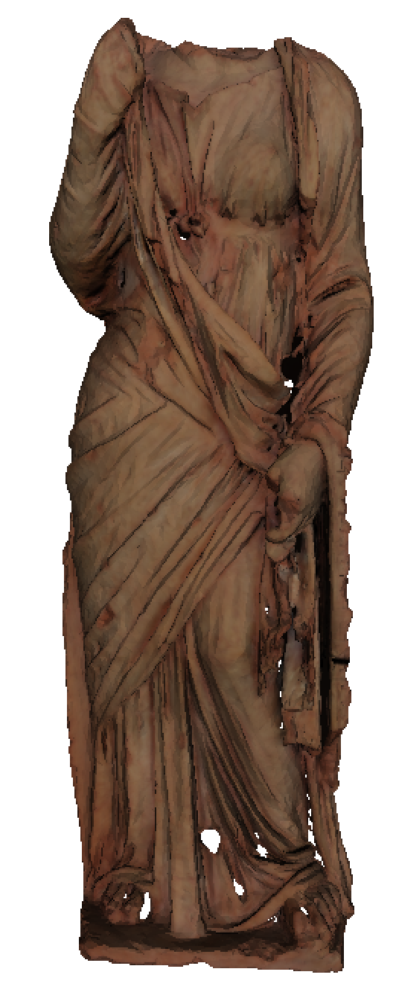
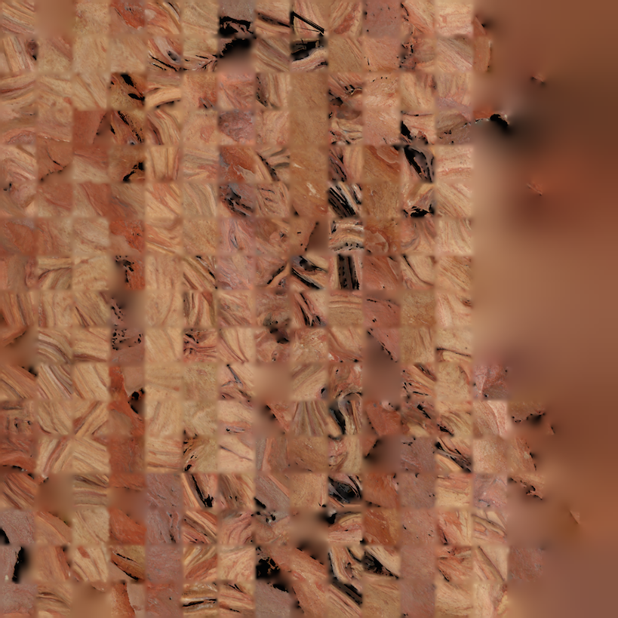
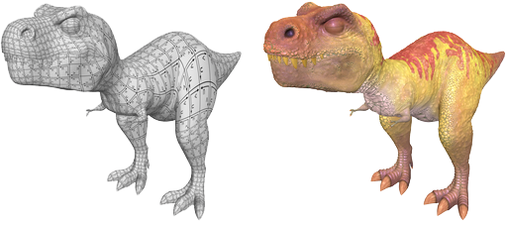
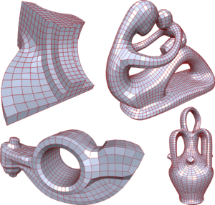
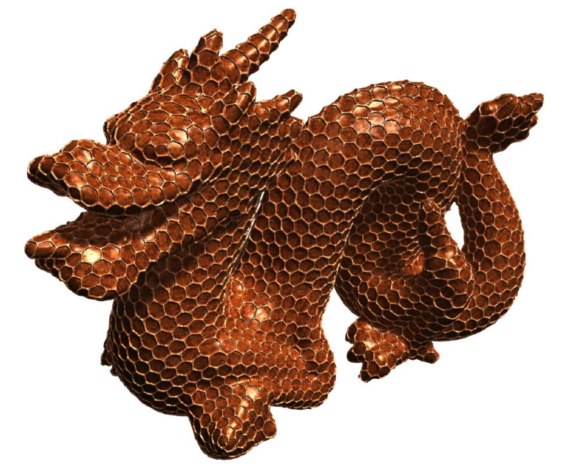
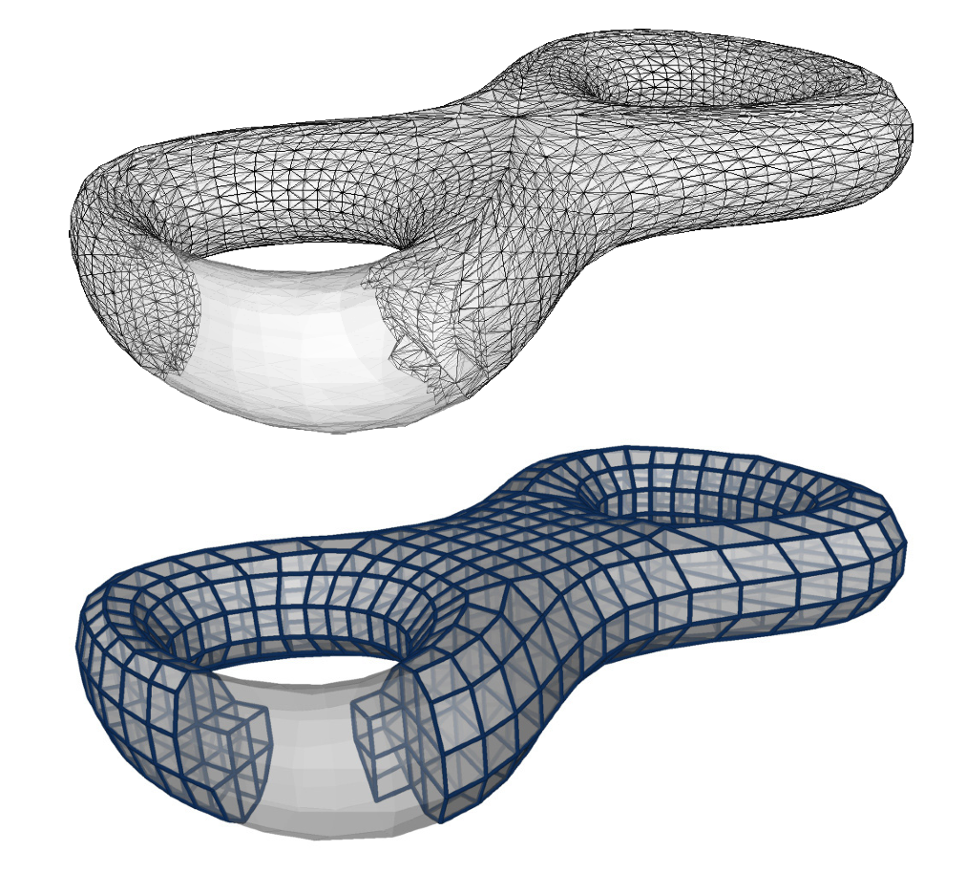
Why Parametrization?
Texture Mapping
Remeshing
….
Lévy, et AL.: Least squares conformal maps for automatic texture atlas generation
Pietroni, et AL.: Almost isometric mesh parameterization through abstract domains
Brent Burley et al : Ptex: Per-Face Texture Mapping for Production Rendering
Bommes, et AL.: Mixed Integer Quadrangulation
Nieser et al.: Hexagonal Global Parameterization of Arbitrary Surfaces
Nieser, et AL. : CUBECOVER – Parameterization of 3D Volumes

Slide 3
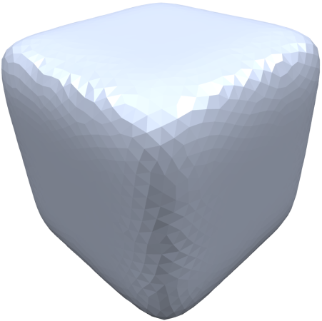
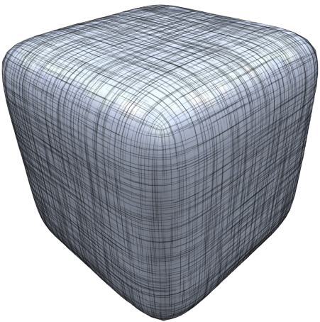
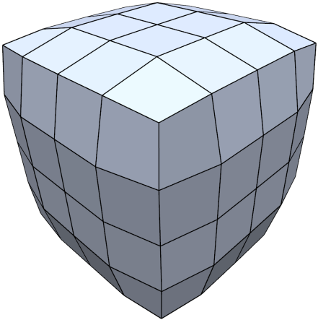
Field Aligned Parametrization
The usual pipeline
input tri mesh
Orientation field
Final parametrization /quadrangulation

Slide 4
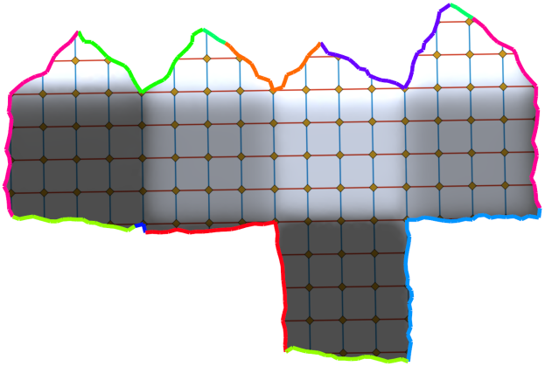
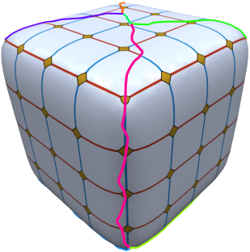
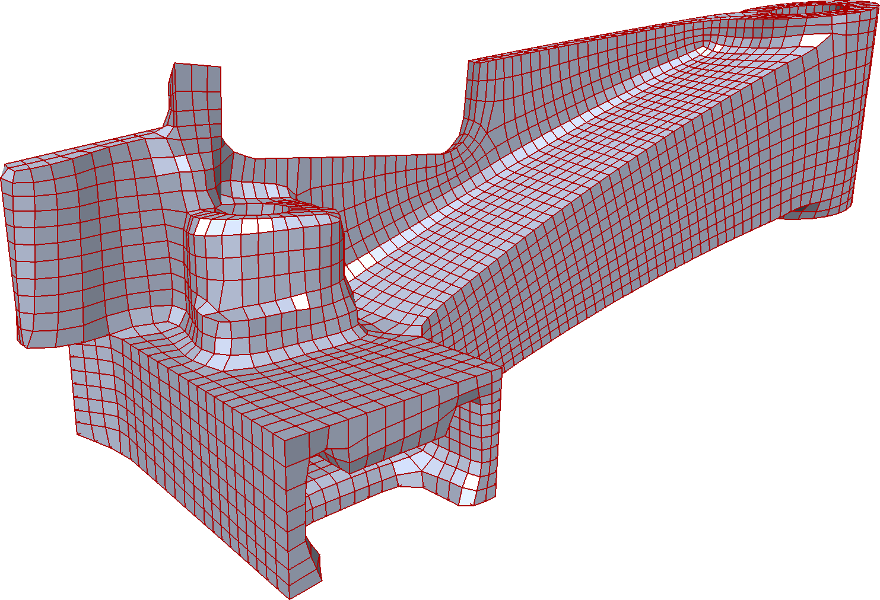

Field Aligned Parametrization
Cut into disk topology
  Continuity across cuts
  Globally smooth
Cut to a disk
Remesh
Bommes, et AL.: Mixed Integer Quadrangulation

Slide 5
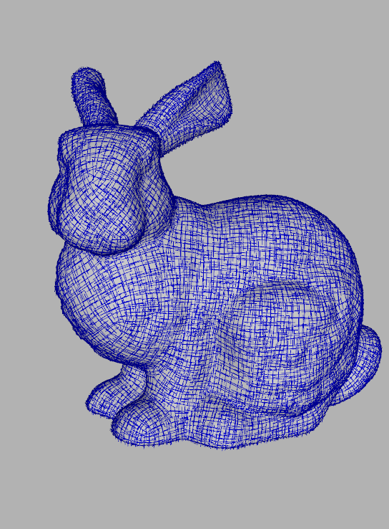
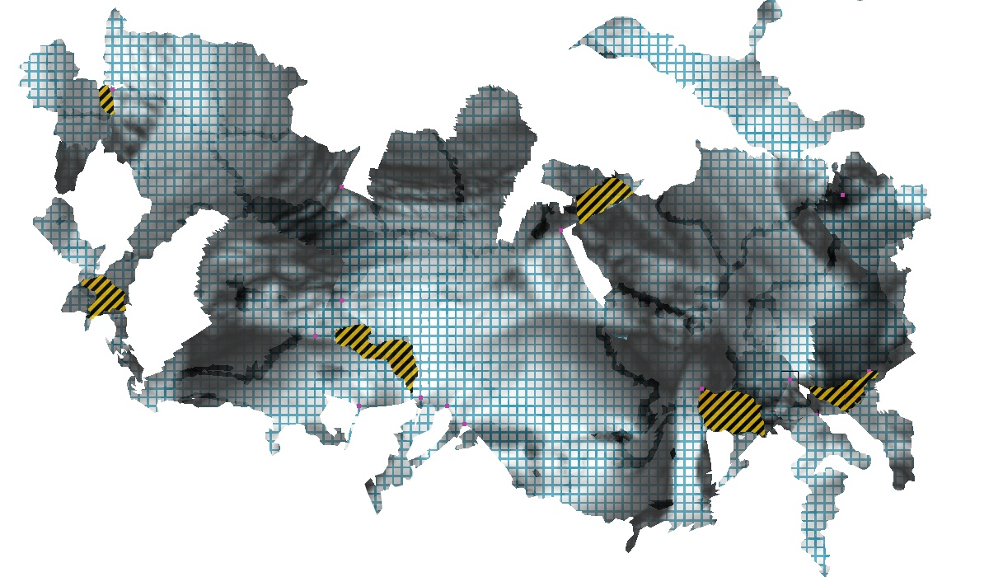
A complex Parametric Domain
S
D
f ⁻¹
f

Slide 6
A complex Parametric Domain (detail)
irregular
borders!
tentacles!
overlaps!

Slide 7
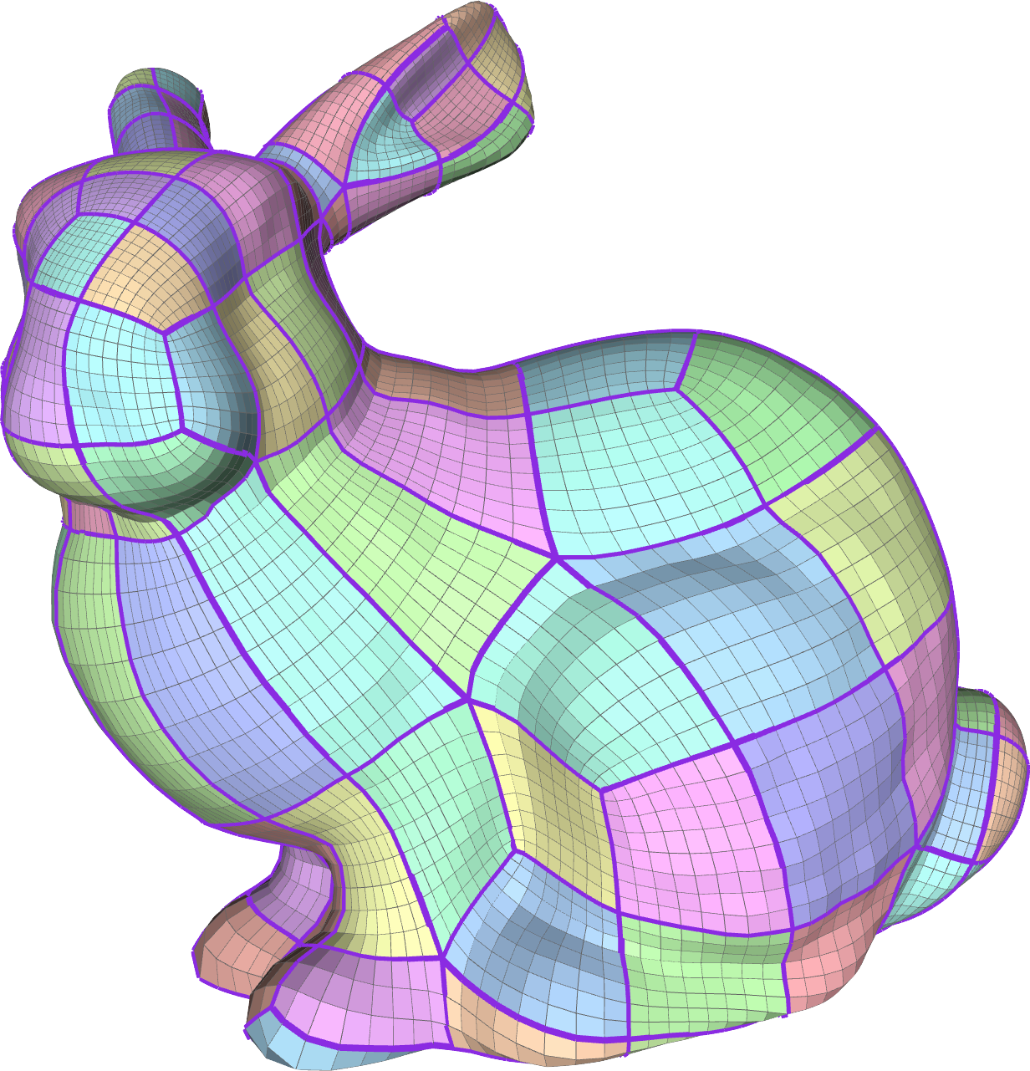
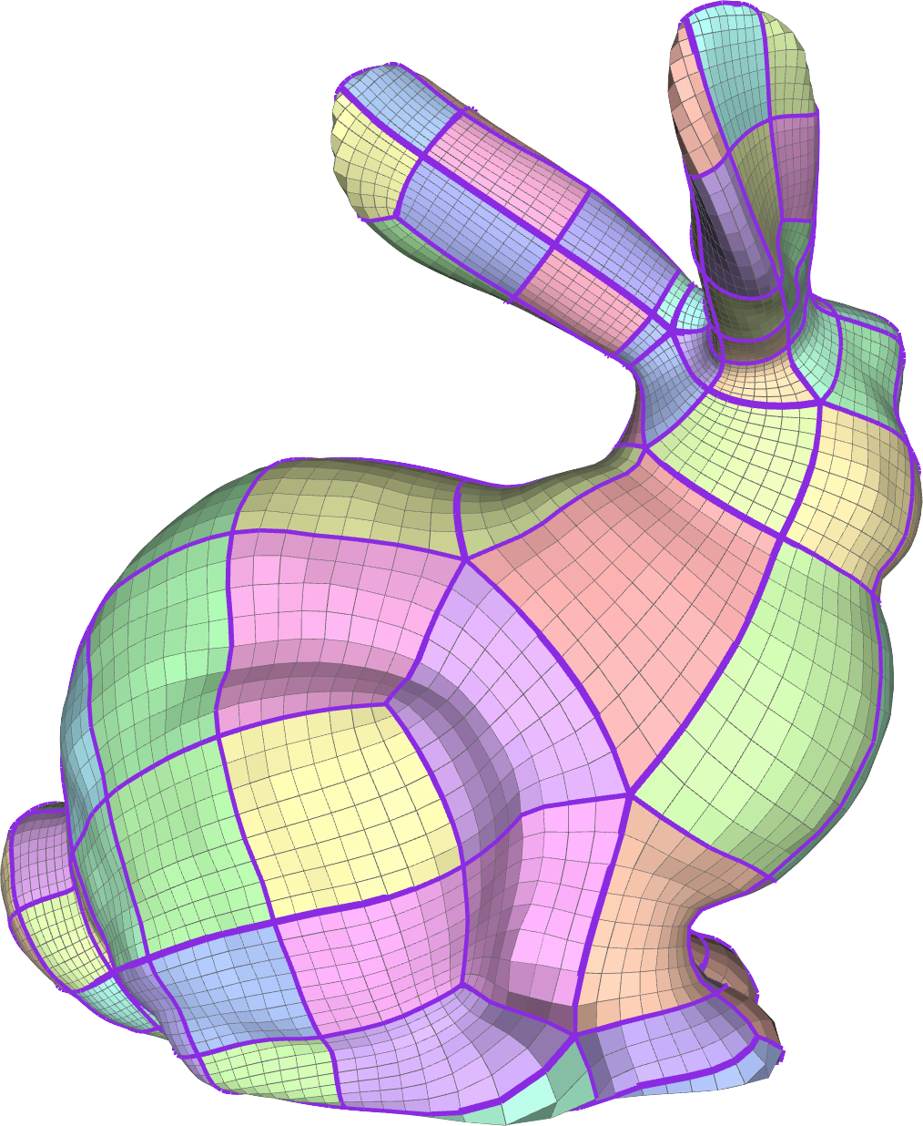
A simpler Parametric Domain (Shape Abstraction)
f ⁻¹
simpler
side-to-side
transitions
f
S
D

Slide 8
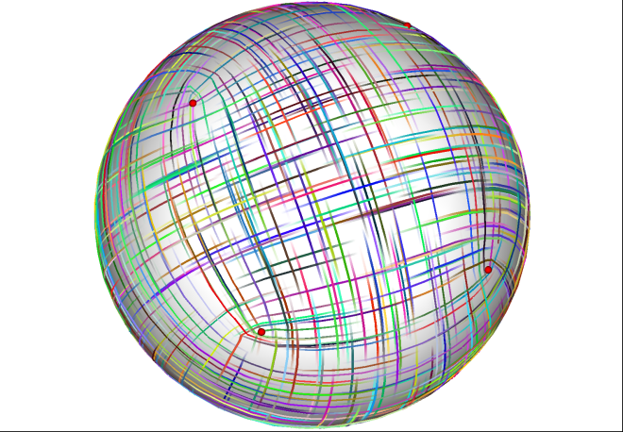
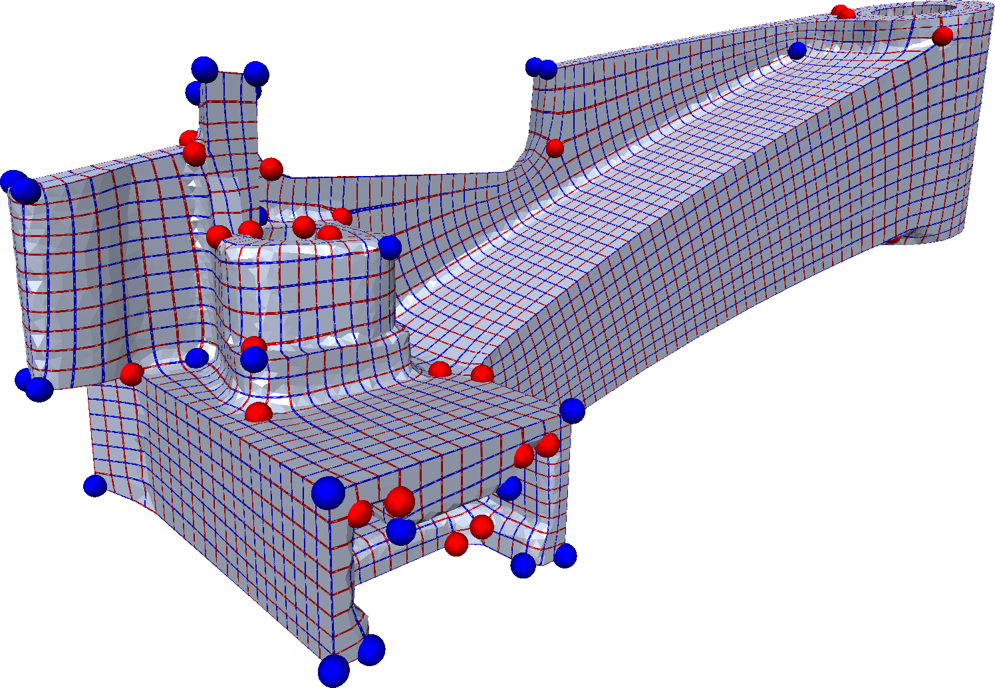
Cross field (brief)
2 orthogonal vector for each face
Laying on tangent space of each face
Singularities
Separatrices connect singularities

Slide 9
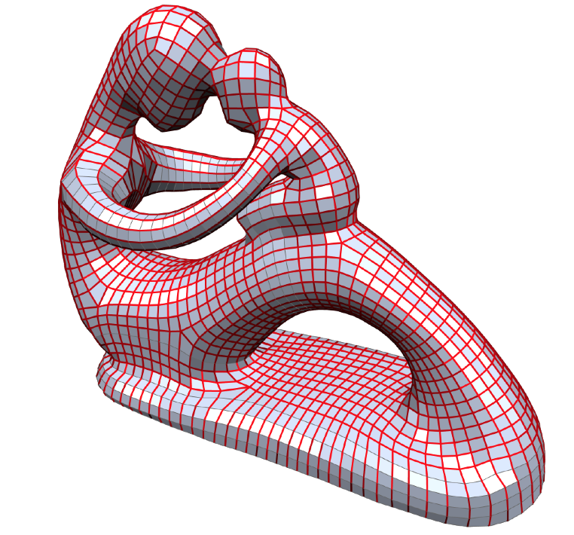
Network of separatices
Separatices induce a quad layout
Usually, they form a complex network
  Too many patches!

Slide 10
The intuition
Connect singularities
  Slightly deviating from the initial field
A
A
connect
B
B

Slide 11
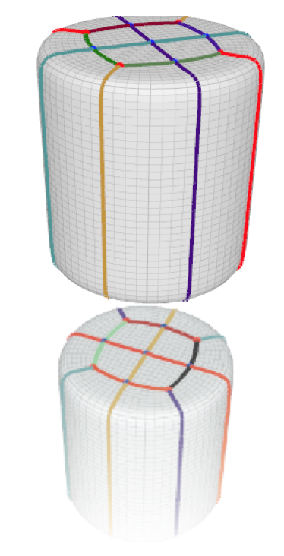
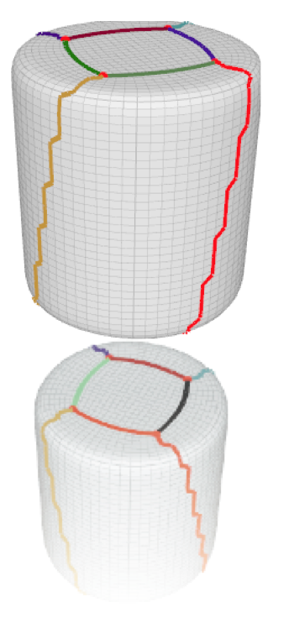
The intuition

Slide 12
The constraints
Constraints
  Match valence of all singularities
  Allow orthogonal cross
  Avoid Tangential cross
5
3
3
3
A
A
B
B
Orthogonal
Tangential

Slide 13
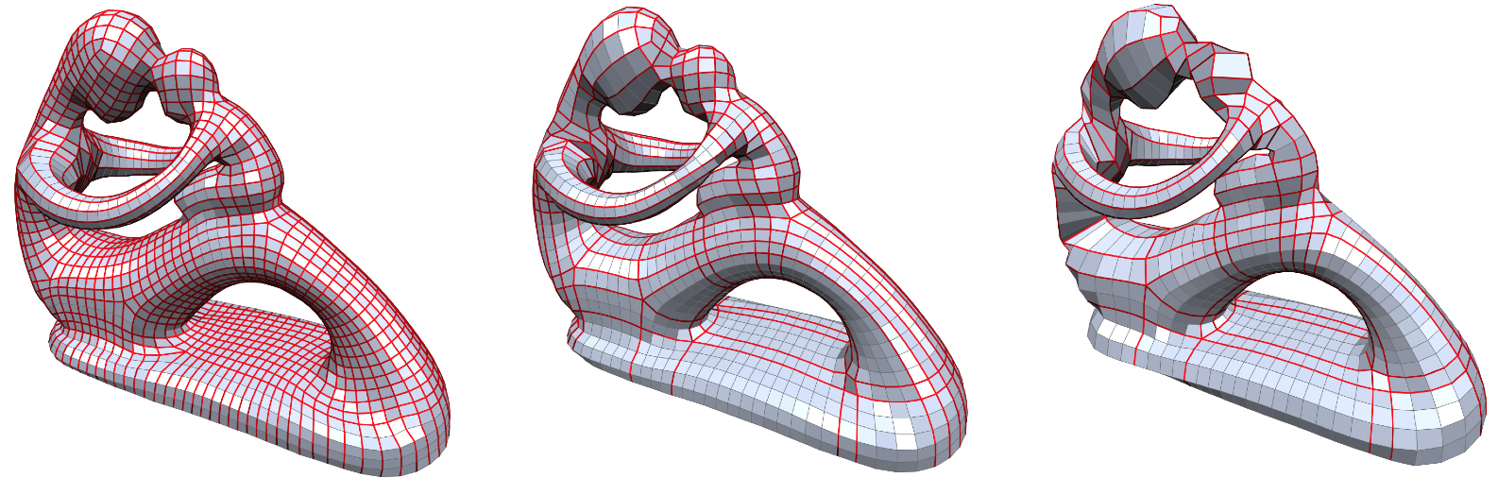
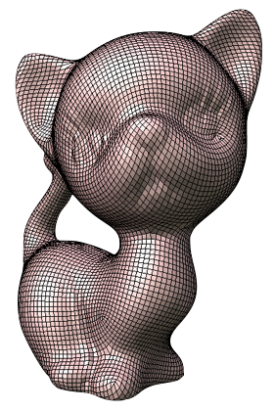
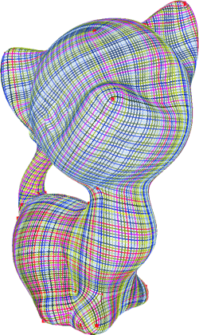
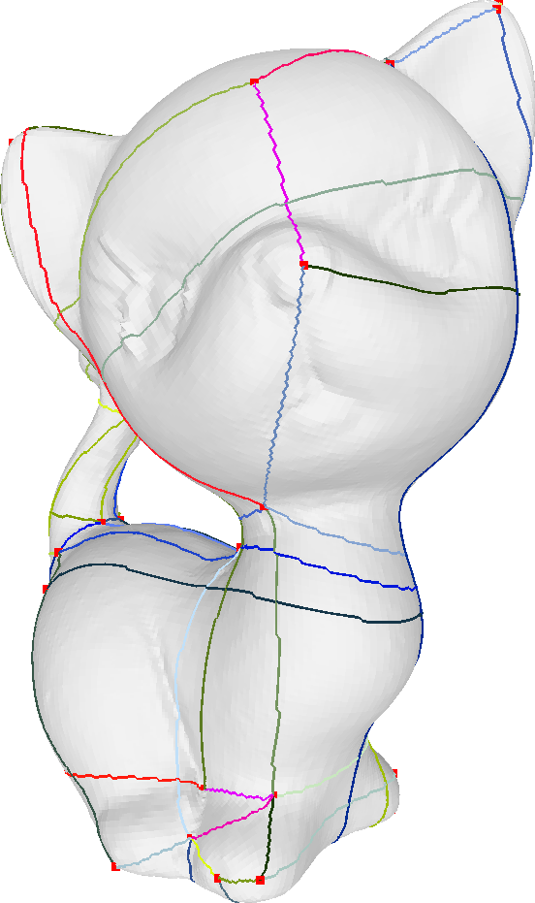
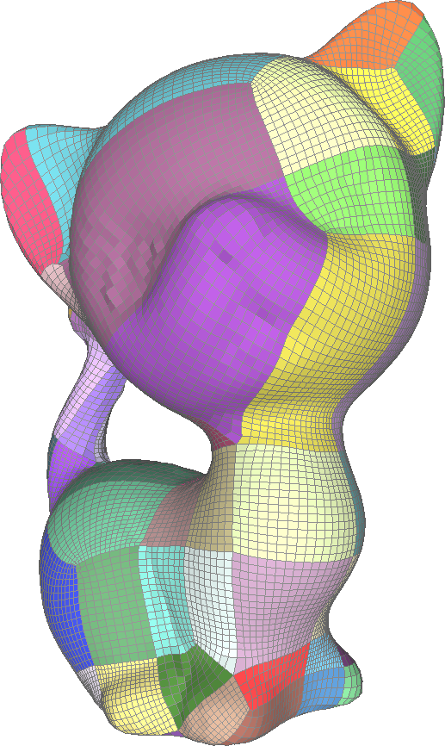
The Approaches (Separatrix simplification)
Start from a quadrangulation
Simplify
  With a greedy approach
May stuck at local minima
NEEDS AN INPUT QUADRANGULATION
David Bommes et al
Global Structure Optimization of Quadrilateral Meshes
Tarini et al
Simple Quad Domains for Field Aligned Mesh Parametrization

Slide 14
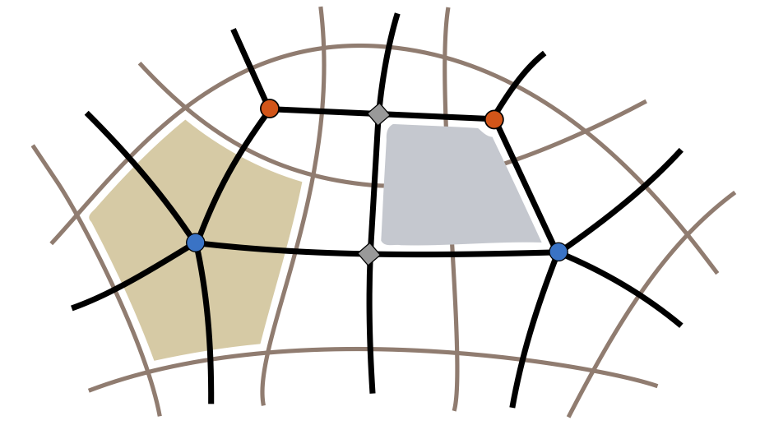
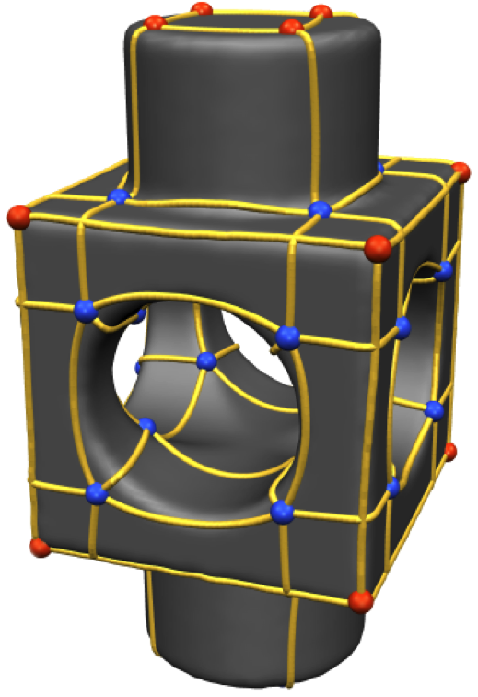
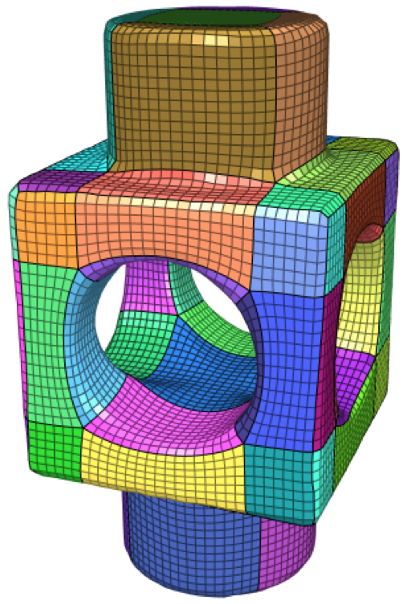
The Approaches (Dual Graph)
Find a the minimal of loop that
  Separate each pair of singularities
  Do not intersect tangentially
  Greedy approach
Not global optimal solution
Campen et al
Dual Loops Meshing: Quality Quad Layouts on Manifolds

Slide 15
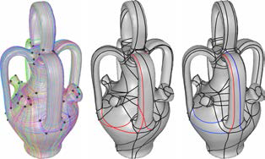
Optimal set of separatrices
Define a set of potential candidates
  Find the optimal sub set
  That respects the constraints
Requiring tracing the candidates
Razafindrazak et al.
Perfect Matching Quad Layouts for Manifold Meshes

Slide 16
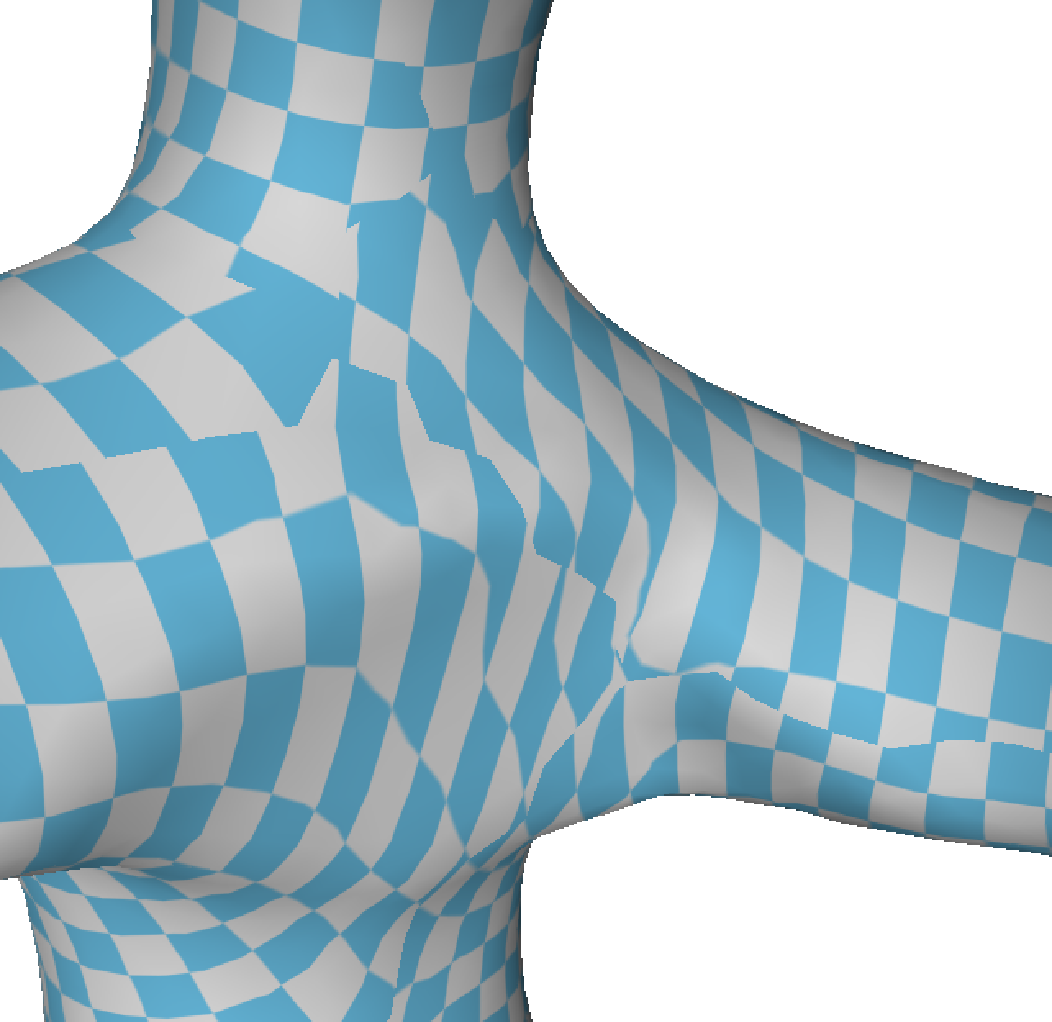
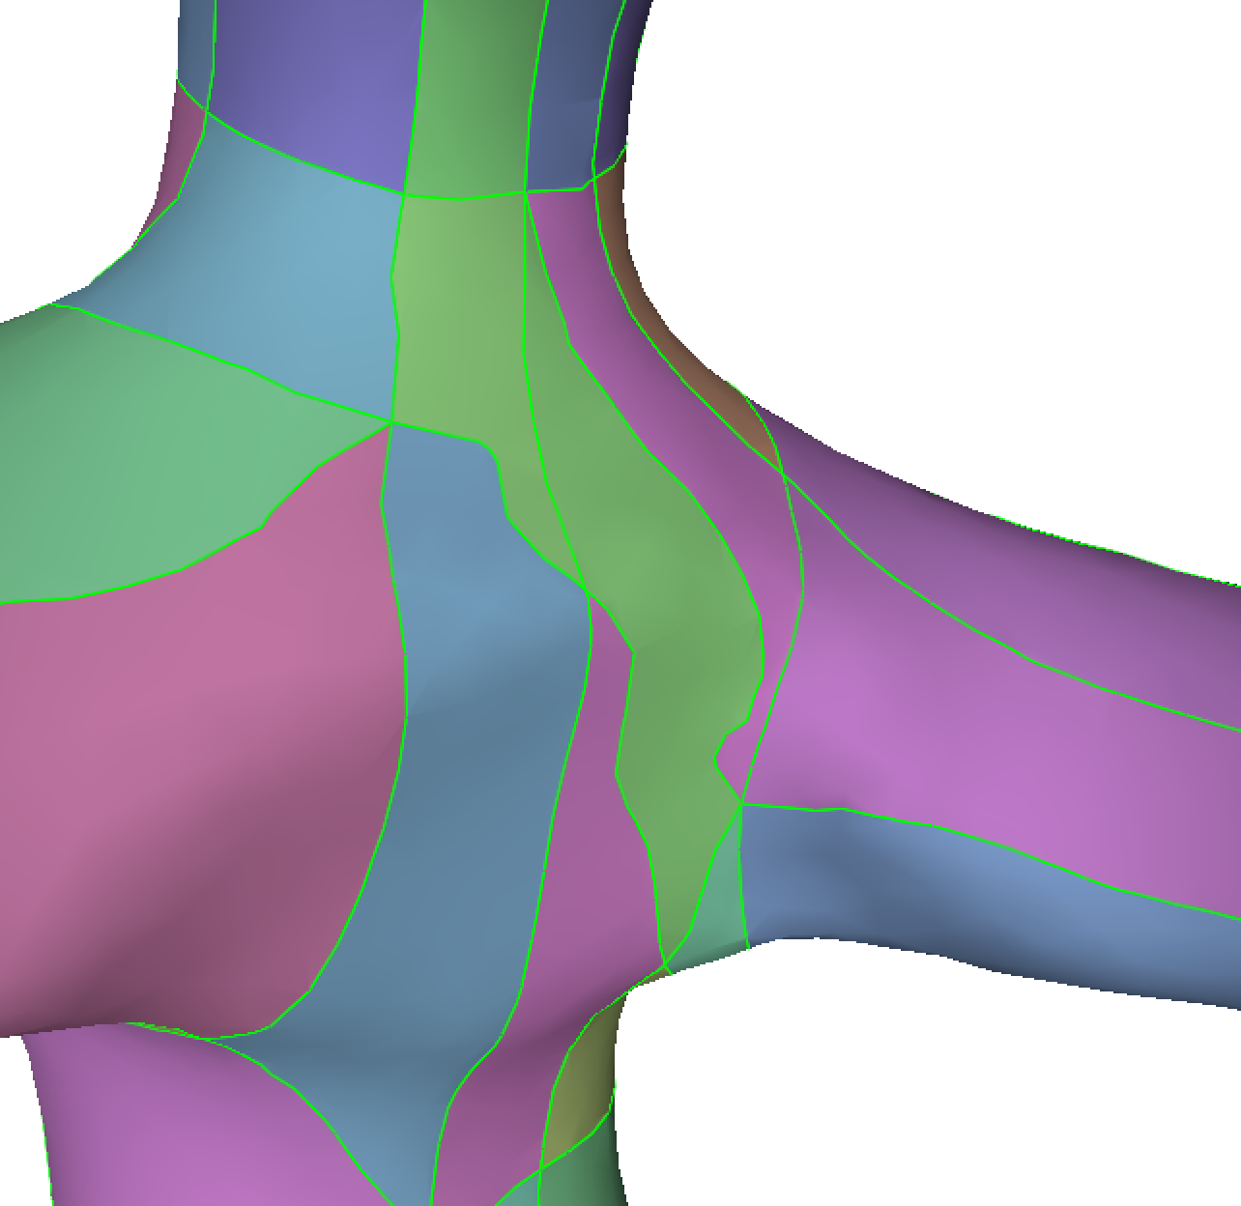
Tracing in parametric space(problems)
No foldovers allowed
Inherits distortion during tracing
Not trivial in case of a complex parametric domain
  Prone to numerical errors
jumps
overlaps

Slide 17
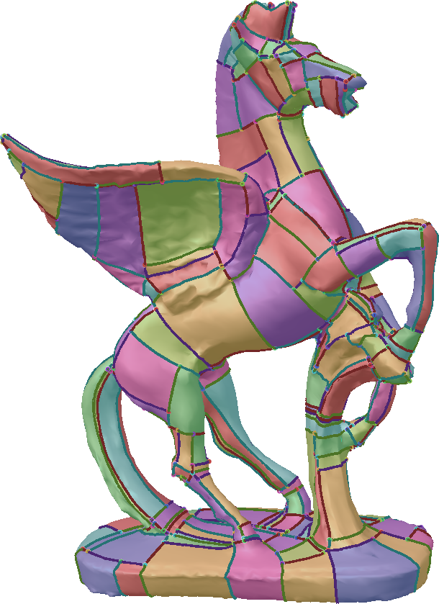
Then trace in 3D!!
Propagate from singularities
Precise tracing leads only to orthogonal crossings
Creates a lot of t-Junctions
Myles et al.
Robust Field-aligned Global Parametrization

Slide 18
Then trace in 3D!!
Propagate from singularities
Precise tracing leads only to orthogonal crossings
Myles et al.
Robust Field-aligned Global Parametrization

Slide 19
The intuition
Precise tracing leads to complicate layouts!
Layout can be simplified by allowing separatrices to drift
A
A
B
B
Precise Tracing
Field-CoherentDiffusion

Slide 20
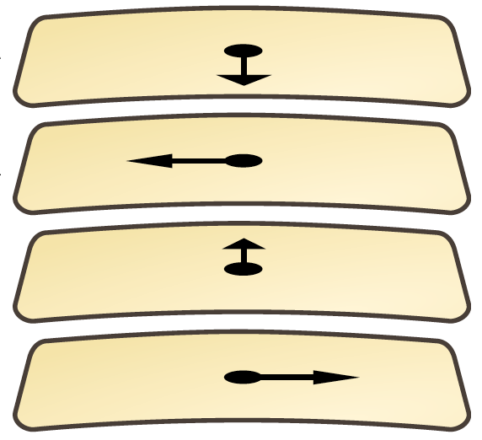
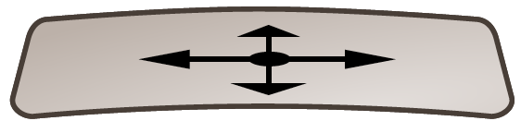
A Deeper look at the field
Each face can be replicated in 4 istances
Felix Kälberer et al
QuadCover – Surface Parameterization using Branched Coverings
Campen et al
Dual Loops Meshing: Quality Quad Layouts on Manifolds
M₁
M₄

Slide 21
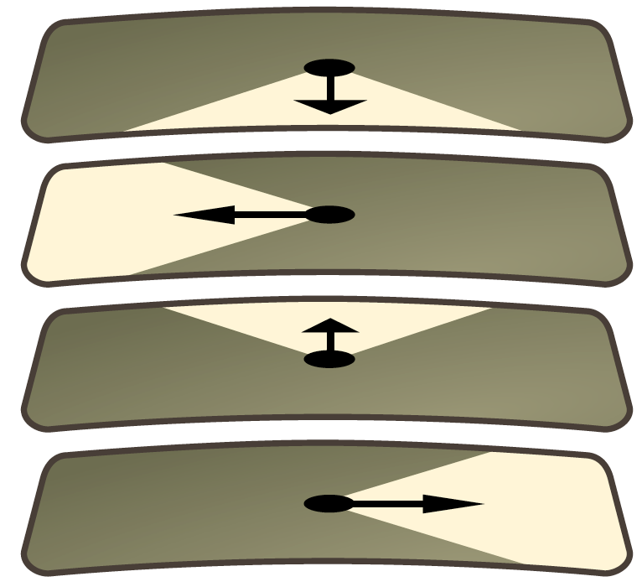
A Deeper look at the field
Each state in M₄ spans a 45° portion of the tangent space
Felix Kälberer et al
QuadCover – Surface Parameterization using Branched Coverings
Campen et al
Dual Loops Meshing: Quality Quad Layouts on Manifolds

Slide 22
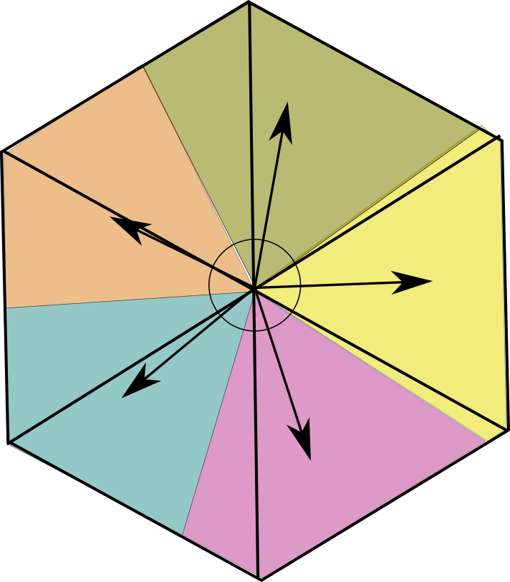
Tracing Field-Coherent (Continuous settings)
For each point on the surface
for point on M4 span a cone of directions
Special case for singularities

Slide 23
Tracing Field-Coherent (Continuous settings)
For each point on the surface
for point on M4 span a cone of directions

Slide 24
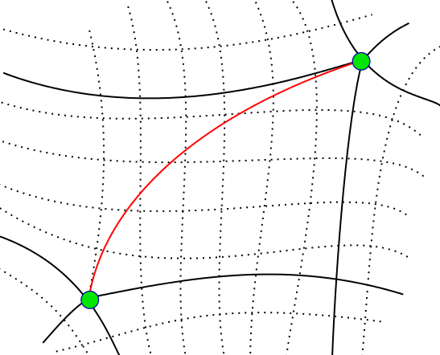
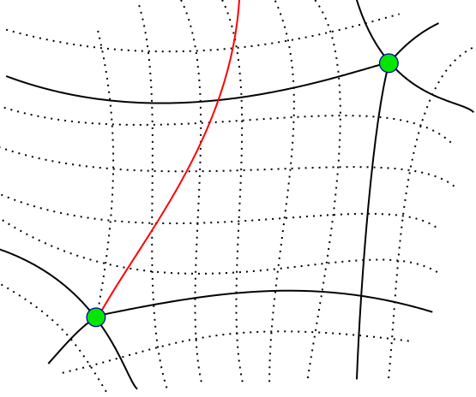
Field-Coherency
Diffuse coherently the cones along the mesh
  Avoid (local) directions switches
NOT Field coherent
A
Field coherent

Slide 25
Tracing Field-Coherent (Discrete setting)
Sample edges

Slide 26
Tracing Field-Coherent (Discrete setting)
In M4 one instance per direction

Slide 27
Tracing Field-Coherent (Discrete setting)
Connect each instance
A
A
A
A
A

Slide 28
Tracing Field-Coherent (Discrete setting)
Connect each instance
A
A
A
A

Slide 29
Tracing Field-Coherent (Discrete setting)
Connect each instance
A
A
A
A
A

Slide 30
Tracing Field-Coherent (Discrete setting)
Connect each instance
A
A
A
A
A

Slide 31
Tracing Field-Coherent (Discrete setting)
singularities

Slide 32
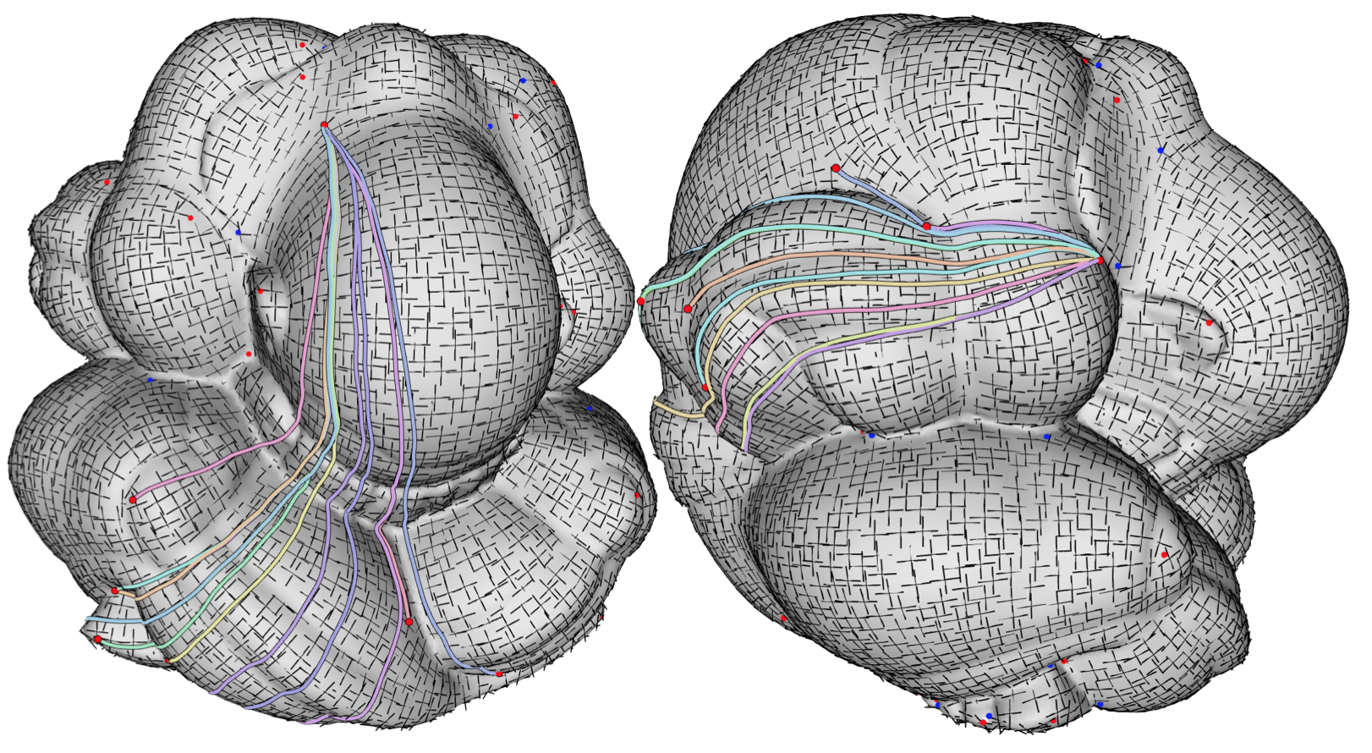
Propagating throught the mesh

Slide 33
Tangential or Orthogonal crossing
Implicitly defined by the graph!
Purely combinatorial test! No geometric test involved!
orthogonal
tangential

Slide 34
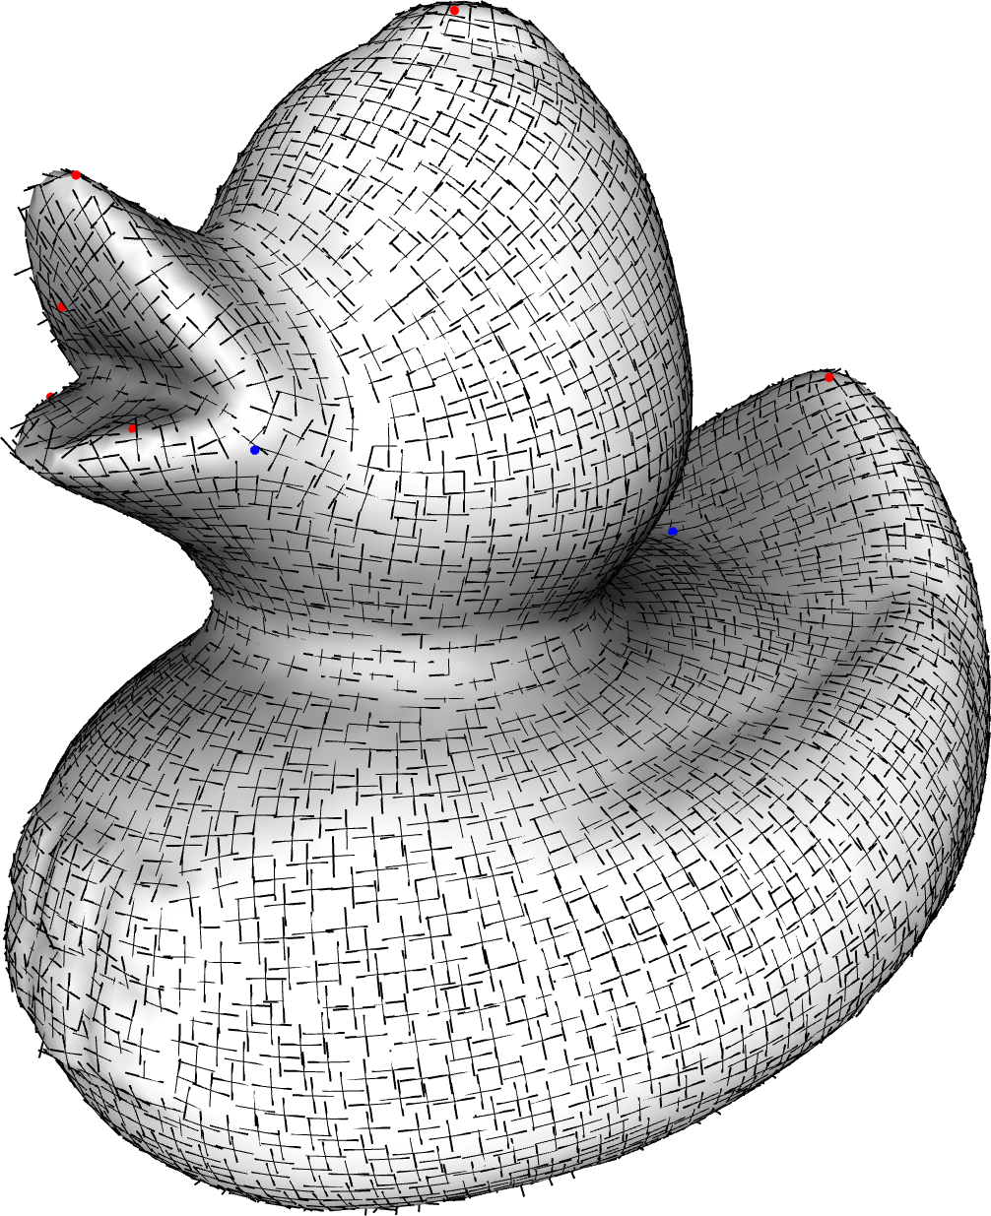
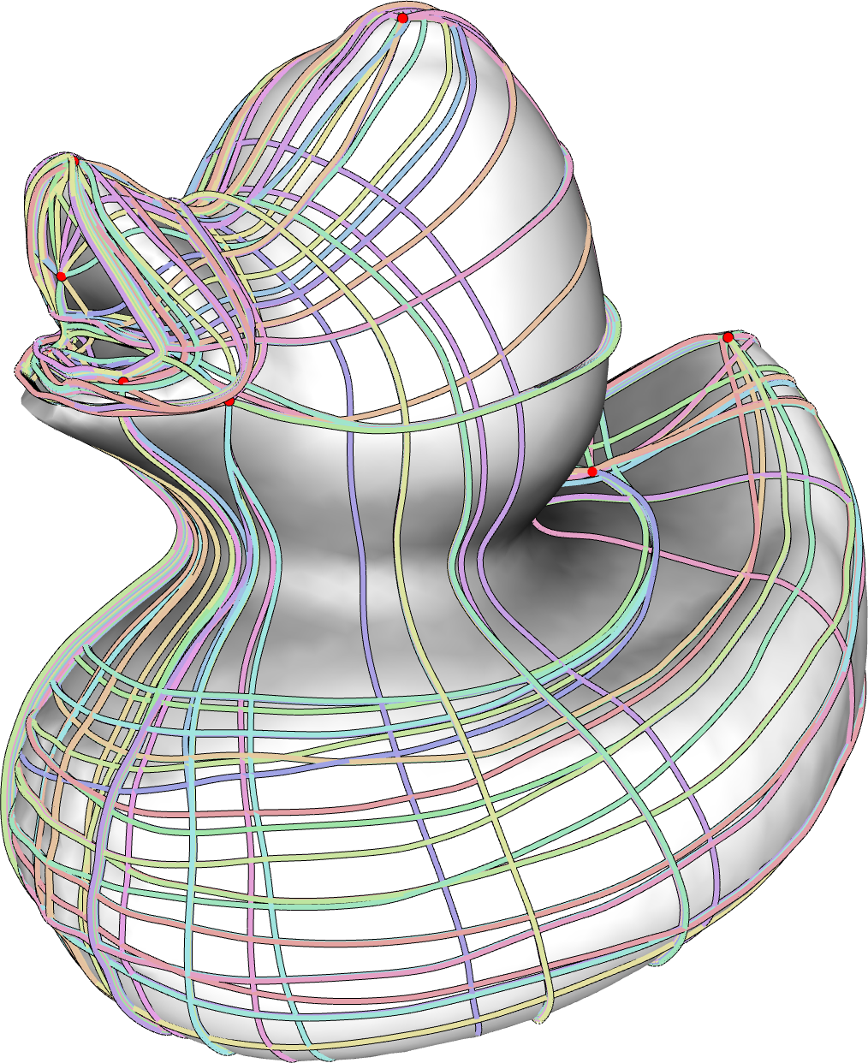
Defining a quad patch Layout (1)
Find a candidate set of separatrices
Each candidate s_{i} connects a pair of singularities
Its field deviationγ(s_{i}) is the sum of the weights of its arcs

Slide 35
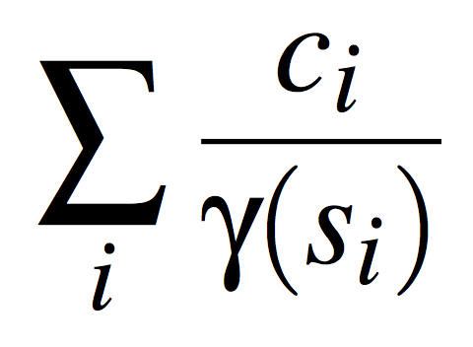
Defining a quad patch Layout (2)
FIND THE OPTIMAL SUBSET OF CANDIDATES
  One Boolean variable c_{i} for each candidate
Find the subset of candidates such that
  Maximize separarices with minimal deviation
  Avoid tangential crossing
  Not exceeds singularity valence
Find the Global Optimum!

Slide 36
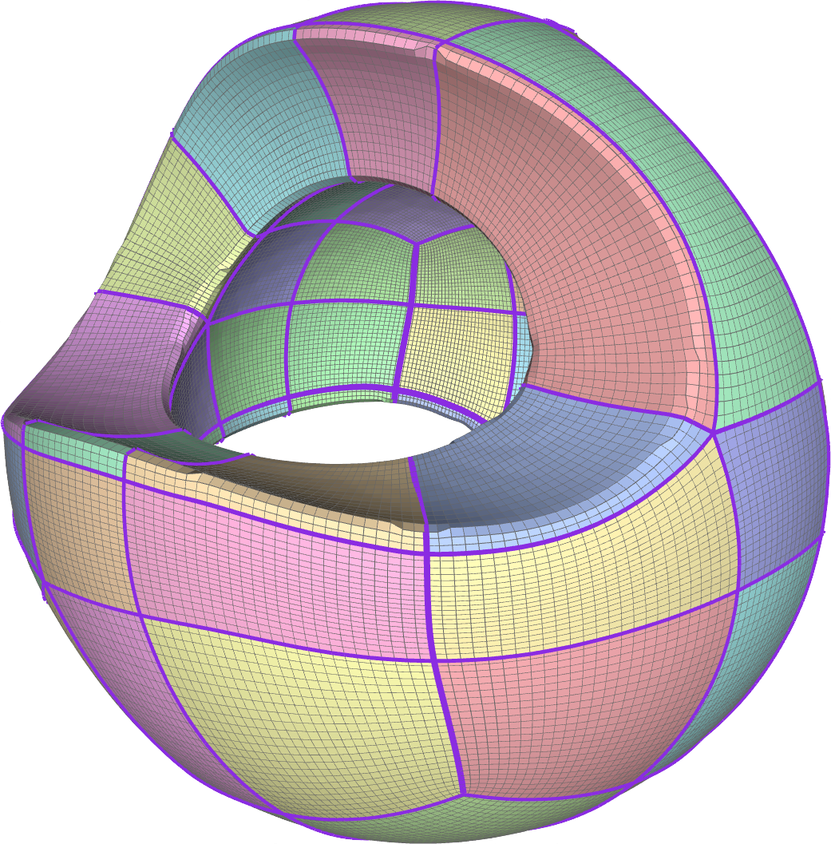
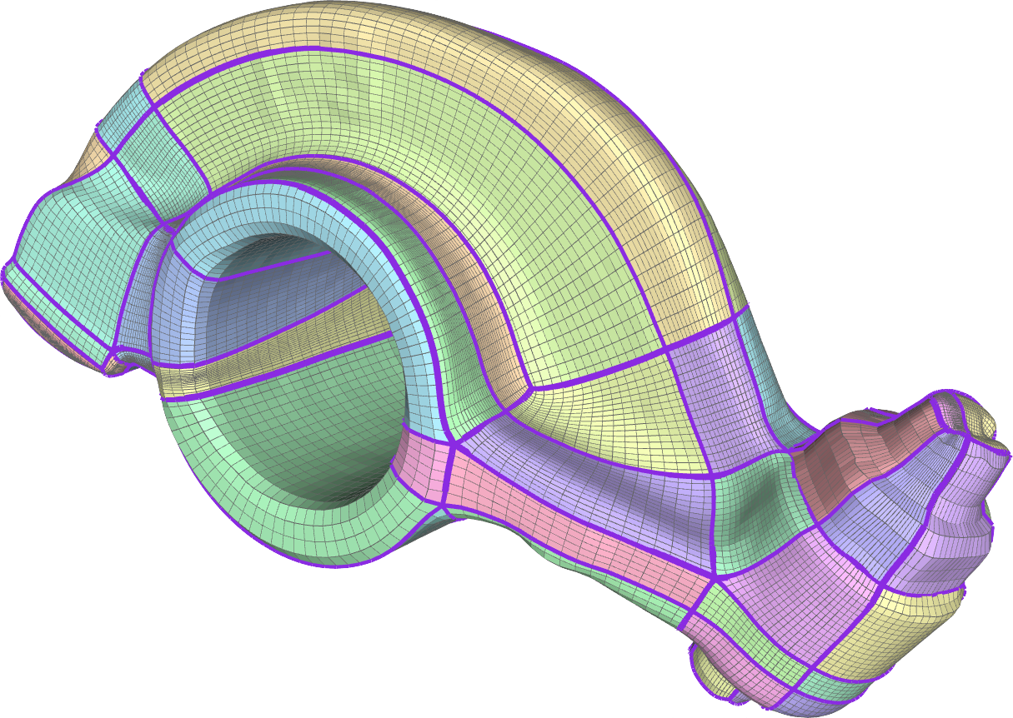
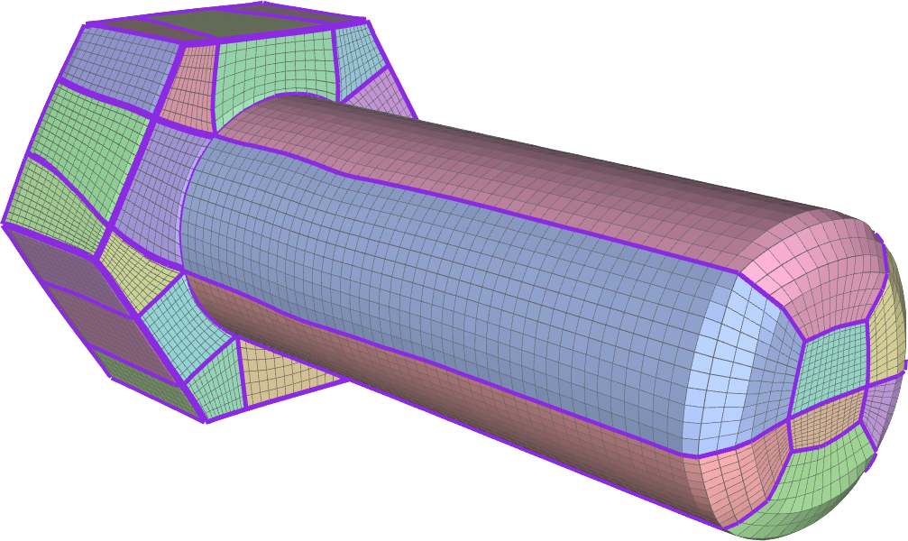
Defining a quad patch Layout (3)
Quad patch layouts!

Slide 37



Defining a quad patch Layout (4)
Do NOT require to have a complete graph of separatrices
Admit also incomplete solutions
A final propagation step will produce a quadrangolation with a few t-junctions
Very useful in the following situations..

Slide 38



Defining a quad patch Layout (5)
Mesh with borders

Slide 39



Defining a quad patch Layout (6)
Complex fields
1170 singularities
450 T-Junctions
226 singularities
62 T-Junctions
173 singularities
62 T-Junctions

Slide 40
Global Parametrization
Assign INTEGER lengths to all edges.
Map each patch to a 2D rectangle with assigned lengths.
Must meet consistency constraints
v, w, x, y, z > 0
v = w
x + y = z
x
y
v
w
z
3D Domain
Parametric Domain

Slide 41








Comparison Wrt exact surface tracing approach
Fewer or No T-Junctions
Proposed
no T-Junctions
RGP
108 T-Junctions
Proposed
no T-Junctions
RGP
92 T-Junctions
Proposed
78 T-Junctions
RGP
687 T-Junctions
RGP -> Myles et al. Robust Field-aligned Global Parametrization

Slide 42


Comparison Wrt exact surface tracing approach
Proposed
RGP

Slide 43










Comparison wrt tracing on parametric space
Inherit distortion of base parametrization
Input Parametrization
Distortion
Perfect Match
Distortion
Proposed
Distortion
Perfect Match -> Razafindrazak et al. Perfect Matching Quad Layouts for Manifold Meshes

Slide 44






Comparison wrt tracing on parametric space
Inherit distortion of base parametrization
Input Parametrization
Perfect Match
Proposed
Distortion
Distortion
Distortion
Perfect Match -> Razafindrazak et al. Perfect Matching Quad Layouts for Manifold Meshes

Slide 45

Cool Application!!
„FlexMolds: Automatic Design of Flexible Shells for Molding“ Luigi Malomo Nico Pietroni Bernd Bickel Paolo Cignoni,
SIGGRAPH ASIA 2016

Slide 46
Questions?
Nico Pietroni¹, Enrico Puppo², Giorgio Marcias¹, Roberto Scopigno¹, Paolo Cignoni¹
¹Visual Computing Lab - National Research Council of Italy
¹University of Genova
nico.pietroni@isti.cnr.it

